Slide 1
Spring Data: Get rid of boilerplate DAOs
„Winners never quit & quitters never win.”
- Vince Lombardi
Cosmin Alexandru SPÎNU
Software Developer @ TSS-Yonder
CodeCamp, apr. 2016
Notes:
Despre mine
Lucrez cu Java din 2012. Am facut si ABAP development in SAP
Acum lucrez la Yonder

Slide 2
meetAudience();
What brings you here ?
Who heard about Spring Data ?
x code campers
Who worked with Spring Data ?
x code campers

Slide 3
why();
Access Layer implementation with specific APIs
A lot of ways for implementing DAOs
Boilerplate
Notes:
Implementarea access layerului se face cu api-uri specifice tehnologiilor iar uneori nu sunt chiar usor de folosit
Foarte multe modalitati de implementare a DAO-ului
Toate astea conduc la Boilerplate
Cred ca e imposibil ca in viata vostra de programatori sa nu fi avut treaba cu Hibernate code, urat lung complicat.
Setarea asteptarilor –
Introduction to spring data
Cand ar trebui sa folosim si cand nu
Limits and capabilities

Slide 4
searchSolution();
Spring Data JPA ofc
Easier way to develop apps using RDB or newer technologies
JPA, MongoDB, Redis, Solr, REST, Cassandra, ElasticSearch and many others
Notes:
Spring data bineinteles
Ofera o cale mai simpla de a dezvolta aplicatii folosind BD relationale sau chiar tehnologii mai noi
Nu e limitat la JPA. Are suport pentru MongoDB, Redis, Solr, REST si multe altele

Slide 5
printCurrentWay();
Persistence mechanism from EJB
JDBC API
ORM – Hibernate
JPA
Notes:
Cum aveti implementat acum layerul de DAO in proiectul curent? Ce tehnologii folositi sau ati folosit ? Va place cum arata ?
EJB – heavyweight, configurari XML complicate, foarte multe boilerplate
JDBC API – deployable in orice servlet container – dar foarte mult boilerplate – tranfer domain model in query si rezultatele din nou in domain model (prepared statements etc)
ORM – Hibernate – o alegere buna pt ca ne scapa de scris cod JDBC, dar f mult boilerplate (JPQL, HQL, Criteria API)
JPA - Mecanism standard pt layerul de persistenta in BD relationale

Slide 6
printNextWay();
Spring Framework
Provides sophisticated support for traditional data access techs
Simplified infrastructure setup and exception translation
The transactional mechanism
Notes:
Spring Framework:
Furnizeaza suport pentru technologiile traditionale de access la date (JDBC, hibernate, iBatis etc) – este simplu sa te integrezi cu ele
Simplifica setupul infrastructurii si deasemeni are exception translation in DataAccessException hierarchy– mai usor de identificat problemele
Bineinteles furnizeaza si mecanismul tranzactional

Slide 7
printNextWay();
Spring Data
First release @ SpringOne 2010
Provides a simple and consistent approach for working with data persistence
Reduces the necessary effort for having the persistence layer in place
Notes:
Primul release a fost in 2010 la SpringOne
Ne construim aplicatii si apoi avem nevoie sa ne stocam informatiile. O facem in mod normal in DB relationale sau NoSQL. Apoi aplicatia trebuie sa acceseze acele date
Aici e sweet spot-ul Spring Data – face accesul la date mai usor
Este un produs matur, se adauga module imediat cum apar alte tipuri de data stores.
Furnizeaza o abordare simpla si consistenta care usureaza modalitatea de lucru cu persistenta datelor
Reduce efortul necesar pentru a avea persistence layerul in place (JDBC, prepared statements, open/closing connections etc)
Da predictibilitate codului, dupa cum ve-ti vedea

Slide 8
getRepository();
The goal of Spring Data repository abstraction is to significantly reduce the amount of boilerplate code required to implement data access layers for various persistence stores.
– This is what Spring officialy says.
The central interface for repository abstraction is ... Repository ☺
Notes:
Interfata centrala in abstractizarea repository-ului este ... Repository ☺...nu cred ca e asa mare surpriza
Actioneaza mai mult ca un marker interface care este extinsa pentru a putea face „discover” interfetelor care o extind
D from SOLID – DI principle – depend upon abstractions and not upon concretions

Slide 9
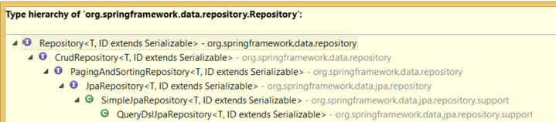
getRepository();
Notes:
Deasemeni exista si mongorepository in modulul pt mongodb
SimpleJpaRepository – default implementation pentru JpaRepository
QueryDslJpaRepository – QueryDSL specific extension pentru SimpleJpa care adauga support pentru predicate QueryDSL

Slide 10

getRepository();
Configuration ?

Slide 11
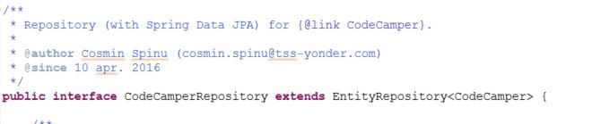
getRepository();

Slide 12
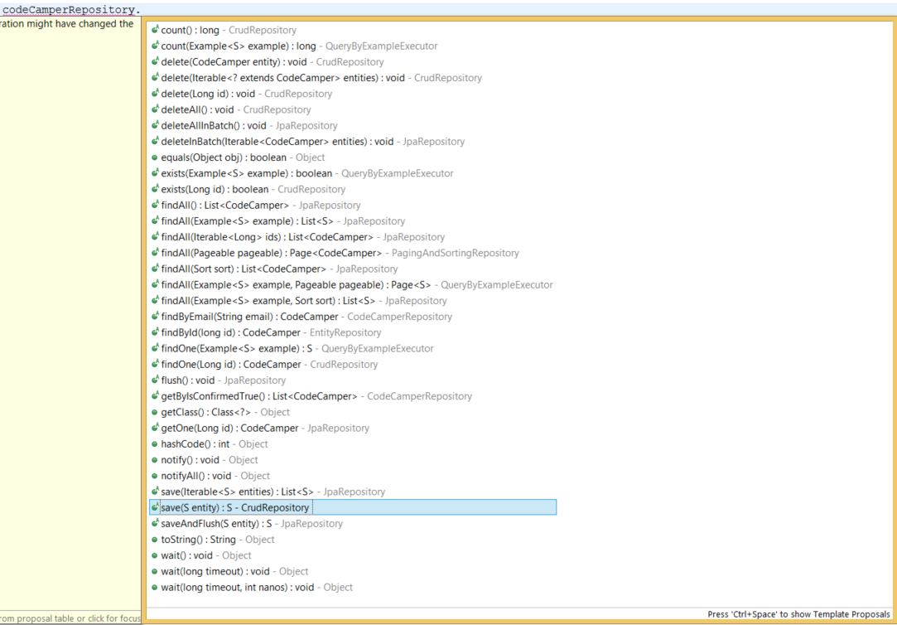
getRepository();
Notes:
Cat de multe metode out of the box sunt aici
Cat de mult v-ar lua sa le implementati toate cu Hibernate ?
2-3 exemple
Dar cu JDBC ?
Doar cu un simplu extends. Cum arata interfata noastra ? Well ... goala. ☺

Slide 13
findBySomething();
Query methods
findBy, getBy, queryBy, removeBy, deleteBy, countBy
findDistinctBy, findFirst3, findTop3
findByFirstNameAndLastNameOrderByAgeDesc
findByDocumentDocumentDate, findByDocument_DocumentDate
Notes:
CRUD operations sunt nice, dar nu suficiente. Intr-o aplicatie cat de cat utila, nu ai ce face doar cu acestea
Stie sa se mapeze singur la entitate si sa creeze singur query-urile behind the scenes
Creezi query-uri doar din numele metodelor
Uneori vor deveni greu de citit si lungi
Depindem de parser-ul pt numele metodelor care ne spune ce putem si ce nu putem folosi
Toate keyword-urile disponibile pot fi gasite in Reference Documentation

Slide 14
findBySomething();
Keywords
And, Or, Is, Equals, Between, LessThan, LessThanEqual, After/Before, IsNull, IsNotNull, Like, NotLike, StartingWith, Containing, OrderBy, Not, In, True, False, IgnoreCase, Regex etc.
Return types
Void, Primitives, Wrapper types, T, Iterator<T>, Collection>T>

Slide 15
findBySomething();
Keywords
And, Or, Is, Equals, Between, LessThan, LessThanEqual, After/Before, IsNull, IsNotNull, Like, NotLike, StartingWith, Containing, OrderBy, Not, In, True, False, IgnoreCase, Regex etc.
Return types
Void, Primitives, Wrapper types, T, Iterator<T>, Collection>T>, Stream<T>

Slide 16
queryAnnotation();
@Query
Supports both, JPQL and SQL queries
It overrides the query method behaviour
There is no naming convention
Notes:
Creare de query-uri dupa numele metodelor are avantajele ei dar si slabiciuni
Avem adnotarea query la dispozitie
Se preteaza in situatii cand avem join-uri

Slide 17
namedQuery();
Named Queries
Define them in properties files, annotation (@NamedQuery , @NamedNativeQuery) or orm.xml file
CodeCamper.findByEmailNamed=„...” in a property file
<named-query> or <named-native-query> in orm.xml
There is no naming convention
Notes:
Named queries
In fisiere de propr, adnotare (@NamedQuery in your entity)
Orm.xml – fisierul contine configurari de mapare intre POJO si DB
Apoi se adauga in interfata doar numele dat mai sus si stie direct query-ul ce trebuie facut

Slide 18
sortAndPage();
Keyword: OrderBy
For @Query you can use ORDER BY in the query string
Sort Class
Extend PagingAndSortingRepository
Notes:
Keyword: OrderByAgeDescNameAsc
New Sort(Direction, property)
Exteding P&sortRepo este metoda findAll(sort)
Paginarea se face prin interfata pageable, clasa pagerequest unde se dau ca parametri dimensiunea paginii si numarul lor

Slide 19
customRepo();
Create an interface CustomRepository
Implement the interface needed methods in CustomRepositoryImpl and annotate it with @Repository
In your main repository extend the CustomRepository
Notes:
Uneori poate chiar aveti nevoie sa implementati o metoda prin hibernate sau JDBC sau altceva
Creati o interfata customrepository cu metodele necesare, faceti implementarea lor si adnotati clasa cu @repository
Extindeti din repo „principal” interfata

Slide 20
advanced();
Supports also Criteria API in Custom repos
Dynamic queries (Criteria API - the standard way in JPA)
Supports advanced quering with QueryDSL
ofc instead of Criteria API ☺
Caching is configurable as in any other Spring/Hibernate project
Notes:
Care e principalul dezavantaj pana acum ? – Nu suport dynamic queries (nu au un nr constant de conditii)
In repository custom putem folosi Criteria API
O aplic existenta (cu Criteria) poate fi mai usor migrata
Criteria – standard way de creare dynamic queris in JPA
Are o problema mare – e foarte greu sa implementezi queriuri complexe – si mai greu sa le citesti

Slide 21
audit();
@CreatedBy , @LastModifiedBy – who ?
@CreatedDate, @LastModifiedDate – when ?
Spring Security integration
Notes:
Furnizeaza support pentru auditare (cine a create sau modificat o entitate si timpul cand a avut loc) – sunt necesare ceva config
Daca aveti deja spring security in place, se face integrare foarte rapid

Slide 22
demo();
https://github.com/cosminspn/cc-apr-2016/
https://github.com/cosminspn/cc-apr-2016/tree/master/source/spring-data-example

Slide 23
removeFromTheProject();
When Spring Data does not bring value ?
A lot of JOIN queries
DB which do not use FKs
When even the CRUD methods should be overriden
May be other situations ...
Notes:
Foarte multe query-uri care fac join-uri si trebuie sa scrii mai mult HQL sau SQL decat sa beneficiezi de avantajele sale
De exemplu entry-urile din tabele sunt versionate si nu poti folosi FK
Si legaturile sunt versionate in alte tabele separate
Cand nici create-ul nu mai e ce-a fost ... De exemplu trebuie sa indexezi intr`un elastic search la save sau update
Sau sa faci remove din elastic search la delete

Slide 24
hopeForTheBest();
Who heard about Spring Data ?
x code campers
Who worked with Spring Data ?
x code campers
Notes:
Cei dinainte + eu = n+1

Slide 25
thankYou();
THANK YOU !
QUESTIONS ?

