Slide 1
Building Architectures that deliver in Practice

Slide 2
ABOUT US
Tudor Teodoru
Software Architect @ Centric
Florin Bîzgă
Cloud Engineer @ Centric

Slide 3
Kahoot

Slide 4
Regardless of the application architecture,
an application that is delivered must comply
with requirements and quality characteristics
(performance, scalability, maintainability, etc.)

Slide 5
Summary - Part 1
Introduction
Evolutionary Architecture
Fitness functions
eShop on containers
Overview
Environment overview
Developer machine
CI/CD pipeline
Environments (T & A)
10 min break (9:50)

Slide 6
Summary - Part 2
Maintainability
Present the metrics
SonarQube Overview
NDepend Overview
Ndepened HandOn
Security
Present metrics
Tools
Break – 15 min (11:30)

Slide 7
Summary - Part 3
Performance
Work in Teams
UI metrics
API metrics
Demo (load testing)
Resiliency
Metrics
Azure Application Insights Overview
Demo

Slide 8
PART 1
Introduction
Evolutionary Architecture
Fitness functions
eShop on containers
Overview
Environment overview
Developer machine
CI/CD pipeline
Environments (T & A)

Slide 9
Evolutionary Architecture
An evolutionary architecture supports
guided,
incremental change
across multiple dimensions.
Notes:
Based Build Evolutionary Architectures Book

Slide 10
Guided change
Fitness function
A particular type of objective function that is used to summarize how close a given design solution is to achieving the set aim

Slide 11
Guided change
Define relevant fitness functions to cover the key and relevant quality attributes of the system

Slide 12
Incremental Change
Small scope change (development)
Level of modularity and decoupling for business features(deployment)

Slide 13
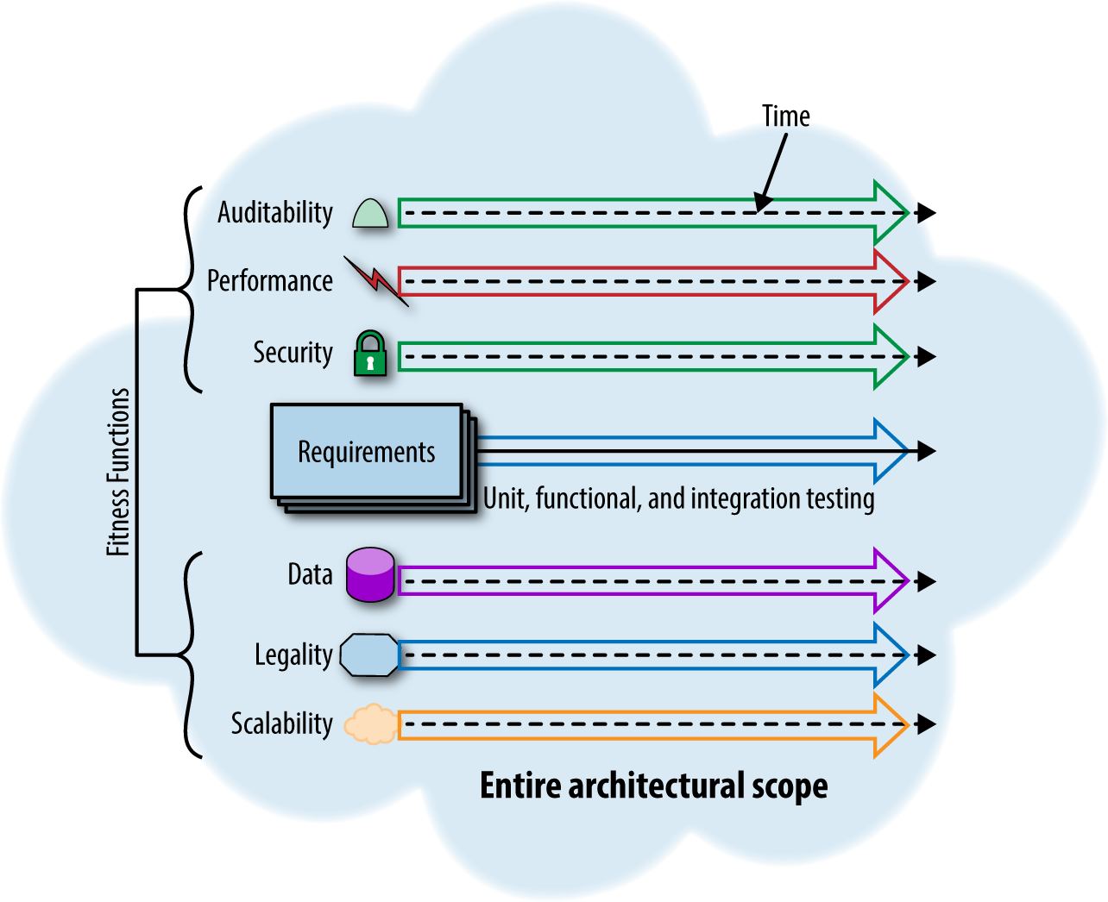
Multiple Dimensions
Dimensions
Technical
Data
Security
Operation/System
Image Source: Building Evolutionary Architectures

Slide 14
Characteristics of an evolutionary architecture
Modularity and coupling
Organized around business capabilities
Fast feedback loops allow experimentation
Notes:
Modularity and coupling -> The ability to separate components along well defined boundaries has obvious benefit if a developer wants to make a non-breaking change
Aim for low coupling
Components should have an appropriate size based on problem context
Organized Around Business Capabilities -> applications partitioned by domain
Conway law -> Inverse Conway law
Experimentation -> Operationally inexpensive trivial change to applications allows common Continuous Delivery practices like A/B testing, Canary Releases
The biggest impediment are the operations that are hard to control (manual steps) -> not able to deploy easily hampered feedback cycle

Slide 15
Building Evolutionary Architectures
Identify Dimensions Affected by Evolution
Define Fitness Functions for Each Dimension
Use Deployment Pipelines to Automate Fitness Functions

Slide 16
eSHOP On Containers
Reference microservice and container based application
eSHOP with mobile and web frontend, implemented using microservices behind an API Gateway

Slide 17
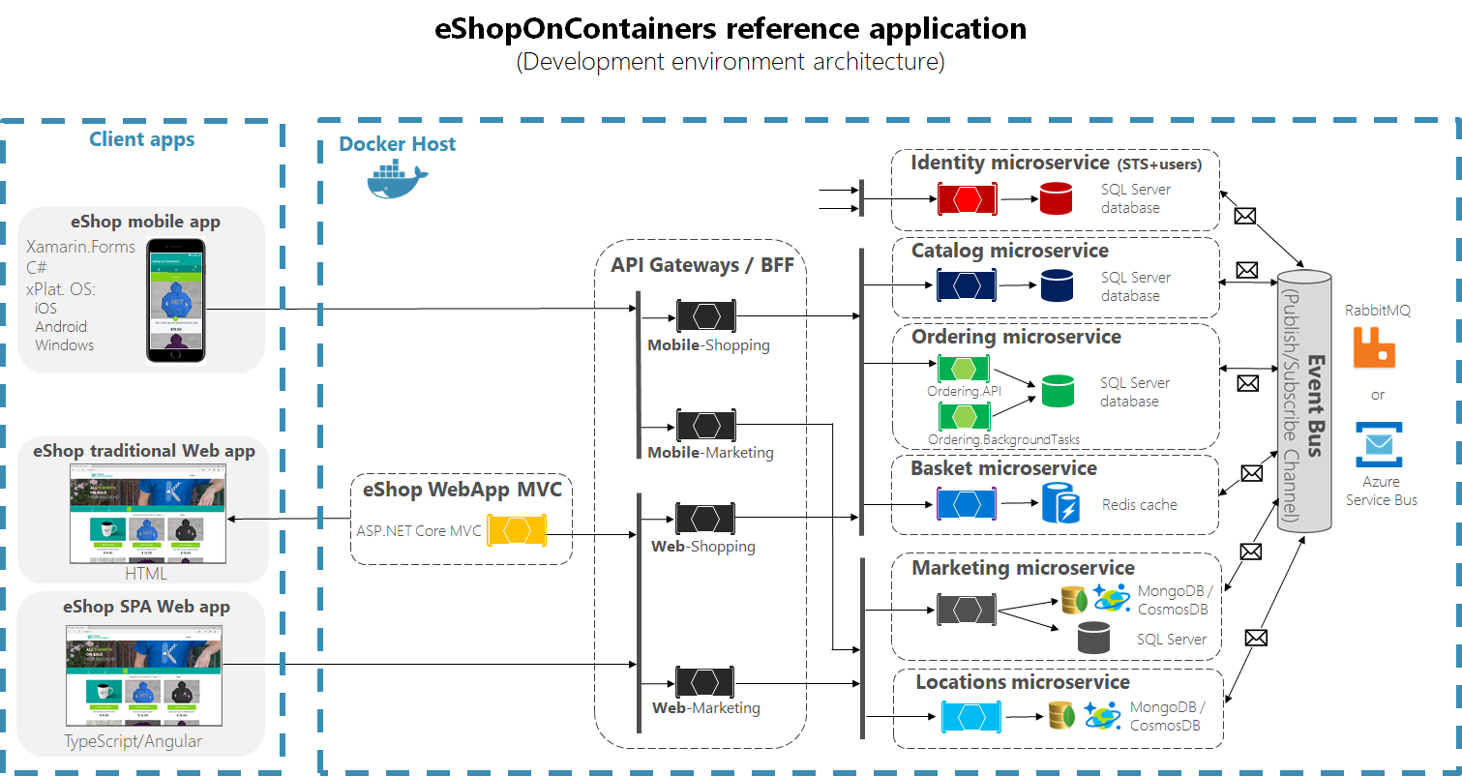
chttps://github.com/dotnet-architecture/eShopOnContainers

Slide 18
Development Environment Setup
Log in to VM in Azure
Check Visual Studio and source files
Open SonarQube
Open AzureDev ops
Install NDepend

Slide 19
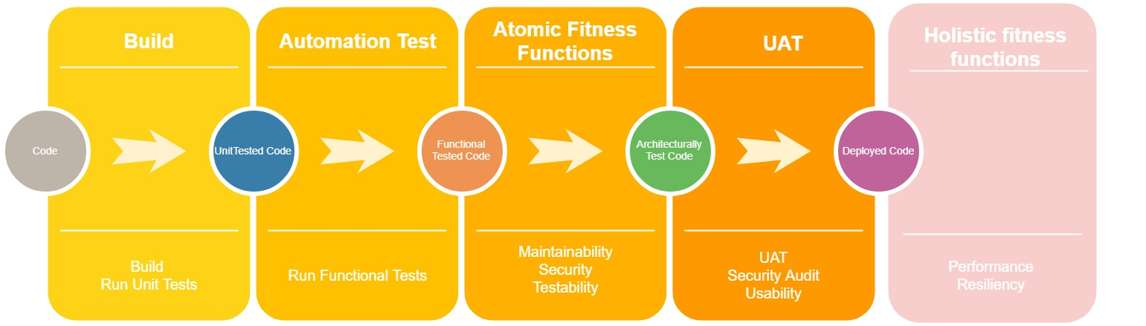
CI / CD Pipeline

Slide 20
AZURE Dev OPS

Slide 21
AKS

Slide 22
BREAK – 10 min

Slide 23
Part 2
Maintainability
Present the metrics
SonarQube Overview
NDepend Overview
Ndepened HandOn
Security
Present metrics
Tools
Break – 15 min (11:30)

Slide 24
Quality Attributes / NFR
Wikipedia:
“A non-functional requirement (NFR) is a requirement that specifies criteria that can be used to judge the operation of a system, rather than specific behaviors. They are contrasted with functional requirements that define specific behavior or functions. The plan for implementing functional requirements is detailed in the system design. The plan for implementing non-functional requirements is detailed in the system architecture, because they are usually architecturally significant requirements.”

Slide 25
Architecturally significant REquirements
Architecturally significant requirements are those requirements that have a measurable effect on a computer system’s architecture. This can comprise both software and hardware requirements. They are a subset of requirements, the subset that affects the architecture of a system in measurably identifiable ways.

Slide 26
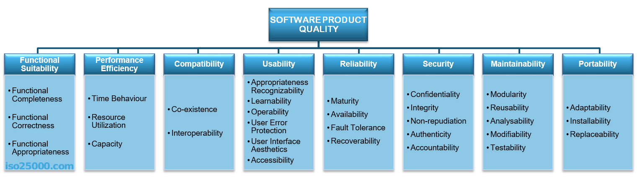
ISO 25010 – Quality Model
Iso25000.com

Slide 27
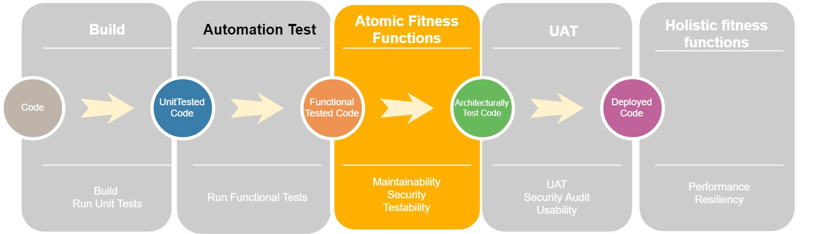
Atomic Fitness functions

Slide 28
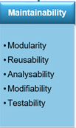
Maintainability
Static Code Analysis
Architecture Characteristics

Slide 29
Static Code Analysis
Best practices based on language (code smell)
Security Concerns (Top10 OAWSP, …)
Bugs (DeadCode….)
FxCop, RoslynAnalyzer, ReSharper, SonarQube

Slide 30
Architecture Characteristic
Short Methods
Simple Methods
Duplication (write code once)
Keep number of parameters for methods small
Separate Concerns in Classes
Notes:
Based on Build Maintainable Software book

Slide 31
Architecture Characteristic
Components Loosely coupled
Components Balanced
Codebase Small
Automated Test
Clean Code
Notes:
Clean Code
Unit level code smells (methods)
Bad comment code
No code in comments
Dead code
No long identifier names
Magic constants
Badly handled exceptions

Slide 32
Maintainability
 | Modularity | Reusability | Analyzability | Modifiability | Testability
Short methods |  | x | x
Simple methods |  |  |  | x | x
Duplication |  |  | x | x
No. of parameters |  | x
SRP | x | x
Components loosely coupled | x |  |  | x
Components balanced | x |  | x | x
Codebase small |  |  | x |  | x
Automated Tests |  |  |  |  | x
Clean Code |  |  | x | x

Slide 33
Maintainability
Short units of code – limit methods to 15 lines
Simple units of code – cyclomatic complexity of a method equal to 5
Duplicate code less than 4%
Limit method parameters to 4
SRP -> Ndepend Metrics -> LCOM < 0.8 and NbFields < 10 and NbMethods <10
Notes:
LCOM = Lack of Cohesion Of Methods

Slide 34
Maintainability
Components loosely coupled
Components balanced : 6-12 components
Codebase small: less than 160 000
Test Automation: 80% unit test coverage
Static analysis in SonarQube with no blocker issues

Slide 35
Demo SonarQUbe

Slide 36
Demo Ndepend & Activity
Write NDpend rule for defining components and count number of lines.

Slide 37
Security
No issues in SonarQube Security Reports for OWASP Top 10 and SANS Top 25
OWASP Zap tool should not identify any issue
Perform initial penetration test and regular 3 months evaluations
Use only approved nuget packages and npm packages
Notes:
Common Vulnerability and Exposure (CVE)
SANS Intitute 25 top
Software Error Category: Insecure Interaction Between Components (6 errors)
Software Error Category: Risky Resource Management (8 errors)
Software Error Category: Porous Defenses (11 errors)
CWE-89Improper Neutralization of Special Elements used in an SQL Command ('SQL Injection’)
CWE-78Improper Neutralization of Special Elements used in an OS Command ('OS Command Injection’)
CWE-79Improper Neutralization of Input During Web Page Generation ('Cross-site Scripting’)
CWE-434Unrestricted Upload of File with Dangerous TypeCWE-352Cross-Site Request Forgery (CSRF)CWE-601URL Redirection to Untrusted Site ('Open Redirect’)

Slide 38
Security
Dependency Checker
SonarQube Reports
OWASP 10 Ten
SANS 25
OWASP Zap

Slide 39
Demo Depency Checker

Slide 40
Break 15 min

Slide 41
Part 3
Performance
Work in Teams
UI metrics
API metrics
Demo (load testing)
Resiliency
Metrics
Azure Application Insights Overview
Demo

Slide 42
Performance
Define performance characteristics.
eShop is an ecommerce application which aims a broad product line. Initially estimated users for the first year is about 1000 unique users per day.
Platform should support at least 1000 unique concurrent users with load page of max 1 sec.
Work in 4 teams to define a set of metrics for these requirements

Slide 43
Results

Slide 44
Demo – Load Tests

Slide 45
DEMO Lighthouse

Slide 46
Realibility
Has less than 1% error rate for new deployment
Avg Availability is 99 %

Slide 47
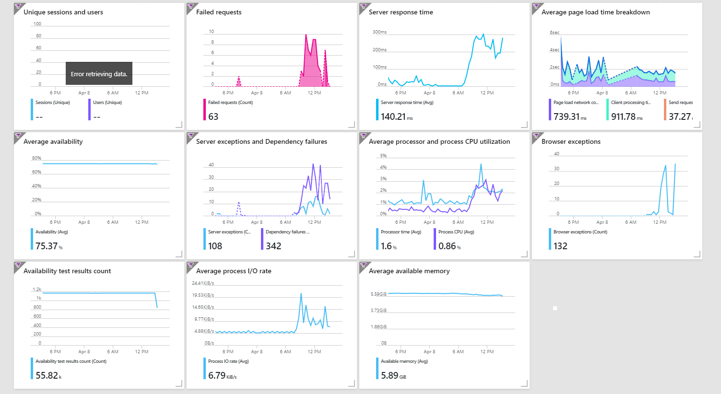
REALIBILITY

Slide 48
ConcLusions

Slide 49
FeeDBack

Slide 50
thanks!

