Slide 1
ECS 165A Milestone3
By Database Builders

Slide 2
Throughput vs Abort Rate vs Number of Threads
From our observation, we figured out as the number of workers increase, the abort rate increase and the throughput increases as well.
This implies even though threads may have conflict with each other, the throughput still increases by adding more threads as well.
*The throughput grows inverse exponentially as we add more threads.

Slide 3
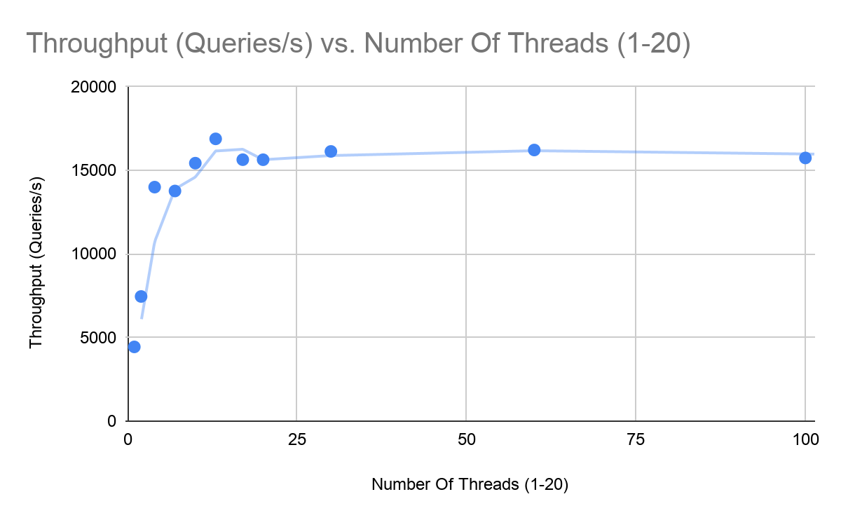
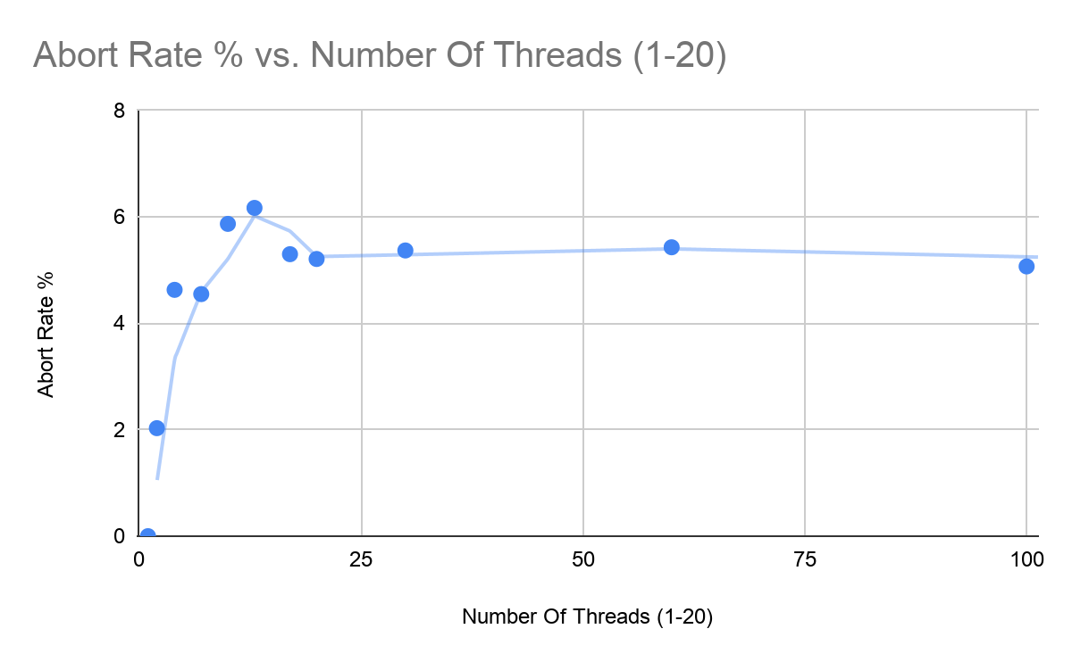
Vs Number of Threads
We observed that both Through and abort rate grow inverse exponentially

Slide 4
VS Size of Records
We observe that as the size of records increase, the abort rate and the throughput decreases.
Recor | Number Of Threads (1-20) | Transactions Per Thread(1-20) | Queries Per Transaction (1- 1000) | Abort Rate % | Throughput (Queries/s)
10000 | 10 | 5 | 100 | 16.04 | 25580.63
30000 | 10 | 5 | 100 | 14.42 | 21907.48
60000 | 10 | 5 | 100 | 9.82 | 18816.98
100000 | 10 | 5 | 100 | 11.11 | 19690.31

Slide 5
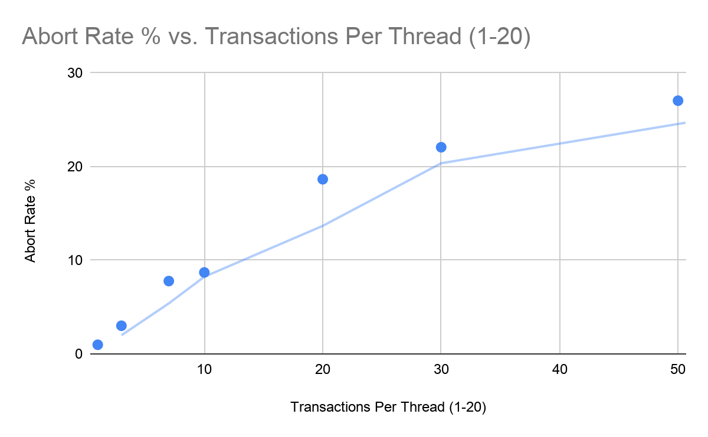
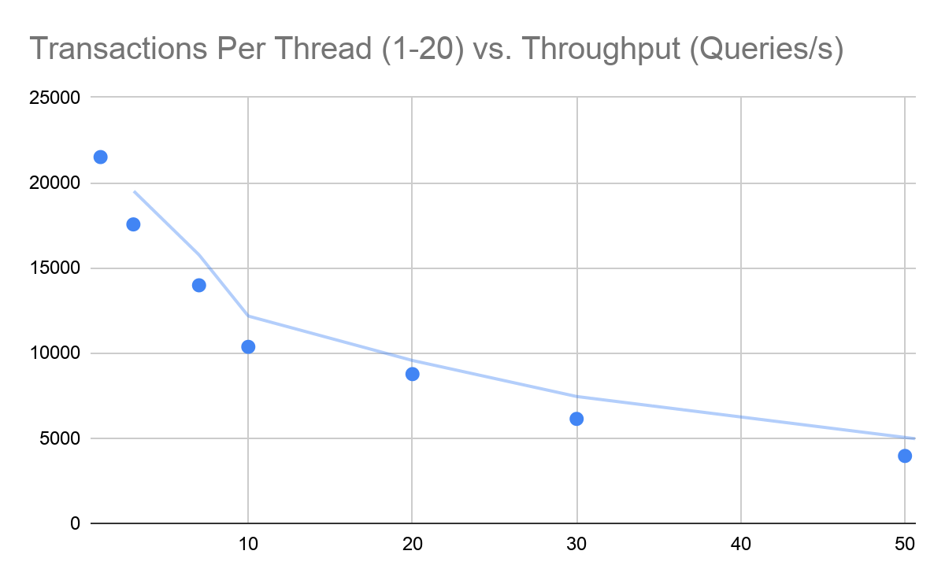
VS Number of Transactions per Thread
As the number of transactions per thread increase, we observe that the abort rate and the throughput increases.

Slide 6
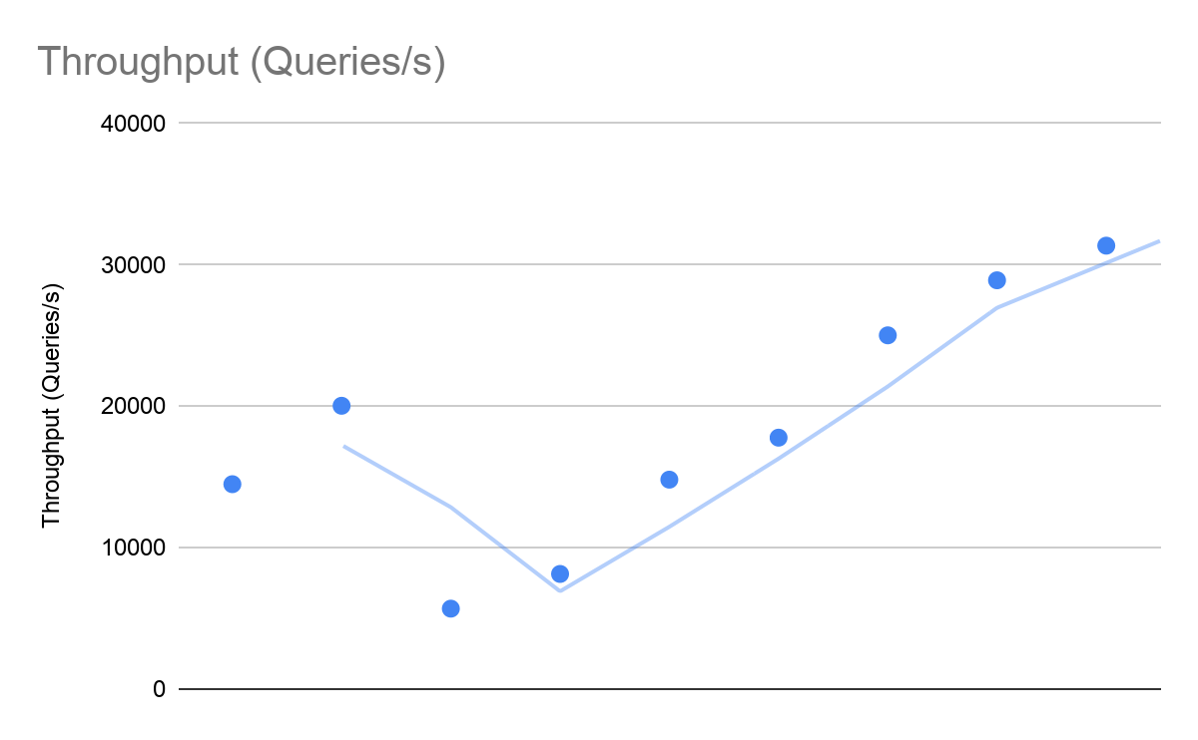
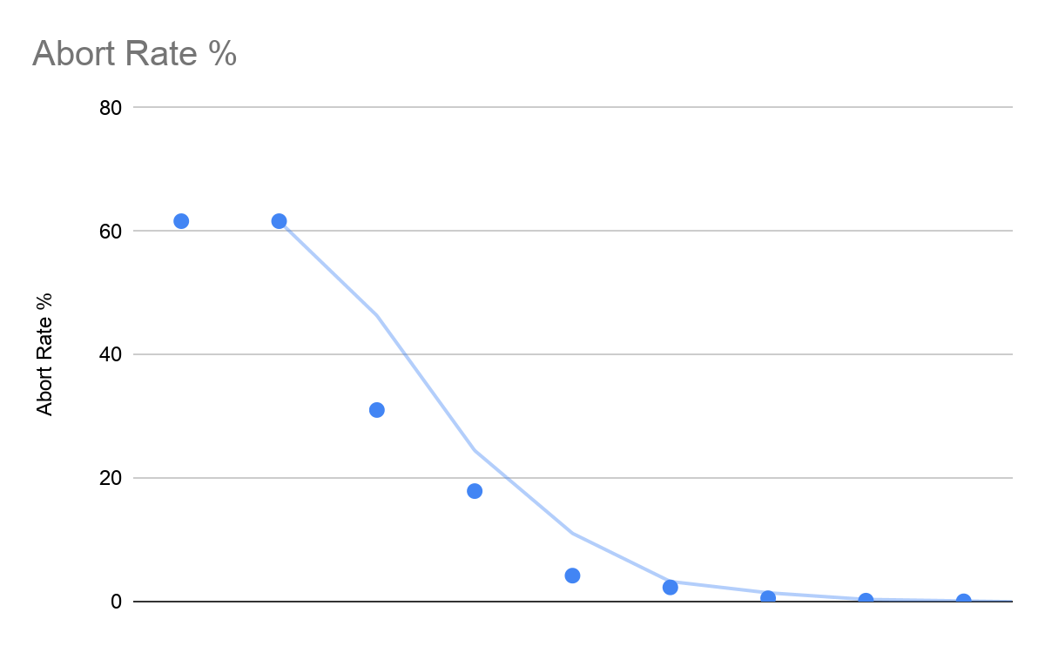
VS Queries per Transaction
We observe that as the queries per transaction increase, the abort rate decrease and the throughput increase.

Slide 7
Base on the previous results, we now kind of know which combinations would lead to high throughput and small abort rate. Hence, we ran this combination where number of threads(workers) = 10 and number and size of records = 30000, number of transactions each thread = 1 and number of queries each transaction = 10000. We therefore, obtained:
Abort Rate = 0.02
Throughput = 43413
Which is a pretty good value!

Slide 8
General layout and some details
1. Lock Manager Class is placed within Table class, which assures the synchronization support even for multiple tables. Its policy is based on strict 2PL.
2. Once the corresponding queries added to transaction class, transaction class will keep a reference of table using “getmembers” functions, therefore our constructor needs zero parameters, strictly following the format of tester.
getmembers(query, lambda member: isinstance(member, Query))[0][1]
=>reference of one particular Query instance=>Table reference
Each query in transaction will keep a reference of one particular Query instance based on the workflow of tester
3. Add page latch to ensure atomic read write operations for page accessing in the abstraction layer of cache

Slide 9
Workflow of Transaction
1. Preprocessing State:
Prepare records locks information by the following:
take note of pkeys and lock type details in all queries
In preprocess state, we store and update the information of locks for queries.
The data structure is hashmap mapping primary key(unique id) -> lock type
lock type: "r" / "w"

Slide 10
Workflow of Transaction
2. Acquire Lock State:
Pass the hashmap to lock manager, asking for locks
Every record lock transaction ask for will have a Lock Base Entry
If the record already has a shared lock on it, update(W) will fail to grap lock
If the record already has a exclusive lock on it, any acquire will fail
If any failure happens, abort the whole transaction based on 2PL

Slide 11
External Package Usage
from readerwriterlock import rwlock
Typically there are three types of lock base:
RWLockRead (solves First readers-writers problem, reader priority);
RWLockWrite (solves Second readers-writers problem, writer priority);
RWLockFair (solves Third readers-writers problem, fair);
Since we are using strict 2PL for this, so there won’t be any starvation, that’s why we simply choose a random lock base for each record, say, Fair Lock
a = rwlock.RWLockFair(); a.gen_wlock() # Generate Exclusive Lock

Slide 12
Workflow of Transaction
3. Ending State
If abort, then discard the whole transaction without processing the queries
If not abort, then release all the locks and commit
Ret 1 if success
Ret 0 if aborted
Ret value will be pushed in thread-safe deque for book-keeping of transaction worker’s result

Slide 13
Page Latch
Page latch is implemented in Cache abstraction by providing a critical section for page revision and Tid increments where threading lock and pin mechanism will prevent race condition.
Both static methods of setting page and getting page will have their own corresponding latches.

