Slide 1
ECS 165A Milestone-2

Slide 2
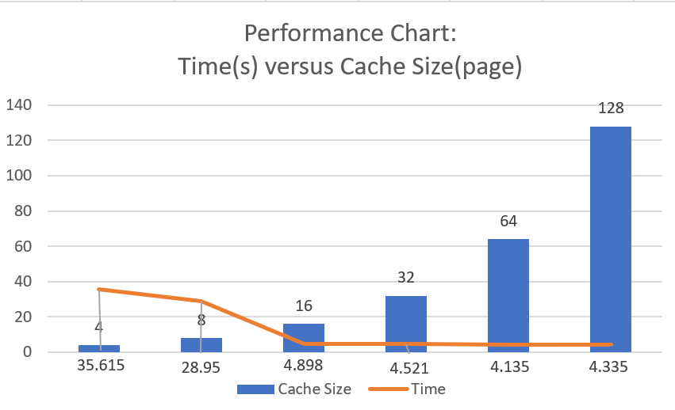
Cache Performance Analysis
Operations: Insert 10k records;
select 10k records; Update 10k records;
Then do select for 10k records again
Result:
Converges at 16-page sized cache

Slide 3
Low Memory Requirement
Very economic operations for disk operations:
Minimum amounts of files---one file per column, use page offset within column-stored file to get 4096 bytes of data each time from disks

Slide 4
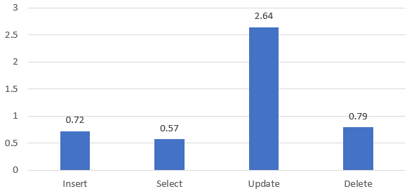
General Performance Analysis
Update takes the longest runtime;
Reason: Update will trigger background merge which takes resources; Expensive context switch for multi-thread because of limitation of python
Basic Operations Runtime(s) with 10K records workload

Slide 5
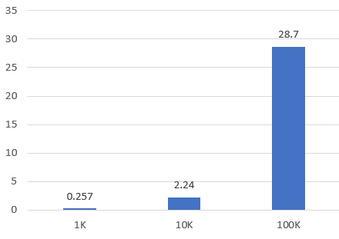
Throughput Stability
Performance of time increases in 1:1 ratio as throughput changes;
For example, everytime workload of update operations increases by 10 times will also result in 10 times the original runtime
Total runtime(s) for update versus #records

Slide 6
Major Restructure from Milestone 1
Combine multiple page directory into one page directory in the layer of cache;
Page of different layout: Spare extra room in 4096 byte array for metadata.
Base pages: TPS and num records. Tail Pages: Num records only.
Reason: So that everytime reading operation from disks will read for one page size consistently, matches the modern operating system setting.
Index: Now index class is now stored within table layer instead of query layer
as a coherent logical part. In db.py abstraction layer, index will be initialized and stored together with table.

Slide 7
Structure Overview
First Layer: durable Database (db.py)
Allow multiple table to co-exist
Handling database index and table initialization, storage for each table
one file per column, and one extra file for index
Second Layer: Index and Table (index.py and table.py)
Pure logical layer for milestone 1 features like manipulating indexing, page range, merge, all sorts of L-Store features of data accessing and manipulation.
Third Layer: Cache
Bufferpool management for actually fetching the data from pages or write to pages
Fourth Layer: Disk Helper
Media between cache and disks, provide data for Cache either from disks or memory

Slide 8
Cache Implementation
Ordered Dict: custom key ----> (Bool, Page) ;
Initialization: Empty dictionary; However it will setup the last position available for RID when opening database for later operations
Eviction Policy: LRU;
All data were in disks in the first place. Cache start to fetch data from disks and store them inside bufferpool only when the corresponding data is accessed.
Extension functionality:
generate keys for certain pages so that pages are stored
in one page directory only
Get Page and Set Page: Specifically made for Merge, allowing page-wise operation
Destructor will trigger the final flush-to-disk operation

Slide 9
Merge
Incentive: Usually when I do merge and scan tail pages backward, I found out sometimes I could possibly access a lot of tail pages that are unnecessary to be scanned because there are many tail pages which only contain old update records (ie not the latest updates), so my incentive is to find a way to avoid accessing those tail pages and baseRid redirections. This motivates me to find a solution to optimize a little bit
After lots and lots of overturns of model design and codes testing, balancing of pros and cons, I ended up using a special way to implement merge most suitable for my current codes.

Slide 10
Key Elements
Multiple Merge Queues - thread safe FIFO deques to get update infos
Merge Counter - thread safe FIFO deque to get δ# of tail pages
Merge Counter and MERGE_EPOCH - decide when to merge
Merge trigger - concurrency helper

Slide 11
Multiple Merge Queues
One deque for each base page with the same LOGICAL position. When update: O(1) atomic access to get corresponding deque and O(1) atomic append per update. When merge: keeps popping infos out of deques
Pros?
Element: Tuple(BaseRid, TailRid)
Pros?
deque
deque
deque
deque
deque
deque
deque
deque
deque

Slide 12
Roles of Merge Queues in Merge Thread
Hashmap SeenUpdate for merge queue analysis:
Deque --Popleft()--> Tuple(BaseRid, TailRid) --> SeenUpdate[BaseRid] = TailRid
As the result:
Get every 1 to 1 mapping of baseRid to its latest tailRid. SeenUpdate will always end up with one tail rid of newest update for one baseRid because of dictionary key conflicts and replacement.
Pros?
Lineage = Last TailRid popped for that page

Slide 13
Main
2 threads Workflow
Merge
Wait for next trigger…..
len(Merge Counter) > MERGE_EPOCH
Trigger.set()
Merged Base Pages
Trigger.reset();
Refresh Counter

Slide 14
Optimization
db.close() will trigger last round of merge; no possible WW conflicts for base pages, even for those ones that are still not full
db.close() will let all the tables break their loop of merging
Merge waiting for next trigger…..
db.closed
Trigger.set()
No Limits on merging base pages
Break the loop

Slide 15
final contribution
and corresponding Q&A
Haoyang Li: main architect, cache, disk
Wenhao Su: merge, index, db, disk
Anthony Yang: testing
Justin Buhay: testing
Jung-Cheng Chang: testing

