Slide 1
Off-Label Drug Usage Patterns: Comparative Analysis of Automated Drug Usage Pattern Identification Leveraging Multiple Databases
Symbolic Methods Course Project
Annie Choi, Kayla Schiffer

Slide 2
Study Design Overview
Data Extraction
Patient Drug and Diagnosis Data from MIMIC for a given hospital visit
Drug-Diagnosis databases
Treat Relationships: NDF-RT
Drug-Indication: DrugCentral
Clinical Trials: AACT
Vocabulary mappings: OMOP
Drug Usage Classification at Varying Vocabulary levels
Classify patient diagnoses according to database extracted indications at different hierarchical and parallel levels
Match patient drugs according to database extracted treat relationships

Slide 3
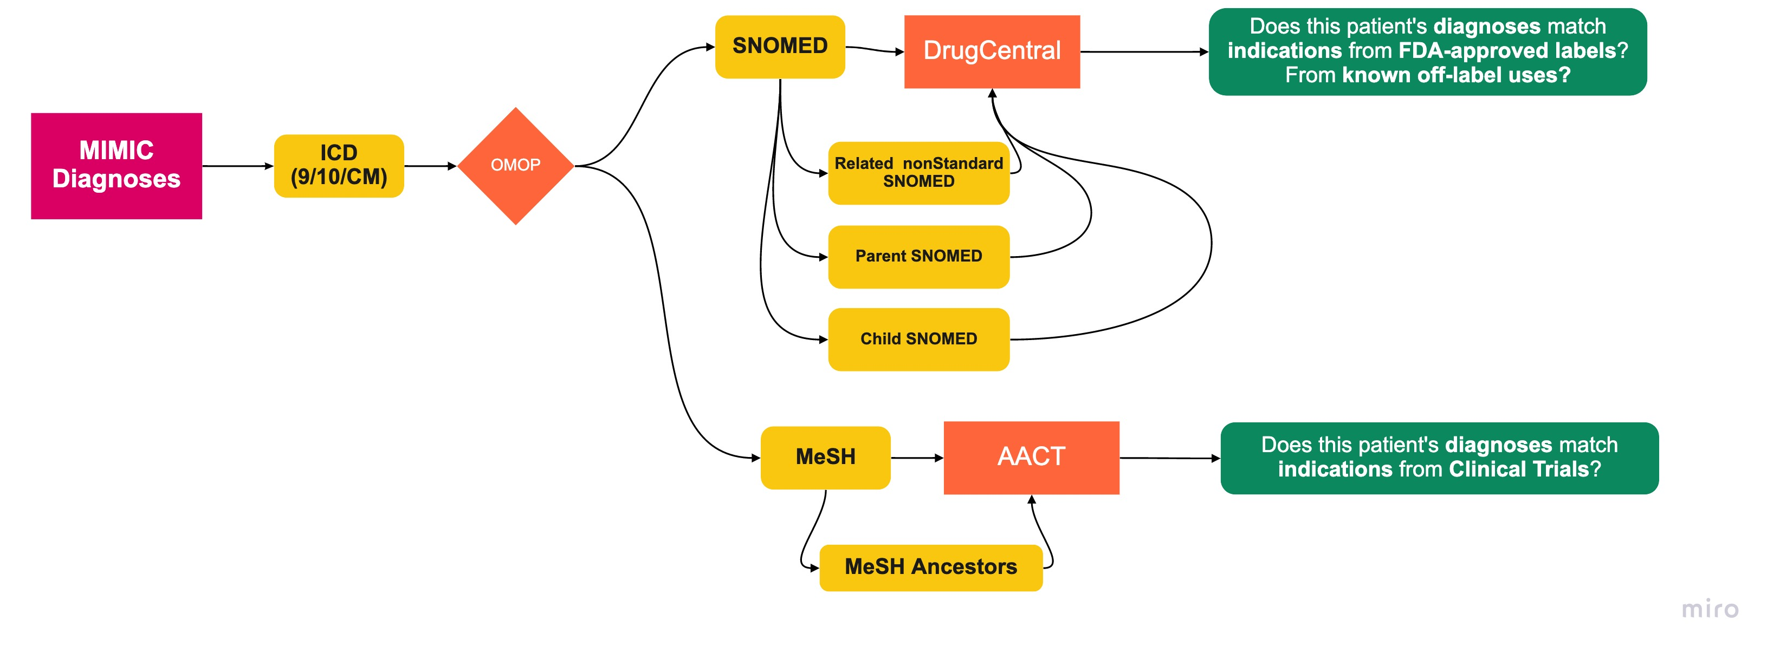
Study Design: Mappings from Diagnosis

Slide 4
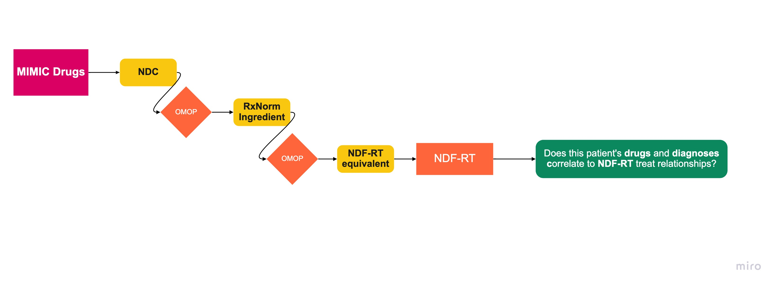
Study Design: Mappings from Drugs

Slide 5
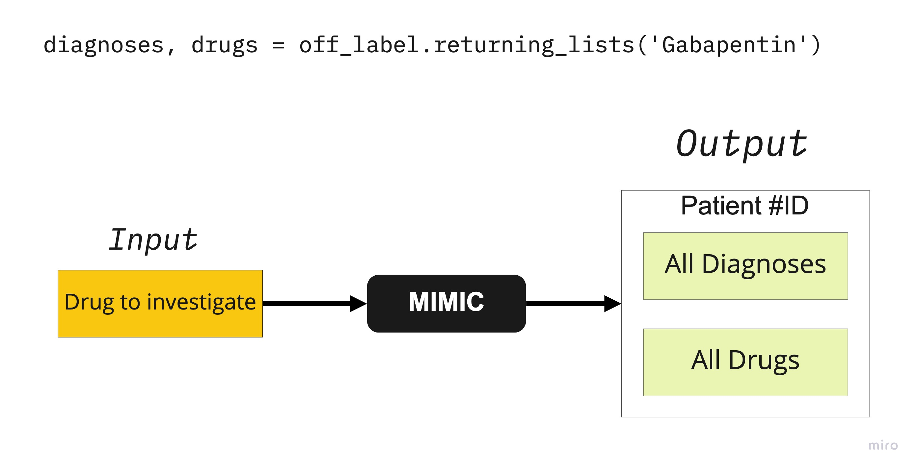
Patient Data Extraction: MIMIC
Unit of analysis is the patient and their associated diagnoses
Question: Looking at the patient data, how might a diagnosis be identified as:
FDA approved indication
Typical off-label use
Evidence assessment off-label use
Otherwise unidentified, potentially unassociated or novel off-label use

Slide 6
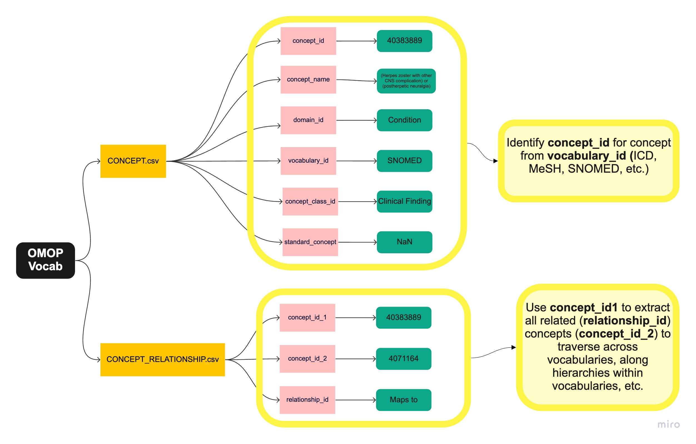
Database Extraction: OMOP Vocabulary
Enables vocabulary traversals, identifying variation in results when incorporating :
Standard to nonstandard mappings
Parent/child hierarchical traversals
Cross-vocabulary mappings

Slide 7

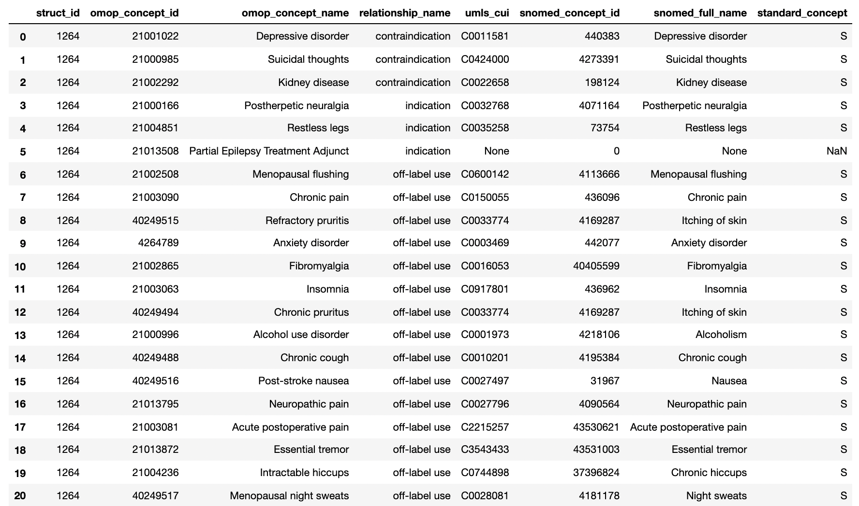
Database Extraction: Drug Central
DrugCentral is a publicly available database providing information on active pharmaceutical ingredients (drugs)
Live updates
Ingredients as unit of analysis
Accessed via PostgreSQL
Indications identified using:
Pre 2012: extracted from OMOP vocabularies
Post 2012: UMLS indications extracted from free-text drug labels
For our project, used to identify:
FDA-approved indications
Established off-label uses (mapped from OMOP)
Link to gabapentin DrugCentral page
Notes:
Indications in DrugCentral were collated from OMOP vocabularies (http://omop.org/Vocabularies) for those drugs approved before 2012; for drugs approved after 2012, indications were extracted from drug labels, and mapped to SNOMED-CT (6) concepts. Indication data from these two sources are currently being harmonized using the UMLS (7) application programming interface, as well as manual mapping
DrugCentral publication: https://academic.oup.com/nar/article/45/D1/D932/2333938
Website: https://drugcentral.org/

Slide 8
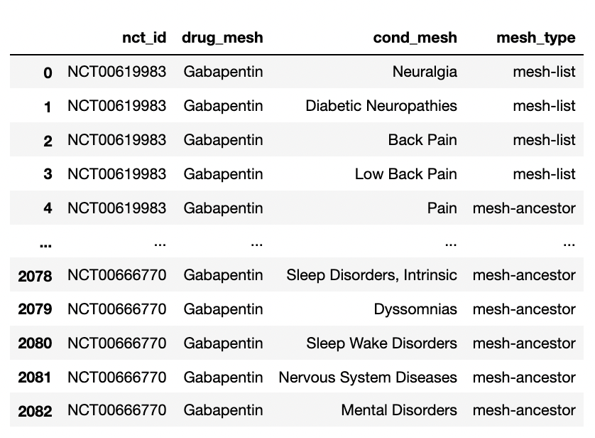
Database Extraction: AACT
AACT is a publicly available database that contains data extracted from ClinicalTrials.gov
Live updates
Accessed via PostgreSQL
Notes:
AACT is a publicly available relational database that contains all information (protocol and result data elements) about every study registered in ClinicalTrials.gov. Content is downloaded from ClinicalTrials.gov daily and loaded into AACT. The Clinical Trials Transformation Initiative (CTTI) enhanced AACT in October, 2016 to include the following features:
Indications were drawn from the American Association of Clinical Trials Database (the ‘AACT Database’, Clinical Trials Transformation Initiative, 2016), which contains structured records from the National Library of Medicine’s ClinicalTrials.gov database service. Indications in the AACT database are again annotated using medical subject heading (MeSH) terms (a subset of UMLS terms), and represent a mix of investigator-submitted and automatically extracted annotations

Slide 9
Database Extraction: NDF-RT

Slide 10
Results: Formal Indications
Given specificity and limited number of formal indications, parallel and hierarchical traversals do not contribute to shifts in indication classification unless a diagnosis is 1-degree ancestor/descendant of an indicated concept

Slide 11
Results: Off-Label DC vs AACT
Given specificity and limited number of formal indications, parallel and hierarchical traversals do not contribute to shifts in indication classification unless a diagnosis is 1-degree ancestor/descendant of an indicated concept

Slide 12
Results:

Slide 13
Results: Insurance

Slide 14
Clinical Perspective Drug Central Notes - to be organized/formatted
SP identified diagnoses likely to prescribe gb for:
* 7 - pateints would come in already on gabapentin, out of scope of field
* 16 - Neuropathic pain
* 17 - acute post operative pain
* 5 - rarely for epileptic

Slide 15
Clinical Perspective AACT Notes - to be organized/formatted
Depression: Wouldn't stop gabapentin because of presence of depression diagnosis - not a true contraindication
Anything <10 mentions get rid of
Some are really vague:
Polyneuropahty, never prescribe gb for headache, back pain/acute pain, peripheral nervous disease
GB and opiod use offset:
Constipation – may not be prescribed for treating directly, but for minimizing opioid requirement
Diagnosis as indicator of other diagnosis GB actually treating:
i.e. Diabetes → GB treating diabetic neuropahty – symptom/associated covariant
Vs. Sciatica - primary treatment

Slide 16
Clinical Perspective Equity Issues Notes - to be organized/formatted
Equity issues in critical care, physiologic data/societal biases
Empathy for pain tolerance varies based on race
pain thresholds perceieved by discordant races of caregivers
administration of pain meds
drug seeking behaviors - a bit of a jump
Demographics: race, gender - subject pain threshold
Administration patterns vary
drug seeker - more opiod sparing medications, earlier to gabapentin
or you don't believe thier pain, so don't prescribe gabapentin
match by diagnosis, severity
In-pateint - less scrutiny around diagnosing properly per drug for reimbursement
reimbursed by diagnosis

Slide 17
Future work
Drug-disease cooccurrence: For patient data, assign drug-diagnosis correlation (this is hard!) to more precisely classify drugs as on-label/off-label/novel use/evidence-based use/etc.
Complicated indications: Create dictionary of FDA terms for precise indication mapping
For example, gabapentin is approved for “treatment adjunct for partial epilepsy”
“Treatment adjunct” is not a diagnosis, but a condition that there is another drug that is indicated for epilepsy already in the patient record to qualify gabapentin as “adjunct”

