Slide 1
DOOR ACCESS CONTROL SYSTEM WITH FACE RECOGNITION
GROUP MEMBERS
IIT2019037 - ABHISHEK BHAWARE IIT2019034 - RAJAT MEHRA
IIT2019030 - KAUSHAL KUMAR IIT2019061 - RAJPAL SINGH SHEKHAWAT

Slide 2
PROBLEM STATEMENT
Door access control system using face recognition

Slide 3
Why we’ve chosen it
In today's world, home security is of utmost priority. IOT (Internet of Things) being an emerging technology can be used along with facial recognition to make our task of providing smart home security easier, simpler and foolproof.
The Face Detection System (FDRS) is a technology that recognizes body features by using mathematical factors inherent in human appearance. This technology is easy to use and secure. The Internet of Things (IoT) is a popular technology that allows you to track and control harmful devices in your house. Identifying a person to enter and exit the house is an important aspect of a home security system.

Slide 4
APPLICATION
The aim of this project is to assist users for improvement of the door security of sensitive locations by using face detection and recognition. The proposed system mainly consists of subsystems namely image capture, face detection and recognition, notification and automatic door access management. Face Recognition supported openCV is brought up because it uses Eigen faces(it utilizes linear algebra and Principal Component Analysis (PCA) to perform face recognition). and reduces the scale of face images without losing vital features, facial images for many persons can be stored in the database. The door lock can also be accessed remotely from any part of the room. The captured image from esp32 camera will be sent to the authorized person.

Slide 5
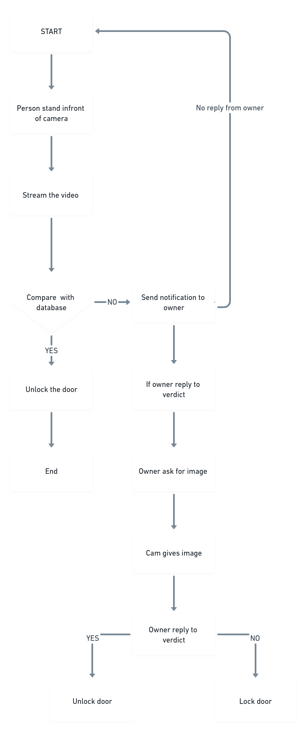
USE CASE DIAGRAM

Slide 6
SOLUTION
HARDWARE requirements
ESP32 CAM WiFi Module Bluetooth with OV2640 Camera Module 2MP For Face Recognition
FT232RL USB to TTL 3.3V 5.5V Serial Adapter Module
Bread Board
Arduino Uno
Jumper wires
Serial port USB cable 5V mini
Electronic door lock 12V
PCB Mounted Passive Buzzer Module
2 Channel 5V Relay Module with Optocoupler
Battery
Software requirements
OpenCV python package
Arduino software
Web Browser
Raspberry Pi/ PC as server
Technology/language requirements
C++/C
Python

Slide 7
Deliverable
User can expect:
Fully functional Facial recognition device.
User also get a list of people with time who are coming in front of camera.
The device setup also consist of a strong solenoid lock.
For security purposes, video streaming can only be seen if both the devices are on same network.

Slide 8
Timeline
Module 1 - Connect esp32 cam with PC and stream the data in real time from esp32 to processing unit, and for security purpose we are transferring the data directly by wifi. The only requirement is that both sender and receiver has to be connected to that same wifi service.
Module 2 - Processing unit is able to process the real time stream, applies Face Recognition model and check that person in our database. It then sends the verdict to the solenoid lock. If it is “YES”, we open the lock, else we take some photos of that person, and send them to the user. If user allows that person, lock opens and that person is registered in the database else the lock remains closed. Also if user ignores, then that is interpreted as “NO”.
Module 3 - With the given verdict processing unit is able to open the lock and also maintaining a excel sheet by which client can get info about who is entering at what time.

Slide 9
Implementation of Module 1
Screenshot
Readme file Explaining in details how to run your code
Code
Sample input/output

Slide 10
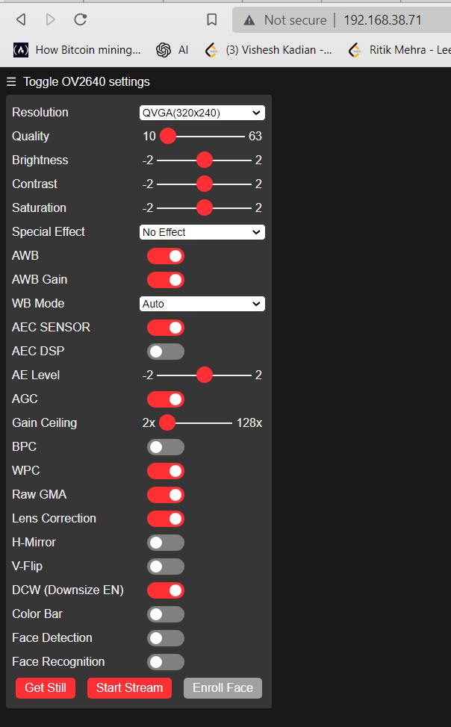
Screenshot of ESP32 Website where video is streamed

Slide 11
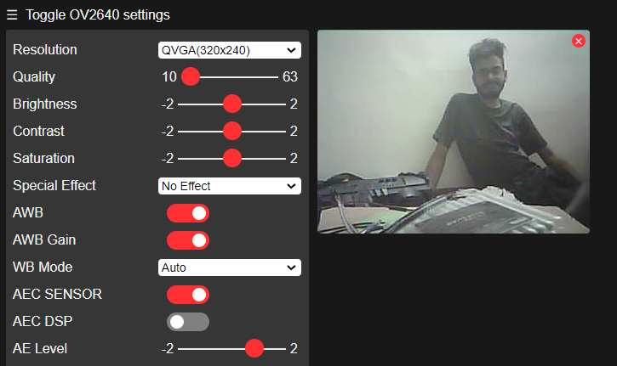
Video streamed on site

Slide 12
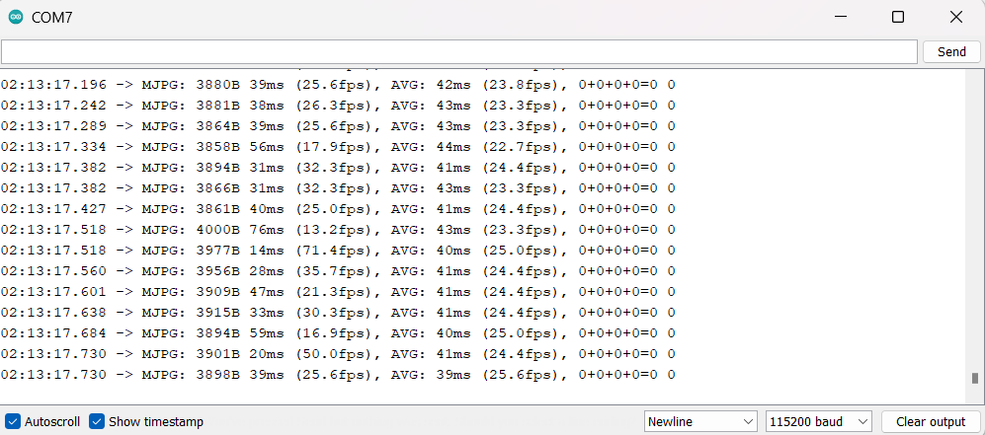
Continuous Image Transfer log

Slide 13
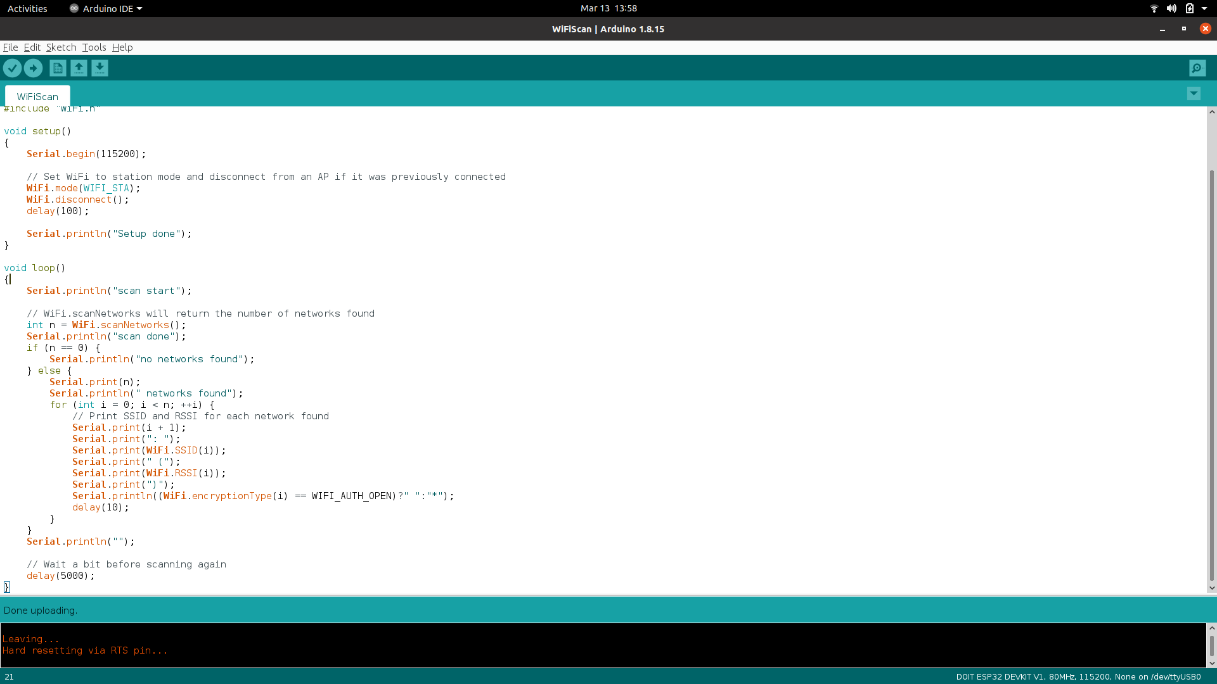
Code Screenshots

Slide 14
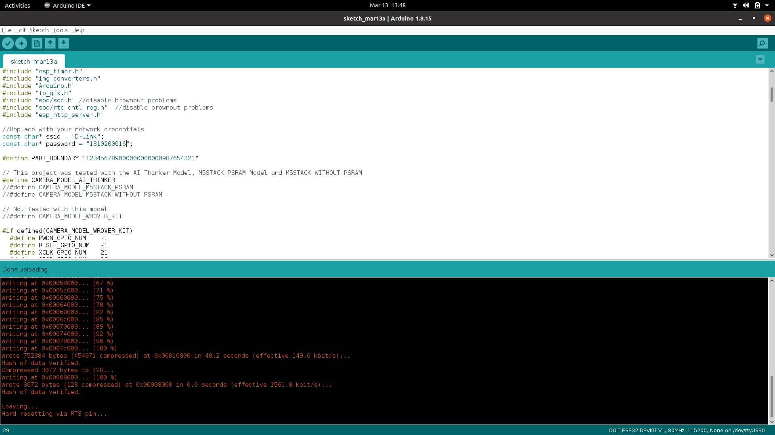
Code Screenshots

Slide 15
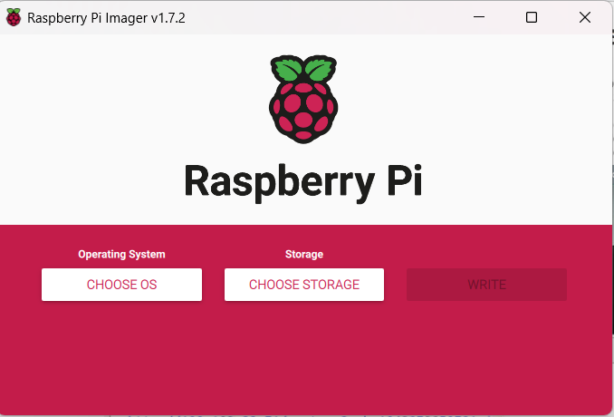
Using Raspberry Pi imager to write on disk

Slide 16
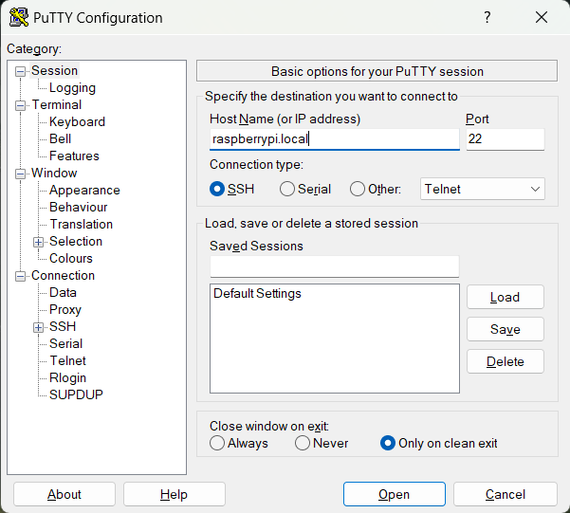
Setting PuTTY for configuration

Slide 17
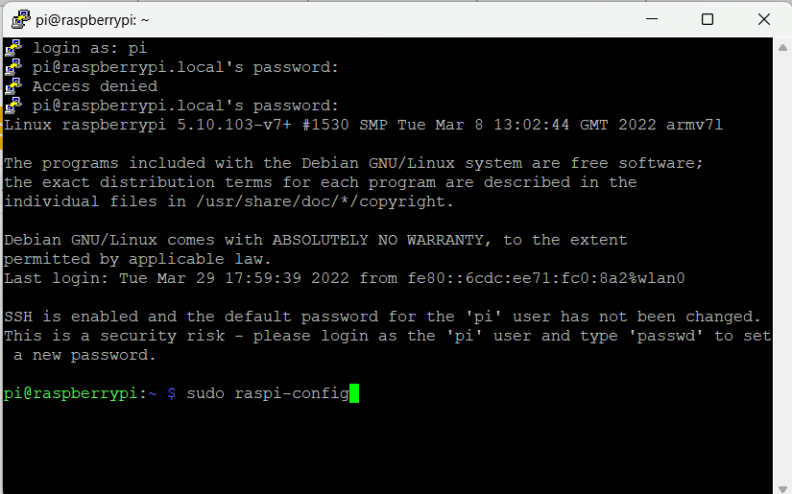
Configuring raspberry pi

Slide 18
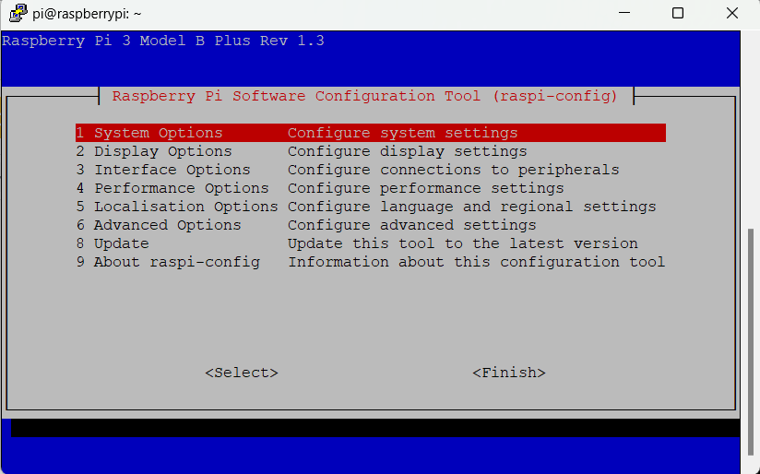

Slide 19
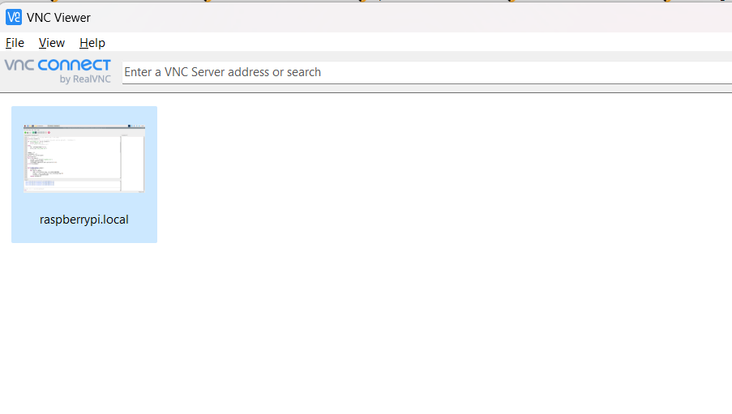
Using VNC viewer to display Raspi’s screen

Slide 20
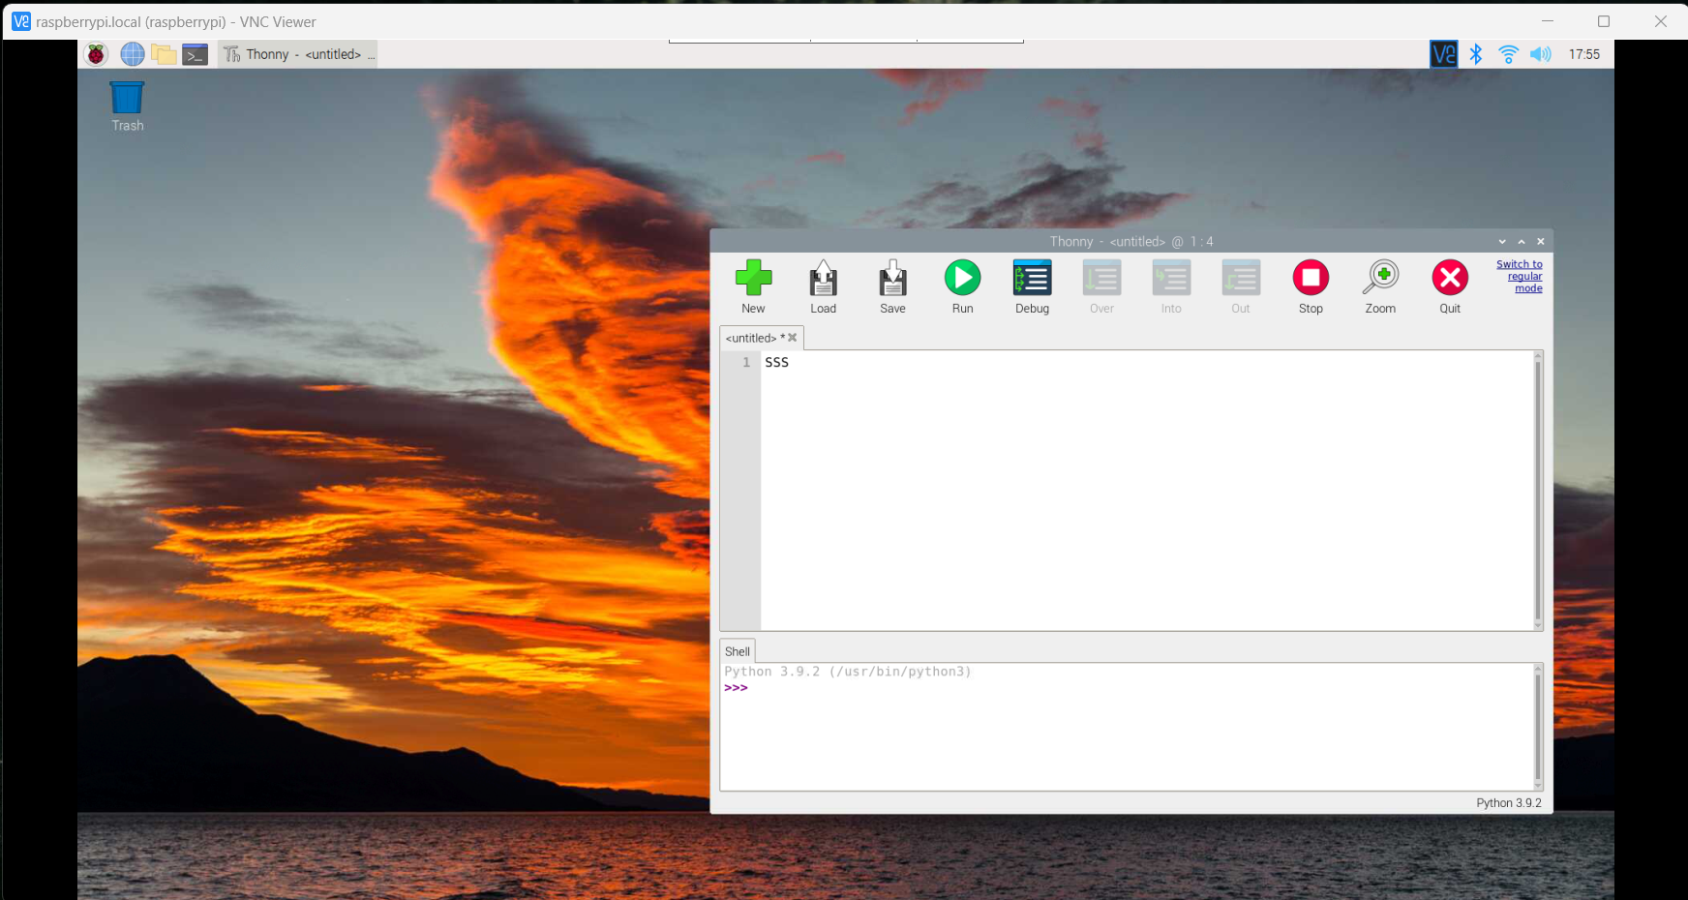

Slide 21
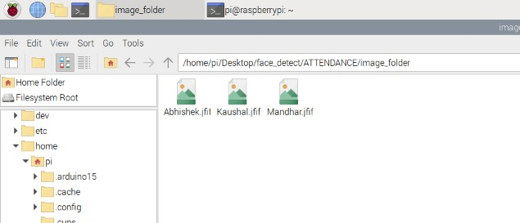
Implementation of Module 2
In this module, we implemented the machine learning part in Raspi and ran a successful facial recognition. We have a folder named images_folder that contains images of all the person allowed to enter. We feed those images to our machine learning algorithm to train it so that it can recognize them whenever they come in front of camera. The screenshots of the same are attached here.

Slide 22
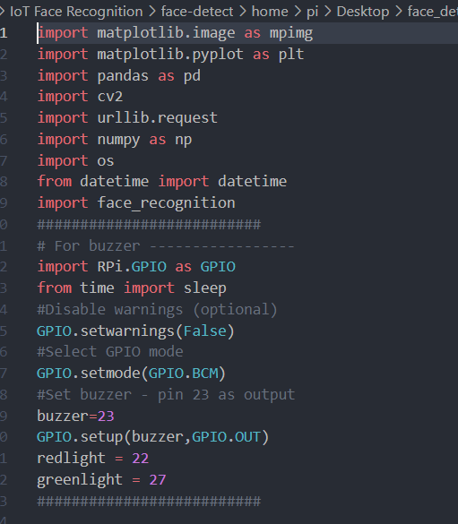
Implementation of Module 2
All the important packages are imported including matplotlib.image which is used to handle images and datetime, face_recognition to recognize faces

Slide 23
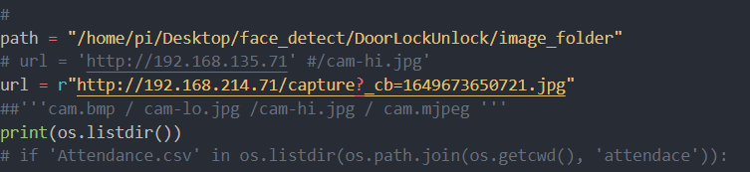
Implementation of Module 2
This is where we set the path of the training data set containing images of all the authorized people and the url to the live streaming of esp32 cam. Both are stored in their respective variables.

Slide 24
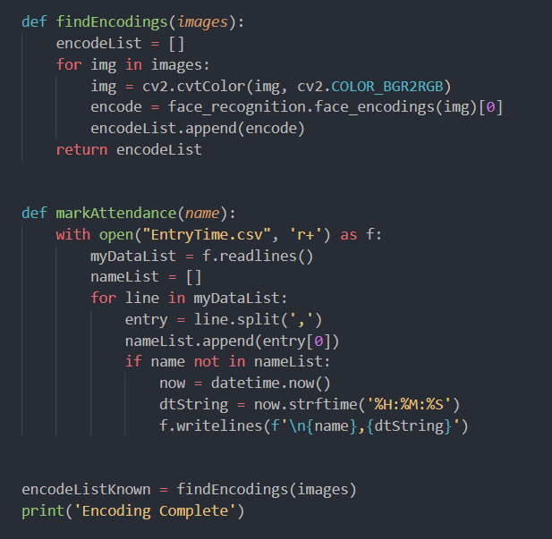
Implementation of Module 2
This section right here shows two functions, findEncodings which is used to find encodings in a n image and another is markAttendance, which is used to mark the entry time of any person who enters through the door.

Slide 25
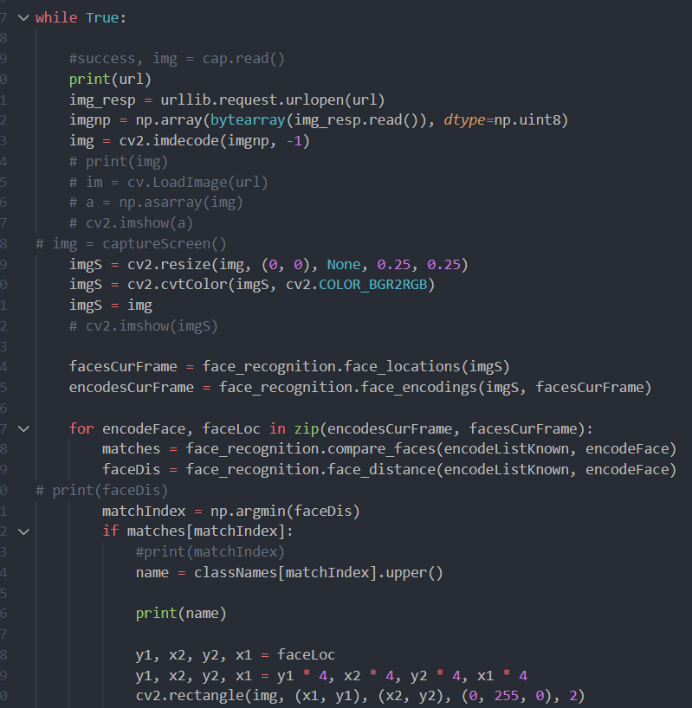
Implementation of Module 2
Now from this while loop, our main logic starts. This while loop make sure that the esp32 cam runs constantly and in each run, we capture the livestream, check if there is someone in front of the camera, and if there is a person, there are two scenarios created:
Person is known : In this case, the door simply unlocks and allows the person to enter
Person is Unknown : In this scenario, a photo is take of the intruder, and sent to the owner. Now the owner has to allow or disallow the intruder.

Slide 26
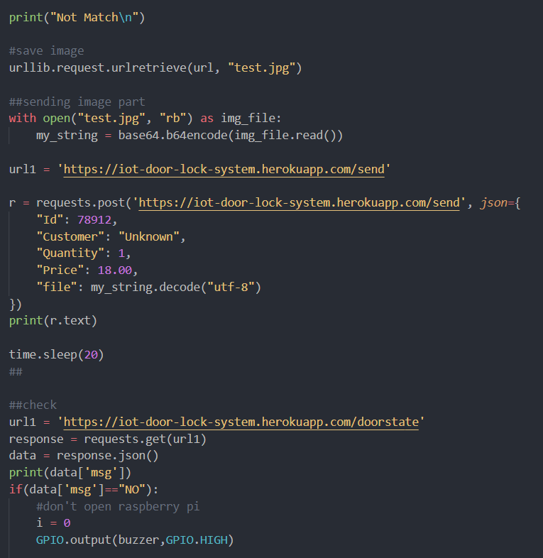
Implementation of Module 3
This part is handled here. When the person is not recognized, we take a snap from the livestream, save it as test.jpg, and send it our app which is hosted at herokuaap. Our app has a basic functionality. The image of the intruder is shown and there are two options, YES, or NO. If the owner hits YES, the intruder is given the permission to enter, or else the intruder is disallowed. If the owner does not respond, the intruder is disallowed automatically after 20 seconds.

Slide 27
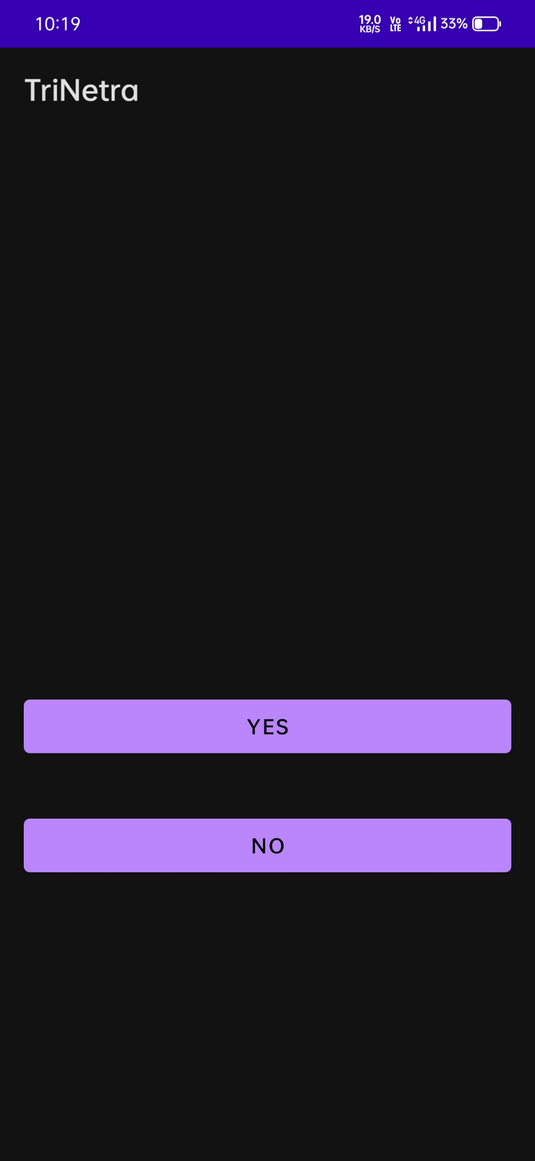
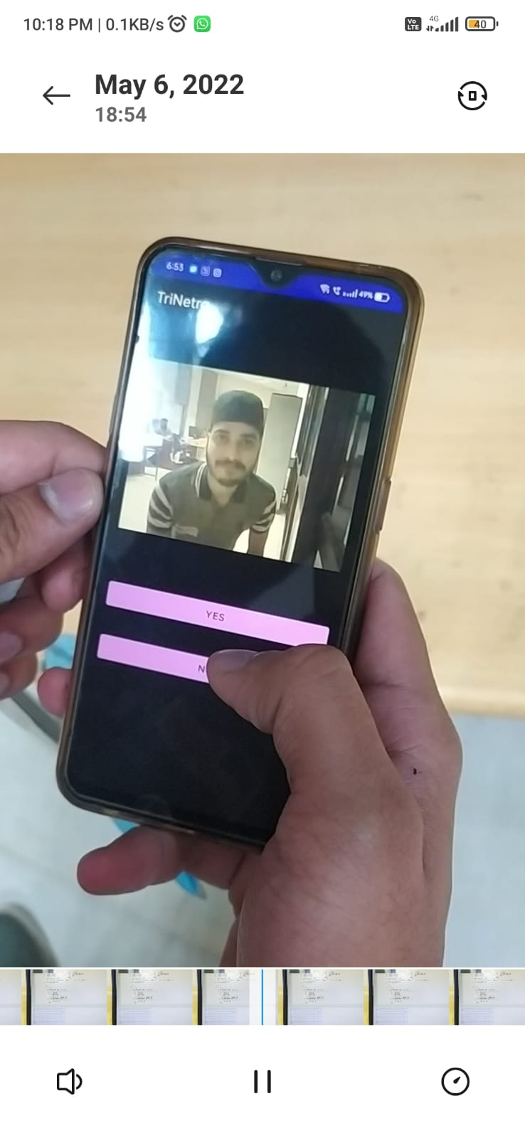
Implementation of Module 3
This is the UI of our app. It displays a photo of the intruder and gives two options to the user, Yes(to allow) and No(to disallow).

Slide 28
Final Results
Below attached are the screenshots of verdict given by our Machine Learning Model.

Slide 29
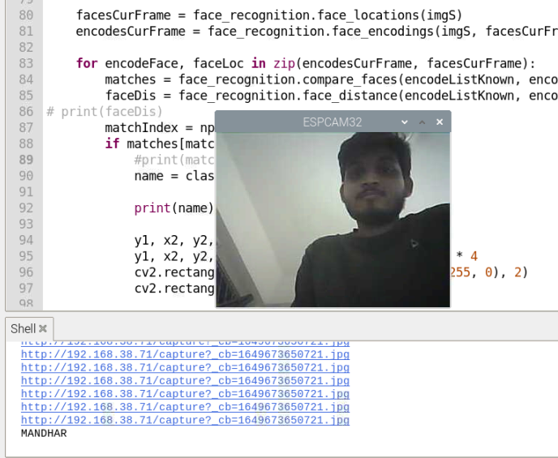
Known person Mandar in front of Cam

Slide 30
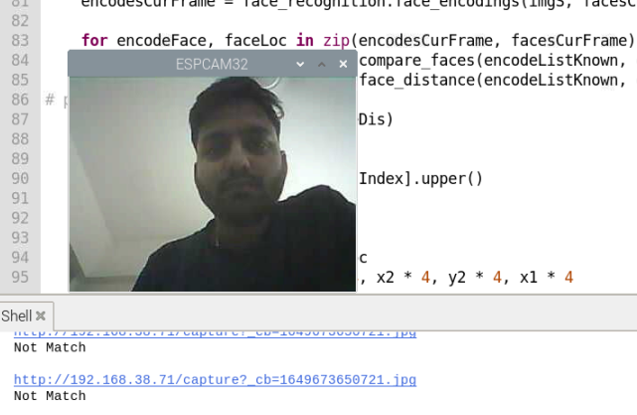
When an unknown person comes in front of camera

Slide 31
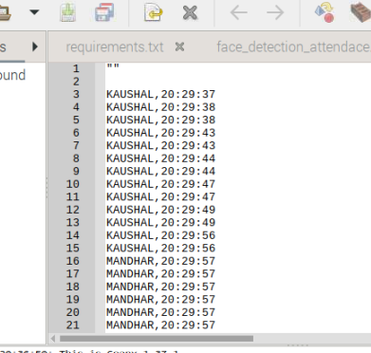
EntryTime.csv maintaining all records

Slide 32
Challenges Faced
Since it was an IoT project involving lots of hardware and software components, collaborating the hardware with the required software was a major challenge we faced.
The computation power of Raspi 3b+ was not enough to handle big machine learning models like face recognition. Also the modules required for the program took hours for installation in Raspi.
The connection of esp32 with wired was on breadboard and thus was not tight. So it would disassemble any time. Each time it did, we have to reset the whole ESP32 cam module and start again.
Each time the ESP32 was disconnected from internet, the IP address gets changed and therefore we have to reset it in the code.

Slide 33
Future Scope
This project is in ready-to-use state. We can just put the system on any door and it will work just fine.
In future, there is a huge scope in it,
We can always make the app better, giving more functionalities like blocking a particular intruder, emergency calling(in case of breach), sending the notification to multiple users.
We can improve the computational efficiency of raspberry which therefore improves the speed and we can also improve the face recognition algorithm for better accuracy.

Slide 34
README.MD
ESP32 Arduino code

