Slide 1
MPI-Style Workflows
July 28: Simulated Distributed Systems
Ranks • collectives • scatter/gather/reduce • mini-MPI
MPI
Big idea
Distributed computing is about explicit communication among workers.
⏱
Student output
Implement mini-MPI primitives using multiprocessing.
Day 5 — MPI-Style Distributed Workflows by Simulation | 01

Slide 2
Today’s Roadmap
From process pools to MPI-style communication
01
Recap
shards and parallel inference
02
MPI model
rank, world size, root, communicator
03
Collectives
broadcast, scatter, gather, reduce
04
Simulation
queues, workers, messages, barriers
05
Lab
build mini-MPI and distributed word count
Day 5 — MPI-Style Distributed Workflows by Simulation | 02

Slide 3
1. Recap and Motivation
Why simulate distributed systems before using real clusters
Day 5 — MPI-Style Distributed Workflows by Simulation

Slide 4
Day 4 Recap: Shards Become Distributed Work
Inference taught split → compute → gather
S
Split
divide data into chunks or requests
C
Compute
workers run local work independently
A
Aggregate
combine predictions, metrics, or partial counts
Day 5 adds explicit communication patterns: who sends what to whom?
Day 5 — MPI-Style Distributed Workflows by Simulation | 05

Slide 5
Why Learn MPI-Style Thinking?
These ideas appear in HPC, cloud systems, and distributed AI
SIM
Weather simulation
domain decomposition + reductions
WEB
Search indexing
scatter documents, gather indexes
REC
Recommendation
score user shards, reduce top-k
LLM
LLM serving
route requests, aggregate telemetry
DL
Distributed training
broadcast parameters, all-reduce gradients
ETL
Data analytics
map chunks, reduce summaries
Day 5 — MPI-Style Distributed Workflows by Simulation | 06

Slide 6
2. MPI Mental Model
Rank, world size, root, communicator, messages
Day 5 — MPI-Style Distributed Workflows by Simulation

Slide 7
MPI Mental Model
Many processes run the same program but know their rank
0
Rank 0
worker id = 0 world size = 4
1
Rank 1
worker id = 1 world size = 4
2
Rank 2
worker id = 2 world size = 4
3
Rank 3
worker id = 3 world size = 4
Rank = process identity; world size = number of participating processes
Day 5 — MPI-Style Distributed Workflows by Simulation | 08

Slide 8
Key Terms
Vocabulary for collective communication
R
Rank
unique integer ID for a process
N
World size
number of processes in the group
0
Root
special source or destination rank
C
Communicator
group/context of participating processes
msg
Message
data exchanged between processes
all
Collective
operation involving all processes in a group
Day 5 — MPI-Style Distributed Workflows by Simulation | 09

Slide 9
SPMD: Same Program, Multiple Data
Each rank branches based on its identity
# Pseudocode for SPMD style rank = get_rank() world_size = get_world_size() if rank == 0: data = read_dataset() else: data = None chunk = scatter(data, root=0) local_result = compute(chunk) all_results = gather(local_result, root=0) if rank == 0: final = reduce_results(all_results)
Day 5 — MPI-Style Distributed Workflows by Simulation | 10

Slide 10
3. Collective Communication Patterns
Broadcast, scatter, gather, reduce, all-reduce, barrier
Day 5 — MPI-Style Distributed Workflows by Simulation

Slide 11
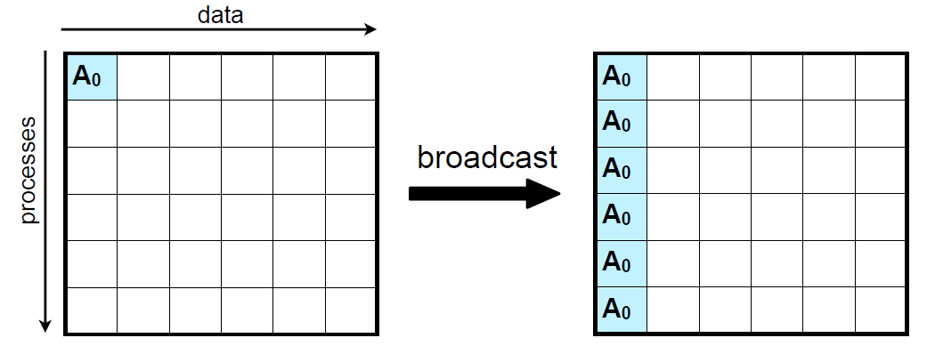
One-to-all Broadcast
AI use: broadcast model parameters, configuration, vocabulary, or random seed

Slide 12
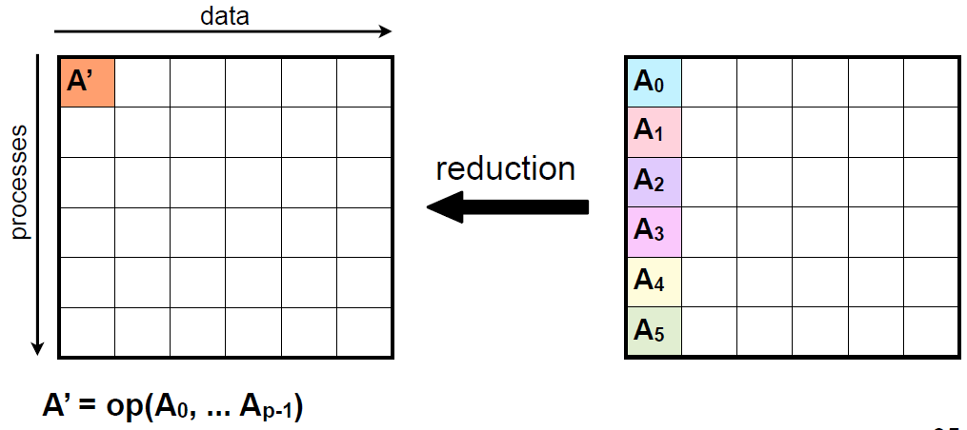
All-to-one Reduction (Reduce)
Notes:
Recvbuf only matters at the root.
Count: number of elements in send buffer

Slide 13
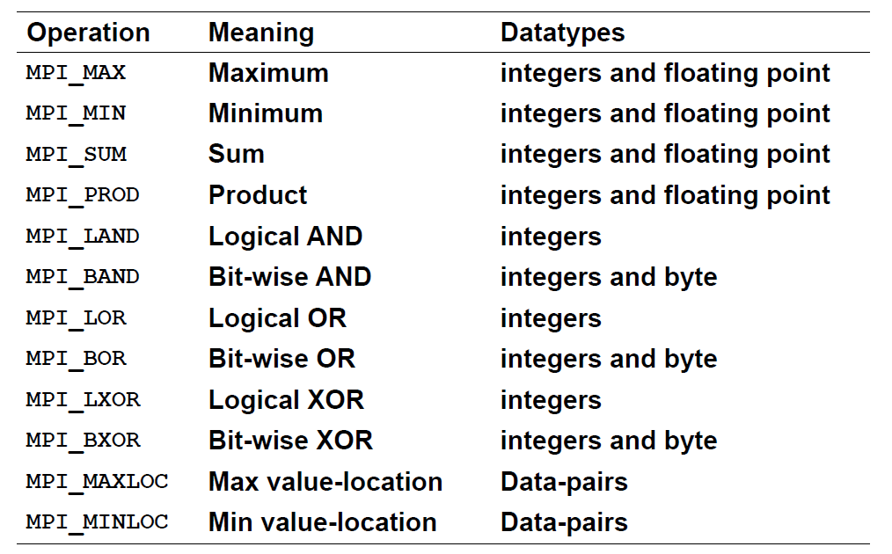
MPI_Op Predefined Reduction Operations

Slide 14
Reduce and All-Reduce
Combine values such as sum, max, min, average
Σ
Reduce
Many ranks send values; root receives one combined result. Example: total word count or global accuracy numerator.
all
All-reduce
Every rank receives the combined result. Example: gradient averaging concept for data-parallel training.
Day 5 — MPI-Style Distributed Workflows by Simulation | 15

Slide 15
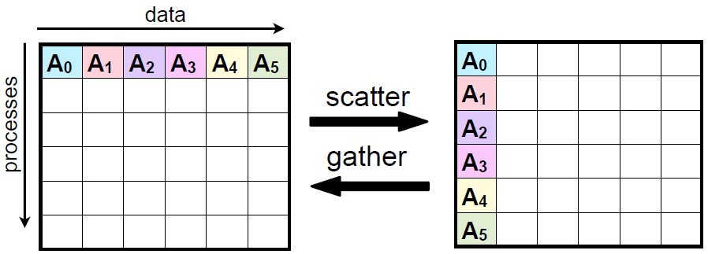
Scatter/Gather
AI use: partition dataset examples, users, documents, images, or prompts

Slide 16
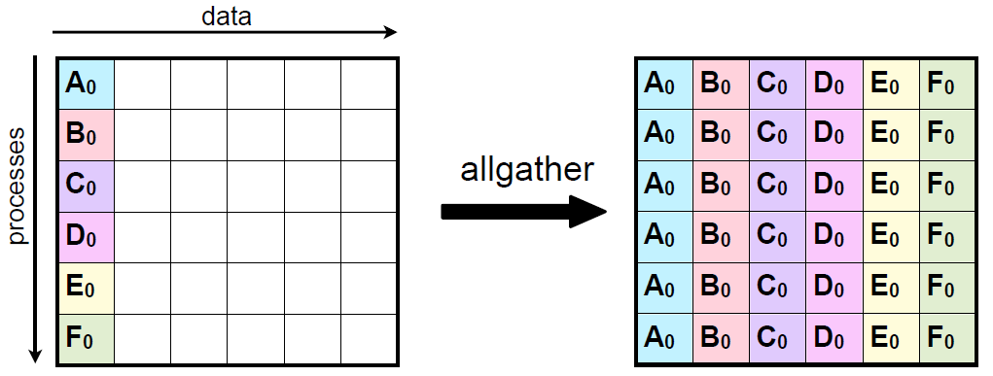
Allgather

Slide 17
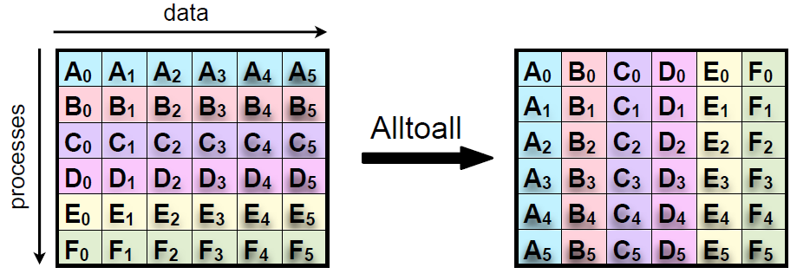
All-to-All Personalized Communication
Each process starts with its own set of blocks, one destined for each process
Each process finishes with all blocks destined for itself
Analogous to a matrix transpose

Slide 18
Barrier: Synchronization Point
All ranks wait until everyone arrives
Rank 0
Rank 1
Rank 2
Rank 3
B
Barrier
continue only when all arrived
Useful for timing experiments, but unnecessary barriers can slow systems
Day 5 — MPI-Style Distributed Workflows by Simulation | 16

Slide 19
4. Simulation Design
Building mini-MPI with multiprocessing and queues
Day 5 — MPI-Style Distributed Workflows by Simulation

Slide 20
How We Simulate MPI Today
One main process coordinates worker processes
1
Worker 1
rank 1
Q
Queues
messages to/from workers
0
Coordinator
rank 0 / root logic
2
Worker 2
rank 2
3
Worker 3
rank 3
Day 5 — MPI-Style Distributed Workflows by Simulation | 18

Slide 21
Simulation Limitations
We learn the idea, not full MPI performance
✓
What we simulate
rank IDs, scatter/gather/reduce patterns, worker coordination, correctness checks
~
What we simplify
network topology, true MPI runtime, optimized collective algorithms, fault tolerance
AI
Why it matters
students learn distributed reasoning before real clusters or torch.distributed
Day 5 — MPI-Style Distributed Workflows by Simulation | 19

Slide 22
Deadlocks and Collective Rules
Distributed bugs often mean someone waited forever
1
All ranks participate
missing participant can hang a collective
2
Same order
collectives must be called consistently
3
Matching shapes
send/receive sizes must match expectations
4
Root agreement
everyone must know who the root is
5
Timeout/debug logs
rank-aware logging helps debugging
6
Small tests first
use 2–4 ranks before scaling up
Day 5 — MPI-Style Distributed Workflows by Simulation | 20

Slide 23
5. Day 5 Lab
Implement mini-MPI and distributed map–reduce
Day 5 — MPI-Style Distributed Workflows by Simulation

Slide 24
Lab: mini-MPI Collective Simulator
Goal: implement collectives and apply them to word count or data analysis
1
Setup
rank/world abstractions
2
Collectives
broadcast/scatter/gather/reduce
3
Application
distributed word count
4
Benchmark
workers + chunk size
5
Explain
communication cost + correctness
Deliverable: mini_mpi.py + demo + runtime table + workflow diagram
Day 5 — MPI-Style Distributed Workflows by Simulation | 22

Slide 25
Starter Code: Chunking and Local Work
Begin with deterministic chunks and local computation
from collections import Counter def chunk_data(items, num_chunks): chunks = [[] for _ in range(num_chunks)] for i, item in enumerate(items): chunks[i % num_chunks].append(item) return chunks def local_word_count(lines): c = Counter() for line in lines: c.update(line.lower().split()) return c def reduce_counters(counters): total = Counter() for c in counters: total.update(c) return total
Day 5 — MPI-Style Distributed Workflows by Simulation | 23
Notes:
Local_word_count:
This code counts the total frequency of every individual word across all the text lines provided.

Slide 26
Starter Code: Serial Baseline
Always verify distributed outputs against serial outputs
def make_fake_lines(n=50000): vocab = ["ai", "data", "model", "parallel", "rank", "scatter", "gather", "reduce", "python"] return [" ".join(vocab[(i+j) % len(vocab)] for j in range(20)) for i in range(n)] lines = make_fake_lines() serial = reduce_counters([local_word_count(lines)]) print(serial.most_common(5))
Day 5 — MPI-Style Distributed Workflows by Simulation | 24
Notes:
This code snippet generates a list of n strings, where each string contains 20 words sampled from a list of words called vocab. It uses a rolling or shifting window technique to create predictable sequences of words.
(i+j) % len(vocab): This calculates the index of the word to grab from vocab. The modulo operator (%) ensures that if the index exceeds the length of the vocabulary, it wraps back around to the beginning (index 0).
" ".join(...): This takes the 20 retrieved words and merges them into a single string, separating each word with a space. [1, 2]
The counter.most_common() method returns a list of tuples containing elements and their corresponding frequencies, sorted in descending order from the highest count to the lowest

Slide 27
mini-MPI: Scatter Function
Root conceptually splits data and assigns chunks to ranks
def scatter(data, world_size): #Return one chunk per rank. return chunk_data(data, world_size) world_size = 4 chunks = scatter(lines, world_size) for rank, chunk in enumerate(chunks): print(rank, len(chunk))
Day 5 — MPI-Style Distributed Workflows by Simulation | 25

Slide 28
mini-MPI: ProcessPool Gather + Reduce
Simulate ranks with worker processes
from concurrent.futures import ProcessPoolExecutor def worker_count(args): rank, chunk = args local = local_word_count(chunk) return {"rank": rank, "counter": local, "n": len(chunk)} def distributed_word_count(lines, world_size=4): chunks = scatter(lines, world_size) tasks = [(rank, chunk) for rank, chunk in enumerate(chunks)] with ProcessPoolExecutor(max_workers=world_size) as ex: outputs = list(ex.map(worker_count, tasks)) counters = [out["counter"] for out in outputs] return reduce_counters(counters), outputs
Day 5 — MPI-Style Distributed Workflows by Simulation | 26

Slide 29
mini-MPI: Reduce and All-Reduce
Reduce returns one result; all-reduce shares it with everyone
def reduce_sum(values): return sum(values) def all_reduce_sum(values): total = reduce_sum(values) return [total for _ in values] local_counts = [10, 12, 9, 11] print("reduce:", reduce_sum(local_counts)) print("all_reduce:", all_reduce_sum(local_counts))
Day 5 — MPI-Style Distributed Workflows by Simulation | 27

Slide 30
Step 5: Benchmark and Check Correctness
Compare serial vs simulated distributed workflow
import time for world_size in [1, 2, 4, 8]: start = time.perf_counter() dist_counter, outputs = distributed_word_count(lines, world_size) elapsed = time.perf_counter() - start print({ "world_size": world_size, "time": elapsed, "lines_per_sec": len(lines) / elapsed, "correct": dist_counter == serial, "chunk_sizes": [out["n"] for out in outputs], })
Day 5 — MPI-Style Distributed Workflows by Simulation | 28

Slide 31
Optional Real MPI Preview: mpi4py Pattern
Same mental model if students later use real MPI
# Conceptual mpi4py pattern; not required for this course day. from mpi4py import MPI comm = MPI.COMM_WORLD rank = comm.Get_rank() world_size = comm.Get_size() if rank == 0: chunks = scatter(data, world_size) else: chunks = None chunk = comm.scatter(chunks, root=0) local_result = compute(chunk) all_results = comm.gather(local_result, root=0)
Day 5 — MPI-Style Distributed Workflows by Simulation | 29

Slide 32
Mini Challenge
Build, test, and explain mini-MPI
1
Implement
scatter, gather, reduce_sum, all_reduce_sum, and broadcast.
2
Apply
distributed word count or numeric statistics over chunks.
3
Explain
communication pattern, correctness, speedup, and bottlenecks.
Day 5 — MPI-Style Distributed Workflows by Simulation | 30

Slide 33
Expected Result Format
Students should report correctness and communication cost
✓
Correctness
distributed result equals serial baseline
LB
Load balance
chunk sizes and runtimes similar
⇄
Communication
scatter/gather/reduce cost explained
Day 5 — MPI-Style Distributed Workflows by Simulation | 31

Slide 34
Exit Ticket
Short reflection + mini-MPI demo
Q
Answer
• What is rank and world size? • Scatter vs broadcast? • Gather vs reduce? • What caused speedup to flatten? • Where will your project use collectives?
✓
Submit
• mini_mpi.py • demo script or notebook • runtime/correctness table • architecture diagram • 1-paragraph explanation
Day 5 — MPI-Style Distributed Workflows by Simulation | 33

Slide 35
Instructor Notes
Teaching moves for Day 5
1
Emphasize patterns, not real MPI installation complexity.
2
Use rank/world size language consistently all day.
3
Require serial baselines for correctness.
4
Make students draw the communication pattern before coding.
5
Discuss deadlocks and collective participation rules.
6
Connect collectives to Day 6 gradient averaging.
Day 5 — MPI-Style Distributed Workflows by Simulation | 34

Slide 36
References and Further Reading
MPI collectives and distributed communication
1. MPI Tutorial: Scatter sends array chunks to processes, while Gather collects results back to a root process.
2. LLNL HPC Tutorials: collective operations include synchronization, data movement such as broadcast/scatter/gather, and reductions.
3. MPI standard overview: collective communication includes barrier, broadcast, gather, scatter, allgather, reduce, and allreduce operations.
4. Optional mpi4py learning resources: broadcast, scatter, gather, and reduce patterns in Python.
Day 5 — MPI-Style Distributed Workflows by Simulation | 35

