Slide 1
SOCIAL FEED INGEsTION PIPELINE
Sandeep Bhat

Slide 2
ABOUT ME
EXTREME NETWORKS(THROUGH ACQUISITION FROM BROCADE)
KU PNNI SIMULATOR (MS PROJECT)
Represent company at AT & T Capacity expansion discussion
MANAGE and TRAIN a PROTOCOL team of 6
Delivered many software features which are deployed in networks.
2 SONs and I try to keep them busy

Slide 3
AGENDA
ASSUMPTIONS/LIMITATIONS
INPUT/OUTPUT
INGESTION PIPELINE
DEMO - AWS-LAMBDA
JUNIT
CODE-COVERAGE/CODE WALKTHROUGH

Slide 4
AGENDA
ASSUMPTIONS/LIMITATIONS
INGESTION PIPELINE
JUNIT
CODE-COVERAGE/CODE WALKTHROUGH
DEMO - AWS-LAMBDA

Slide 5
ASSUMPTIONS
Assumption | Comment
Simulate Twitter/FB events | 100 Ids each along with 100 userIds
2 Twitter Feeds types | RETWEET, FWD
2 FB Posts Types | LIKE,REPLY
Producer produces messages serially in a thread context. | Messages are produced serially, using random generator
User ID is present in Twitter and FB posts | Same UserId in Tweet and a FB post means the same user.
Controlled environment. We can just specify number of messages to inject | Messages will be processed and stored in database.

Slide 6
LIMITATIONS/DISCLOSURE
Assumption | Comment
Processing Twitter/FB from 3rd party APIs not supported | Simulations of events
Handling of document changing retroactively | Java Lambda functions used to process messages to store in DB.
No high availability support
No worker threads for parallelism
No multiple consumer based queue.

Slide 7
Feeds
Twitter Feed | FB post
TWITTER ID | FB ID:
USERID | USERID
TYPE: TWEET, RETWEET | TYPE:LIKE,REPLY
Text: “This is tweet” | Text: “This is FB post”

Slide 8
STATS
TWTS | 100 | FBPOSTS | 100 | USERIDs | 100
TWTR-ID | 0 | RETWEET | 122 | FWD | 129
FB-ID | 0 | LIKES | 120 | REPLY | 144
USERID | 0 | LIKES | 136 | REPLY | 115 | RETWEET | 136 | FWD | 114

Slide 9




INGESTION PIPELINE
Blocking Msg Q
Serdes
Producer
Consumer,
Batching
Lambda Stream
Simulate
Engagement Sim
Read Stats
Write Social Feeds
Database
Thread Safe
Engagement Sim-Thread
Consumer-Thread

Slide 10
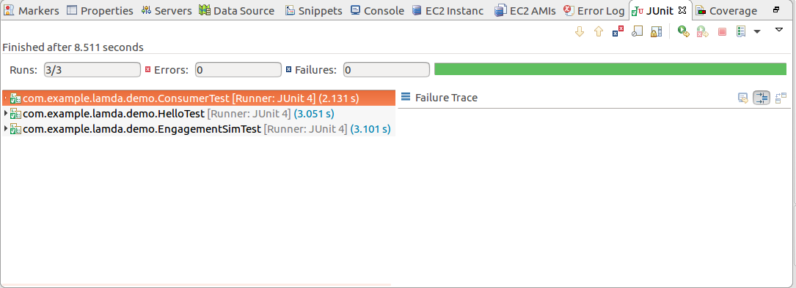
JUNIT

Slide 11
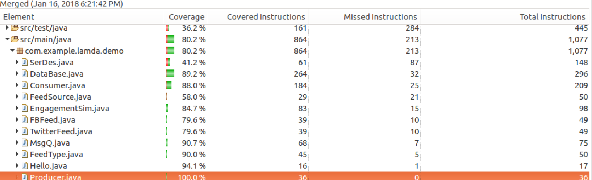
Code-CoVERAGE

Slide 12
ENGAGEMENT STATS

Slide 13
THANK YOU
https://github.com/cosmos342/Engagement

