Slide 1
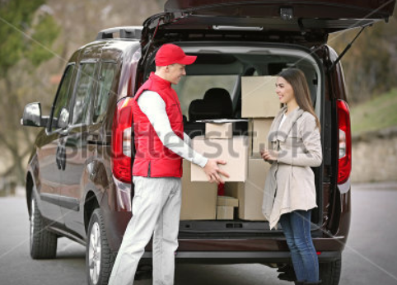
Special-Delivery
Build Community one package at a time

Slide 2
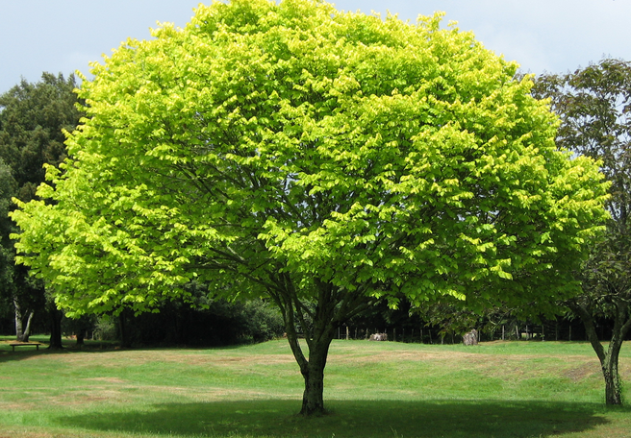
Ever wondered why that package to your loved one stuck in a delivery center?
Ever felt the guilt of hurting environment when that special delivery package comes to deliver a small package
There may be someone in the neighborhood who may be able to deliver that package
Don’t have to feel guilty ever again and this tree will be happy

Slide 3
Match Criteria
Driver | Sender
StartingAddress | StartingAddress
DestinationAddress | DestinationAddress
Space | Space
Review | Desired Review
Price

Slide 4
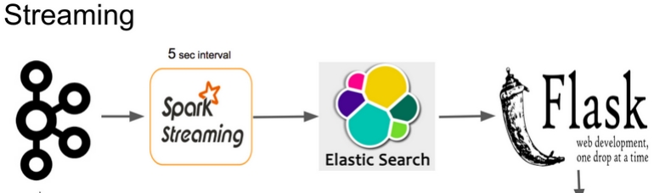


PIPELINE
Driver Events
Sender Events
Spark Stream does geo query on Elasticsearch nearest driver
Spark Stream does geo query on Elasticsearch nearest driver
Redis database is used to store the matches
Redis database is used to store the matches

Slide 5

Challenges
Slow elastic search. Optimal indexing solution
Overbooking of a driver by two or more senders
Low throughput

Slide 6
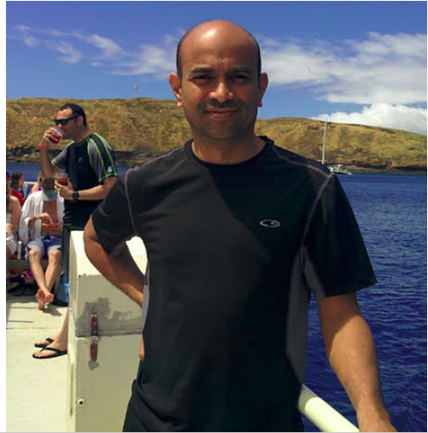
Love outdoors nature and plants

