Slide 1
Special DeliVERY
Build Community One Package At A Time
Sandeep Bhat

Slide 2
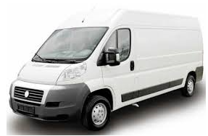
SHIPPING TODAY
EXPENSIVE
HARD TO TRACK A MISSING PACKAGE
INCONVENIENT
SPECIAL PURPOSE DELIVERY

Slide 3

SHIPPING TOMORROW
GET COMMUNITY INVOLVED
CONNECT TO PARTY GOING TO YOUR DESTINATION
BEST SERVICE BY REVIEW RATING
SPECIAL DELIVERY

Slide 4
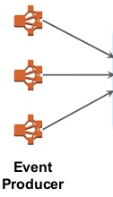





PIPELINE

Slide 5
PIPELINE THROUGHPUT
Elasticsearch
Elasticsearch Bulk API
Write Records One at a Time
Query One At a Time
Write records in Bulk
Query in Bulk

Slide 6
OVERBOOKING
S1
D1
S1
S2
S2
D1

Slide 7
OVERBOOKING Resolution
S1
D1
S1
WATCH D1
S2
S2
D2
WATCH D1
REDIS WATCH TRANSACTION MECHANISM

Slide 8
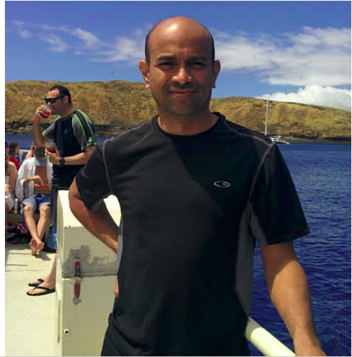
ABOUT ME
LOVE
OUTDOORS AND PLANTS
ORGANIC FARMING
TO PLAY BASKETBALL WITH KIDS

