Slide 1
THE AUTONOMOUS ODYSSEY
From Single Agent to Ambient AI
A Journey Through 3-Layer Cognitive Brains, Factory Assembly Workers, and Zero-Cognitive-Load Ambient AI
Simple * Intuitive * Graphical * Fun * Autonomous

Slide 2
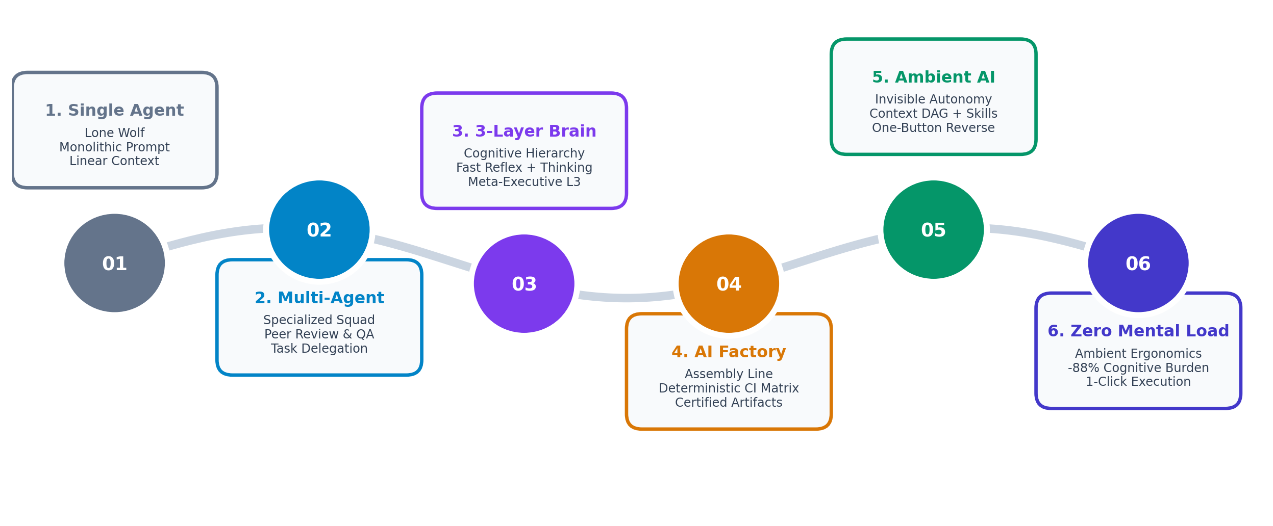
EVOLUTION MAP
The Evolutionary Path of Autonomous AI
Visualizing how our architecture matured from brute-force prompts to an intelligent autonomous ecosystem
Phase 1: Tool Execution
Early single/multi-agent scripts acting as simple task runners. Required high human babysitting and constant prompt tweaking.
Phase 2: Cognitive Factories
Brain-inspired 3-tier cognition + AI Factory assembly workers with deterministic verification gates.
Phase 3: Ambient Intelligence
Context DAGs, self-healing skills, one-button rollbacks. AI runs quietly in the ambient background with near-zero human fatigue.

Slide 3
MILESTONES 1 & 2
From Lone Wolf to the Specialized Squad
Breaking out of the single-prompt trap by assembling cooperative specialized agents
MILESTONE 1: The Lone Wolf (Single Agent)
- Concept: One giant prompt attempting to be architect, coder, tester, and deployer simultaneously.
- The Pain Point: Context rot: as conversations grew past 50 turns, the lone agent forgot previous constraints and hallucinated.
- Bottleneck: Linear thinking with 0 peer review. If the model made a false assumption at step 1, the entire codebase broke.
- Fun Analogy: Asking a single intern to build a skyscraper, draft legal contracts, and inspect plumbing alone.
MILESTONE 2: The Squad (Multi-Agent Systems)
- Concept: Role specialization: Researcher, Architect, Coder, and QA Critic working in tandem.
- The Breakthrough: Cross-verification: The Coder cannot push until the QA Critic asserts exit code 0.
- The Emerging Challenge: Coordination tax: Agents chatting endlessly in loops ('After you!' 'No, after you!') consuming massive context.
- Key Lesson: Specialization is essential, but without hierarchical cognitive control, multi-agent teams drift into chaos.

Slide 4
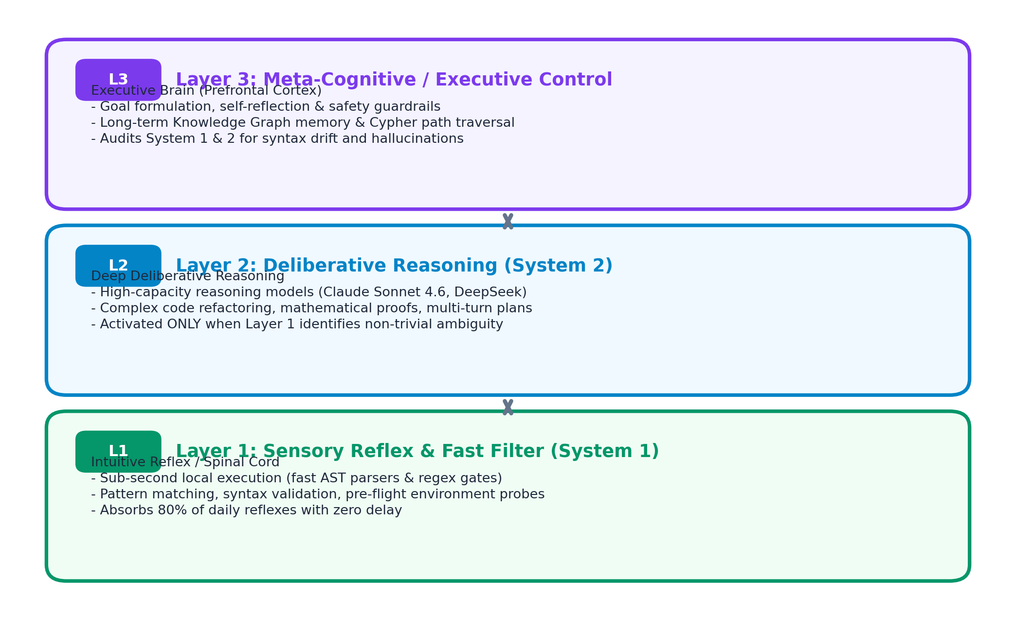
MILESTONE 3
Brain-Inspired Cognitive Architecture (3 Layers)
Mimicking biological cognitive hierarchy to balance instant reflexes with deep deliberative reason
Biological Cognition in AI
- Why 3 Layers?: The human brain doesn't fire millions of neurons to blink an eyelid. Fast tasks stay in the spinal cord; only novel dilemmas wake the prefrontal cortex.
- Layer 1 (Reflex): Fast local/edge filter. Handles AST syntax, regex gates, and pre-flight probes with sub-second latency.
- Layer 2 (Deliberation): Heavyweight deliberative LLMs (Claude Sonnet 4.6). Engaged only for complex synthesis, algorithmic proofs, and code diffs.
- Layer 3 (Meta-Cognitive): The Executive Monitor. Maintains long-term Knowledge Graph memory, verifies goal alignment, and halts runaways.
- Fun Takeaway: Stop waking heavy frontier models to verify if a semicolon exists!

Slide 5
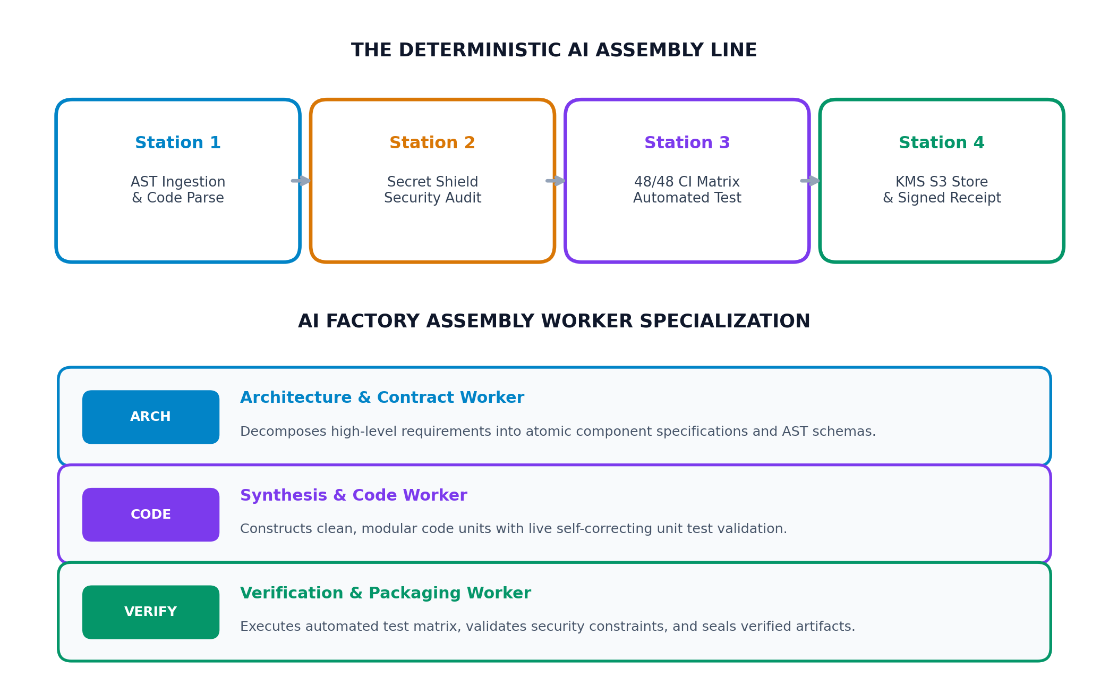
MILESTONE 4
The AI Factory & Assembly Workers
Replacing artisanal prompt crafting with standardized assembly lines and specialized worker roles
The Industrial AI Paradigm
- The Assembly Metaphor: Henry Ford didn't build cars by shouting vague verbal orders. He built a conveyor belt with specialized stations and strict tollgates.
- Assembly Workers: Specialized agents (Architect, Coder, Verifier) execute discrete tasks with clean contracts (<50 lines).
- Deterministic Gates: AI is probabilistic; code execution is deterministic. The factory wraps LLMs in rigid 48/48 CI matrix tests.
- Automated Testing VM: GitHub Actions runners act as robotic inspectors, auditing diffs for secrets and syntax drift before commit.
- Certified Storage: Verified artifacts are sealed into Amazon S3 with KMS encryption and verifiable attestation receipts.
- Fun Takeaway: Treat prompts like machine tooling, not creative writing!

Slide 6
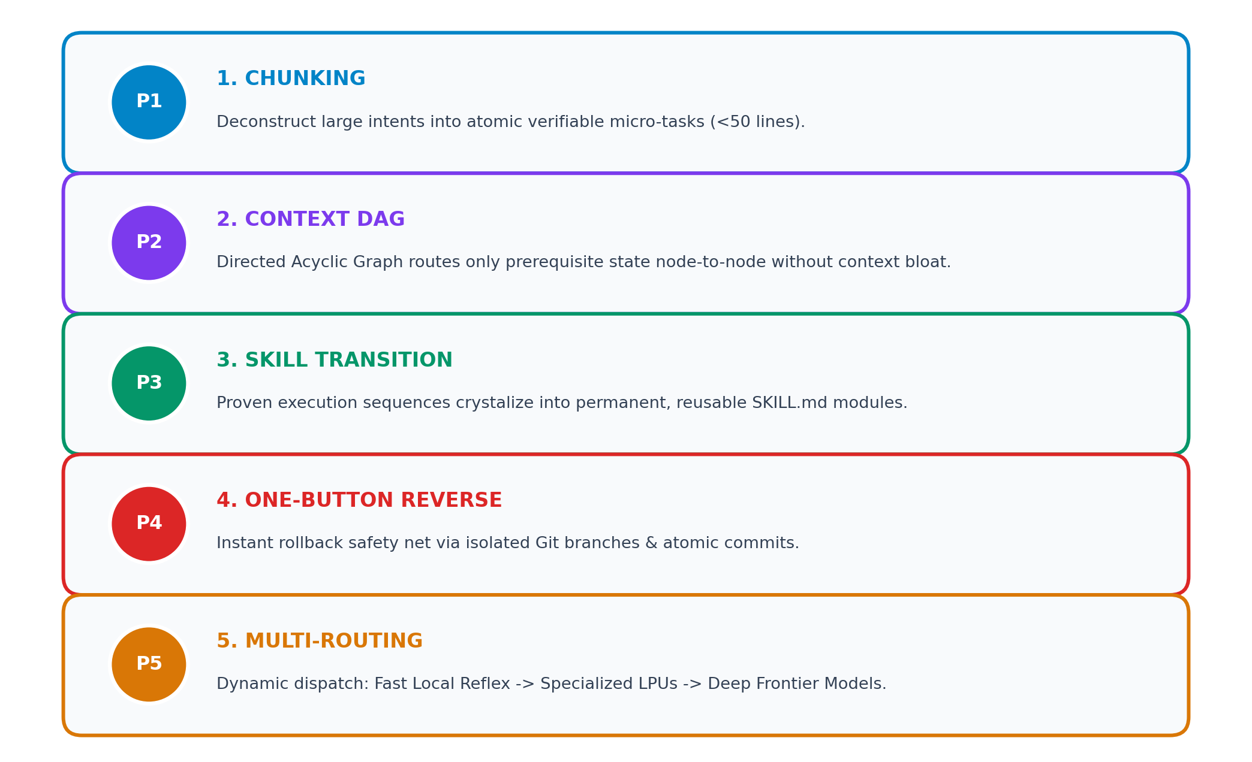
MILESTONE 5
Ambient AI: The 5 Pillars of Invisible Ergonomics
Moving from active prompt manipulation to quiet, ambient background autonomy
What is Ambient AI?
- Invisible Autonomy: AI shouldn't demand your constant attention. It should operate like electricity: always on, reliable, invisible until called.
- Zero Context Bloat: Instead of dumping 100,000 tokens into every turn, context is managed as an active Directed Acyclic Graph (DAG).
- Evolution to Skills: When an agent discovers a reliable workflow, it packages it into a permanent SKILL.md so it never has to re-learn it.
- Reversible Safety: Total psychological safety: any change can be rolled back in one click via atomic Git branches.
- Fun Takeaway: The ultimate luxury in AI is not a chatbox - it's not having to chat at all!

Slide 7
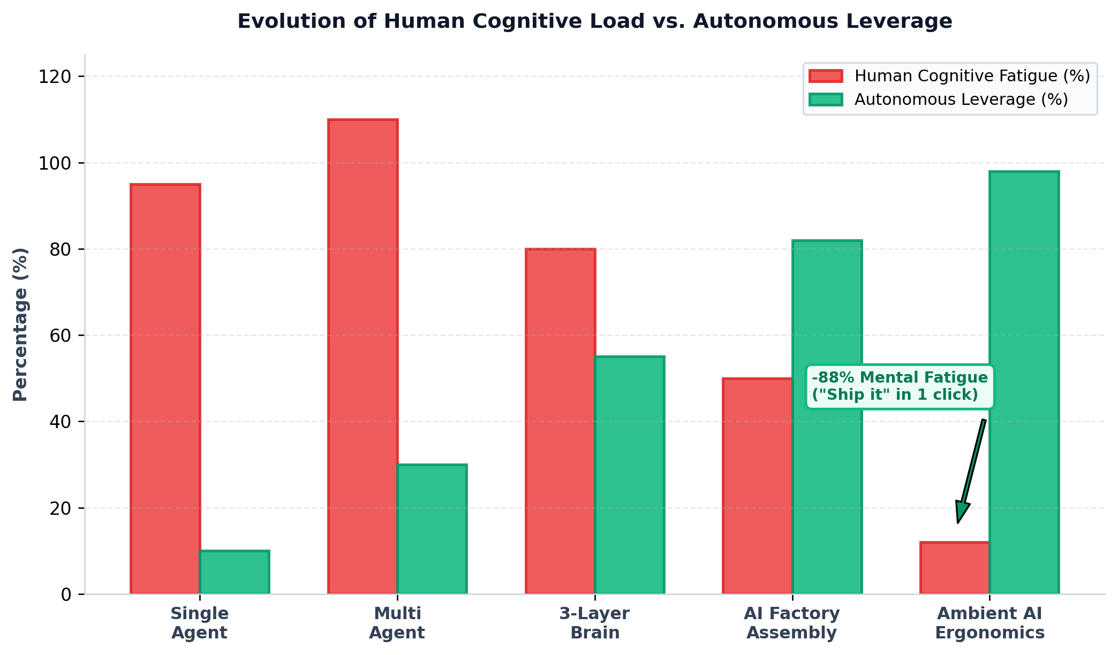
MILESTONE 6
The North Star: Minimizing Human Cognitive Load
Transforming human operators from stressed micromanagers into confident directors
OLD WAY: The Babysitting Trap
- Context Exhaustion: Paste stack traces, re-read code diffs, re-prompt.
- Manual Babysitting: Anxiously inspect every single line & syntax output.
- Mental Burnout: 40+ context switches/hour causing extreme fatigue.
NEW WAY: Ambient Autonomy
- Executive Intent: Human gives high-level directive: 'Ship it' or 'Proceed'.
- Autonomous Execution: Context DAG routes state, executes 48/48 CI matrix.
- Reversible Safety: One-button rollback safety net + signed receipts.
- Proven Result: -88% cognitive mental fatigue eliminated!

Slide 8
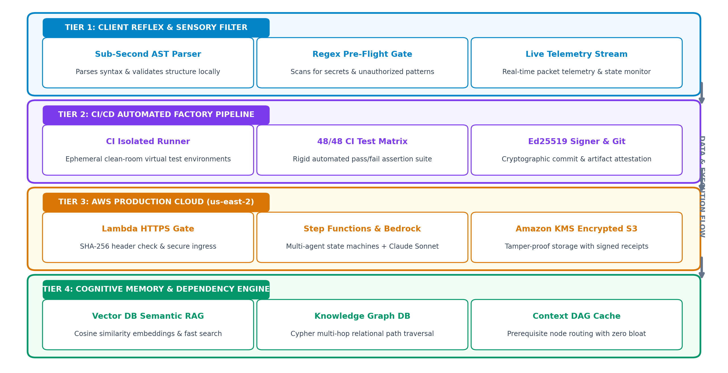
TECH SHOWCASE
Production Tech Stack & Cloud Architecture
Real-world infrastructure connecting client reflex, CI/CD factory, and AWS us-east-2 (966273137102)
Architectural Guarantees
Tier 1: Sub-Second Reflex
Local AST parsing & regex filters absorb routine syntax probes before cloud API invocation.
Tier 2: Deterministic CI
48/48 automated assertions on clean-room virtual runners before merge.
Tier 3: AWS us-east-2
Lambda HTTPS gateway, Step Functions state machine, Bedrock Claude Sonnet, and KMS S3.
Tier 4: Cognitive Memory
Vector DB cosine embeddings + Knowledge Graph Cypher multi-hop traversal.

Slide 9
THE FUTURE OF AUTONOMOUS SYSTEMS
From Chatting with Models to Conducting Orchestras
Key Takeaways from Our Journey:
1. Lone agents hit context ceilings; 3-Layer Brains distribute cognition from instant reflexes to deep deliberation.
2. The AI Factory organizes assembly workers along a deterministic line to turn unpredictable LLM outputs into certified software.
3. Ambient AI makes the entire apparatus invisible: you speak your intent, and the system executes with total safety.
4. Minimizing human cognitive load is the ultimate north star: from anxious babysitting to high-leverage execution in 1 click.
"The best AI system is the one you don't have to micromanage."

