Slide 1
📘 GROUNDTRUTH AI ENGINEERING
Capturing World Invariants:
The Foundation of True Ground Truth
Why AI Agents Fail in the Real World — and How Root Invariants Turn Hallucination into Deterministic Reliability.
4 Real-World Case Studies: Enterprise Security • FinTech AML • Cloud DevOps • Narrative Literature

Slide 2
📘 GROUNDTRUTH ARCHITECTURE PRINCIPLES
The Core Principle: What is a World Invariant?
Understanding why traditional prompting hallucinates and how ground truth anchors agent execution.
🚫 Rule 1: Never Hallucinate Constants
If a source (like Wikipedia) defines an optimization formula algebraically as J = sum(w*(r-x)^2), DO NOT invent a fake 42.0 kPa ceiling.
Ground truth means exact fidelity: keep unspecified bounds algebraic and extract ONLY what exists.
⚖️ Rule 2: World Physics != Agent Strategy
World Invariants are what the ENVIRONMENT enforces (gravity, token expiration, barren soil).
Agent Policies are choices the actor makes. Policies can bend; world physics never bend for any prompt.
🛑 Rule 3: Every Invariant Needs a Tripwire
An invariant is useless as passive prose. It must be wired into the Directed Acyclic Graph (DAG) as a hard circuit breaker.
If state telemetry crosses the boundary, execution freezes instantly into safe fallback.

Slide 3
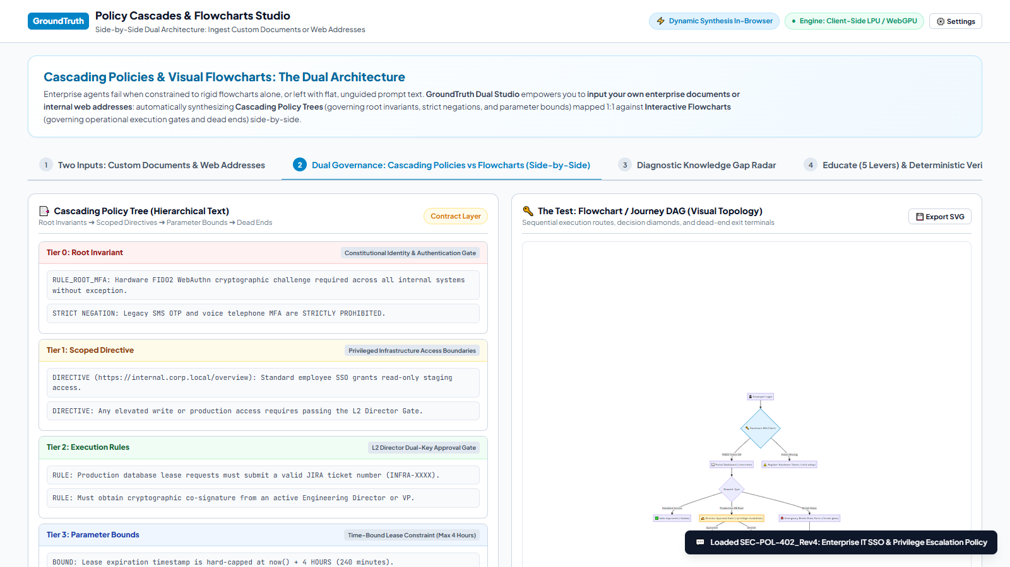
📘 EXAMPLE 01: ENTERPRISE IDENTITY & SOC2 COMPLIANCE
Enterprise IT Security: FIDO2 & Break-Glass Governance
🏛️ THE WORLD INVARIANT
Hardware FIDO2 WebAuthn cryptographic keys are strictly mandatory across production VPCs. Legacy SMS OTP and voice telephone MFA are STRICTLY PROHIBITED due to SIM-swapping vulnerabilities.
📏 GROUND TRUTH BOUNDS
Direct database write lease TTL: capped at exactly 4 HOURS (240 minutes).
Emergency Break-Glass tokens: hard-capped at exactly 2 HOURS (7,200 seconds).
⚡ DAG CIRCUIT BREAKER
The DAG intercepts unauthorized escalations: if Break-Glass token expires at 2 hours, it instantly terminates DB leases, reverts credentials, and dispatches an immutable SOC2 audit incident to SIRT.

Slide 4
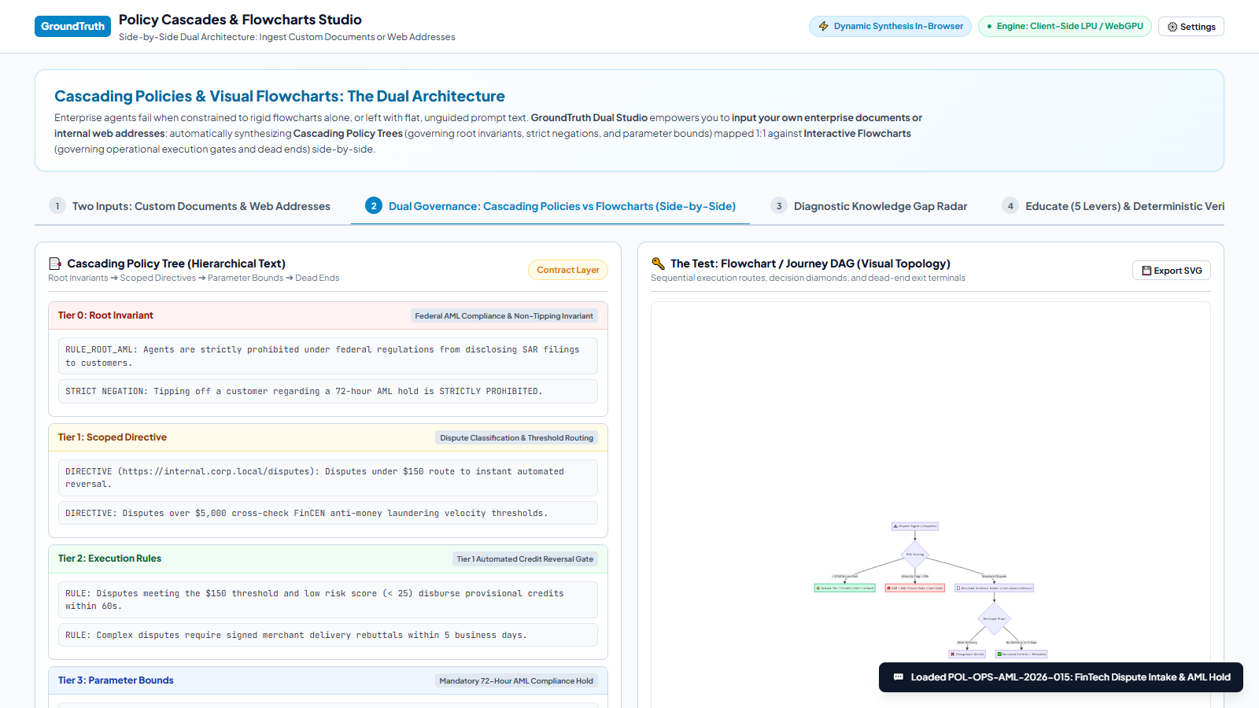
📘 EXAMPLE 02: FINANCIAL CRIME & REGULATORY COMPLIANCE
FinTech Dispute Intake: AML Velocity & Federal Non-Tipping
🏛️ THE WORLD INVARIANT
Federal Non-Tipping Invariant (31 U.S.C. 5318(g)): Agents and customer support are STRICTLY PROHIBITED from tipping off customers about Suspicious Activity Report (SAR) filings or AML freezes.
📏 GROUND TRUTH BOUNDS
Instant Tier-1 Provisional Credit: EQUAL TO OR LESS THAN $150.00.
High-Velocity AML Hold Window: exactly 72 HOURS.
Merchant Delivery Proof Rebuttal: strictly 5 business days.
⚡ DAG CIRCUIT BREAKER
The DAG routes claims < $150 to automated reversal. If 24h card velocity exceeds $5,000, it instantly routes into a 72-hour frozen gate. Missing tracking proof triggers automatic merchant forfeiture.

Slide 5
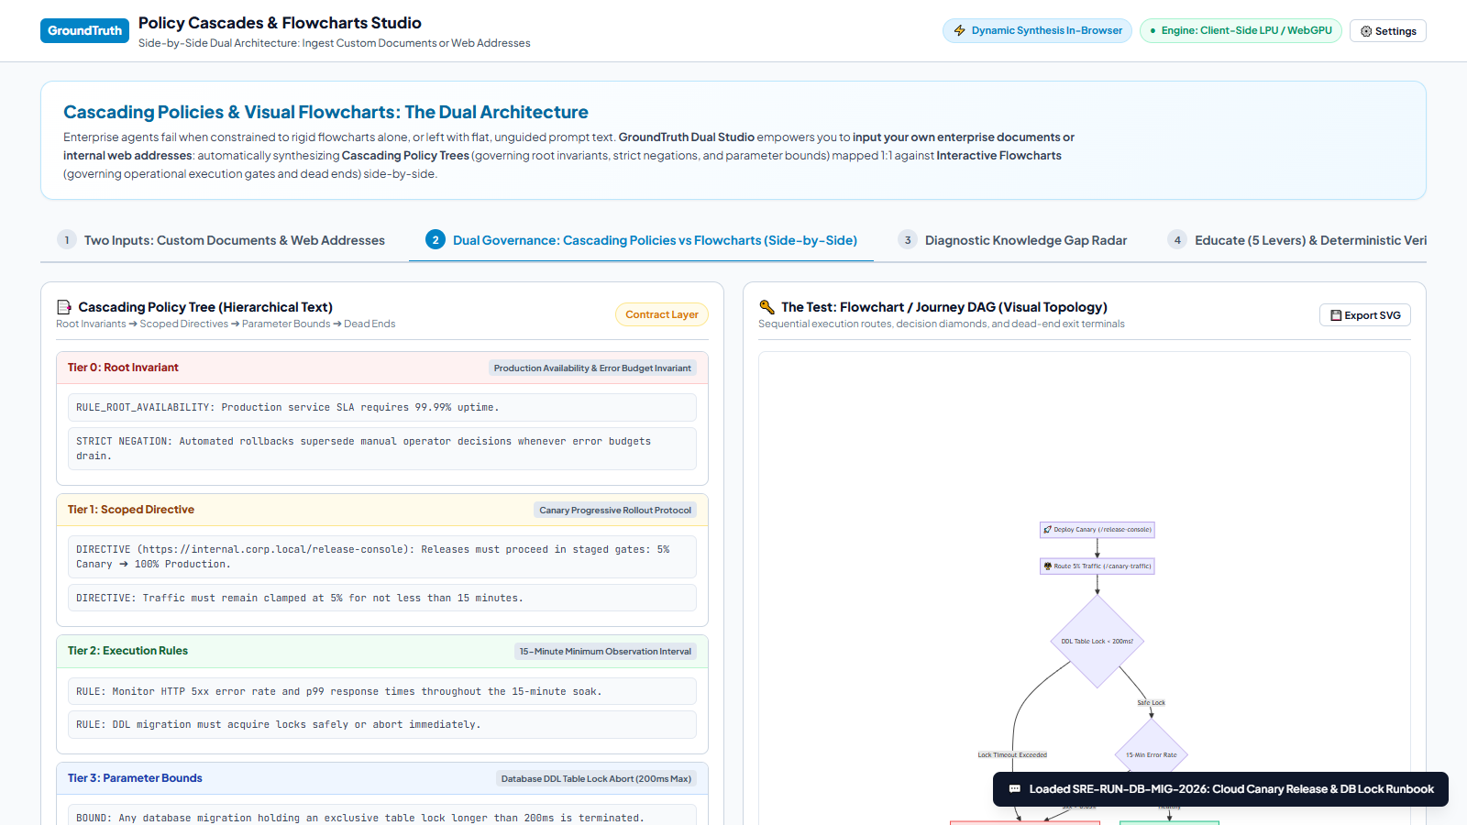
📘 EXAMPLE 03: SITE RELIABILITY ENGINEERING (SRE)
Cloud DevOps: Canary Rollouts & Zero-Downtime DDL Locks
🏛️ THE WORLD INVARIANT
Production Availability Invariant: 99.99% service uptime supersedes manual operator overrides. Automated rollbacks trigger instantly whenever error budgets or lock latency thresholds drain.
📏 GROUND TRUTH BOUNDS
Canary Traffic Proportion: strictly 5% for not less than 15 MINUTES (900s).
Database Migration Metadata Lock: MUST NOT EXCEED 200 MILLISECONDS.
⚡ DAG CIRCUIT BREAKER
The DAG mounts automated tripwires: if DDL migration metadata lock wait exceeds 200ms or Canary 5xx error rate exceeds 0.05%, it immediately aborts migration and triggers an automated instant rollback.

Slide 6
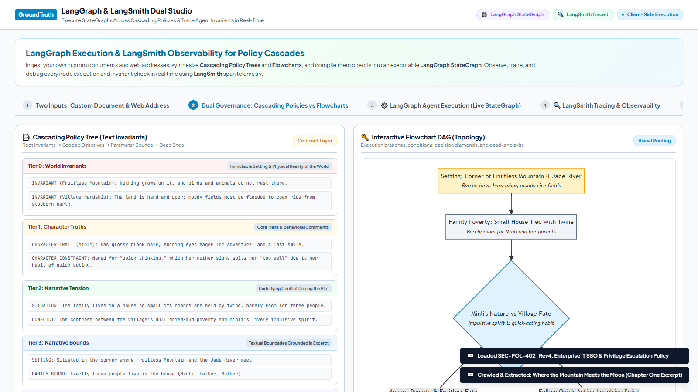
📘 EXAMPLE 04: NARRATIVE PHYSICS & FOLKLORE MODELING
Literature & Narrative: Story Invariants & The Hero's Journey
🏛️ THE WORLD INVARIANT
World Invariant: Fruitless Mountain is completely barren; nothing grows on it and birds/animals do not rest there. The mud village land is stubbornly poor. Minli has an impulsive, quick-acting nature.
📏 GROUND TRUTH BOUNDS
Exact Family Bounds: only 3 people live in the house (Minli, Father, Mother).
House Bound: tiny boards tied with twine.
Geography: the corner where Fruitless Mountain and Jade River meet.
⚡ DAG CIRCUIT BREAKER
Instead of IT jargon ('cryptographic telemetry'), the DAG maps the real dramatic dilemma: Accept Poverty & Stagnate vs. Follow Impulsive Spirit and embark on the quest to find the Old Man of the Moon.

Slide 7
📘 GROUNDTRUTH ARCHITECTURE PRINCIPLES
The GroundTruth Formula: From Raw Input to Reliable Agent
How the 5-Tier Policy Tree and DAG Circuit Breakers eliminate hallucination across any domain.
🎯 KEY TAKEAWAYS FOR AI SYSTEMS ARCHITECTS
• 1. True Ground Truth Means No Hallucinated Numbers
If a source (novel, Wikipedia, whitepaper) doesn't specify physical constants, leave them algebraic. Inventing 42 kPa or $1.5% from thin air is a catastrophic failure of ground truth.
• 2. World Invariants Govern the Reality of the Environment
Whether it's the physics of Fruitless Mountain, SOC2 4-hour lease timers, or mass-conservation laws, world invariants never bend to an LLM's prompt persuasion.
• 3. The 5-Tier Policy Hierarchy Bridges Any Domain
Root Invariants ➔ Scoped Directives ➔ Execution Rules ➔ Parameter Bounds ➔ Dead Ends provides a universal contract layer for both engineering runbooks and story plots.
• 4. Circuit-Breaker DAGs Enforce Deterministic Safety
By compiling invariants directly into LangGraph decision nodes and tripwire terminals, agents are evaluated and constrained by a deterministic hidden answer key.

