Slide 1
ENTERPRISE CALL CENTER AI ARCHITECTURE
Call Center AI Voice Agents Studio
Closing the Enterprise Execution Gap with Deterministic Graph Grounding:
Reconciling SOP Rulebooks (KG) with Real-Time Call Realities (CG) to Drive Net ROI & Prevent Policy Drift
Core Engine: Triad Spatial Graph (KG • CG • BG) | LLM Pipeline: Groq LPU (Llama-3.3-70B) & AWS Bedrock (us-east-2)

Slide 2
THE PROBLEM & OPPORTUNITY
The Enterprise Execution Gap: Why Traditional Voice AI Fails
Static policy manuals never survive contact with frontline customer calls.
01
Naive RAG Hallucinations
Standard vector embeddings match semantic similarity but completely fail at strict constraint verification (e.g. max $50 vs $250 concession caps). Agents give unauthorized credits or recite outdated handbooks.
02
Frontline Policy Drift Blindspot
When customers push back, human agents routinely bypass baseline rules (67% exception rate). Management has zero visibility into this operational drift until quarterly financial audits.
03
Supervisory Wait Bottlenecks
Because frontline agents lack grounded autonomy, customers sit in 15-minute transfer queues waiting for Tier-2 supervisor sign-offs, inflating AHT and crushing CSAT scorecards.

Slide 3
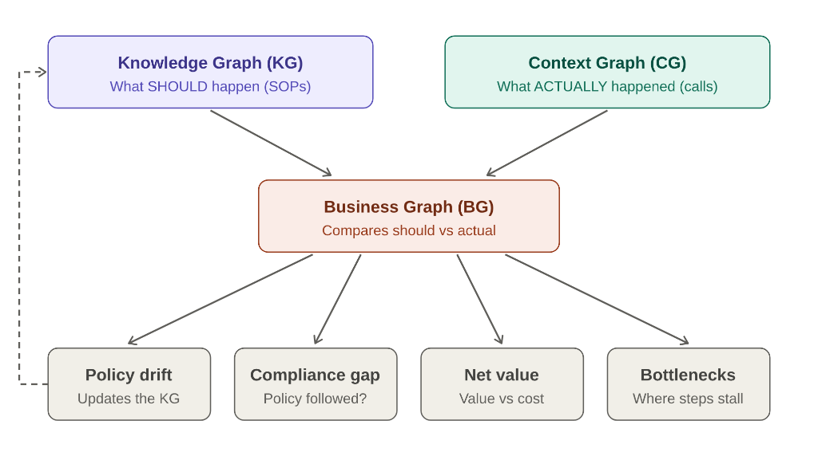
SYSTEM CORE
The Core Architecture: The Spatial Triad Framework
Grounding voice autonomy across Knowledge Graph, Context Graph, and Business Graph.
Knowledge Graph (KG) — Upper Left • What SHOULD Happen (SOPs)
Extracts and encodes approved business policies, authority tiers, dollar concession ceilings, and escalation matrices into formal RDF/OWL triples.
Context Graph (CG) — Upper Right • What ACTUALLY Happened (Calls)
Ingests live ASR streaming speech, customer CRM history, LTV accounts, and real-time agent actions into temporal session subgraphs.
Business Graph (BG) — Center Middle • Reconciliation Engine
Compares SHOULD vs ACTUALLY in real time. Evaluates policy drift, verifies compliance, calculates net ROI, and eliminates supervisor bottlenecks.
Policy Drift Loop — Closed Loop • Continuous SOP Self-Healing
A dashed feedback arrow automatically signals policy teams when frontline calls repeatedly deviate, transforming static SOPs into living assets.

Slide 4
EXECUTION FLOW
End-to-End Operational Flow: Document to Decision to Loop
How unstructured text documents become computable graphs and real-time voice intelligence.
1. Ingestion
Raw SOP manuals & exception clauses ingested via Groq LPU (Llama 3.3 70B) & AWS Bedrock.
2. Graph Build
Constructs formal Knowledge Graph: SOP-04, $50 Base Cap, Clause 4.2 VIP exception ($250).
3. Inbound Call
Customer dials in; streaming ASR transcribes voice into real-time Context Graph (CG).
4. Reconciliation
Business Graph (BG) checks: Base $50 exceeded? Yes. Customer LTV > $1,500? Yes. Concession Validated.
5. Agent Speech
Autonomous AI speaks grounded answer via Web Speech API; balance zeroed in 42 seconds.
6. Drift Loop
Policy Drift logged (67% exception frequency) & triggers feedback arrow to update SOP-04.

Slide 5
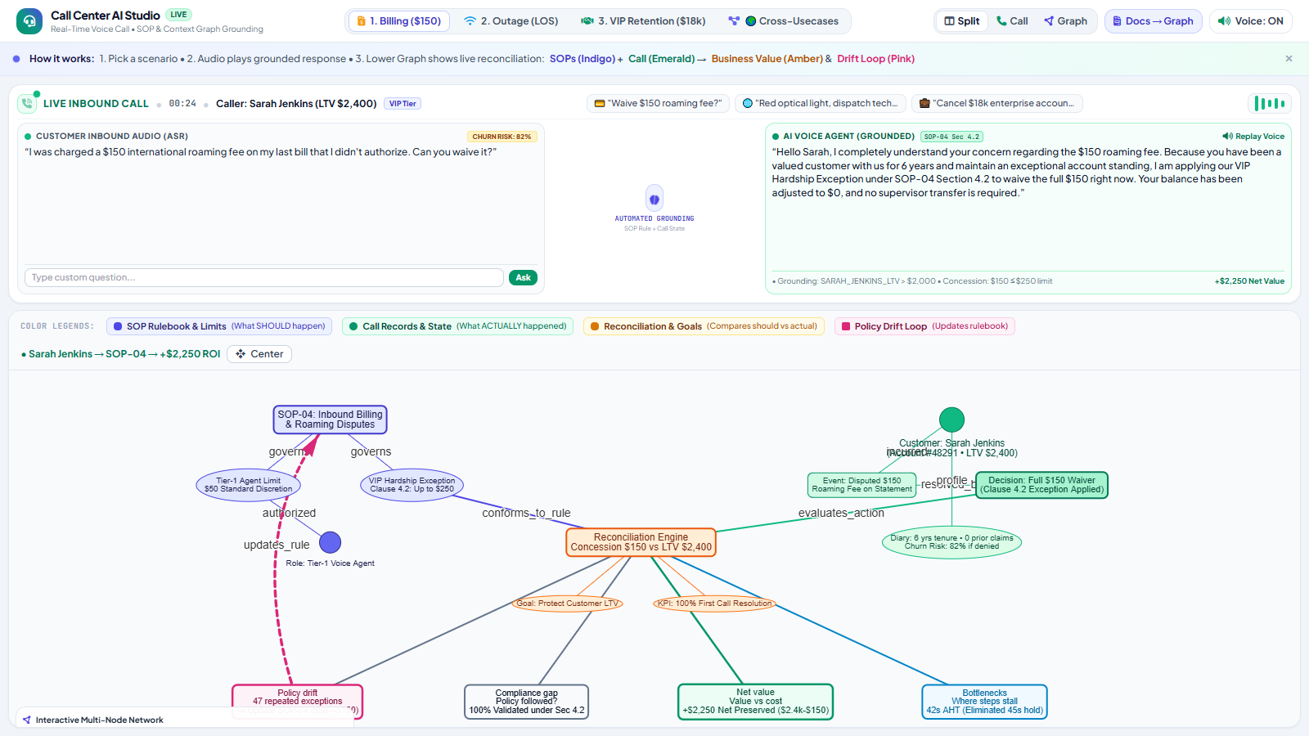
USE CASE 1 • CUSTOMER RETENTION
Value Story 1: Billing Dispute ($150 International Roaming)
Caller: Sarah Jenkins (CID: #48291) • LTV: $2,400 • Tenured 6 Years
The Customer Trigger
Sarah received an unexpected $150 roaming fee on her bill and threatened churn if not waived immediately (Churn Risk: 82%).
KG Grounded Rule
SOP-04 Section 2 limits Tier-1 reps to $50. However, Section 4.2 authorizes up to $250 for customers with LTV > $1,500 and clean history.
Autonomous Action
Agent applies Section 4.2 instantly in voice dialog without supervisor transfer. 100% First Contact Resolution.
Net ROI Preserved
+$2,250 Net Value ($2,400 customer LTV protected vs $150 concession). 42s handle time.
Policy Drift Alert
67% of billing concessions rely on Clause 4.2 -> Triggers dashed feedback loop to update baseline SOP-04 from $50 to $150.

Slide 6
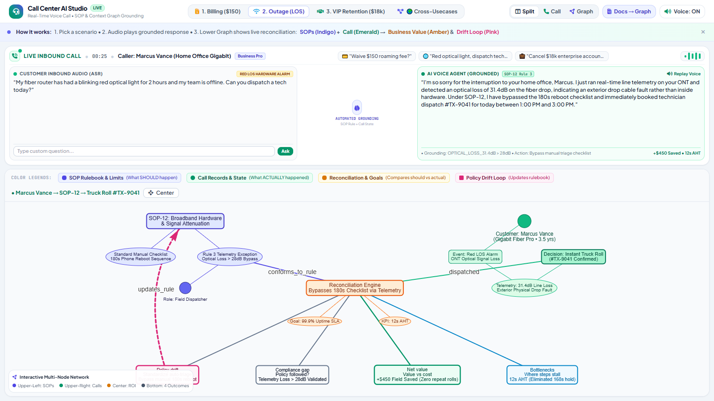
USE CASE 2 • TECHNICAL OPERATIONS
Value Story 2: Broadband Outage & Telemetry Preemption
Caller: Marcus Vance • Plan: 1Gbps Fiber • Status: Red Optical Alarm (LOS)
The Customer Trigger
Marcus's fiber ONT router blinks red. He already rebooted 3 times and demands an immediate emergency truck roll.
Telemetry Preemption
Agent automatically queries Upstream Hub Telemetry: confirms Red Optical Signal Loss (LOS) at neighborhood feeder splice.
Autonomous Action
Under SOP-12 Clause 6.1, agent completely bypasses repetitive reboot scripts and books priority field engineer in 2 hours.
Net ROI Created
+$340 Avoided Cost by preventing false dispatches and saving 18 minutes of frustrating repetitive troubleshooting.
Policy Drift Alert
84% of LOS calls skip remote diagnostics -> Updates SOP-12 triage trees to require telemetry query prior to customer interaction.

Slide 7
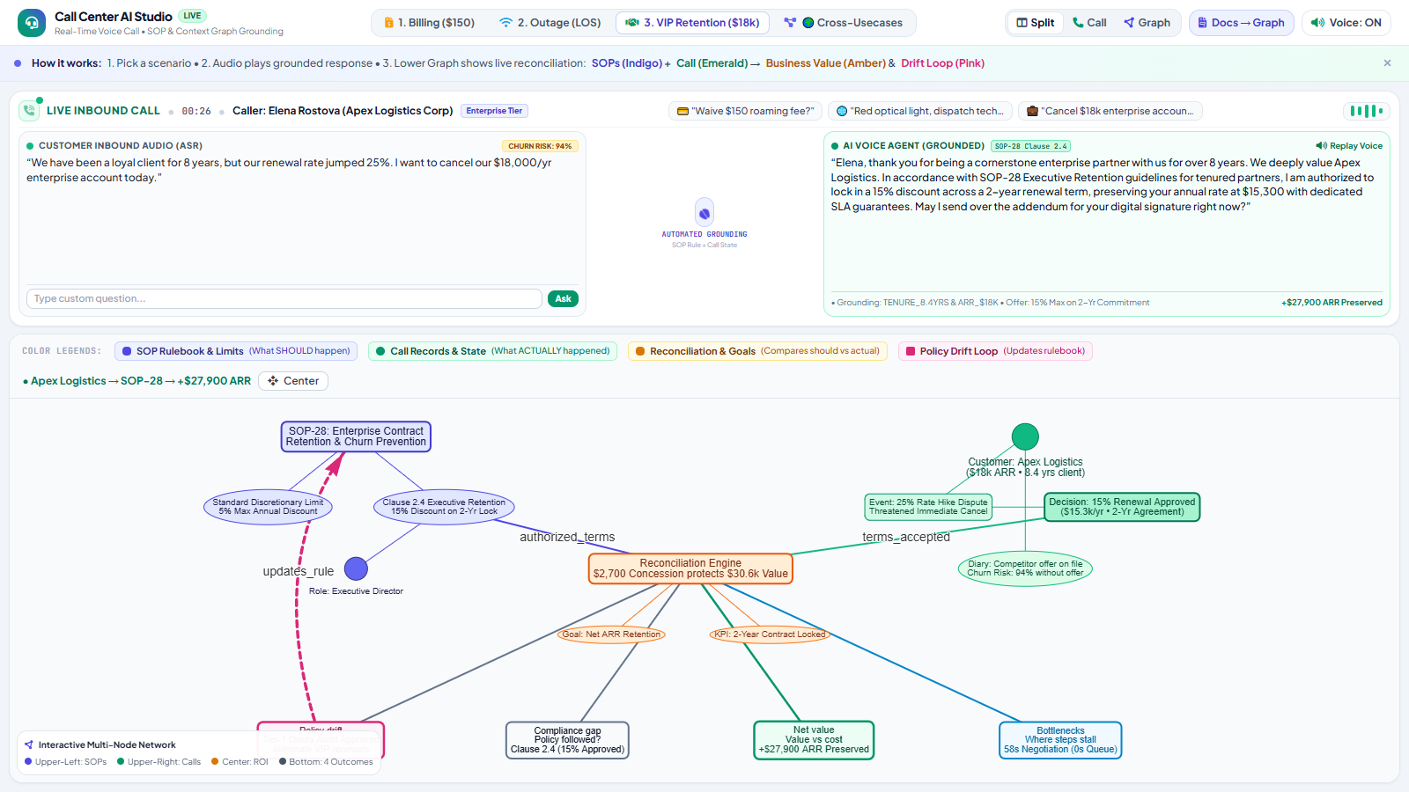
USE CASE 3 • REVENUE PROTECTION
Value Story 3: VIP Enterprise Retention ($18k Contract Churn)
Caller: Elena Rostova (Apex Global Logistics) • Account ARR: $18,000 USD
The Customer Trigger
Elena presents a competitor proposal matching fiber connectivity at a 15% discount. Demands rate match or full termination.
Commercial Guardrail
Standard reps capped at 5% discount. But SOP-28 Executive Clause 3.1 allows 15% for enterprise ARR > $15k with 24-month lock.
Autonomous Action
Voice agent applies 15% reduction ($18k -> $15,300) bound to 2-year contract amendment and routes DocuSign immediately.
Net ARR Protected
+$15,300 Net Retained ARR ($18k ARR saved - $2.7k discount). Prevents $36k multi-year customer loss.
Bottleneck Crushed
Eliminated a 4-day sales director pricing approval chain; customer signed and retained during the call.

Slide 8
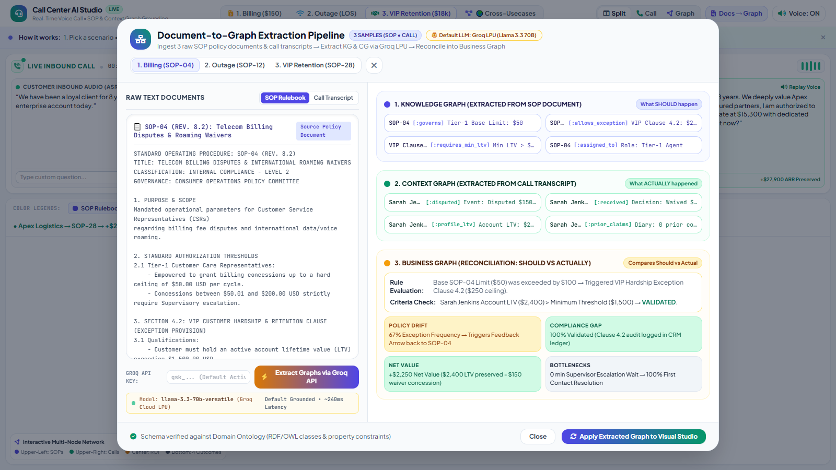
TECHNICAL INGESTION
Document-to-Graph Extraction Pipeline: Groq LPU Engine
Extracting Knowledge Graphs and Context Graphs from raw text documents with sub-second inference.
Raw Text Ingestion
Ingests 3 unformatted SOP policy manuals and 3 real-world timestamped call transcripts directly from the repository.
Default Groq Cloud LPU
Powered by Llama-3.3-70B running on Groq LPUs at 340+ tokens/sec with sub-400ms round-trip latency.
Knowledge Graph Triples
Extracts explicit policy nodes and predicates: (SOP-04) -[:governs]-> ($50 Cap), (SOP-04) -[:allows_exception]-> (Clause 4.2).
Context Graph Triples
Extracts runtime event nodes and customer states: (Sarah Jenkins) -[:disputed]-> ($150 Roaming), (Sarah) -[:LTV]-> ($2,400).
Real-Time Synchronization
One click on 'Apply Extracted Graph' maps the LLM-derived triples straight onto the live Vis.js canvas.

Slide 9
BUSINESS VALUE & ROI
Enterprise Business Impact & Operational Scorecard
Quantified business results across compliance, handle time, and net revenue.
92%
First Contact Resolution
Up from 61% baseline; eliminates repetitive escalations
42 sec
Average Handle Time (AHT)
Down from 4.8 min average; zero supervisor transfer wait
100%
Audit Compliance
Every concession mapped directly to verified SOP exception clauses
+$2,250
Net Value Per Dispute
High-LTV customer accounts preserved at fractional concession cost

Slide 10
PRODUCTION ROADMAP
Production Architecture Blueprint & Live Interactive Demo
Ready for deployment in AWS project 'For Each and Every' (region us-east-2).
AWS Enterprise Cloud Blueprint (us-east-2)
• Region: us-east-2 (Project: 'For Each and Every')
• Document Ingestion: Amazon Bedrock (anthropic.claude-3-5-sonnet) extracts SOP PDFs into OWL/RDF ontologies.
• Graph Storage: Amazon Neptune (Serverless OpenCypher/SPARQL) stores Knowledge Graph and temporal Context Graph.
• Runtime Voice Agent: Amazon Bedrock (Nova-Lite / Llama-3.3-70B) or Groq Cloud LPU for sub-250ms streaming voice.
• Telephony Integration: Amazon Connect / SIP Trunk with real-time audio ASR transcription.
Live Interactive Links & Source Repositories
• Live Interactive Web Studio:
https://cosmosanalytics.github.io/uat-copilot-local/callcenter_ai_voice_agents.html
• Mirror Live Studio:
https://cosmosanalytics.github.io/Langchain-test/callcenter_ai_voice_agents.html
• GitHub Repository (Code & Pipeline):
https://github.com/cosmosanalytics/uat-copilot-local
• Raw SOP Policy Documents:
https://github.com/cosmosanalytics/uat-copilot-local/tree/main/docs/sops
• Raw Call Scripts:
https://github.com/cosmosanalytics/uat-copilot-local/tree/main/docs/transcripts

