Slide 1
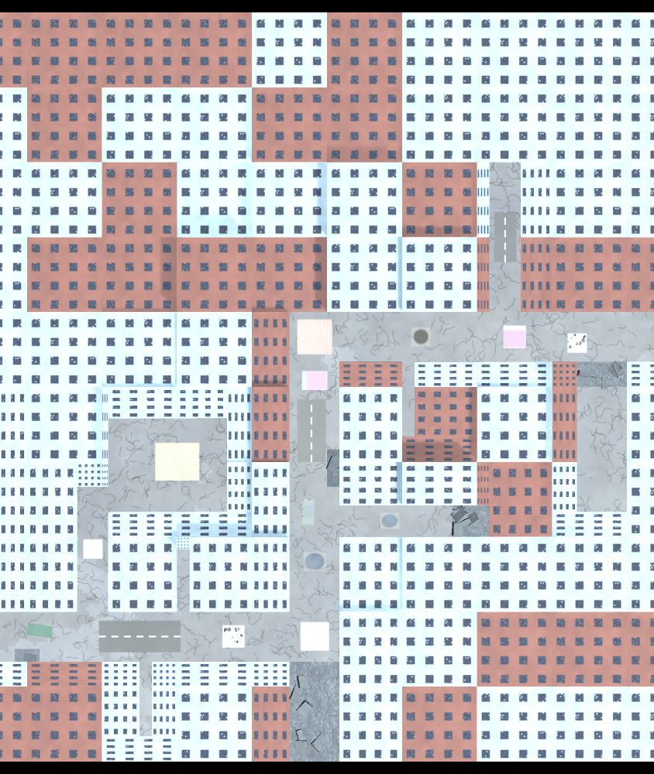
Intelligent Wi-Fi Relay Drone for Autonomous Disaster Communication
A self-deploying chain of relay drones — reinforcement-learned flight, vision-guided landing, developed in simulation
LOKESHWARAN P 23BAI1098
ANNAMALAI SRINIVAS 23BAI1006
YATHARTH TIWARI 23BAI1401
Notes:
Introduce the team and the one-line idea: drones that land as Wi-Fi relays to reconnect a disaster camp.

Slide 2
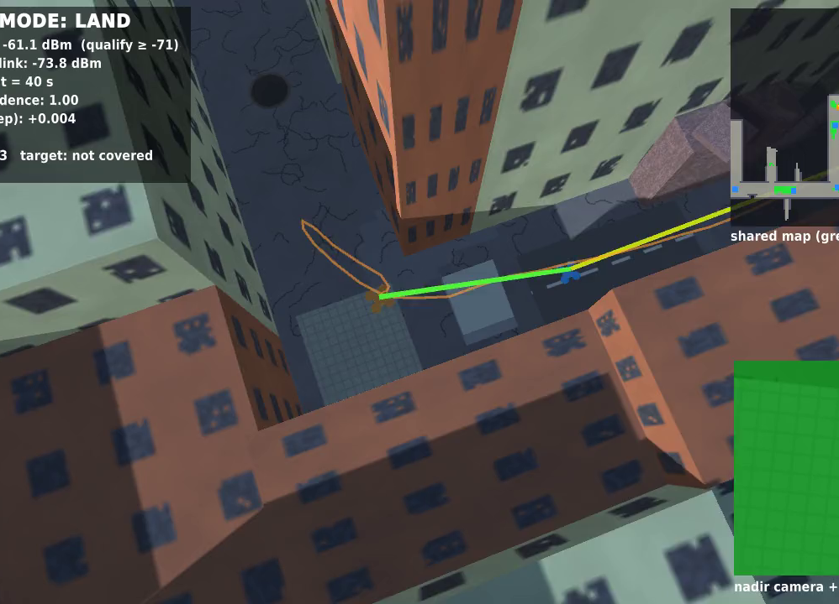
Disasters cut communication off
▸ Blackout: floods and earthquakes destroy towers, power and fibre; rescue teams lose contact.
▸ One drone isn't enough: 15–30 min of hover, and buildings block Wi-Fi around every corner.
▸ Our idea: launch drones one by one; each lands on a safe spot that still hears the previous relay and becomes the next link.
▸ Landed relay = long endurance: it only powers its radio, not its rotors.
A relay drone landing on a camera-detected safe patch (nadir camera, bottom right).
2
Notes:
Explain why a chain of perching drones beats one hovering drone.

Slide 3
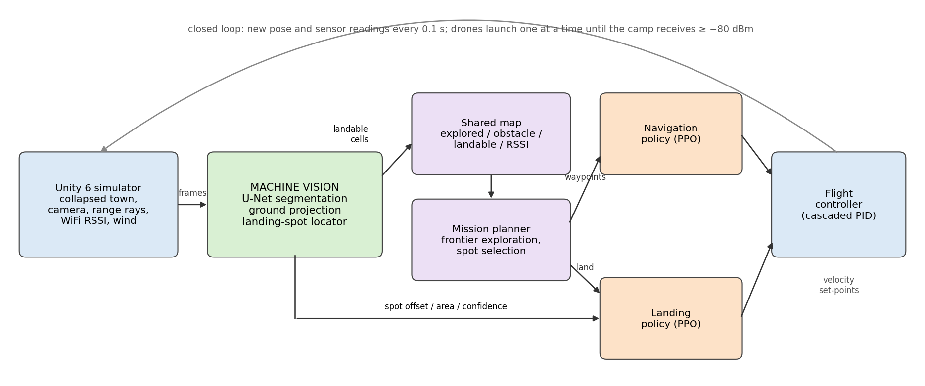
Planner decides where; policies fly
Hierarchical autonomy — every step runs at 10 Hz
Mission planner rules: frontier exploration, radio-aware landing spot, shared map
Two PPO policies navigation through unknown streets; landing under gusts
Machine vision U-Net segmentation → landable map + landing-spot features
3
Notes:
Rules where verification matters; learning where hand-written controllers fail (unknown obstacles, gusts, noisy detections).

Slide 4
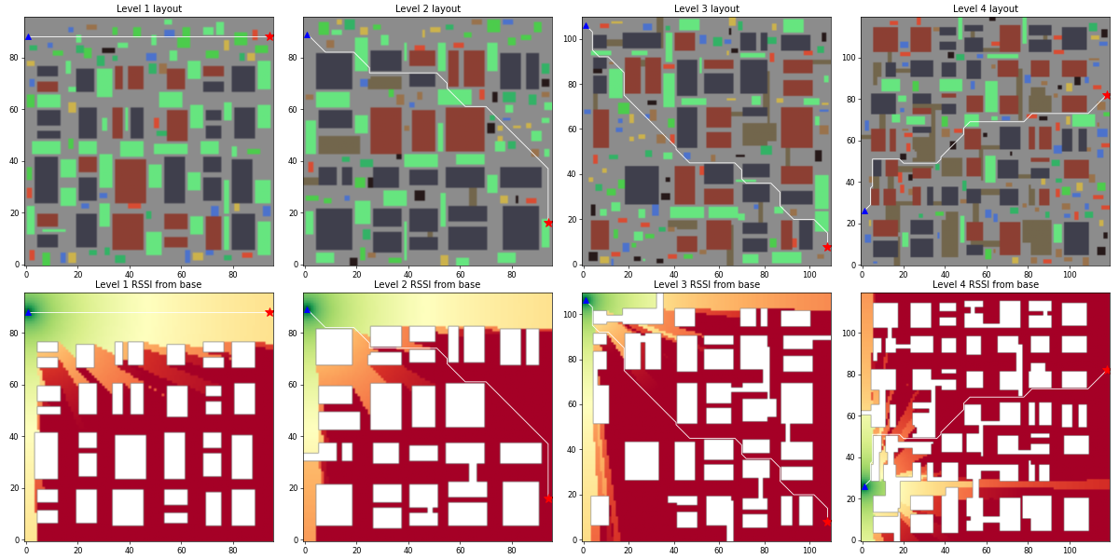
A Unity simulator built entirely from code
4 levels
rubble, collapses, scarce landing spots, wind up to 1.5 m/s gusts
−80 dBm
link threshold; log-distance path loss + 10/7/5 dB per wall
−71 dBm
Seeded procedural towns, 4 difficulty levels — training on even seeds, every test on unseen odd seeds.
needed to land as a relay (≈ 35 m along a clear street)
4
Notes:
Same grid drives collisions, range sensors and radio; a 3-D textured scene is built from it for the camera.

Slide 5
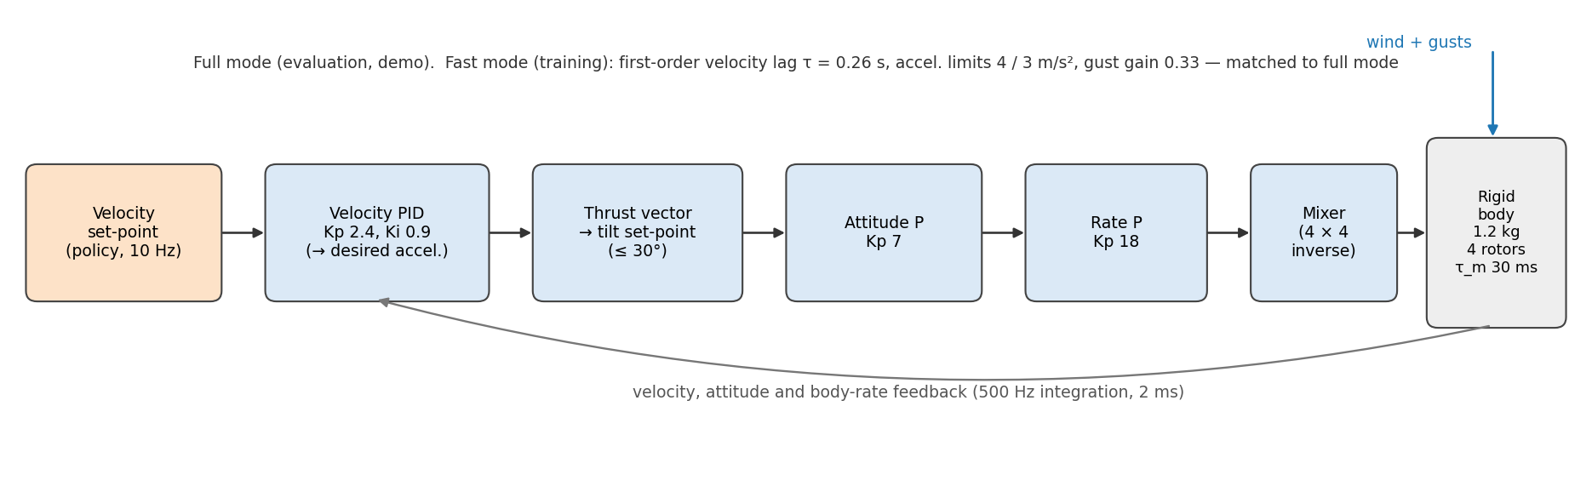
Two flight models, one autopilot interface
Policies send velocity set-points, like a companion computer to PX4
Full
Fast
0.83 / 0.84 s
0.38 m
1.2 kg quadrotor, 4 rotors, cascaded PID, 500 Hz — evaluation
first-order surrogate, 50 Hz — RL training (millions of steps)
settling time full / fast — matched
drift in a 3 m/s gust, both models
5
Notes:
Trained on Fast, tested on Full: 3–6 points lost per flight; fine-tuning on Full is future work.

Slide 6
Navigation PPO: unknown streets, no map
▸ Inputs (33): 24 range rays ≤ 10 m, waypoint distance/bearing, velocity, heading, last action
▸ Outputs (3): forward, sideways speed ≤ 3 m/s, yaw rate
▸ Network: MLP 2 × 256, PPO, γ 0.995
▸ Reward: progress along the street path, −1 crash, +1 arrival, small time/wall/jerk costs
▸ Curriculum: level 1 → 4; 10.75 M steps in ≈ 35 min
6
Notes:
Path-progress reward makes detours rewarding. Potential field gets stuck in dead ends (46 % timeouts at level 4).

Slide 7
Landing PPO: gusts and noisy detections
▸ Inputs (10): patch offset, area, confidence, clearance from the U-Net + altitude, velocity
▸ Reward: offset & fast-descent penalties + potential shaping Φ = −0.1(h + 2·offset); +1 soft touchdown
▸ Lesson learned: v1 hovered forever (timeout was cheaper than failing) → fixed in v2
▸ Robust: 100 % even at 6 m/s (never trained) and 2× detector noise, where PID drops to 0 %
7
Notes:
Touchdown error 1–5 cm. Gust curriculum 0→4.5 m/s, then fine-tuned with the measured detector noise.

Slide 8
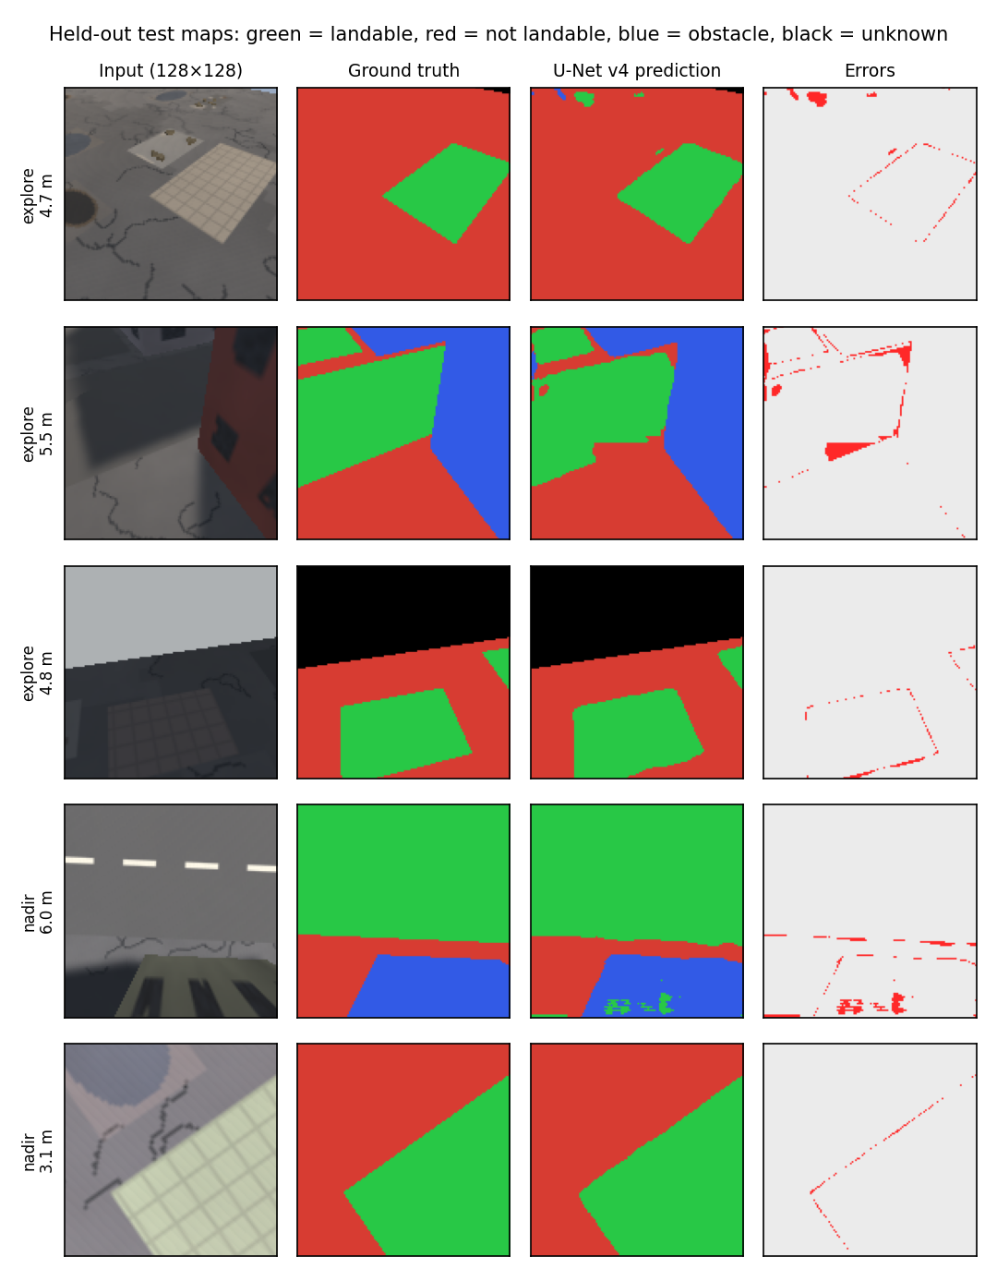
Vision: which ground is safe to land on?
0.92
0.83
mean IoU on unseen towns
landable-class IoU
0.48 M
≈ 4 ms
U-Net parameters
per frame on CPU in Unity
▸ 13,750 synthetic images, labels free by re-rendering in flat class colours
▸ Projected to the ground with the camera pose and fused into a shared map
8
Notes:
Input | ground truth | prediction | errors. Green landable, red not, blue obstacle.

Slide 9
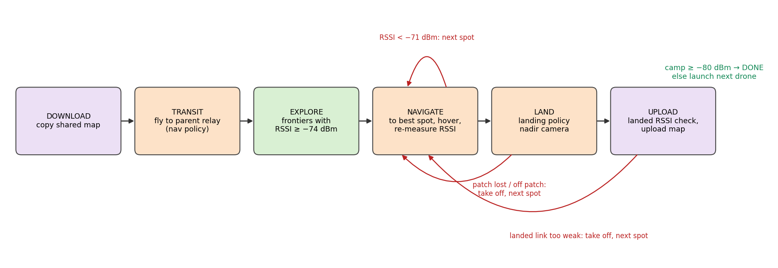
Mission: explore, pick a spot, land, relay
Explore rule
go to the frontier closest to the camp whose predicted signal is still ≥ −74 dBm
Spot rule
landable spot furthest toward the camp that still hears the parent at ≥ −71 dBm
Shared map
next drones reuse what earlier ones saw: exploration 52 s → 30 s
9
Notes:
This rule is why relays end up at street corners. Random spot: 25 %, nearest spot: 3 %, our rule: 47 %.

Slide 10
Results on 100 unseen towns
Level-2 towns, up to six drones, real U-Net in the loop
45 %
missions where the chain reaches the camp (51 % with perfect vision)
+62 m
average coverage extended toward the camp
−72.5 dBm
weakest link of a chain (threshold −80)
10
Notes:
All-or-nothing metric on random towns; the ceiling with perfect vision is 51 %, set by whether a landable spot exists at each corner. Learned navigation is the biggest single contributor (47 % vs 9 %).

Slide 11
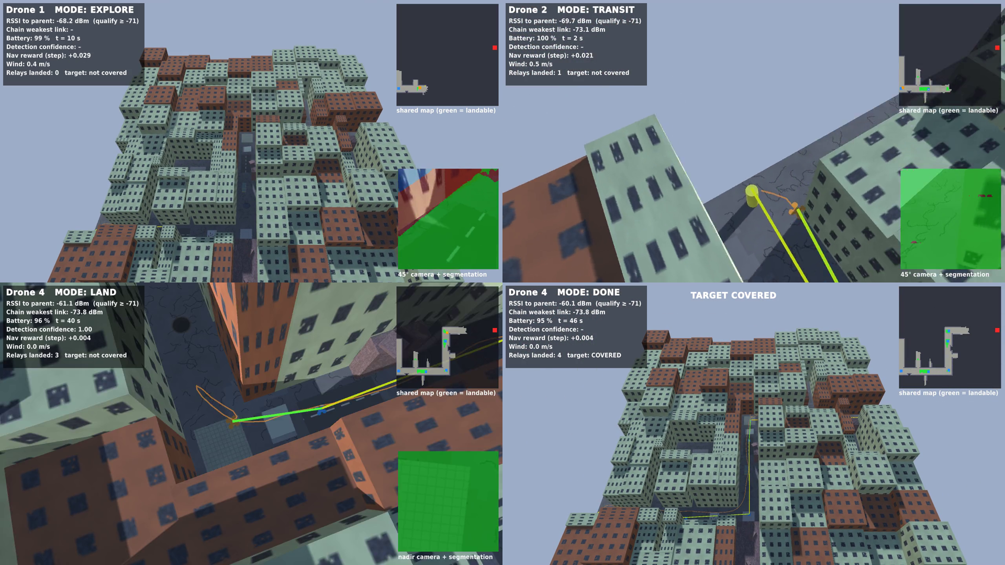
Live demo: six maps, 58/60 reliability
▸ Z-route, U-turn, Staircase, Blocked boulevard + two unseen procedural towns
▸ Fixes from failure analysis: camera aimed at the goal, distance-weighted evidence, cautious radio prediction
▸ Reliability: 34/60 → 58/60 runs over 10 seeds per map
▸ Run it: ./demo (keys 1–6, R, Space, V)
11
Notes:
Switch to the live demo here: start with Z-route, then Blocked boulevard, then Procedural town A.

Slide 12
Limitations and next steps
Limitations
Next steps
▸ Simulation only; synthetic images and a signal-strength radio model
▸ Trained on the fast model: 47 % → 30 % on the full quadrotor
▸ Dense towns lack landing spots at corners (level 4: 2 %)
▸ 2.5-D flight at a fixed 5 m altitude
▸ Fine-tune both policies on the full quadrotor
▸ PX4 SITL in Gazebo, then Pixhawk + RV1103 hardware
▸ Hover-relay fallback when no landing spot exists
▸ Real aerial images to close the sim-to-real gap
12

Slide 13
Thank you
Drones that land as relays, learned flight that handles the unknown, and vision that finds where to land — together they carry the network ≈ 62 m toward a disconnected camp.
Questions? github.com/cosmosapien200/communication-drone-relay-sim
13

