Slide 1
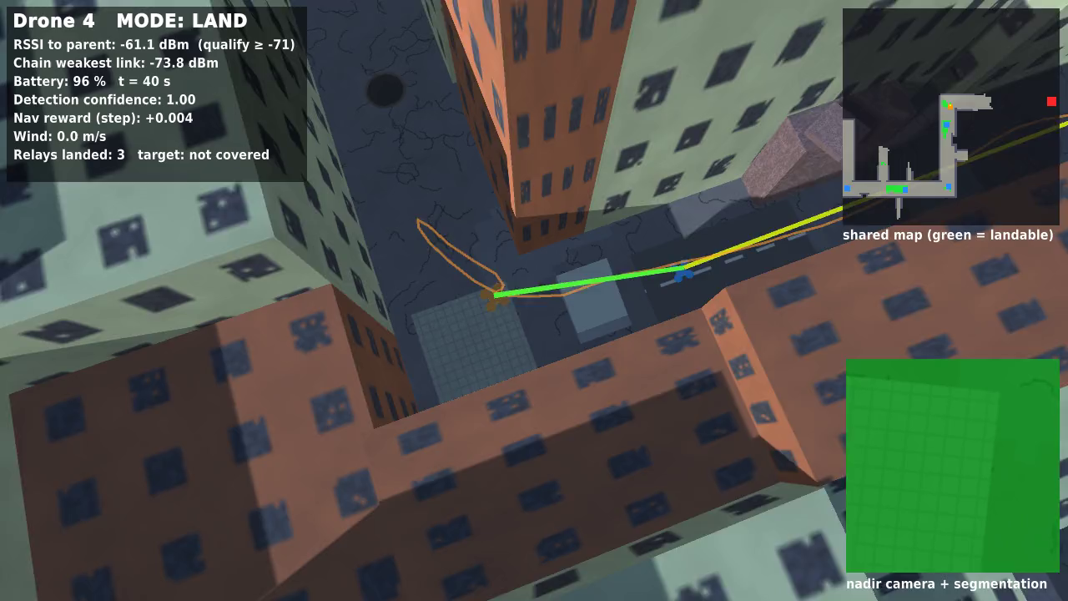
Proximal Policy Optimization Algorithms
Base paper for the Communication Drone project
J. Schulman, F. Wolski, P. Dhariwal, A. Radford, O. Klimov (OpenAI), arXiv:1707.06347, 2017
Theory DA1 — Reinforcement Learning
LOKESHWARAN P 23BAI1098
Notes:
We present the PPO paper, then show why it is the base method for our relay-drone project.

Slide 2
Why this paper
▸ Our task: autonomous drones that fly unknown streets and land under gusts, forming a Wi-Fi relay chain after a disaster.
▸ Both skills are continuous control: the policies output velocity commands.
▸ The paper's promise: the stability of trust-region methods with the simplicity of first-order optimisation.
▸ It scales with simulators: many parallel actors collect data, which suits our 32 training arenas.
A relay drone landing in our simulator, flown by a PPO policy.
2

Slide 3
The problem PPO solves
Vanilla policy gradient
L = E[log π(a|s) · A]. Only one safe gradient step per batch; repeated steps cause destructively large policy updates.
TRPO
Limits each update with a KL trust region. Reliable, but needs conjugate gradients and is complicated to implement.
Goal of PPO
Several epochs of minibatch updates per batch of data, using only a first-order optimiser such as Adam.
3
Notes:
The surrogate objective in TRPO is maximised under a KL constraint; PPO replaces the constraint with a clipped objective.

Slide 4
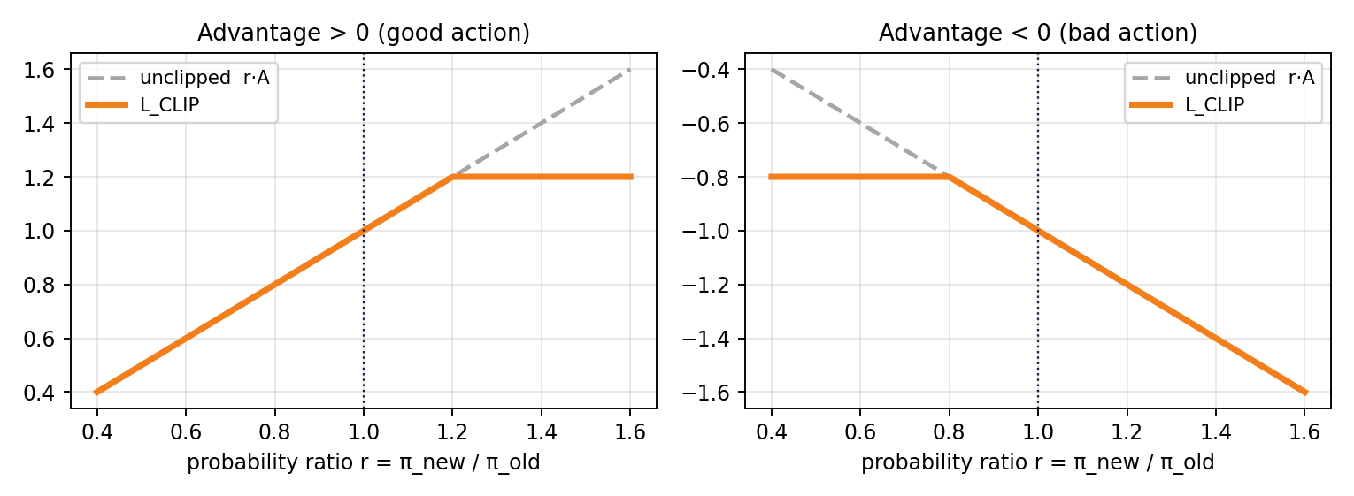
Core idea: clip the probability ratio
L_CLIP(θ) = E_t [ min( r_t(θ) A_t , clip(r_t(θ), 1 − ε, 1 + ε) A_t ) ]
Taking the minimum gives a pessimistic bound: there is no gain from pushing r outside [1 − ε, 1 + ε].
4

Slide 5
Full objective and advantage estimate
L_t(θ) = E_t [ L_CLIP − c₁ · (V_θ(s_t) − V_target)² + c₂ · S[π_θ](s_t) ]
clipped policy term − value-function error + entropy bonus for exploration
Â_t = δ_t + (γλ)δ_t+1 + … + (γλ)^(T−t+1) δ_T−1 , δ_t = r_t + γV(s_t+1) − V(s_t)
truncated generalised advantage estimation over T steps
▸ Policy and value function can share parameters, hence the combined loss.
▸ The paper also tests an adaptive KL penalty as an alternative; the clipped version performed better.
5

Slide 6
The algorithm
for each iteration:
for each of N parallel actors:
run π_old for T timesteps
compute advantages Â_1 … Â_T
optimise L for K epochs
with minibatch Adam (M ≤ NT)
θ_old ← θ
N
T
parallel actors: ours 32 arenas
horizon: ours 256 (nav), 128 (land)
K
ε = 0.2
epochs per batch: ours 3
the paper's best clip value, used by us
Simple enough to implement in full: our DA2 code does this in one Python file.
6

Slide 7
What the paper showed
0.82
▸ Continuous control: beat TRPO, CEM, vanilla PG and A2C on almost all 7 MuJoCo tasks at 1 M steps.
▸ 3-D humanoid: learned running, steering and getting up, showing that it scales to hard high-dimensional control.
▸ Atari (49 games): fastest learning (best training-average reward on 30 games), with final scores close to ACER.
▸ Practical: much simpler than ACER or TRPO, with one main hyperparameter, ε.
average normalised score with ε = 0.2 on 7 MuJoCo tasks: best setting tested
−0.39
same benchmark with no clipping or penalty
7

Slide 8
Why PPO for our drones
Algorithm | Actions | Why / why not for this project
DQN | Discrete only | Velocity commands are continuous
SAC | Continuous | Sample-efficient, but off-policy: more complexity when the simulator already gives cheap data
PPO | Continuous | Stable, few settings, scales with parallel arenas; proven on quadrotors and in drone racing
Our environment produces more than 10,000 steps per second, so simplicity and stability matter more than sample efficiency.
8

Slide 9
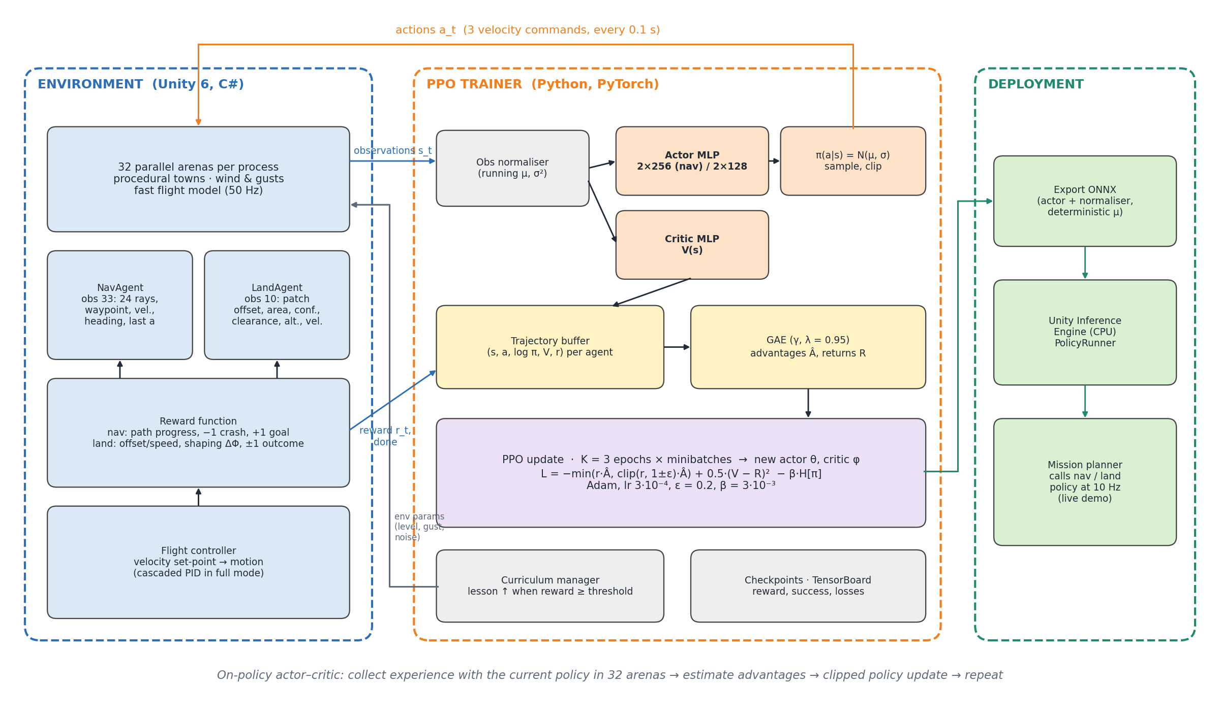
How PPO fits our system
9

Slide 10
What the paper leaves open, and our plan
Gaps for a real mission
Assignment plan
▸ Assumes the reward is given: reward design is left to us
▸ Benchmarks have perfect state, while drones have noisy detectors
▸ One task, not a multi-drone mission with radio constraints
▸ Hard tasks can fail from a cold start
▸ DA2: implement PPO from the paper in PyTorch and train it on our drone tasks
▸ DA3: the proposed novelties: path-progress reward, shaping, curriculum, noise calibrated from the real detector, radio-aware mission planner
10

Slide 11
References
[1] J. Schulman et al., Proximal Policy Optimization Algorithms, arXiv:1707.06347, 2017. (base paper)
[2] J. Schulman et al., Trust Region Policy Optimization, ICML 2015.
[3] J. Schulman et al., High-Dimensional Continuous Control Using Generalized Advantage Estimation, ICLR 2016.
[4] J. Hwangbo et al., Control of a Quadrotor with Reinforcement Learning, IEEE RA-L, 2017.
[5] E. Kaufmann et al., Champion-level drone racing using deep reinforcement learning, Nature, 2023.
11

