Slide 1

TopiQAL
Topic Modeling based QA Model to answer topical COVID-19 questions
Hamsa Shwetha Venkataram
Data Scientist

Slide 2
We all have questions.

Slide 3
Who am I ?
How big is the Universe ?
How many days in a Martian year ?
Is there a vaccine to COVID-19 ?

Slide 4
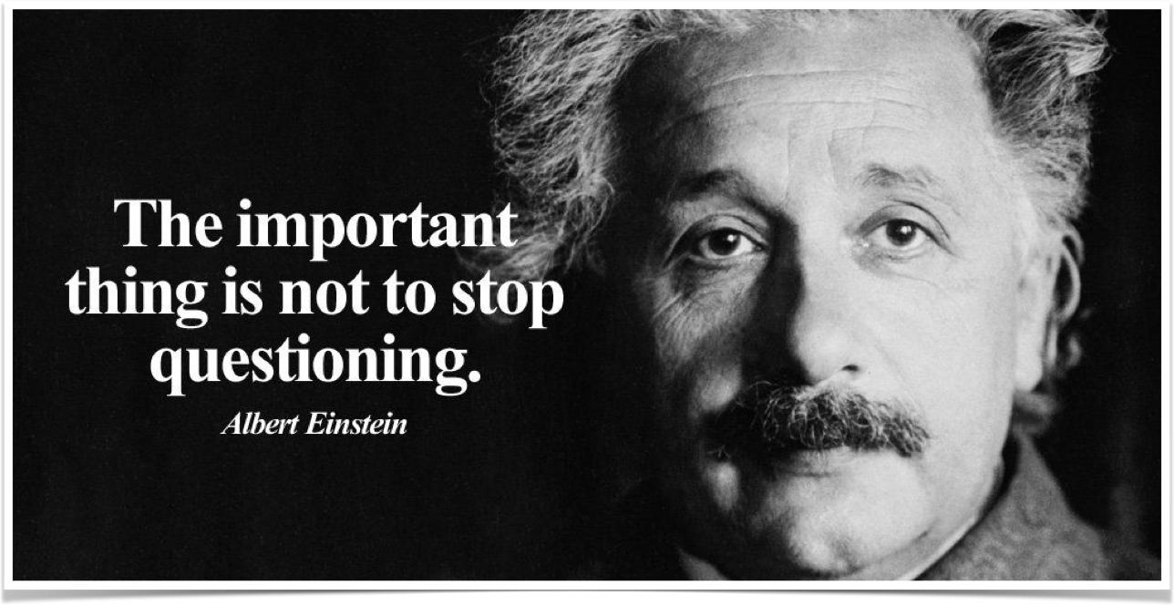
https://pbs.twimg.com/media/D1lyBC7X0AAYn4d.jpg

Slide 5
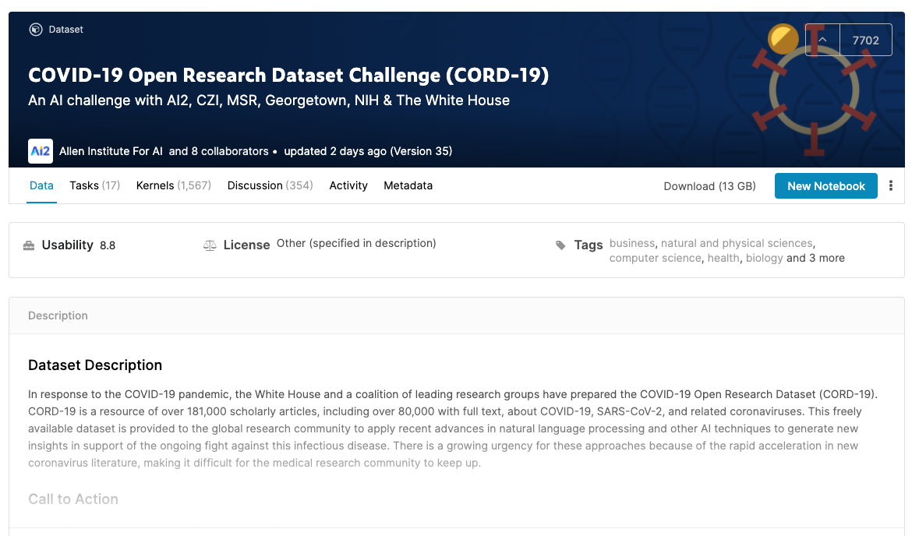
Let’s step back a bit ..
The White House and a coalition of leading research groups have prepared the COVID-19 Open Research Dataset (CORD-19). CORD-19 is a resource of over 29,000 scholarly articles, including over 13,000 with full text, about COVID-19, SARS-CoV-2, and related coronaviruses.
Challenge Submission: https://www.kaggle.com/venkat1949/topic-modeling-based-biobert-qa-system

Slide 6









Articles
CORD-19 Dataset
Subject Matter Experts
Labels
Answers
Tasks - Questions

Slide 7
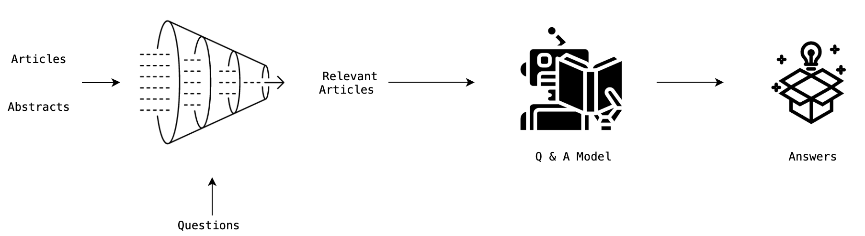
Why TopiQAL ?

Slide 8

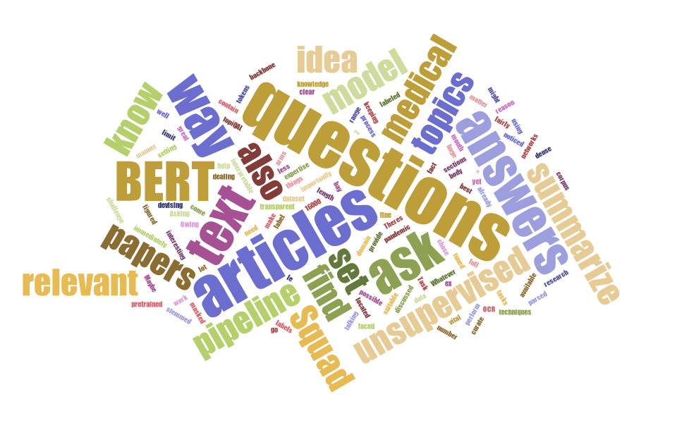
Sums up all that we do!

Slide 9
Topic Models

Slide 10
Topic Models
Discover hidden thematic structure
Latent Dirichlet Allocation
Interpretability of models
Hierarchical modeling
Journals
Abstracts
Articles
Setting priors for word-topic combination
GuidedLDA
Gensim (eta)
Evaluation
Visualization
pyLDAVis

Slide 11


Hierarchical Topic Modeling
Data Preprocessing on entire corpus
CZI
PMC
bioRxiv
medRxiv
Abstract topic models
Filter abstracts
Assign abstract topics to all articles
Article topic models
Filter body text
Assign body topics to all articles
Each topic is seeded with words from 10 Kaggle Tasks

Slide 12
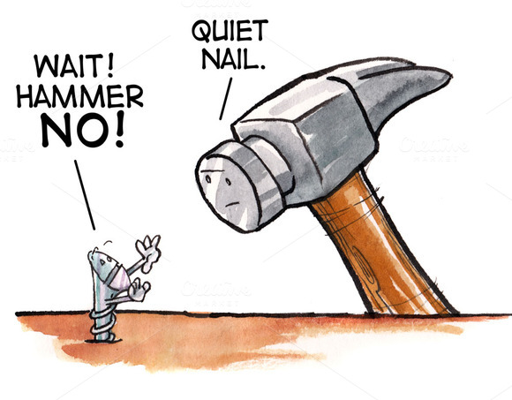
(Bio)BERT- SQuaD

Slide 13
BERT
What is BERT ?
How can BERT answer questions ?
SQuaD Dataset
BioBERT
Fine-tuning and Inference on TPUs
Google Colab notebooks and gsutil
Evaluation

Slide 14
Inference

Slide 15
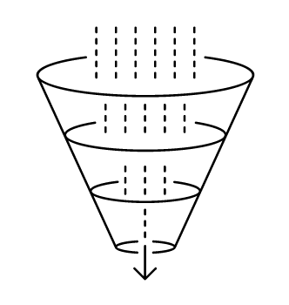


Inference Cycle
Question
Abstract Topic Models
Articles
Topics
Filtered article sections
Body text topic models
Context

Slide 16
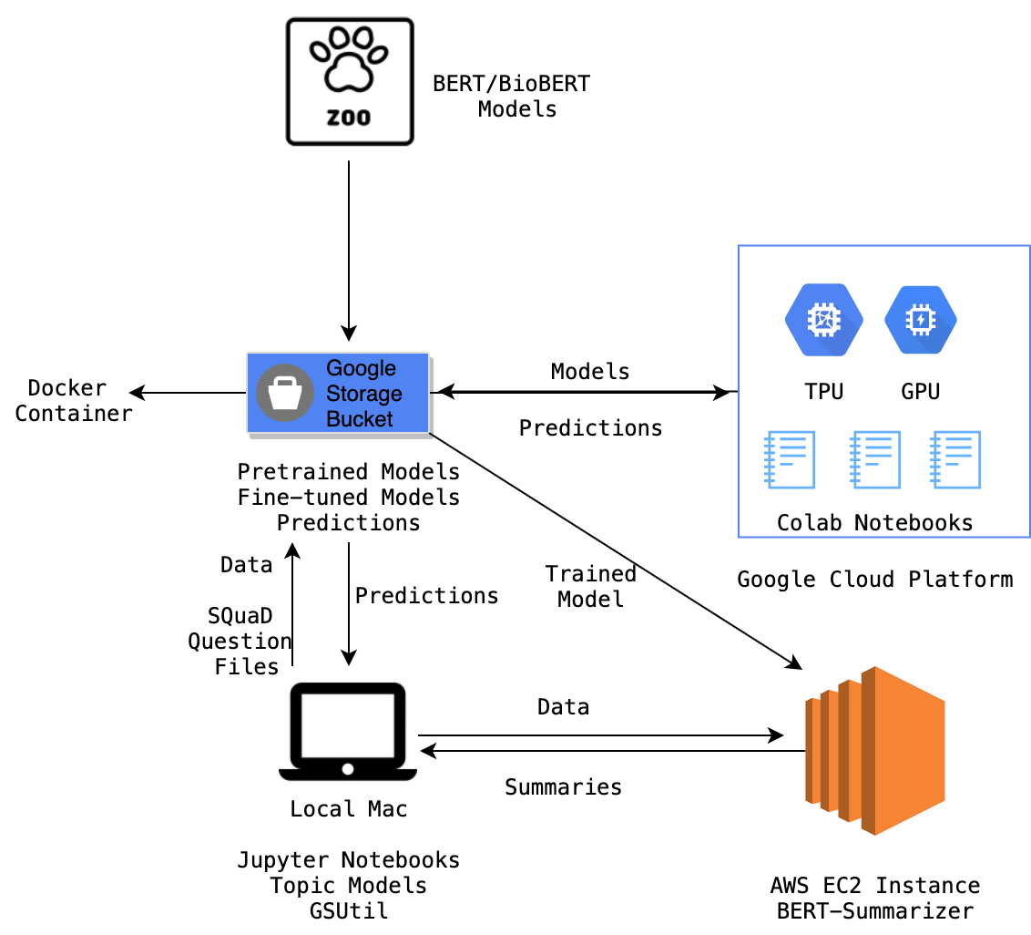
Architecture & BioBERT Answers
Question: Methods evaluating potential complication of Antibody-Dependent Enhancement (ADE) in vaccine recipients.
Answer: Nsp3b and E-channel
Question: Exploration of use of best animal models and their predictive value for a human vaccine.
Answer: no target has been predicted
Question: Capabilities to discover a therapeutic (not vaccine) for the disease, and clinical effectiveness studies to discover therapeutics, to include antiviral agents.
Answer: scientists have come up with three strategies for developing new drugs
Question: Exploration of use of best animal models and their predictive value for a human vaccine.
Answer: ARIMA

Slide 17

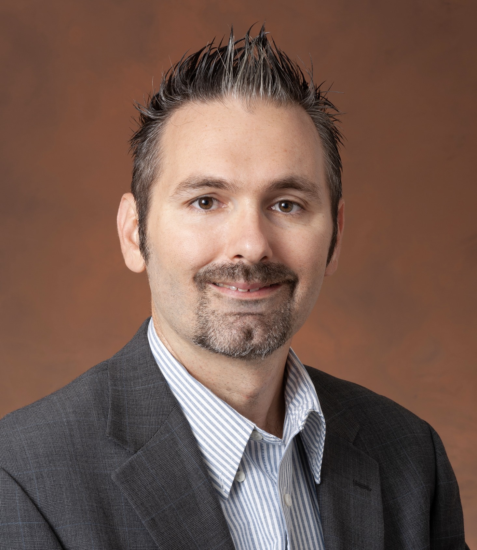
Team
Hamsa Shwetha
Asitang Mishra
Dr. Chris Mattmann
Annie Didier
Anastasia Mensikova

Slide 18
Thank You!

Slide 19
References
Icons from Noun Project
https://github.com/vi3k6i5/GuidedLDA
https://github.com/nasa-jpl-cord-19/topiQAL

