Slide 1
Overcoming Geographic Isolation:
The Design and Implementation of a Web-based Collaborative Learning Environment
A Master's Thesis Defense by Ryan Lewis
Clarkson University: Department of Computer Science
December 15, 2011

Slide 2
Outline
Motivation
Related Work
Leveraged Software
Features
User Survey
Conclusions & Future Work

Slide 3

Motivation: STEP
STEP (Science and Tech. Entry Program)
  Prepare minorities and economically disadvantaged for entry into post-secondary STEM programs
  Funds institutes offering programs that meet a set of priorities and requirements

Slide 4
Motivation: STEP
Priorities
  Male recruitment and retention
  Hispanic/Latino recruitment and retention
  8th grade NYS math and science assessment scores
Requirements
  Collaboration evidence
  Activities to aid acquiring skills to pursue STEM fields
  Build math and science skills in accordance with Adv. Regents
  Means of involving parents

Slide 5


Motivation: IMPETUS
Integrated Mathematics and Physics for Entry To Undergraduate STEM
  Clarkson's STEP funded program
    Year round events on and off campus
  Collaboration happens in person...
    Served region (Northern NY) covers a lot of area
    Participating schools can 1+ hours to get to campus
    Results in all participants collaborating only 7 times/year

Slide 6
Motivation: IMPETUS
Solution: web-based Collaborative Environment
  Helps satisfy many of the priorities and reqs
  Students that need help can have personalized tutoring with Clarkson students
  Teachers can survey and receive feedback from students and parents
  Parents have access to student data
  Collect student data and usage data for analysis
    NSF has stated that analyzing this usage data is a key cyberlearning research topic

Slide 7
Related Work
Several existing Cyberlearning Systems (CLS)
  Traditional
    Blackboard (WebCT)
    Moodle
  Specialized
    Khan Academy

Slide 8
Related Work: Blackboard
Closed source
Expensive
Custom functionality is possible, but one needs to be a customer

Slide 9
Related Work: Moodle
Open source
Does not store or track changes to user data
  Ex: Track total # of 10th grade students taking biology each year and compare
Offers a lot of unnecessary features
No personalized tutoring component

Slide 10
Related Work: Khan Academy
Provides a personalized Knowledge Map of math topics and exercises associated with each
Open source
Does not have robust enough user management
Exercises can not be created by non-technical users (require extensive HTML and JS)

Slide 11
Related Work: Summary
No perfect drop-in solution
Required:
  Khan Academy Knowledge Map
  Easy quiz (i.e. exercise) creator
  Continuous user data tracking
Create IMPETUS Collaborative Environment

Slide 12
Leveraged Software
Symfony2
  PHP MVC framework
    Requires the use of well-understood design principles: service layer, repository layer, ORM, …
    Handles security, database abstraction, templating
    Should make sustainability easier
Khan Academy
  Adopting their Knowledge Map code to better suit IMPETUS

Slide 13
Feature: User Management
All non-anonymous users have an account with a role that defines their general privileges
Students have additional data stored
  Year independent
    Ethnicity, gender, graduated, diploma
  Year dependent
    Activities, standardized exam scores, courses, grade, school district
Used to show increases in recruitment/retention rates

Slide 14
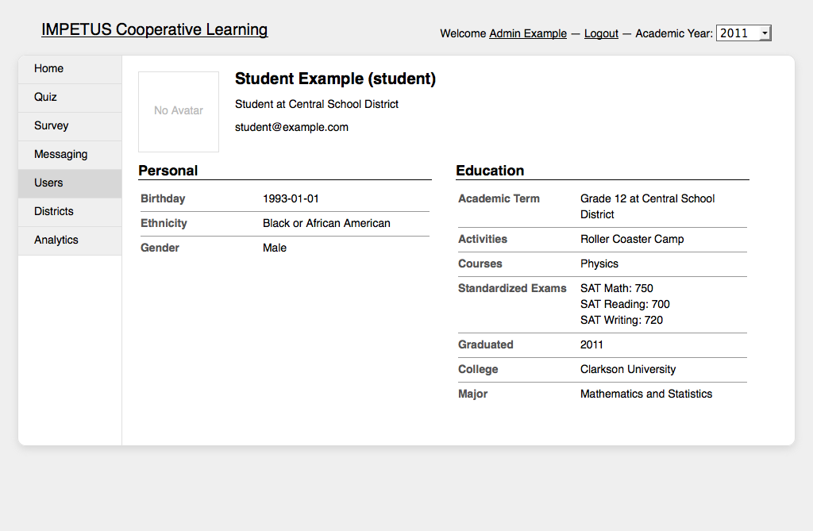
Feature: User Management

Slide 15
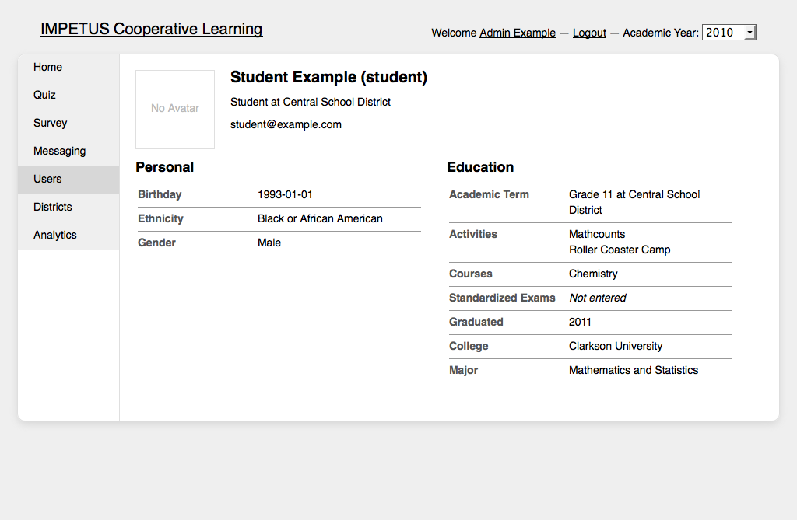
Feature: User Management

Slide 16
Feature: Learning Pathway
IMPETUS adoption of Khan Academy Knowledge Map
Students are shown a hierarchical tree of concepts based on State Standards
  Nodes represent a concept
    Has videos and quizzes associated with it
    Completing a quiz changes the color of the node
  Edges represent requisite knowledge
Enhance math and science skills in accordance with the Advanced Regent Diploma and 8th grade assessments

Slide 17
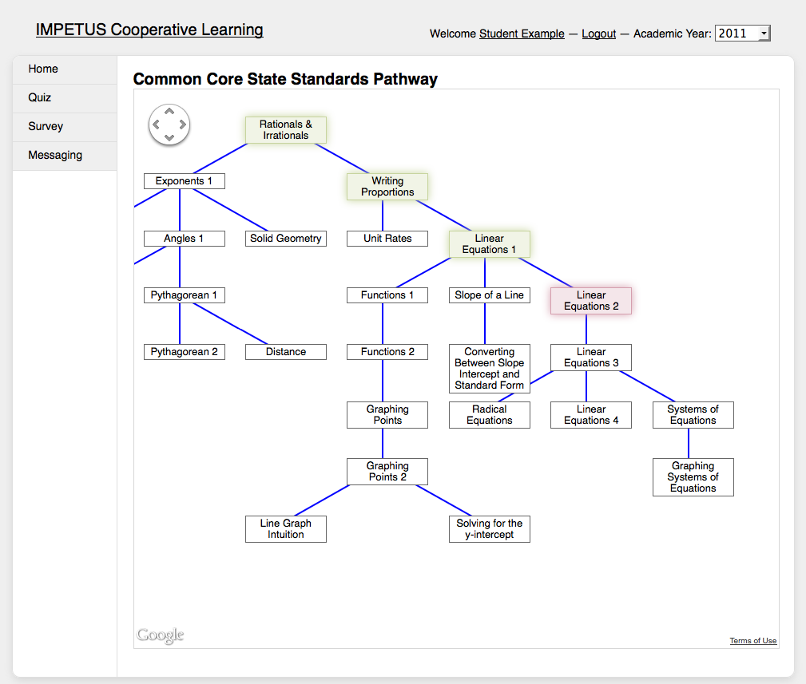
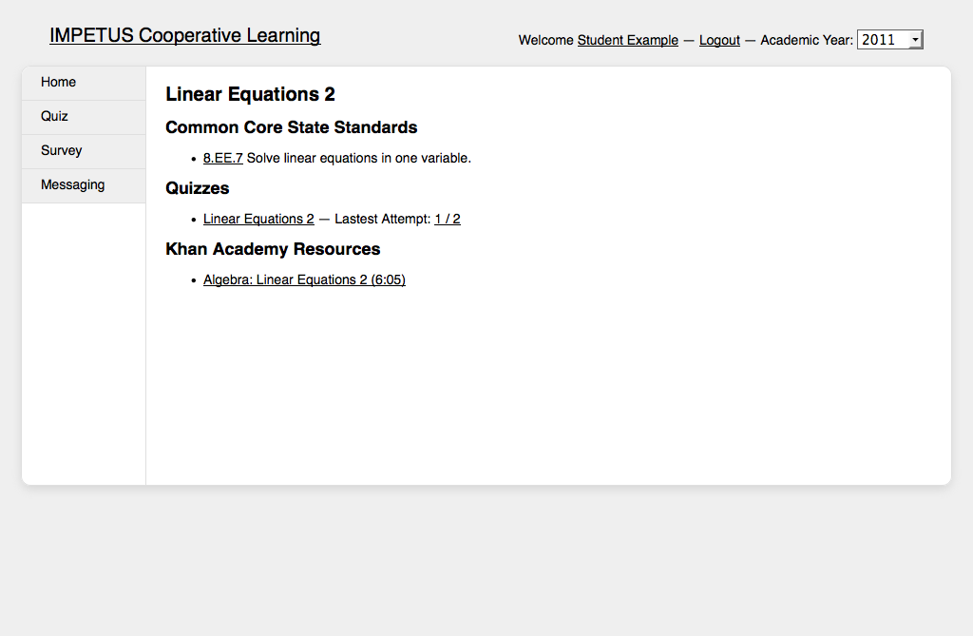
Feature: Learning Pathway

Slide 18
Feature: Quiz System
Teachers and TAs can create new assessments that can be linked with the Learning Pathway tree
Students can attempt quizzes numerous times until they master the topic
Formal collaborations between the funded institute and the local school districts
Activities that assist students in acquiring the skills and aptitudes necessary to pursue collegiate STEM disciplines

Slide 19
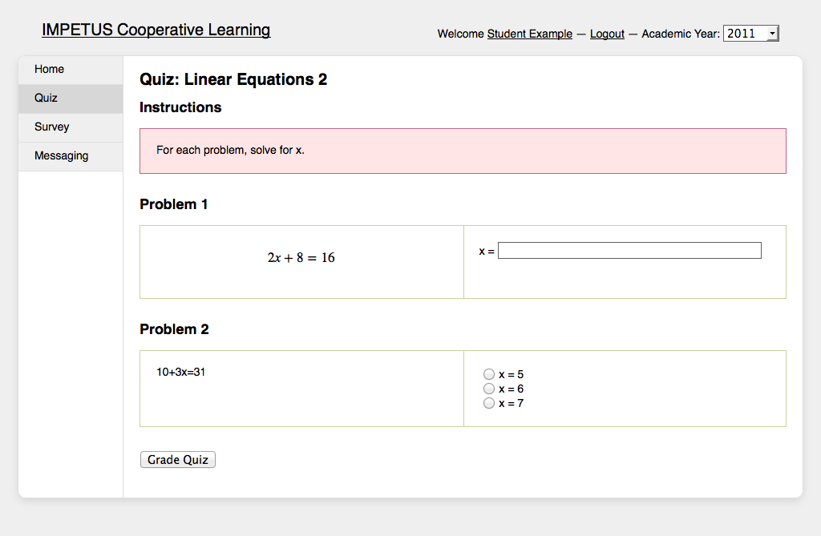
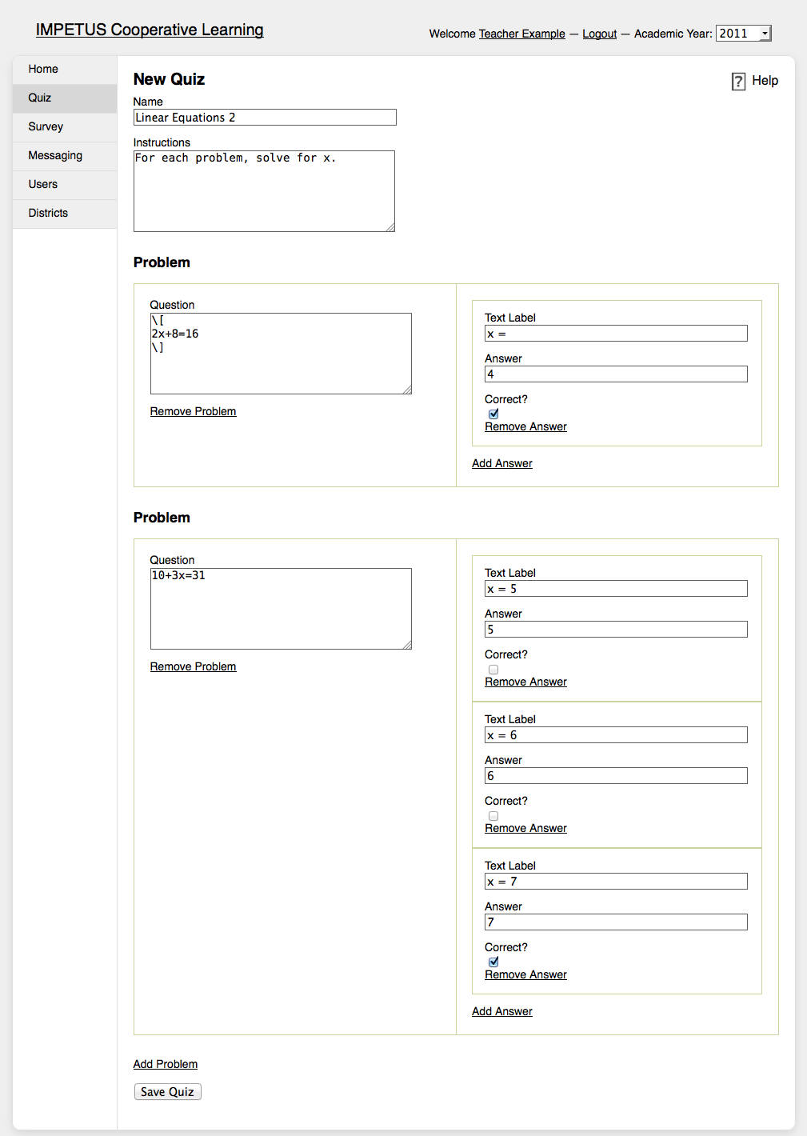
Feature: Quiz System

Slide 20
Feature: Survey System
Teachers and TAs can get feedback from any type of user
If a student does not participate in surveys, this could be seen as an early indicator of needing more attention
Means of involving parents

Slide 21
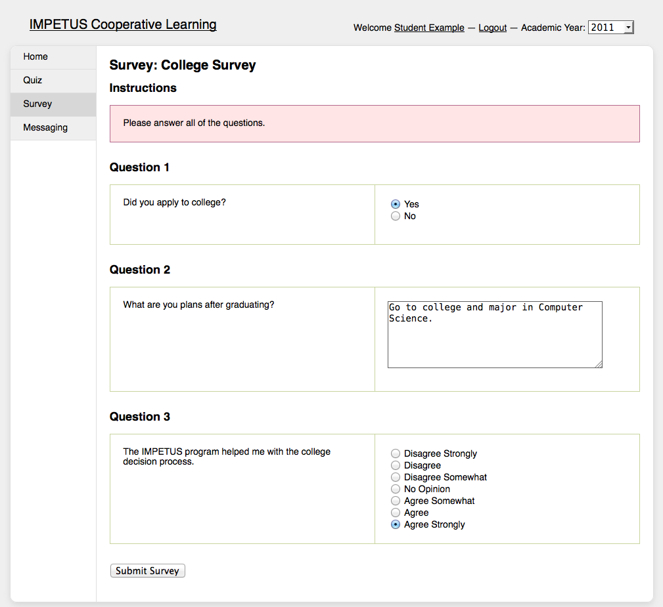
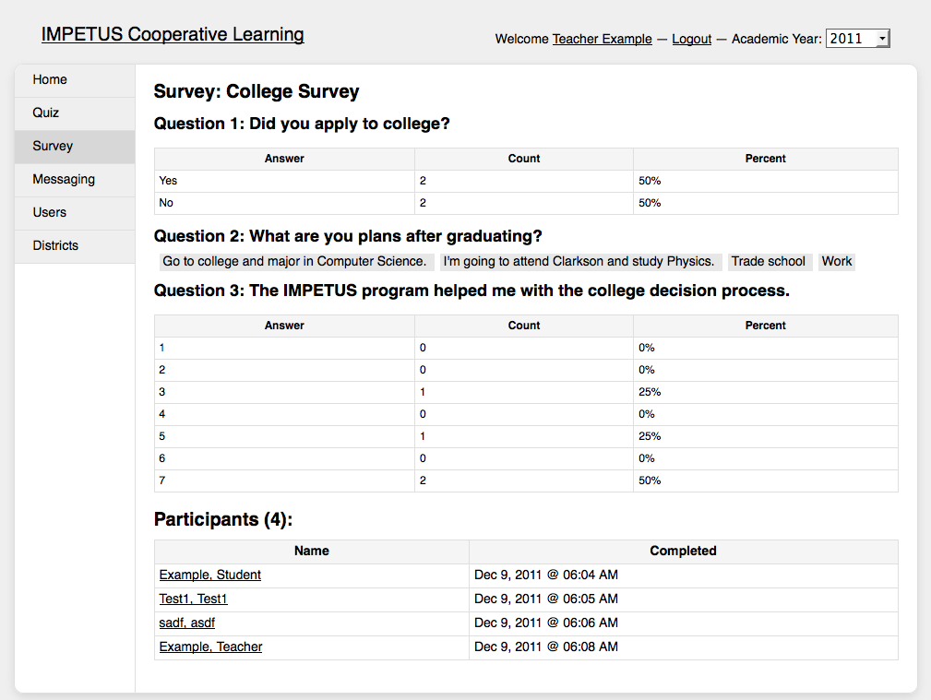
Feature: Survey System

Slide 22
Feature: Messaging
To facilitate communication between all users, a messaging system was created
Can send messages to single users or groups of users (Teachers, Example District Grade 10)
Users are notified via email that they have a new private message

Slide 23
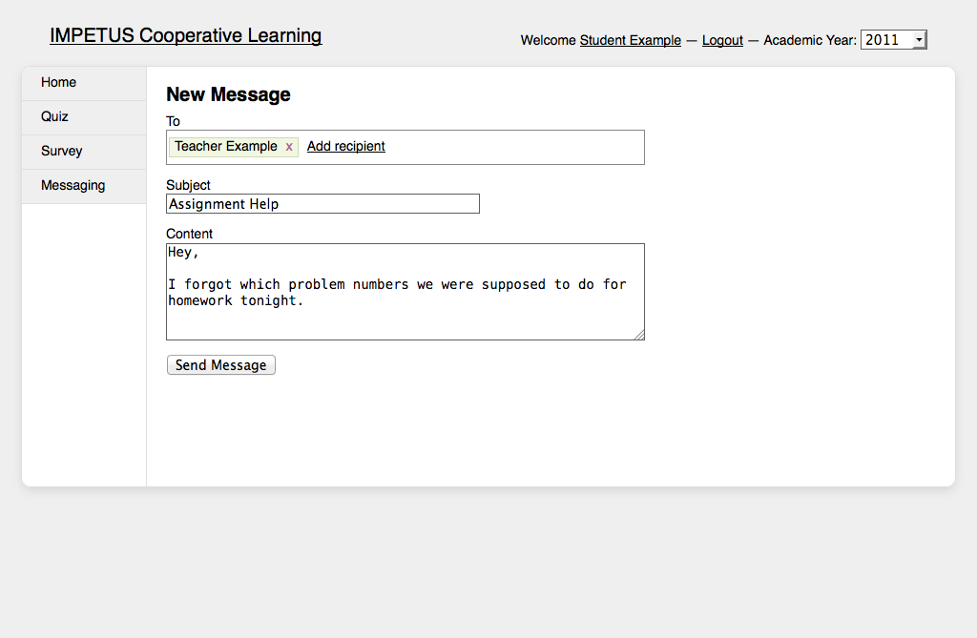
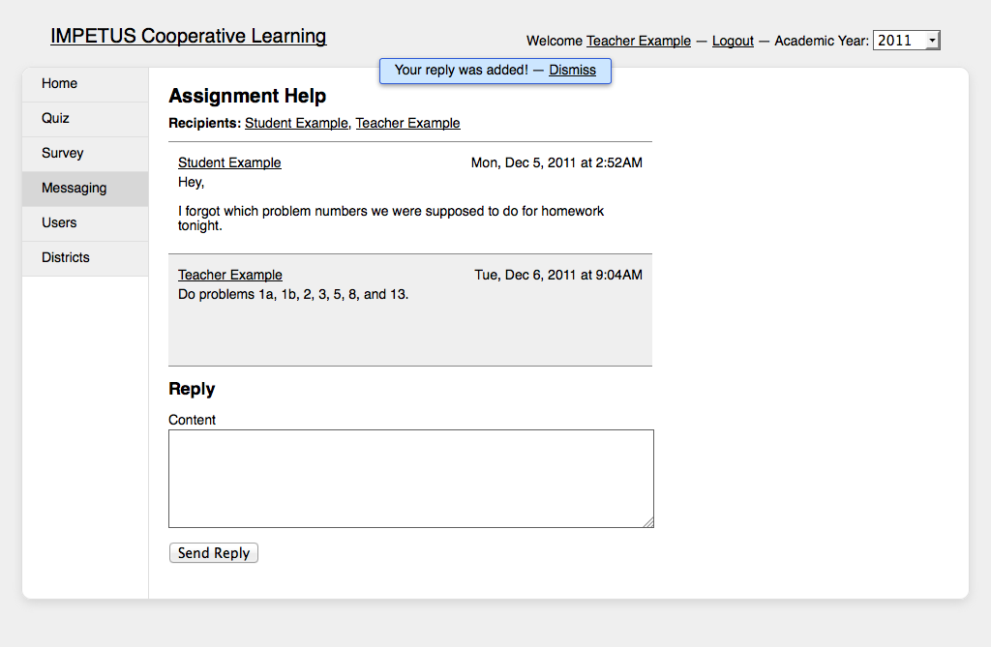
Feature: Messaging

Slide 24
Feature: Analytics
A STEP funded program must submit, each year, a report to NYSED that summarizes data about the participants, activities, program content, and outcomes
The Collaborative Environment collects this data and outputs it in the format that the report mandates

Slide 25
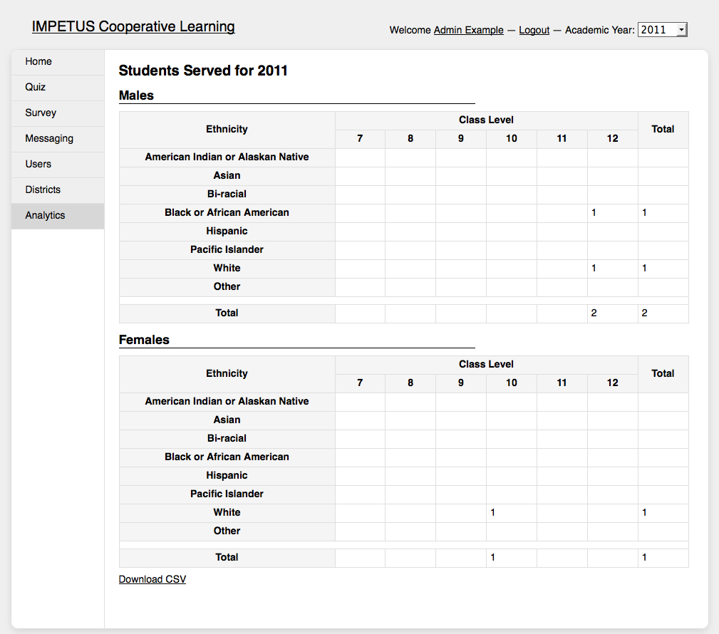
Feature: Analytics

Slide 26
User Survey
Gather initial qualitative data and get feature feedback
Surveyed IMPETUS administrators, teachers, and graduate fellows; 18 total
Participants used the survey as a guide and left feedback throughout the process
Played the role of a teacher performing routine tasks

Slide 27
User Survey
Only one survey thus results are just indicators
  Satisfaction
    User management, messaging, surveys: >=84%
    Quiz creation: >55%
      Confusion with creating correct/incorrect answers
Changes made can now be compared against

Slide 28
Conclusions
Contributed a free and open source Collaborative Environment
Satisfies STEP priorities and requirements while aiding in overcoming the issues of operating a geographically isolated STEP program
In an anecdotal sense, initial survey results have been primarily positive with 89% of the participants indicating satisfaction with the system

Slide 29
Future Work
Add more analytics tables and graphs
Run additional user surveys to quantify data
Once real data starts being collected, this can be used as a powerful tool

Slide 30
¿Questions?

