Slide 1
半导体界统计和R的应用
中芯国际 －良率管理系统
2008-12-13

Slide 2
Content
Background
R Usage at SMIC

Slide 3

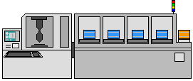

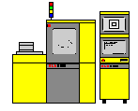
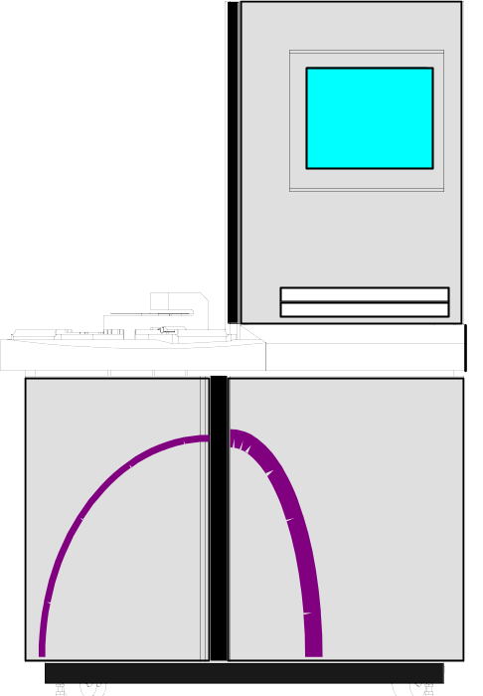

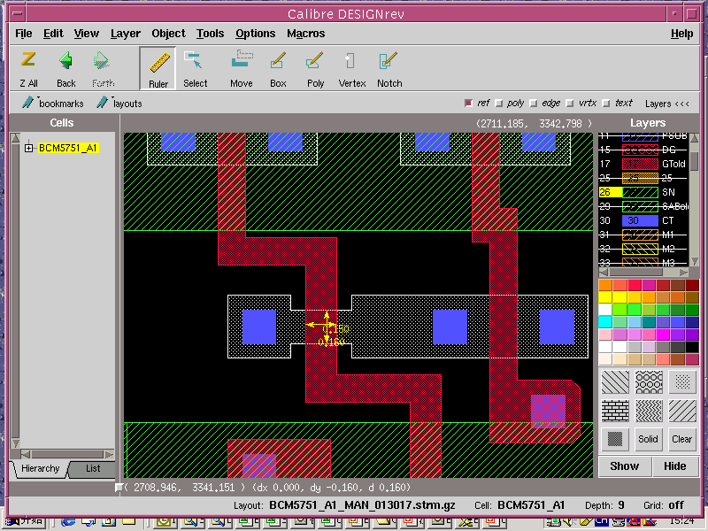
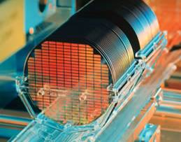
Integrated Circuit (IC) Manufacturing
2. IC Manufacturing
Films
Dep
ASET-F5
Hitachi
5XXX
2401
Etcher
8XXX
Films
Stepper / Track
CD SEM
Overlay
Macro
Etch
CD SEM
Metal 1
P⁺
P⁺
N⁺
N⁺
N-Well
P-Well
3. Fabricated Wafers
1. IC Design

Slide 4
Semiconductor Data Flow
Process data
Continually Defect inspection and review:
inspection tool KLA,compass) review tool: SEM Leica(OM)
Wafer
start
Fab out
WIP (MES, iEMS)
Continually ADI, AEI, CD,etc measurement called metrology
(MES)
Defect
(KLARF)
EQ log
data
MET
WIP
Test data
WAT
WS/CP
FT
Also reliability, memory bit, QC and other data

Slide 5
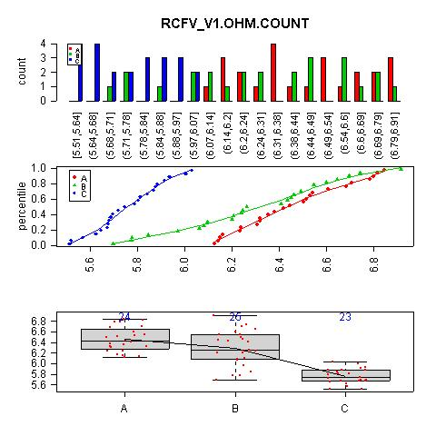
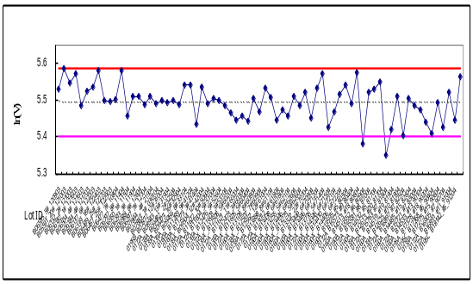
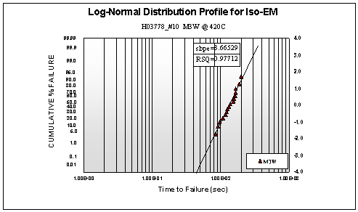
Statisticians at SMIC
Yield Analysis
Quality Control
Reliability Analysis
Price
Improved Yield Ramp
Our Mission:
Original Yield Ramp
Time to Market

Slide 6
R Usage at SMIC
1、线性模型/非线性模型/广义线性模型
  Linear model for inline monitor
  Basic mixed effect model applied to semiconductor data
  Various correlation analyses
2、统计图形：阐述清楚统计原理与图形元素的对应关系
  Useful and interesting plots: histogram w/ splits, plot w/ table (Excel like), wafer map (3-D)
3、非参数统计：各种基于秩的检验以及光滑方法
  Smooth spline usage, EWMA Control Chart
5、多元统计：一方面展示已有方法的应用，如主成分、聚类等，另一方面体现出R在矩阵运算方面的简便
  Wafer pattern classification: clustering analysis
7、数据挖掘和机器学习: Logistic回归、kNN、以及神经网络、SVM等
  Logistic regression application
9、程序接口：C/Fortran/C++/Java等或者R (D)COM、Rserve
  Python / VB / Delphi / mySQL linking with R
  R (D)COM under study

Slide 7


Climb the Mountain Peak of R, Fighting !!!

Slide 8
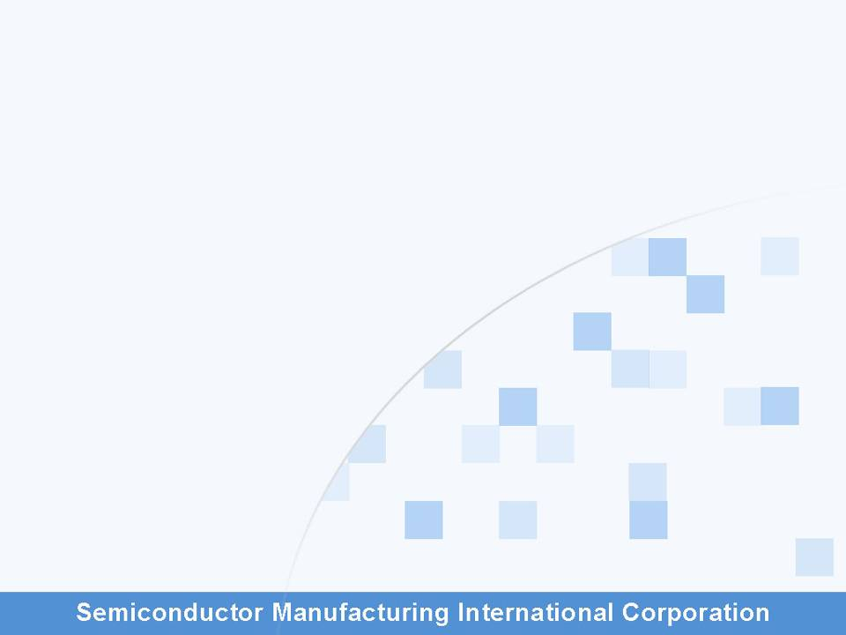
Thank you 谢谢
Q&A 请您提问

Slide 9
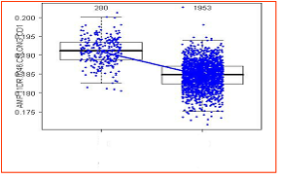
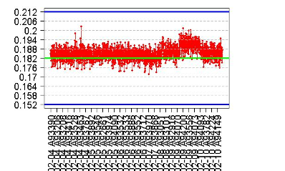
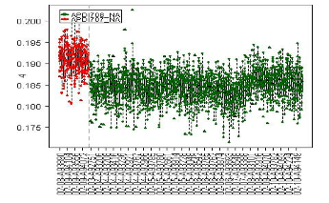
Linear Model for Inline Monitor
  Inline analysis objectives
    Automatically examine ALL metrology items
    Alarm only significant trends and related equipment
Drill Down
A
B

Slide 10

WAT Uniformity Analysis (Mixed Effects Model Example)
Problem Description:
Break WAT parameters variation into lot, wafer & die components;
Highlight large or increasing variance contributors to better control the manufacturing process.
Analysis Method:
Mixed Effects Model: three-level nested linear model;
Applied areas: agriculture, biology, economics, manufacturing & geophysics
Using R (nlme), lot, wafer & die variance components are estimated.
i: lot number 1,2,…a; j: wafer number 1,2,…b; k: site number 1,2,…n.
Reference Book : Mixed Effects Models in S and S-Plus.

Slide 11
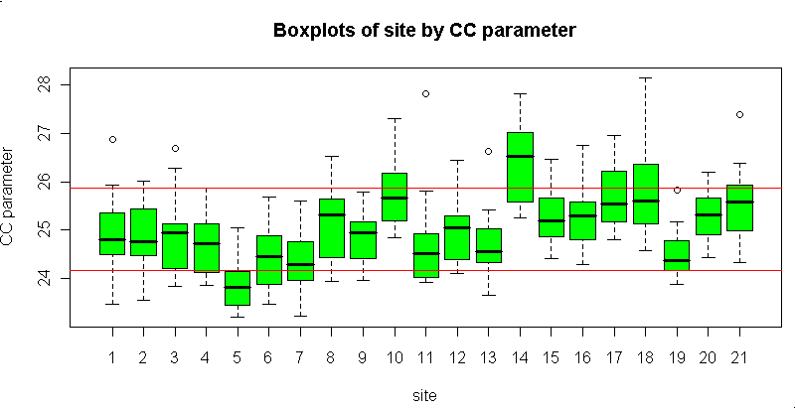
WAT Uniformity Analysis Example Result
Obs
Component
Var Component
% of Total
Sqrt(Var Comp)
1
Lot
0.225
31.6
0.475
2
Wafer
0.419
58.8
0.648
3
Die
0.068
9.6
0.262
4
Total
0.713
100.0
0.844

Slide 12
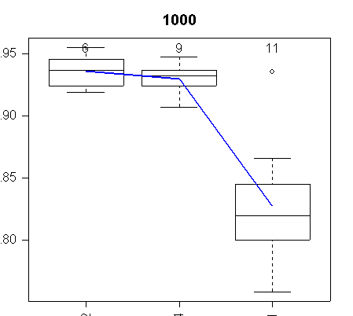
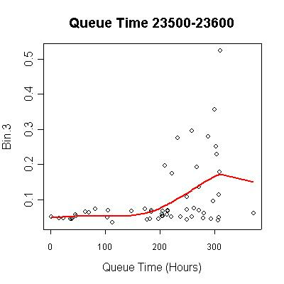
Other Correlation Analyses
Equipment Comparison
Queue Time
9 days
12 days

Slide 13
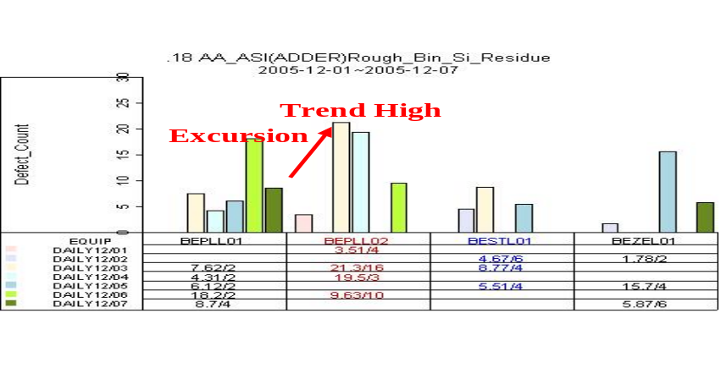
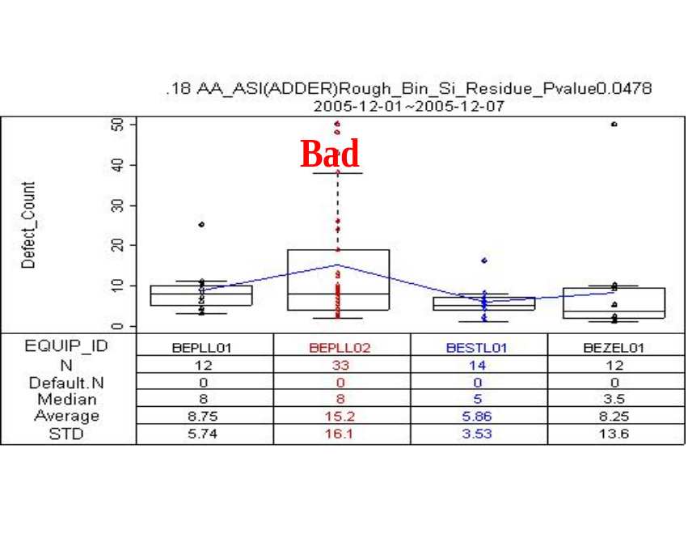
Interesting Plot 1
Histogram plot

Slide 14
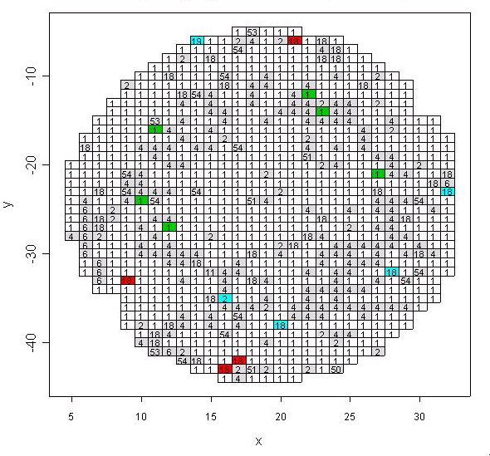
Interesting Plot 2
Wafer Map
Notes:
hhhhhh

Slide 15
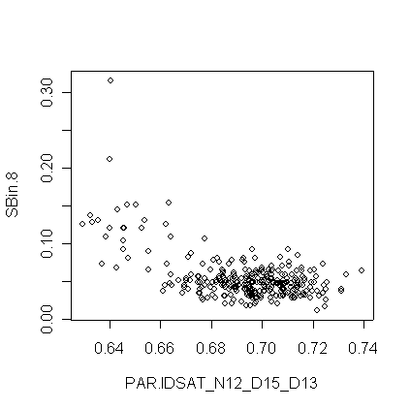
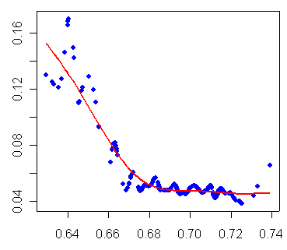
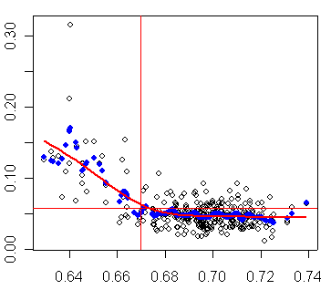
Smooth Spline Usage
Split control limit
  Smooth spline simulates the data for
  reducing noise
Reduce noise
Split

Slide 16
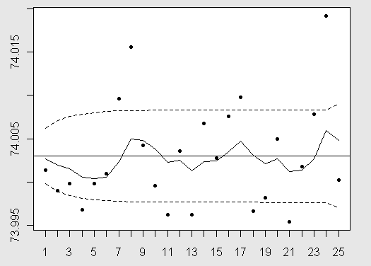
EWMA Control Chart
The Purpose of EWMA Control Chart:
Detect data trend shift ;
Reduce SPC X-bar chart's excursion false alarm rate.

Slide 17
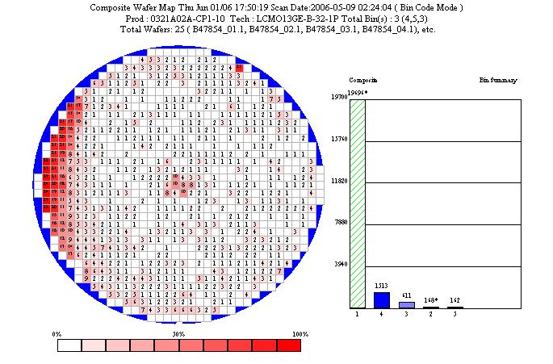
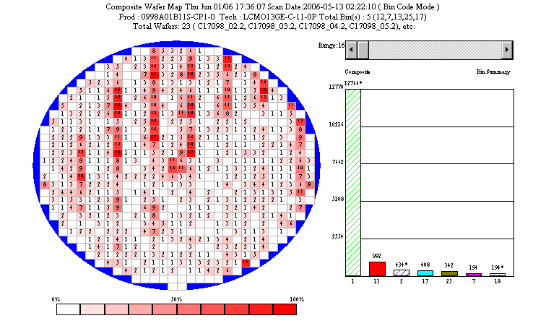
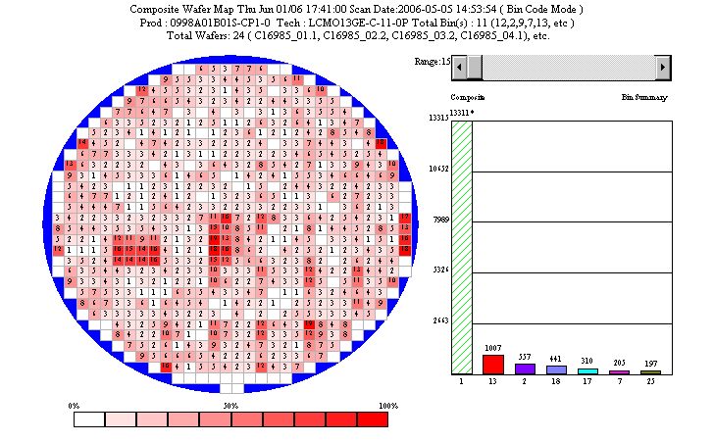
Cluster Analysis
Composite wafers analysis
Cluster fail pattern
Serious edge issue
Periodic fail pattern
Periodic pattern
Continuous fail pattern
Used “neural network like” methods
Block issue
Continuous fail

Slide 18
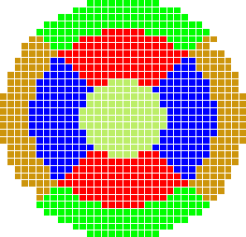
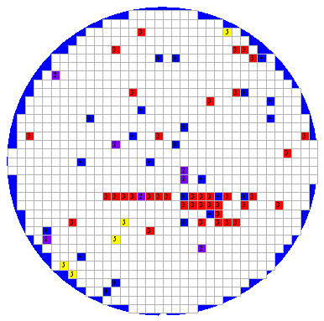
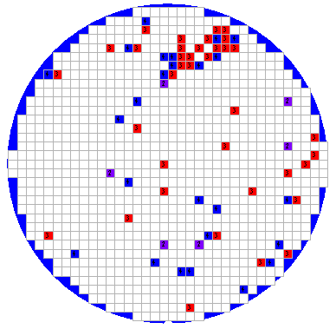
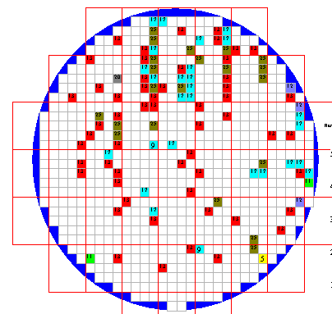
Illustrations for Single Wafer Analysis
Single wafer analysis
Zone pattern
Zone pattern
Continuous fail
Continuous fail
Cluster single & multi bin
Reticle/DUT pattern
Cluster fail
Reticle fail

Slide 19
Procedure Interface / Data Preparation
Procedure Interface :
Python ( Perl ) / VB / Delphi / mySQL linking with R. ( Studying )
Data Convert :
Common use：reshape, merge, sort / order, apply, as.POSIXct….
Purpose：match the format of SMIC data analysis systems .
Data Clean :
Wipe off the influential point , missing data ….
Purpose： prevent “ Garbage In , Garbage out ” .

