Slide 1

Data Mining with R/ORE
Minming Duan
Notes:
Total Number of Slides – 19, Actual Content Slides – 12 …. Plus appendix
Remember: when pasting images, to get around the default practice whereby PPT will paste images as bitmaps …..
Paste to PPT doc
Cut to clipboard
Paste-special as JPEG
This will reduce your overall file size.

Slide 2
iTech Solution Profile
Agenda
1
R/ORE Overview
2
XML output generation using SQL
3
Integration with IBP and BIEE
4
Oracle R for Hadoop Connector
5
R vs. SPSS
6
FAQ

Slide 3
Why analysts use R
R is a statistics language similar to Base SAS or SPSS statistics.
R environment is…
  • Powerful
  • Extensible
  • Graphical
  • Extensive statistics
  • OOTB functionality with many ‘knobs’ but smart defaults
  • Ease of installation and use
  • Free

Slide 4
Limitations of R
R is a client and server bundled together as 1 executable - like Excel
  Single user tool
  Not multi-threaded
  Cannot leverage CPU capacity even on a user's laptop/desktop
R requires data it operates on to be first loaded into memory
  Loading data may not be a limitation given RAM available on laptops/desktops
  R’s call by value semantics means as data flows into functions, for each function invocation, many copies of the data are made
  As a result you quickly run into memory limits

Slide 5
Why should you be interested in R?
Emerging trends
  It’s the next “big thing” in advanced analytics
  Colleges and universities use R for statistics classes
  (replacing more traditional software tools)
  Advanced Analytics as a critical differentiator of the DWH technology stack
Augment Oracle deployments
  Enhance results with powerful graphics
  Integrate R results and graphics with BI Publisher documents and
  OBIEE dashboards
A scalable R via Oracle R Enterprise
  Leverage Oracle-engineered solutions
  A viable alternative to SAS/SPSS

Slide 6
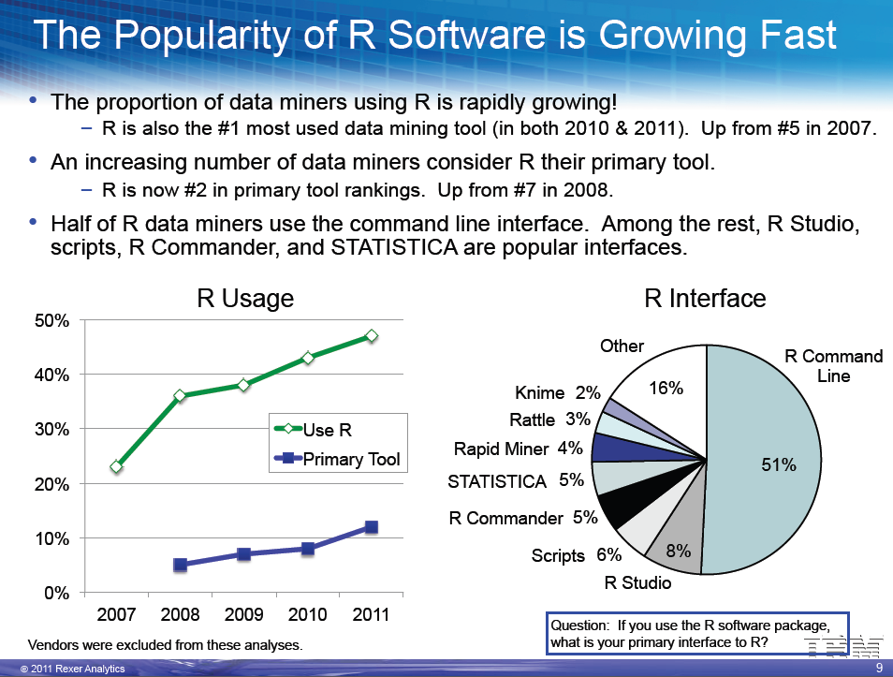
Rexer Analytics Survey 2011

Slide 7
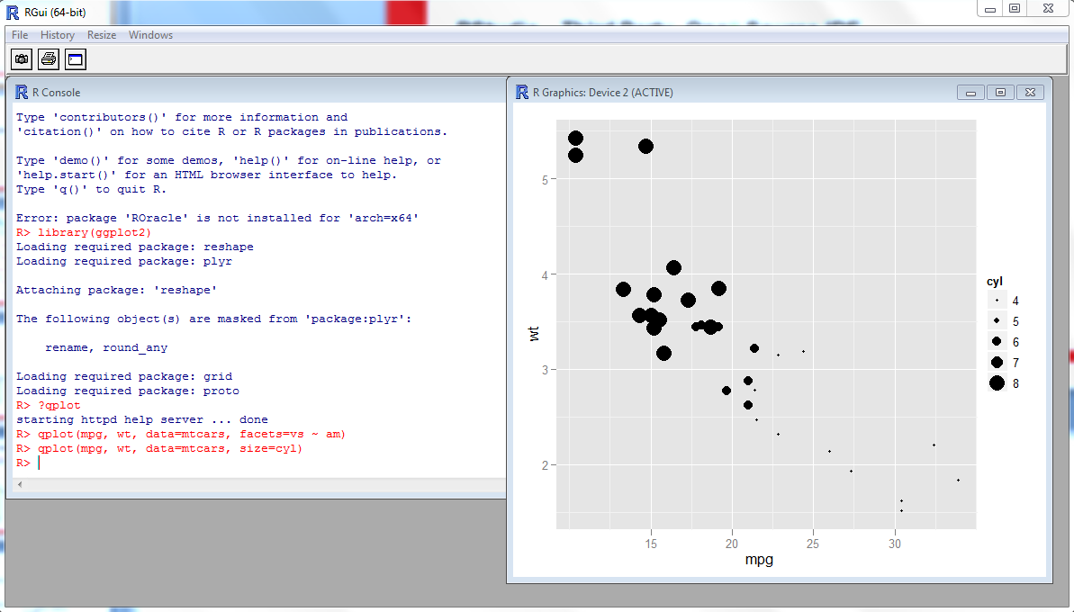
Default R GUI

Slide 8
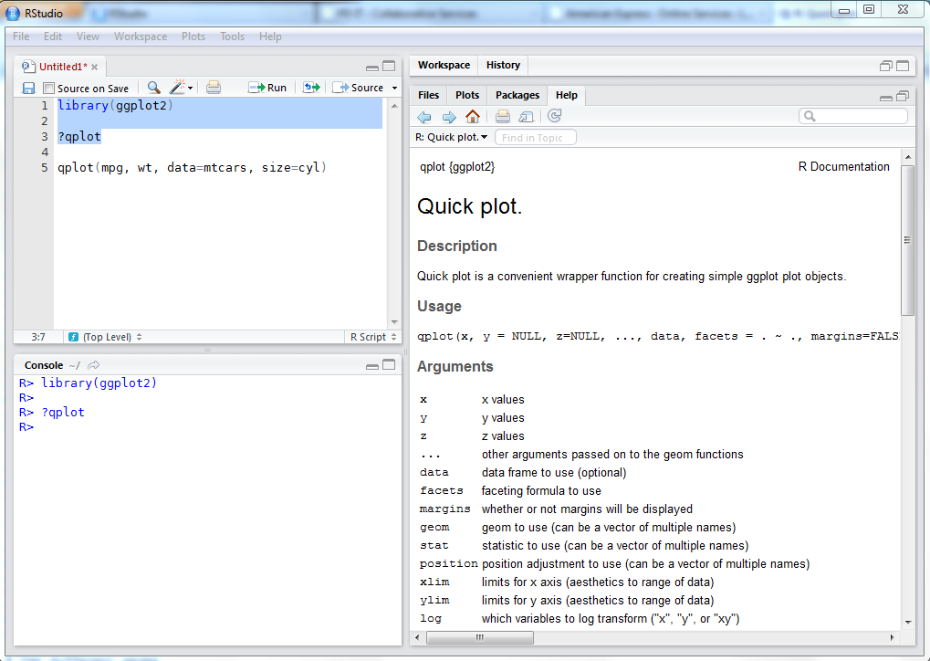
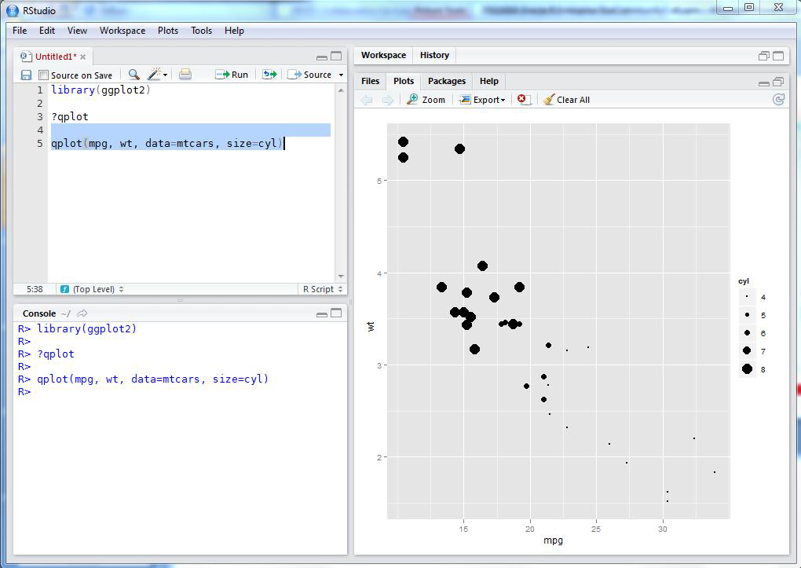
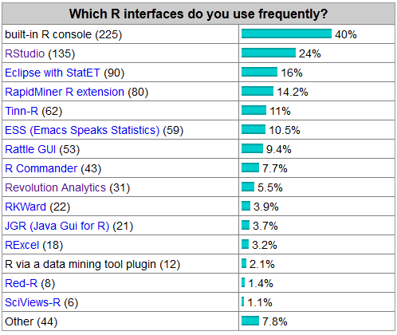
RStudio – Third Party, Open Source IDE

Slide 9


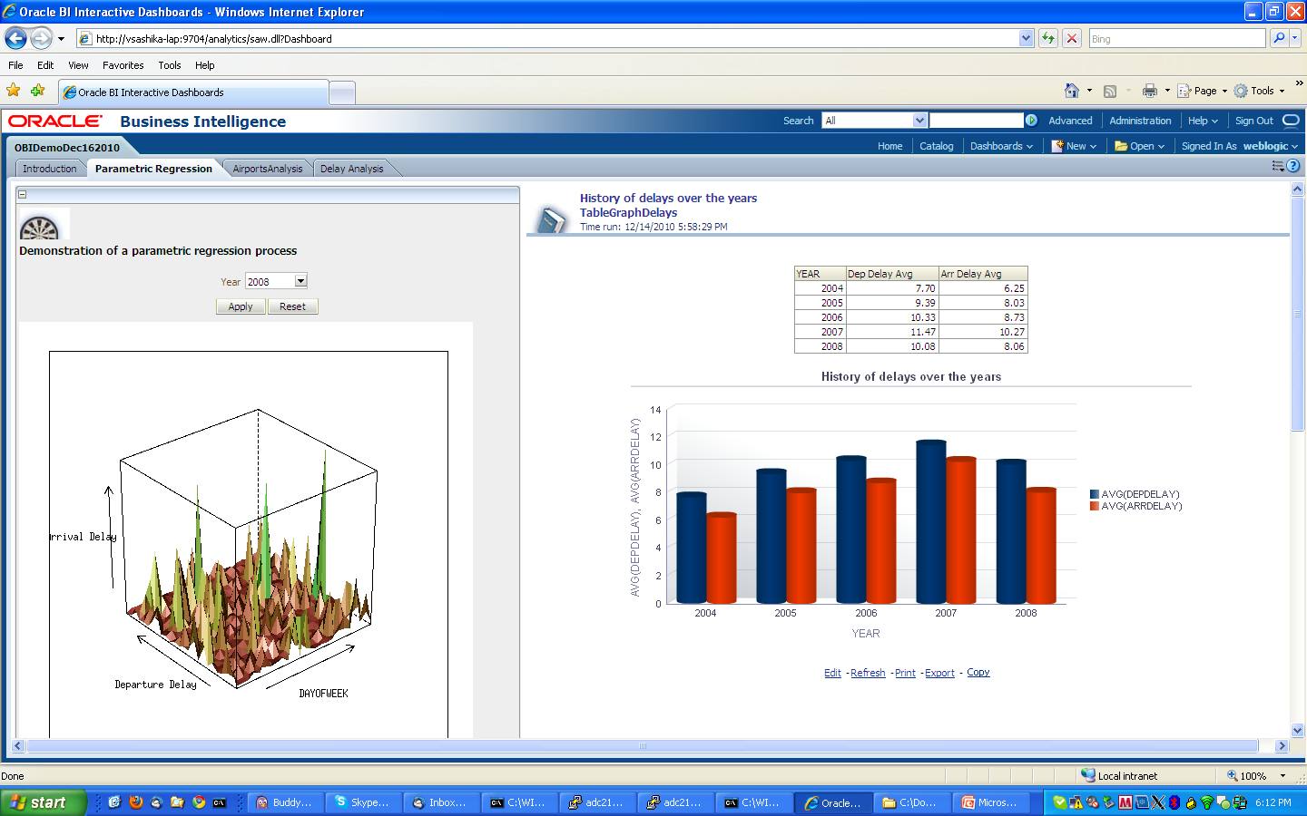
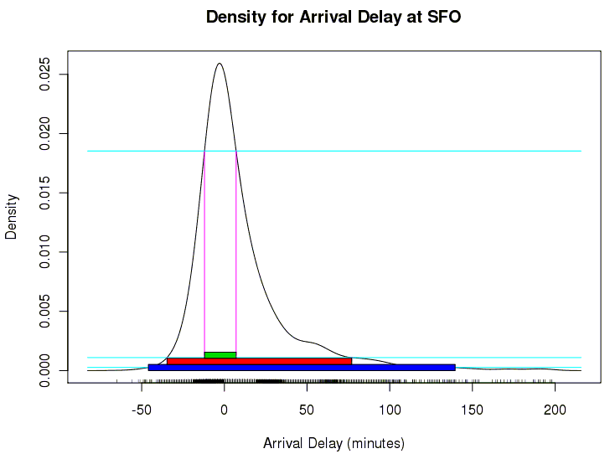
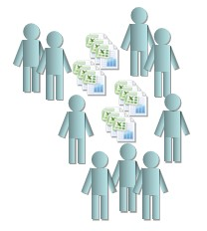
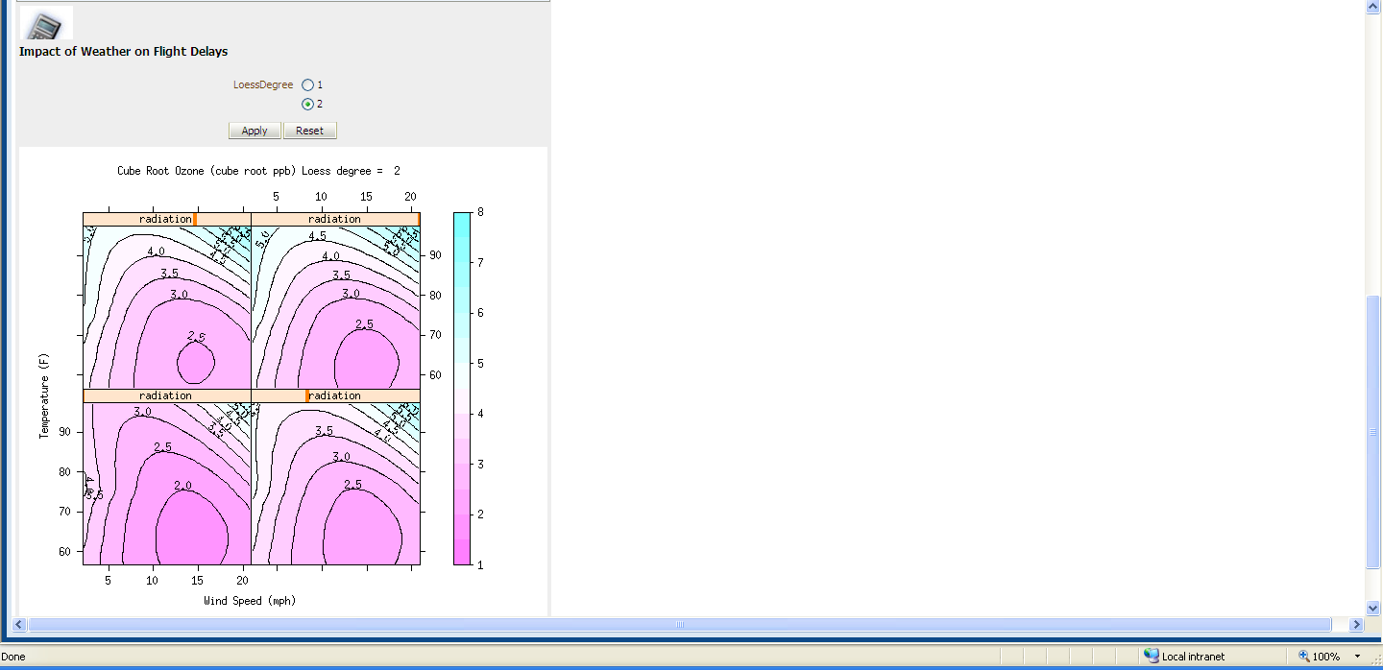

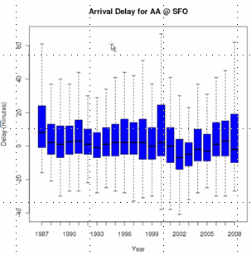
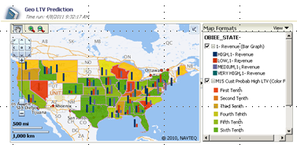



Oracle R Enterprise
R workspace console
Oracle statistics engine
OBIEE, Web Services
Function push-down – data transformation & statistics
No changes to
the user
experience
Scale to large
data sets
Embed in
operational
systems
Development
Production
Consumption

Slide 10


Oracle R Enterprise
R workspace console
Oracle statistics engine
OBIEE, Web Services
Function push-down – data transformation & statistics
Transparently leverage Hadoop for
High Performance Analytics to
Oracle Big Data Appliance
(part of Big Data Connectors software suite)
©2012 Oracle – All Rights Reserved

Slide 11
Oracle R Enterprise – Key messages
Most integrated and complete suite of Enterprise Advanced Analytics software available in the market today
Substantial leap forward from incumbent platforms
  Data volume – using SQL and existing DB functionality
  Data Heterogeneity – Oracle DB + BDA
  Breadth of Analytics – Oracle DB + R packages
  Breadth of User Types – R+SQL+BI report developers, DBAs
Enables enterprise-wide consumption of advanced analytics models via integration with Oracle Exalytics
Notes:
1) data volume: We use SQL and existing database functionality for the most part which is proven
2) heterogeneity - because of oracle database + BDA
3) Breadth of analytics - covers what we have in the database already + R packages
4) User community supported - R developers, SQL developers, BI report developers, DBAs for productionizing R code.

Slide 12
iTech Solution Profile
Agenda
1
R/ORE Overview
2
XML output generation using SQL
3
Integration with IBP and BIEE
4
Oracle R for Hadoop Connector
5
R vs. SPSS
6
FAQ

Slide 13
iTech Solution Profile
Agenda
1
R/ORE Overview
2
XML output generation using SQL
3
Integration with IBP and BIEE
4
Oracle R for Hadoop Connector
5
R vs. SPSS
6
FAQ

Slide 14
iTech Solution Profile
Agenda
1
R/ORE Overview
2
XML output generation using SQL
3
Integration with IBP and BIEE
4
Oracle R for Hadoop Connector
5
R vs. SPSS
6
FAQ

Slide 15
iTech Solution Profile
Agenda
1
R/ORE Overview
2
XML output generation using SQL
3
Integration with IBP and BIEE
4
Oracle R for Hadoop Connector
5
R vs. SPSS
6
FAQ

Slide 16
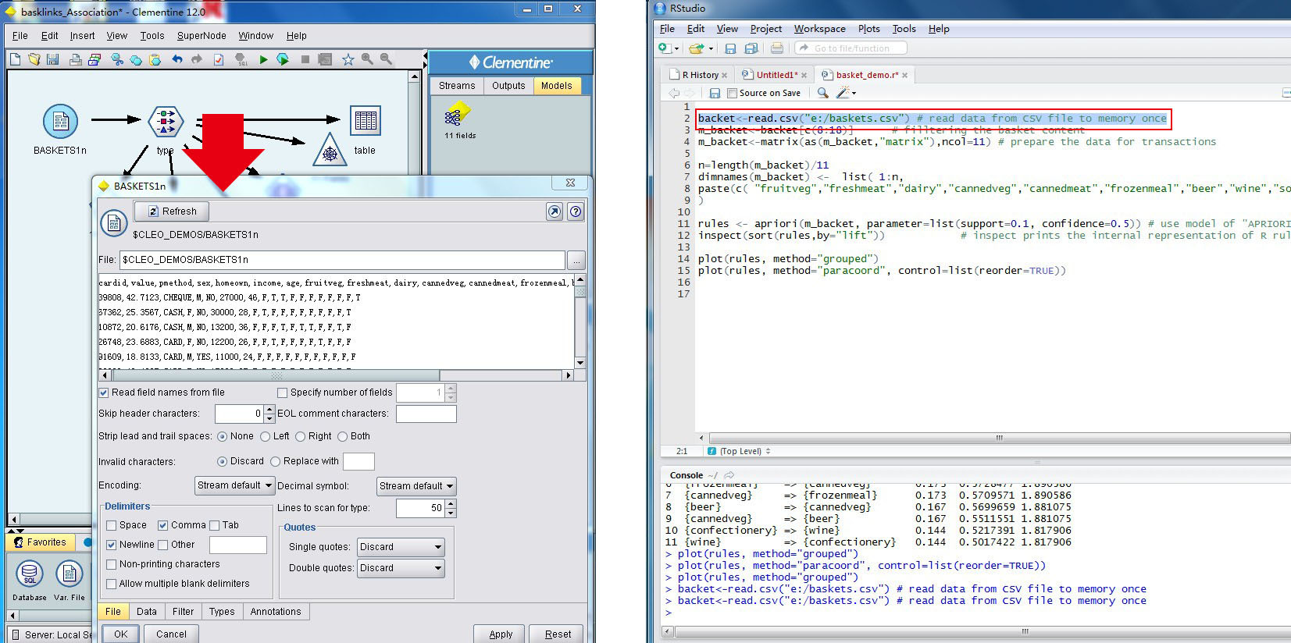
R vs SPSS-data loading

Slide 17
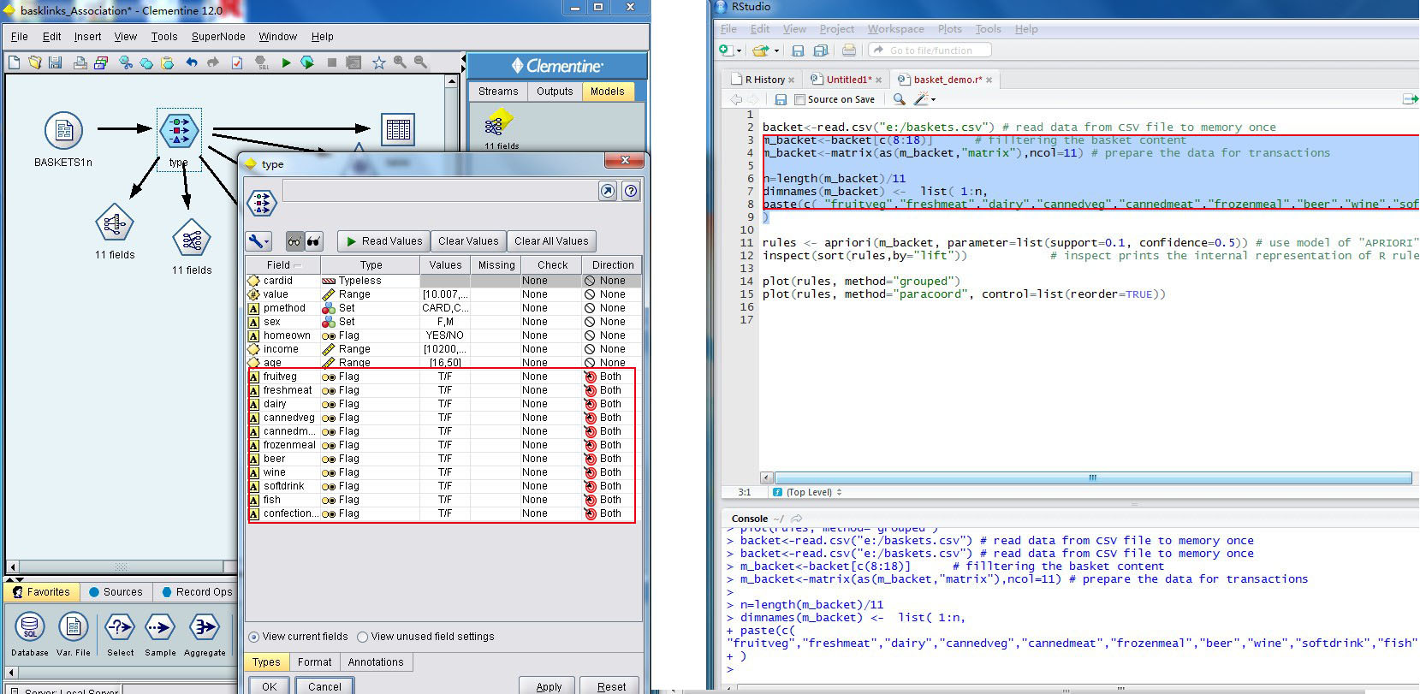
R vs SPSS-processing

Slide 18
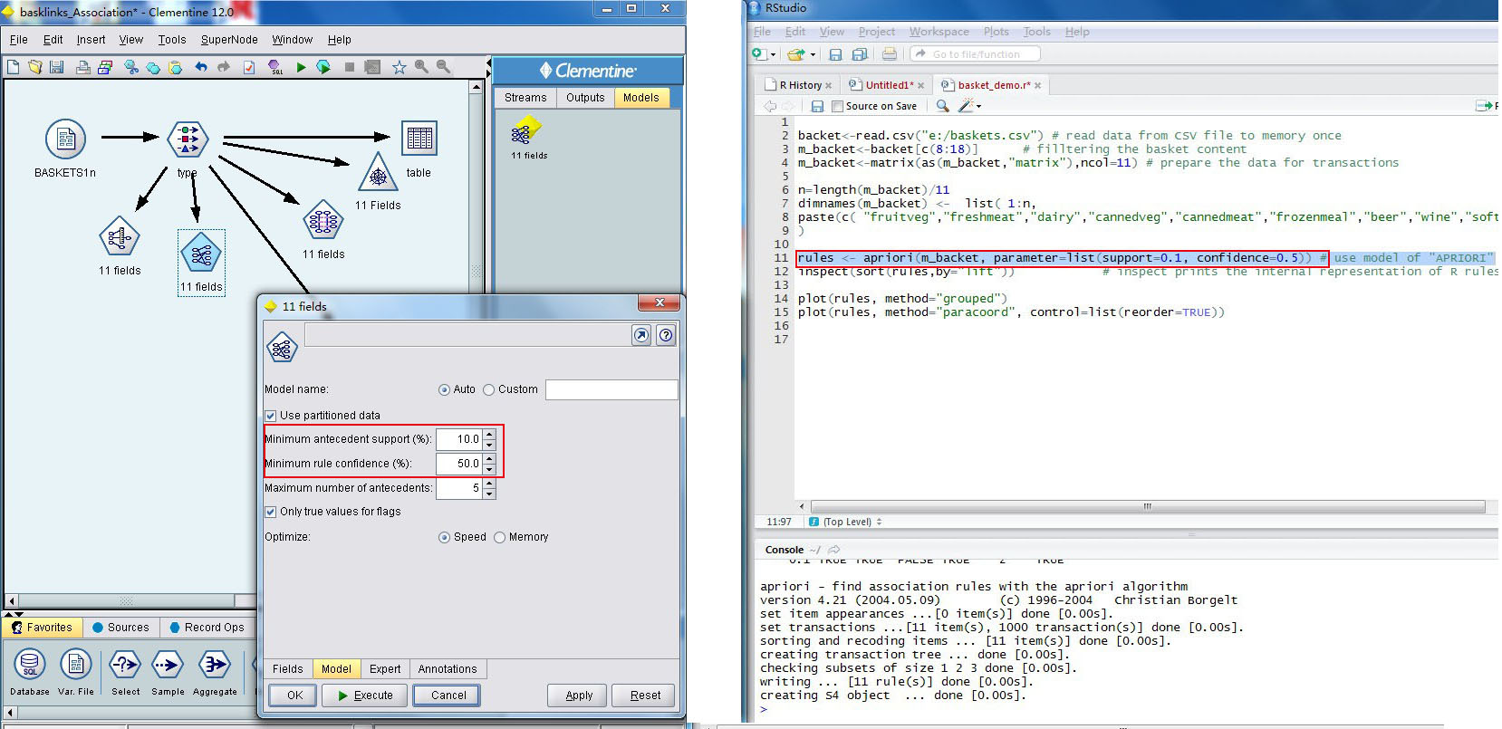
R vs SPSS-modeling

Slide 19
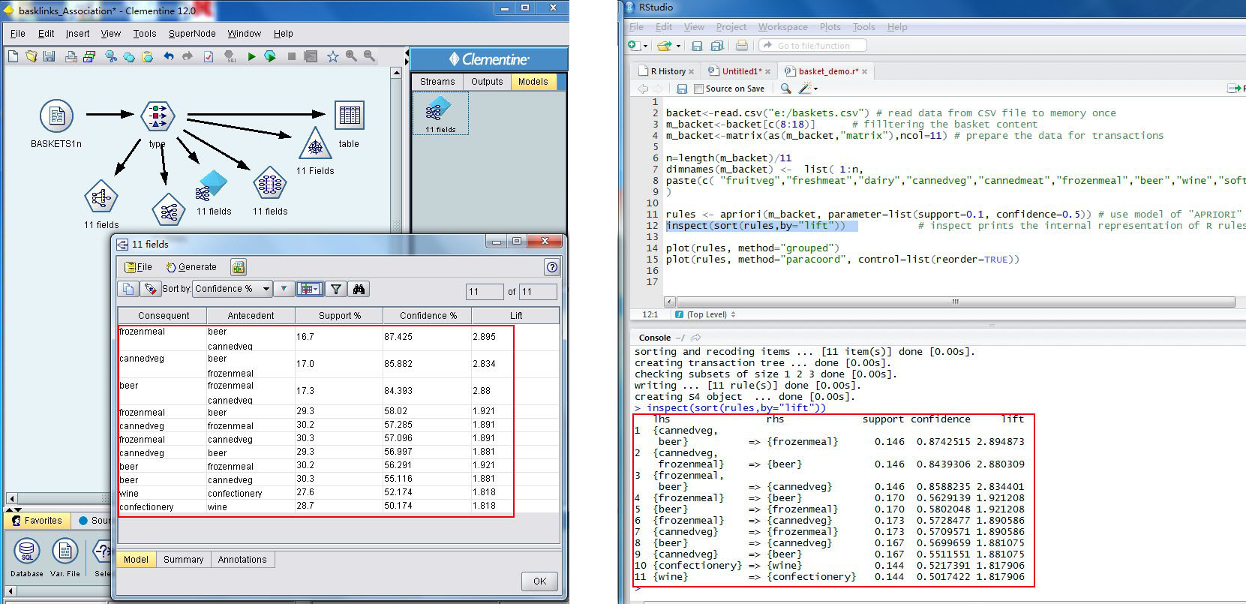
R vs SPSS-results

Slide 20
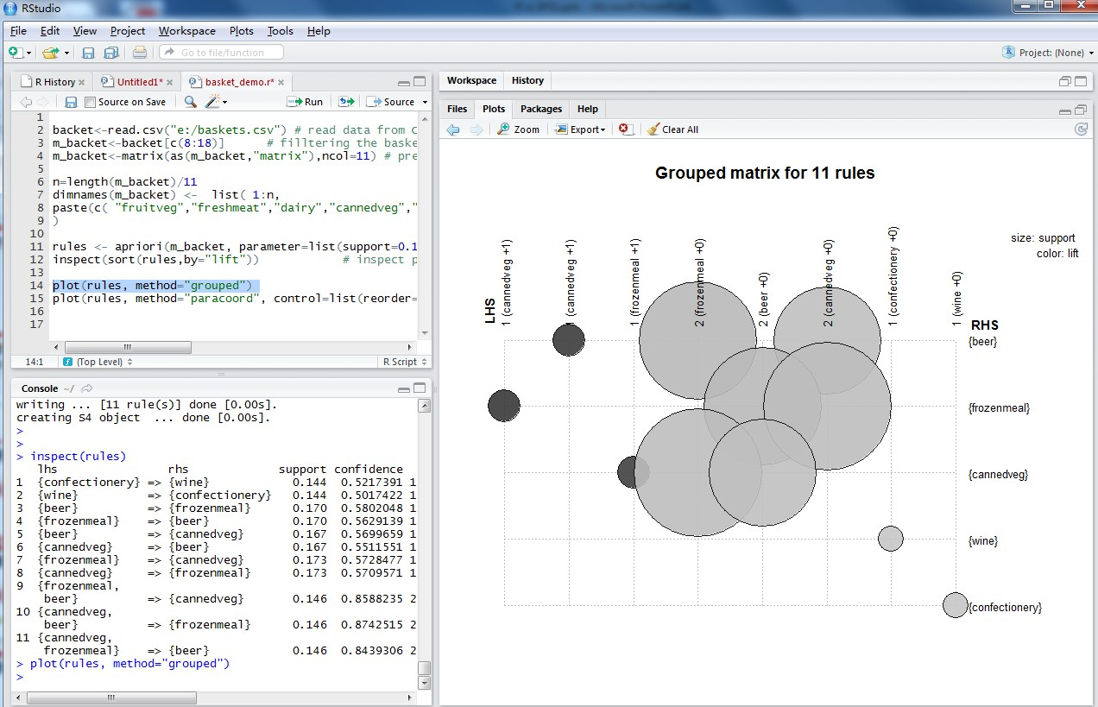
R Visualization

Slide 21
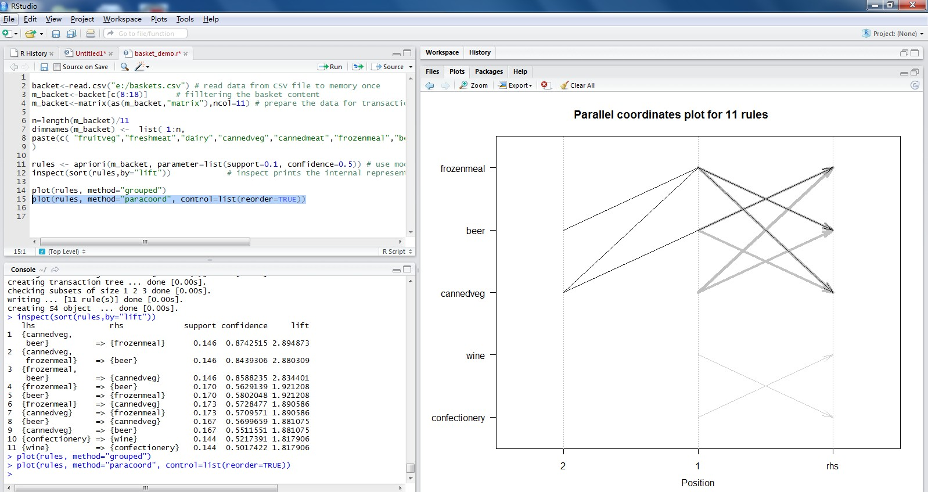
R Visualization-continue

Slide 22
Frequently Asked Questions(FAQ)
What version(s) of R do we support?
  R-2.13.2, however versions R >= 2.12.0 will likely work
What does CRAN stand for?
  Comprehensive R Archive Network
Is there a workflow GUI for R?
  Red-R, see http://www.red-r.org/
What other GUI front ends are there for R?
Are there R interfaces for ROLAP/MOLAP
in Oracle?
  Not yet
Is there an R connector for NoSQL?
  Not yet
http://www.kdnuggets.com/polls/2011/r-gui-used.html

Slide 23
FAQ-continue
Can we use CRAN open source packages in ORE and get the same benefits, e.g., performance, scalability?
  There are benefits, but not the same as from the ORE Transparency Layer
  Users can leverage data parallelism through embedded R execution
What resources are available for learning R / ORE in Oracle?
  See retriever.us.oracle.com
With ORE, is Oracle ANSI SQL enhanced to understand R?
  Using the extensibility framework, SQL table functions exist that can execute R scripts. The SQL syntax itself has not been extended.

Slide 24
FAQ-continue
How does ORE help Exalytics? Is there integration between the two?
  OBIEE dashboards and BIP documents can execute R scripts to generate data and/or graph to be displayed.
  ORE scripts can generate table data for use in an RPD, and hence through Answers
Where do you get the RStudio?
  http://rstudio.org

Slide 25
Q & A
Copyright © 2008, Oracle and/or its affiliates. All rights reserved.

Slide 26
Thanks!

