Slide 1

BootStrap Training
Costa Ivo
Costa_ivo@yahoo.com

Slide 2

HTML
CSS
JavaScript
BootStrap
Contents

Slide 3
HTML

Slide 4
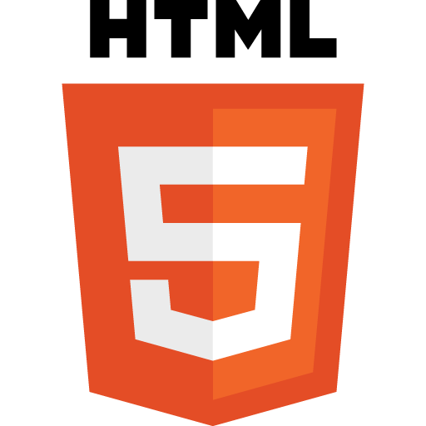
What is HTML?
Hyper-Text-Markup-Language
HTML is a set of pre-defined tags that tells browser
What content to display
How to display the content

Slide 5


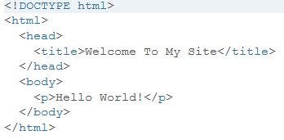







Slide 6



HTML is made up of Tags
Tag tell the browser where the element should start and end.
HTML tag starts with <TagName> and ends with </TagName>
<h1>Hello World!</h1>

Slide 7
CSS

Slide 8

What is CSS?
CSS Stands for Cascading Style Sheets.
CSS descripes how HTML elements are to be displayed on screen, paper or in other media
CSS Saves a lot of work , it can control the layout of multiple web pages at once.

Slide 9
JavaScript

Slide 10

What is JavaScript?
JS is used to program the behaviour of WebPages

Slide 11
BootStrap

Slide 12

What is Bootstrap?
Bootstrap is a free and open source front end development framework for the creation of websites and web apps.
Bootstrap framework is built on HTML, CSS and Javascript (JS) to facilitate the development of responsive, mobile-first sites and apps.

Slide 13
Let the
Web developement Journey Begin..............

