Slide 1

BootStrap Training
Costa Ivo
Costa_ivo@yahoo.com

Slide 2

Contents
HTML
CSS
JavaScript
BootStrap

Slide 3
HTML

Slide 4

What is HTML?
Hyper-Text-Markup-Language
HTML is a set of pre-defined tags that tells browser
What content to display
How to display the content

Slide 5


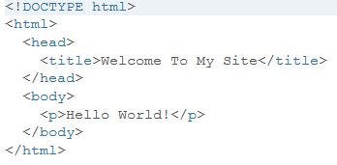







Slide 6



HTML is made up of Tags
Tag tell the browser where the element should start and end.
HTML tag starts with <TagName> and ends with </TagName>
<h1>Hello World!</h1>

Slide 7
CSS

Slide 8
CSS

Slide 9
JavaScript

Slide 10
BootStrap

