Slide 1

Epidemic Models
Theory of compartmental models and hints of epidemic spreading on networks

Slide 2
LECTURE MAP
02
The storyline
One model becomes progressively richer.
1
Exponential growth
2
Compartment idea
3
SI / SIS / SIR
4
R₀ and thresholds
5
Vaccination
6
Networks
Goal: understand what changes the curve: transmission, recovery, susceptibility and contact structure.

Slide 3
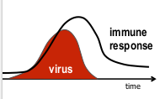

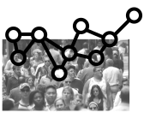
WHAT MAKES AN EPIDEMIC?
03
The 3 ingredients of an epidemic
+
+
Disease natural history
Transmission
Contact patterns
pathogen + immune response
infection moves between people
who meets whom, when, where
Compartmental models compress these ingredients into states and transition rates.

Slide 4
COMPARTMENTS
04
A model as flows between states
Individuals occupy a compartment; equations describe how fast they move.
State variables
S
I
R
S(t), I(t), R(t)
susceptible
infectious
removed / recovered
Transition rates
β: infection*
γ or μ: recovery
Think of ODEs as bookkeeping: “how much leaves one compartment must enter another.”
*if a susceptible enter in contact with an infectious individual he can contract the infection with a probability β per unit time

Slide 5
MASS ACTION
05
The key modelling assumption
Homogeneous mixing: everyone has the same average chance to meet everyone else.
Homogeneous mixing
All individuals behave equally
All individuals have the same number of contacts ⟨k⟩ (no social structure)
Unrealistic, especially for large populations (i.e.regions/countries) but easier math

Slide 6

SI MODEL
06
SI: infection without recovery
S
I
dS/dt = −β S I / N
dI/dt = β S I / N
Use case
Chronic infections or early epidemic approximation.
No one leaves I, so the epidemic saturates only when susceptibles are exhausted.

Slide 7
SI DYNAMICS
07
SI produces a sigmoid curve
Fraction infected in SI
Early phase
almost exponential growth
Late phase
growth slows because few susceptible remain
i(t) = i₀ e^{βt} / (1 − i₀ + i₀ e^{βt})

Slide 8
SI pseudocode
Initialize:
S = initial susceptible population
I = initial infected population
N = S + I
beta = infection rate
dt = time step
For each time step:
new_infections = beta * S * I / N * dt
S = S - new_infections
I = I + new_infections
record S, I

Slide 9
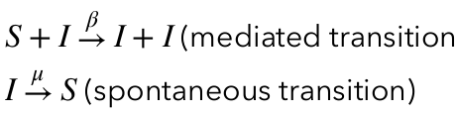
SIS MODEL
08
SIS: recovery without immunity
infection β
S
I
di/dt = β s i − μ i
recovery μ
R₀ = β / μ
Interpretation
Individuals can be infected repeatedly. Useful for diseases without long-lasting immunity.
If R₀ > 1, infection can persist at endemic equilibrium.

Slide 10
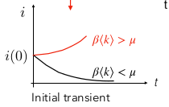
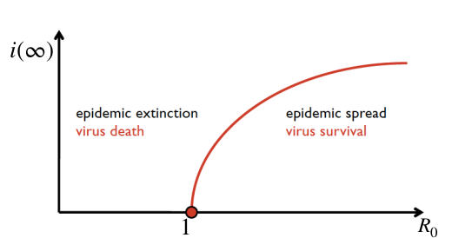

SIS THRESHOLD
09
SIS has an epidemic threshold
Epidemic threshold= minimum value of the infection probability for which the disease survives
Below vs above threshold
Disease-free state
infection dies out
Endemic state
new infections balance recoveries
i* = 1 − 1/R₀

Slide 11
EFFECTIVE R
13
Rₜ decreases as susceptibles are depleted
Early epidemic
Rₜ = R₀ · S(t)/N
S/N ≈ 1, so Rₜ ≈ R₀
Later epidemic
S/N falls, so Rₜ falls
A wave turns around when Rₜ crosses below 1.

Slide 12
SIR pseudocode
Initialize:
S = initial susceptible population
I = initial infected population
R = initial recovered population
N = S + I + R
beta = infection rate
gamma = recovery rate
dt = time step
For each time step:
new_infections = beta * S * I / N * dt
new_recoveries = gamma * I * dt
S = S - new_infections
I = I + new_infections - new_recoveries
R = R + new_recoveries
record S, I, R

Slide 13
SIR MODEL
10
SIR: recovery with immunity
i.e. Kermack and McKendrick model
infection β
recovery γ
dS/dt = −β S I / N
S
I
R
dI/dt = β S I / N − γ I
dR/dt = γ I
Basic model for epidemic waves
Infection gives long-lasting immunity relative to the infectious period.
The population is closed: S + I + R = N.

Slide 14
SIR DYNAMICS
11
SIR creates a wave
SIR trajectories
S decreases
I rises then falls
R increases
The peak occurs before the epidemic is over.

Slide 15
SEIR MODEL
16
SEIR: add a latent period
Why add E?
S
E
I
R
Many diseases have a delay between infection and infectiousness.
exposed
not yet infectious
New parameter
S → E → I → R
σ: incubation / progression rate

Slide 16
INTERVENTIONS
17
Interventions change model parameters
β
distancing
β
masks / hygiene
↓ contacts
↓ transmission
γ
testing + isolation
γ
treatment
↓ infectious time
↑ recovery
In the model, “flattening the curve” means reducing Rₜ by lowering β or shortening infectiousness.

Slide 17
VACCINATION
18
Vaccination adds a protected compartment
Main effects
S
I
R
• fewer susceptible people
• lower effective reproduction number
• smaller and later epidemic peak
vaccination ν
Rₜ = R₀ · S(t)/N
V

Slide 18
MODEL FAMILY
20
Same grammar, different biology
SI
S → I
no recovery
SIS
S ↔ I
no long immunity
SIR
S → I → R
long immunity
SEIR
S → E → I → R
latent period
SIRV
S → V; S → I → R
vaccination
Choose the simplest model that contains the biological mechanism you need.

Slide 19
LIMITATIONS
21
What classical compartmental models hide
—
all individuals behave equally
—
contacts are well mixed
These assumptions are not “wrong”: they are a controlled approximation.
—
parameters are constant
—
space and behavior are compressed
—
data are noisy and delayed

Slide 20
NETWORKS
22
From homogeneous mixing to contact networks
Compartmental mean-field
Network model
everyone interacts with the average population
infection moves only along edges

Slide 21
NETWORK EPIDEMICS
23
Why networks change the epidemic
Degree k
Hubs
number of contacts
individuals with many contacts
Clustering
Components
friends of friends are connected
epidemic may not reach everyone
Same average R₀ can produce different outbreaks if contact heterogeneity differs.

Slide 22
NETWORK THRESHOLD
24
Heterogeneity lowers the epidemic threshold
network threshold depends on degree moments
Intuition
Hubs are both more likely to get infected and more likely to infect others.
roughly: higher ⟨k²⟩ / ⟨k⟩ → easier spread
This is why targeted vaccination or targeted contact reduction can be powerful.

