Slide 1
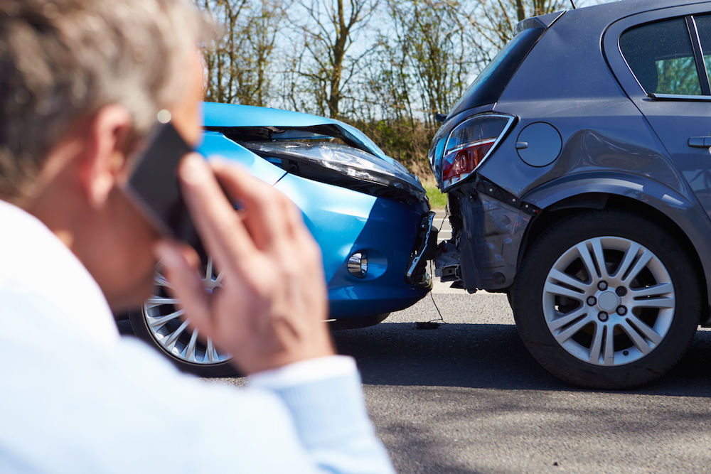
SKETCHING THE FUTURE OF AUTO INSURANCE
Team 2 (Project #9)

Slide 2

INTRODUCTION

Slide 3
Car INSURANCE AS WE KNOW IT
The current insurance market presents many negative and controversial aspects that lead to customer dissatisfaction. To mention some problems:
the price of a car insurance may vary a lot depending on several factors. Considering the fact that the user does not perceive a tangible value or a real experience from a car insurance, it can be perceived as quite expensive.
The process and the contracts themselves can be highly complex and far away from a user-friendly experience.
Insurance companies are able to construct contracts that are favourable or them. Despite the fact that a car insurance can be very expensive, the chances of getting paid out by an insurance are at 5% and it is not even clear how much is covered. Moreover, just 60%-70% of premia are spent on damages.

Slide 4
CURRENT INSURTECH MARKET
Due to recent technological development, the insurance market falls under the radar for technological advancements. A recent report about the Global InsurTech market revealed that the market is expected to grow by 15.63 Billion from 2018 to 2023. This translates to an estimated year-over-year growth of more than 45% for 2019. *³
Blockchain based technologies are seen as an approproiate solution, due to their immutability and transparancy. Additionally, the implementation of smart contracts allows for an automated way of payment. Considering that in the traditional insurance system, payment for claims take weeks or even months, an instant, automated transaction would be a big advancement. Considering the high initial investment cost to implement such a system. Considering the high initial investment cost to implement such a system, the expected entry for blockchain are most likely large short-tail risks, before entering long-term or retail markets. *¹
One of the first implementations in the insurance sector are going to market in the beginning of 2020*²:
B3i is building a platform on distributed ledger technology to create a "single source of truth" in contrast to decentralized and obscure data systems. The ambition is to be able to optimise the processes in the market and reduce the costs significantly.
B3i's concept is that every node processes and verifies each activity. In this way, there exisits a common consensus about the validity of a transaction. Through smart contracting asset transfers are automatically validated and enforced, while they ensure that only the nodes involved in the transaction can access the information.

Slide 5
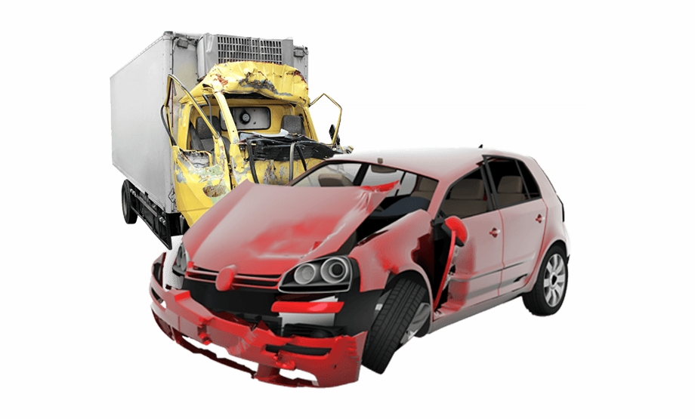
OUR IDEA

Slide 6
PROJECT GOALS
This project aims to address some of the main issues linked to the field of car insurances by implementing a blockchain based smart contracting on Ethereum.
The purpose of this project is to redesign the procedure that starts from the creation of a car insurance contract to the expiration of the contract itself, passing through the management of a car accident and all the related practices.
The major goal and the focus is on making the procedure more efficient and safer. Indeed Blockchain-based networks can from one side secure customer data and improve customer experience, from the side of insurance companies it can prevent frauds, automate payments through smart contracts and therefore reduce the operating costs enhance productivity.

Slide 7
PROCESS FLOW OVERVIEW
The system consists of three main smart contracts:
‘police_report’
It contains all the details of the car accident and its main function is to update the ‘personal_contract’.
‘personal_contract’
It contains all the information about the owner of a car insurance and about his history as a driver.
It's also linked to the ‘insurance_contract’ and feeds it with the information when an accident occurs.
‘insurance_contract’
It's the contract between the driver and the insurance company.
Once it receives the information about the accident it processes all the data and it evaluates if it is possible to provide a compensation or not; if the outcome is positive the insurance should automatically provide for reimbursement.
The implementation of the smart contracts was performed on Remix using Solidity version 0.5.1.

Slide 8
Maybe add a diagram here??

Slide 9
PERSONAL CONTRACT
The personal_contract is created when a person obtains the license. It contains the most relevant information regarding the individual such as: Name, Surname, Birth date, License ID
It has two main functions:
Having all the information about the person, including also his past history, which is a useful tool for insurance companies to calculate the risk premium. Furthermore, since it is based on a blockchain system it is incorruptible, thus the person can’t lie about his previous ‘incident history’ (therefore preventing frauds).
When an accident happens, the police draw up a report with all the information regarding the accident (see below), this report is ‘pushed’ and it updates the personal_contract, which in turn gives an external data feed to the insurance_contract. The latter when receives the information about the accident and starts to process the data.
Essentially, the 'personal_contract' is a sort of ‘incorruptible’ identification card that can be only updated by an official source/node, which is the police (through the police reports). It is useful because the 'insurace_contract’ is based on the information that the 'personal_contract' contains, both regarding the computation of the risk premium and the the resolution of an accident practice.

Slide 10
POLICE REPORT
The 'police_report' is created by the police and it contains all the information about a car accident:
First vehicle involved
Second vehicle involved
Fault ownership
Description of the incident
Damage level
Time at which the report was completed
Since it is drafted by the police, it is an ‘official source’ and its main function is to update the ‘personal_contract’ and to provide all the information necessary for the insurance to assess whether the insured person is entitled to a refund.
We decided not to link the 'police_report’ to the 'insurance_contract', but to let them communicate indirectly through the ‘personal contract’.

Slide 11
INSURANCE CONTRACT
The 'insurance_contract' is the contract stipulated by the insurance to the insured. Its main function is just to evaluate if the fault lies with the insured person or not. If the accident isn't the insured's fault, the insurance can provide automatically the refund to the insured.
This contract has an external data feed from the 'personal_contract', such that when a new accident happens the contract receives new information about it, evaluates it and then decides whether it's correct or not to provide the reimbursement.

Slide 12
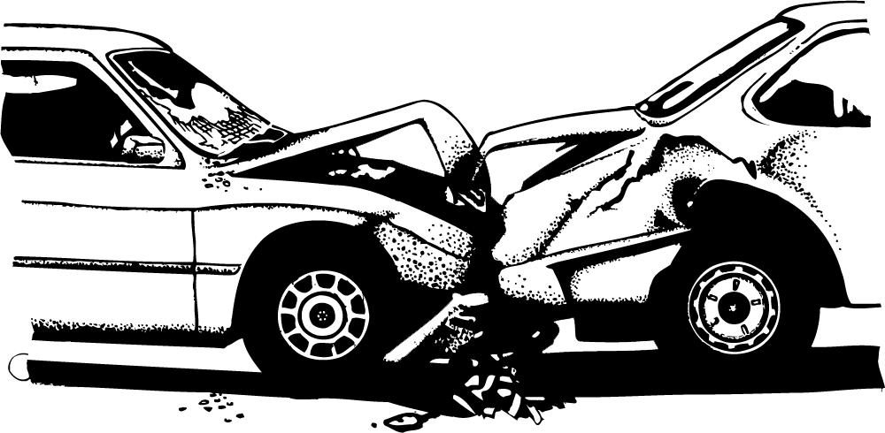
BUSINESS IMPLICATIONS

Slide 13
The economics behind it
Non-life premium growths are globally on the rise, with the US leading the way with an increase of 2.7% of its premium for non-life insurances, with motor segment powering the advance (72.4% of total non-life premiums).
What factors determine the premium of an individual's insurance plan?
Client’s category of risk and behavior
Loading factor → It reflects the insurer’s cost of operating plan
Amount of frauds against the firm
Business automation is expected to reduce the cost of claims by over 30%
Our targets
Insurance companies incur into administrative expenses that are mostly related to personnel and office expenses and time consuming practices (claims processing, data gathering, etc.).
On average, these expenses account for 10% of the GWP (Gross Written Premium) for multiline insurance companies*.
Fraudulent claims payment cost the insurance sector about $80 billion a year across all lines of insurance which is roughly about 20% of the total claims payment annually.
Higher cost of insurance for honest motorist due to high payment of claims that include fraudulent ones.
Notes:
*We took multiline insurance companies as it is impossible with the data we at hand to find specific expenses for vehicle insurance incurred. Multiline insurances (vehicle, property & casualty,) all share a similar cost structure and business model, and are distinguished from life/health insurance.

Slide 14
Business Value
Value created by our proposal:
Reduce inefficiencies: The authomatic data-entry process of clients' information through our set of Smart Contracts makes the old practices obsolete, while guaranteeing security over the management of personal data of customers.
Fraud reduction: We provide an immutable historical record (Personal Contract) which once updated by the Police Report, can independently verify customers, policies and transactions for authenticity. Since blockchain increases transparency, data becomes immutable and reliable witihin our framework.
The more reliable the data, the less room for mistakes which means insurance companies can better meet the ever-evolving needs of policyholders.
Claim Processing: Through our set Contracts, both parties would benefit from managing claims in a responsive and transparent way. The main advantages are:
Customizable → Our Contracts can accommodate the parameters of a policy and execute action automatically through trustless identity verification;
Authomatic → The funds can then be automatically directed to the correct party when a verified event (a claim) triggers the «Insurance Contract» on the Ethereum blockchain;
Fast → Settling a claim can take days or weeks, whereas our smart contracts can settle claims instantly without the need for paper documents, photocopying, and complex web portals.

Slide 15

Thank you!
Adobati Mirco, Basigalup Paula, Colombo Vittorio, Costanzi Martina, Utke Sharlyn

