Slide 1

Full-Stack Development

Slide 2
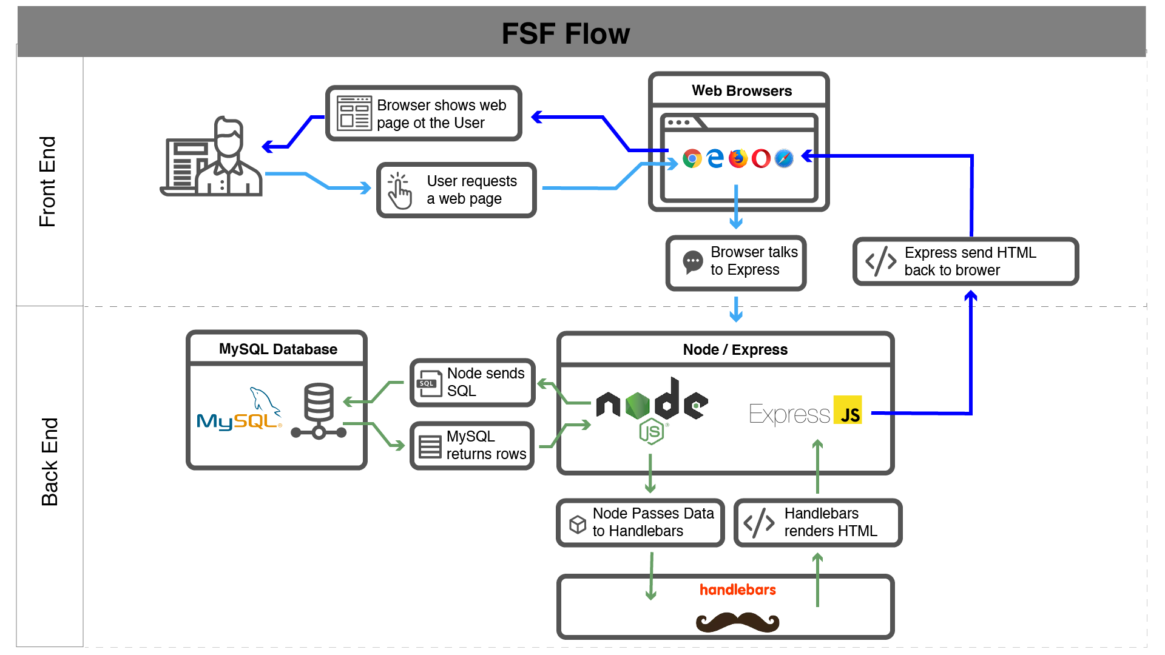
Full-Stack Development

Slide 3
Full-Stack Development
Browser
Dev Ferramentas
Servidor
HTML
CSS
JavaScript
jQuery
Bootstrap
Git
GitHub
Heroku
Node.js
Express.js
Creating APIs
User Authentication
Tests
Python (+Django)
Base de dados
MySQL
MongoDB
API integração
APIs (Consuming)
JSON
AJAX
Real Time Cloud Database via Firebase
Novidades
Algorítimos
React.js
Fundamentos
Notes:
In this course, you’ll learn everything you need to be able to do this –
you’ll be able to build complex web applications even as a single developer.
Questions?

