Slide 1

Full-Stack Development

Slide 2
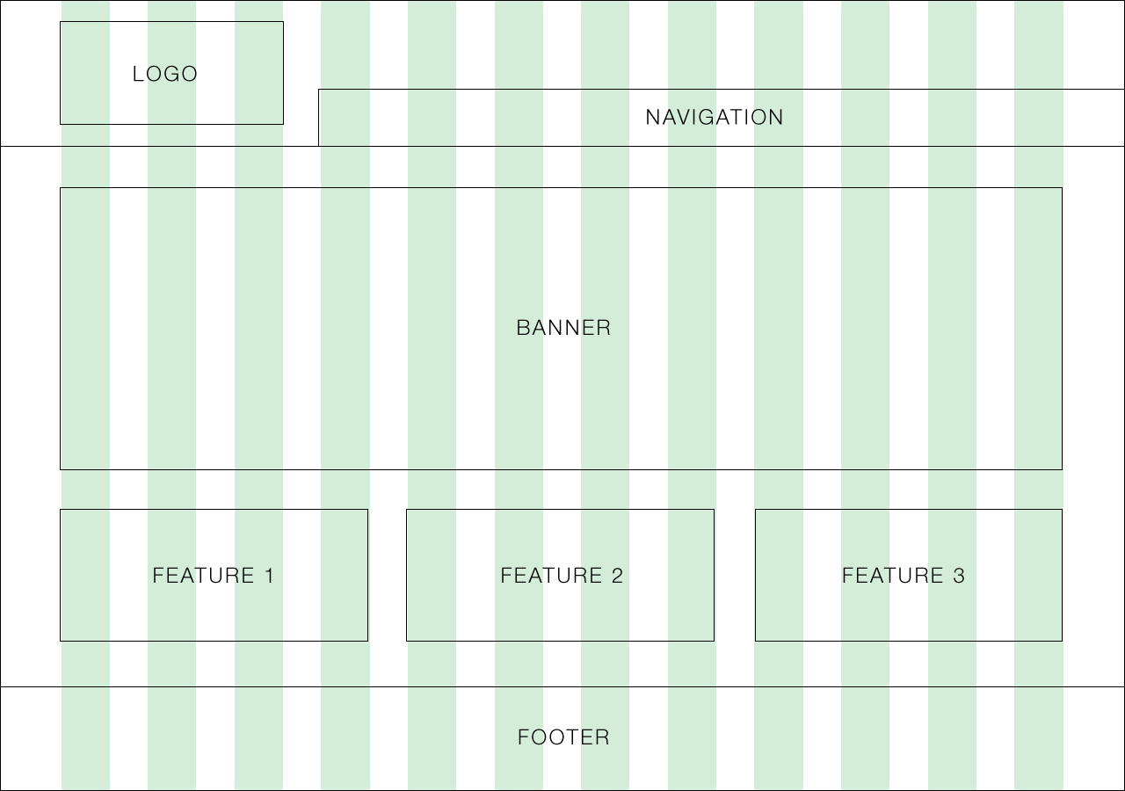
Full-Stack Development

Slide 3

Full-Stack Development

Slide 4

Full-Stack Development

Slide 5
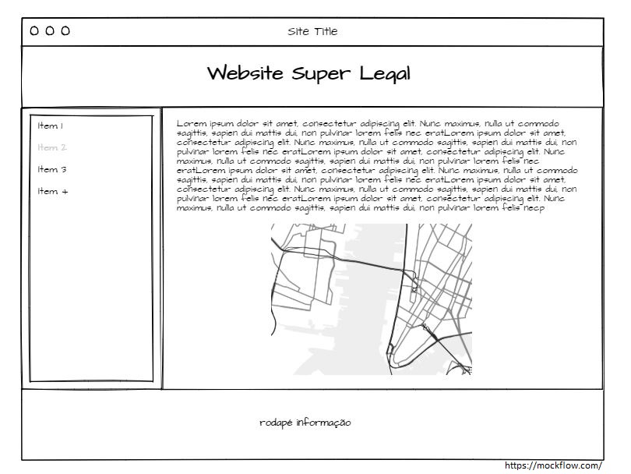
Full-Stack Development

