Slide 1
SHAP Values
ΕΘΝΙΚΟ ΜΕΤΣΟΒΙΟ ΠΟΛΥΤΕΧΝΕΙΟ
Μέξης Κωνσταντίνος

Slide 2
SHAP

Slide 3
SHAP (SHapley Additive exPlanations)
Linear models use their coefficients as a metric for the overall importance of each feature
The coefficients cannot account for the local importance of the feature, and how it changes with lower or higher values
The same can be said for feature importances of tree-based models
This is why SHAP is useful for interpretability of models

Slide 4
SHAP (SHapley Additive exPlanations)
Method to explain individual predictions
Based Shapley Values from cooperative game theory
  A prediction can be explained by assuming that each feature value of the instance is a “player” in a game where the prediction is the payout
  Shapley values tells us how to fairly distribute the “payout” among the features

Slide 5
SHAP (SHapley Additive exPlanations)
SHAP comes with many global interpretation methods based on aggregations of Shapley values
SHAP explains the prediction of an instance x by computing the contribution of each feature to the prediction
  A player can be an individual feature value, e.g. for tabular data
  A player can also be a group of feature values

Slide 6
SHAP (SHapley Additive exPlanations)
SHAP comes with many global interpretation methods based on aggregations of Shapley values
SHAP explains the prediction of an instance x by computing the contribution of each feature to the prediction
  A player can be an individual feature value, e.g. for tabular data
  A player can also be a group of feature values

Slide 7
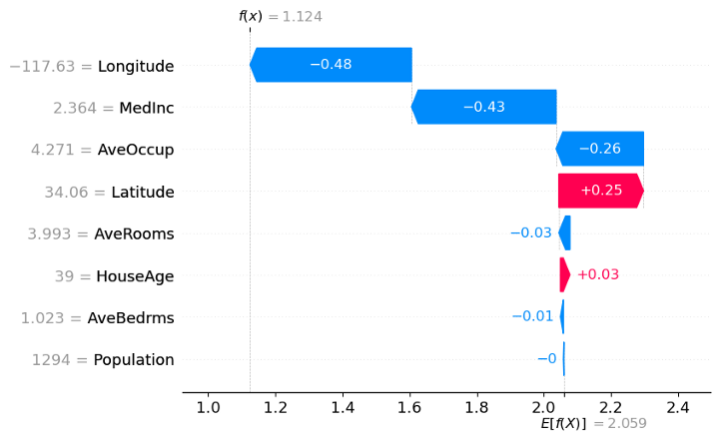
SHAP Waterfall
  X-axis: values of the target (dependent) variable
  x: the chosen observation
  f(x): the predicted value of the model, given input x
  E[f(x)]: the expected value of the target variable (mean of all predictions)

Slide 8
SHAP Waterfall
  The SHAP value for each feature in this observation is given by the length of the bar
  The sum of all SHAP values is E[f(x)]-f(x)
  The absolute SHAP value shows how much a single feature affected the prediction
  Note that these SHAP values are valid for this observation only.

Slide 9
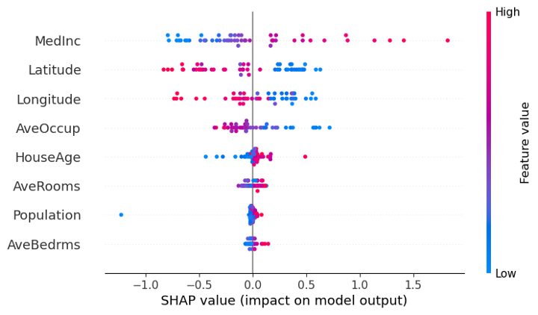
SHAP Beeswarm
  Understand the importance or contribution of the features for the whole dataset
    E.x. high values of the Latitude have a high negative contribution on the prediction, while low values have a high positive contribution
    Population has almost no contribution to the prediction, whether its values are high or low
  All variables are shown in the order of global feature importance

Slide 10
SHAP Beeswarm
  Understand the importance or contribution of the features for the whole dataset
    E.x. high values of the Latitude have a high negative contribution on the prediction, while low values have a high positive contribution
    Population has almost no contribution to the prediction, whether its values are high or low.

