Slide 1

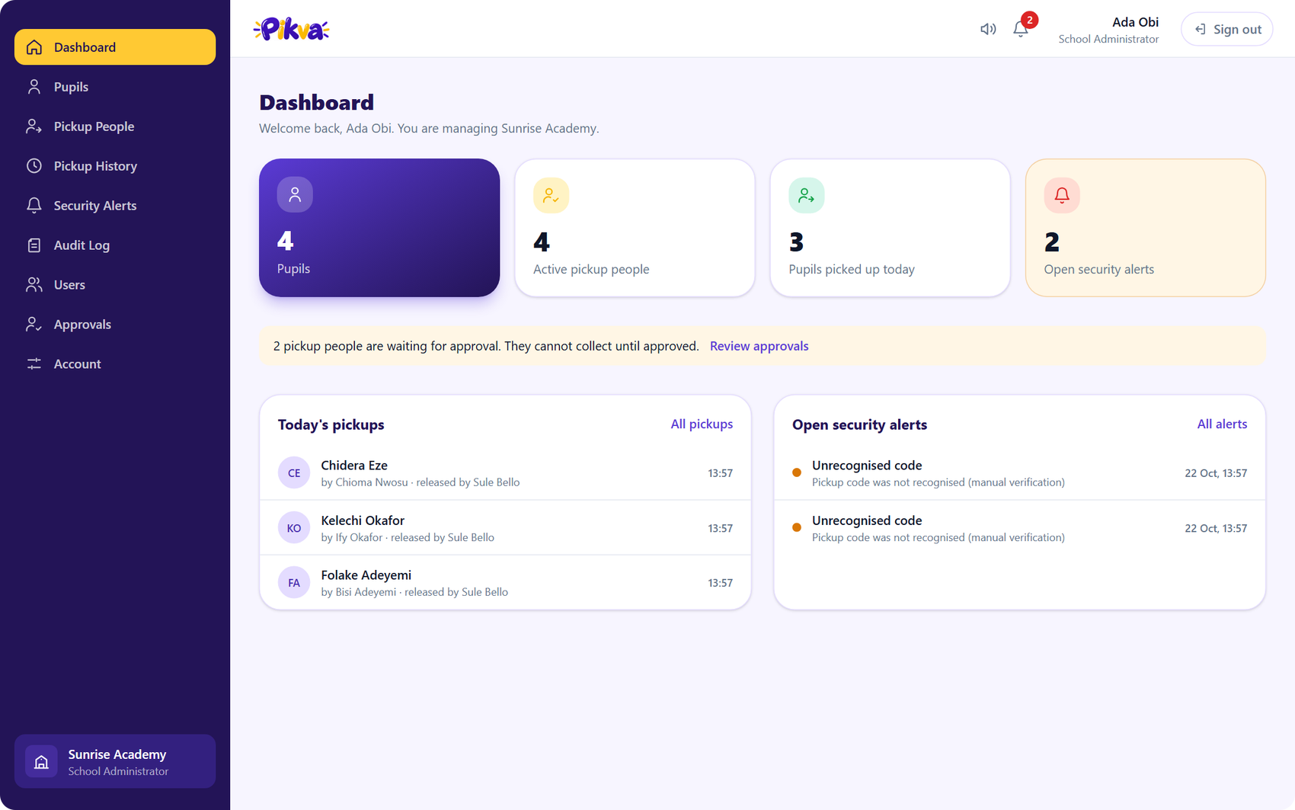
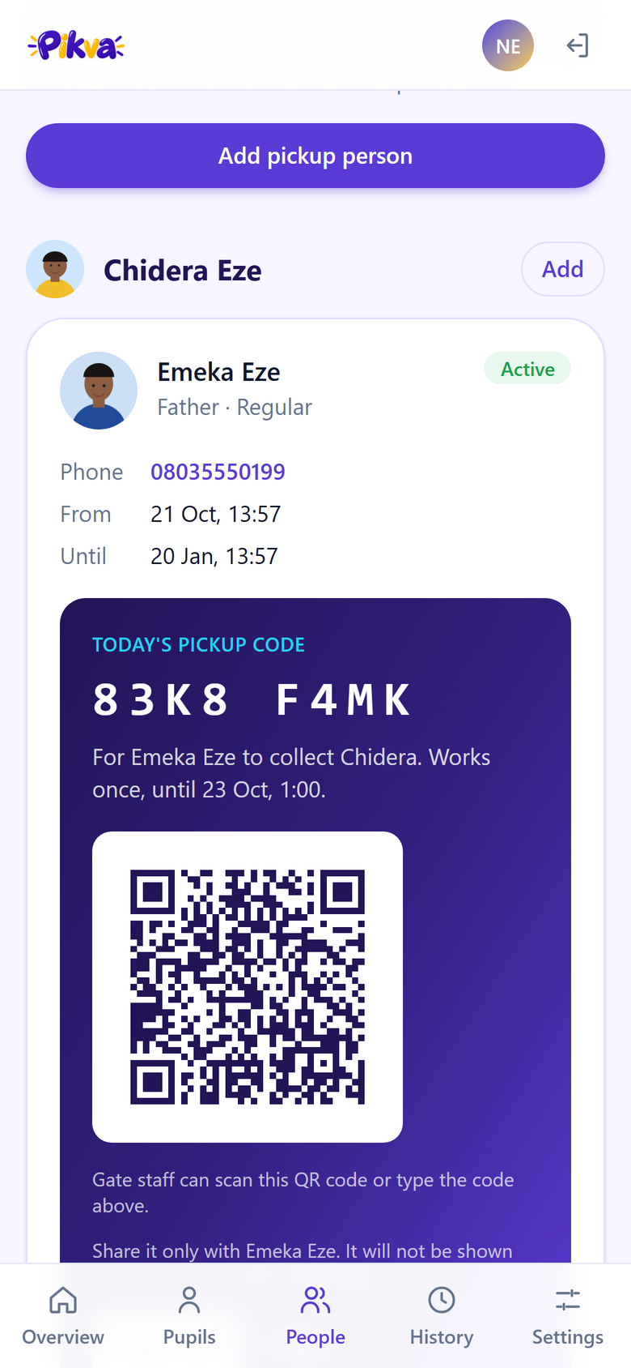
Send every child home with the right person.
Authorise · Approve · Verify · Record
Live project demo · Screens show the running app with demo data
Notes:
Open with the problem in one sentence: schools hand children to whoever turns up. Pikva makes the handover provable. Everything you see in this deck is the real running web app with demo data.

Slide 2



Pickup is the riskiest minute of the school day
Only authorised people
Every handover verified
Nothing unrecorded
Parents name who may collect. The school approves each person before they ever can.
A single-use daily code, shown as text and QR, checked at the gate against a photo.
Who collected, who released and when. Failed attempts raise alerts straight away.
Today: a name on a list, or a familiar face. With Pikva: a rule the whole school follows.
Notes:
Three promises: authorised, verified, recorded. Each one maps to a screen we will see next.

Slide 3





How a pickup works, end to end
1
2
3
4
5
Parent adds
School approves
Code issued
Gate verifies
Pupil released
Names a pickup person and uploads their photo
Admin reviews and approves before anyone can collect
Parent gets today's one-time code and QR
Staff check the code and match the face to the photo
Logged in history and the audit trail
PARENT
SCHOOL ADMIN
PARENT
GATE STAFF
AUTOMATIC
Three roles, three screens: the parent authorises, the school controls, the gate decides.
Notes:
This is the storyline for the live demo: add a person as a parent, approve as admin, issue the code, verify at the gate.

Slide 4
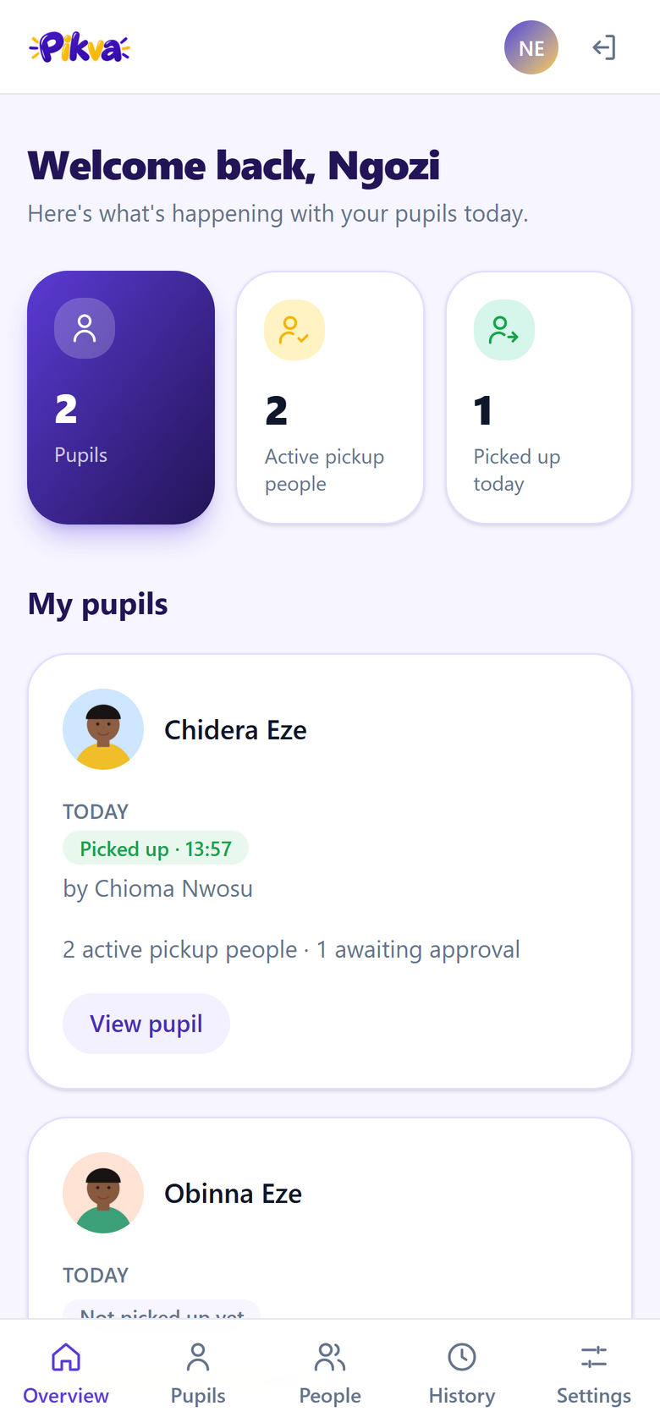
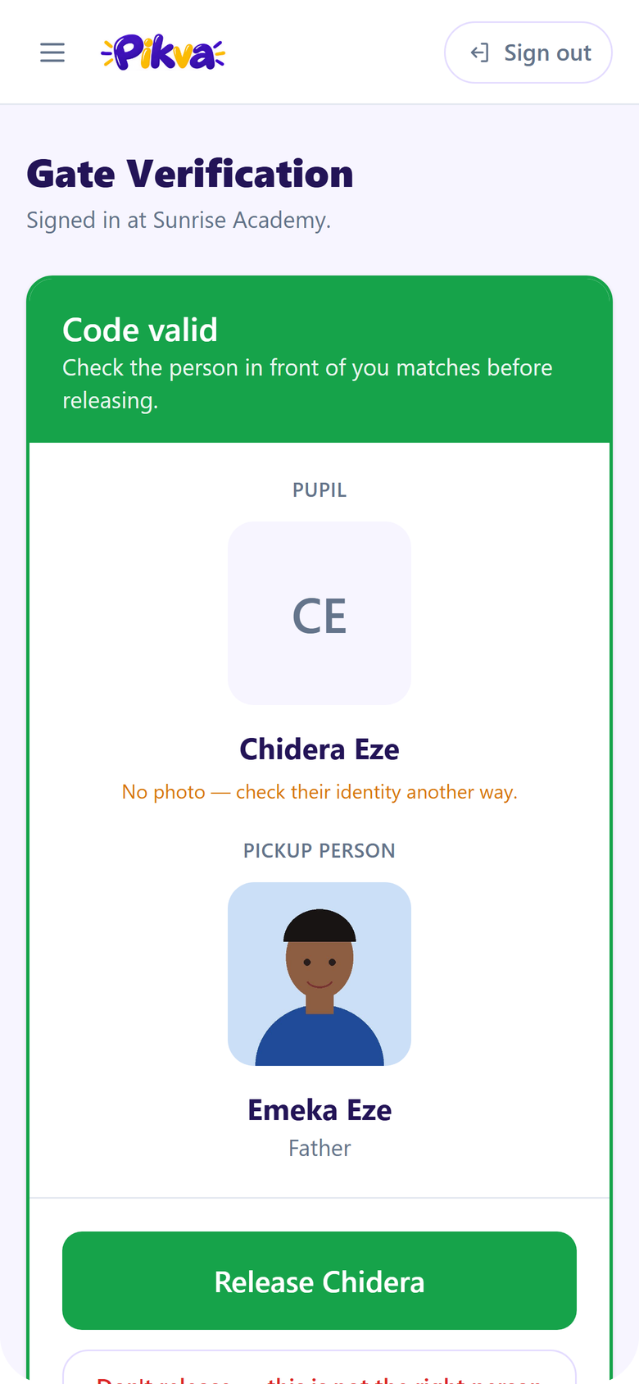
One platform, three people
School admin
Runs the school's setup, approves people, watches alerts and history.
Parent
Gate staff
LAPTOP OR DESKTOP
Authorises pickup people and gets the daily code. Works on a phone.
Checks the code, compares the photo, releases or refuses.
Notes:
The same web app serves all three roles. After sign-in, each person lands on their own home and only sees their own menu.

Slide 5
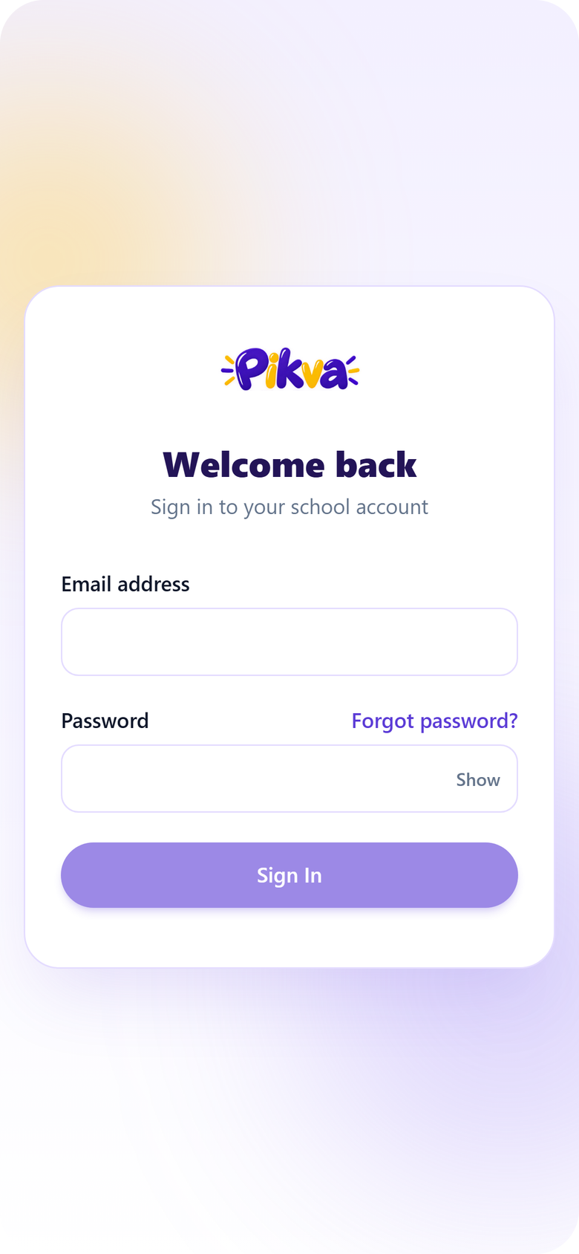
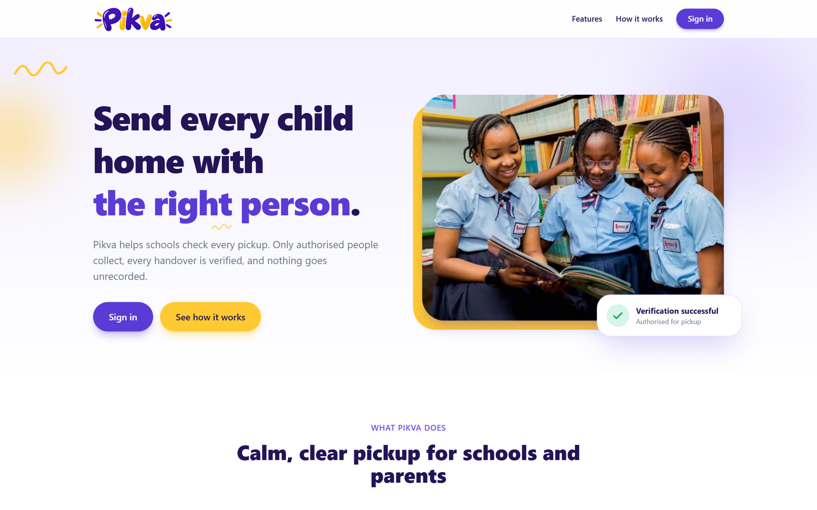
A clear front door
Public landing page
Explains Pikva in one screen. Schools sign in; there is no open sign-up.
Notes:
The landing page and sign-in are the only public screens. School accounts are created by the Pikva operator, not self-service.

Slide 6




School admin: the whole school at a glance
Live numbers
Pupils, active pickup people and pickups today.
Approvals waiting
A banner links straight to the review queue.
Security alerts
A bell with a count, a sound and a push notification.
Today's pickups
Who collected whom, released by which staff member.
Notes:
Show the dashboard first when you sign in as the admin. Point at the red bell count and the approvals banner.

Slide 7
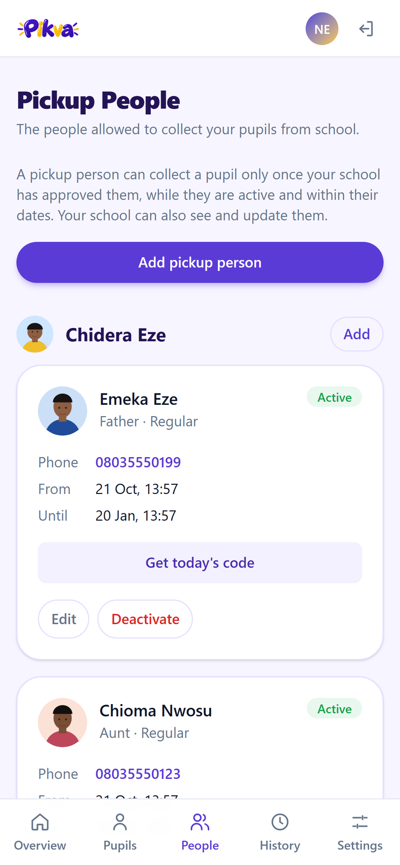
Parent: authorise people from a phone
1 See your children
2 Add a pickup person
3 Get today's code
Overview with each child and their pickup people.
Name, phone, dates and a photo from the device.
A one-time text code and a QR for the gate.
Notes:
Live demo: add a pickup person with a photo, then show the awaiting-approval badge. After approval, tap Get today's code.

Slide 8
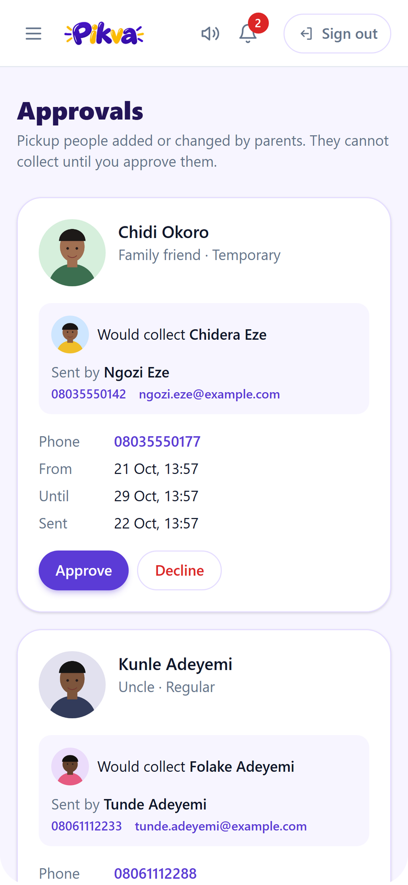
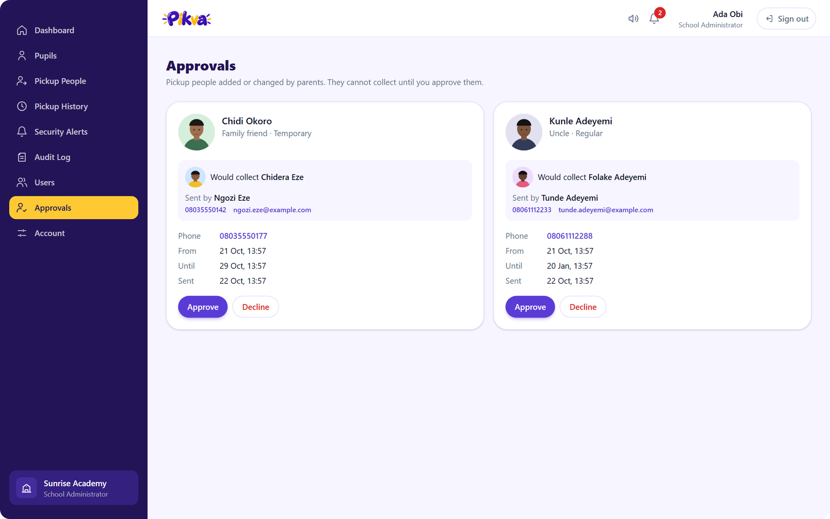
The school approves before anyone can collect
A second safeguard
Each card shows the photo, the pupil and the sender. Approve or decline in one tap.
Notes:
This is the safeguard that stops a parent account from creating a valid pickup person on its own. Approve one request live.

Slide 9
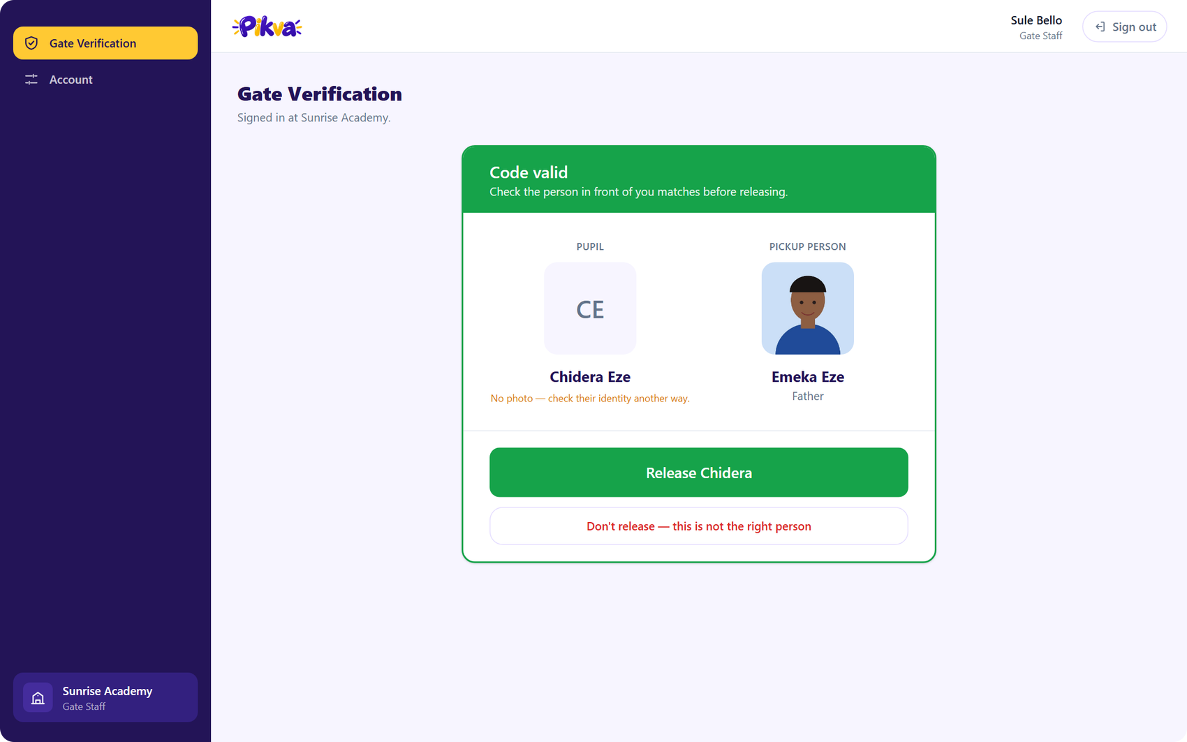
Gate staff: green means go, red means stop
Check, then release
Type the code or scan the QR, match the face to the photo, then release or refuse.
Notes:
Show a wrong code first (red, raises an alert), then the valid code (green, with photos). Release the pupil, then show the same code fails the second time.

Slide 10
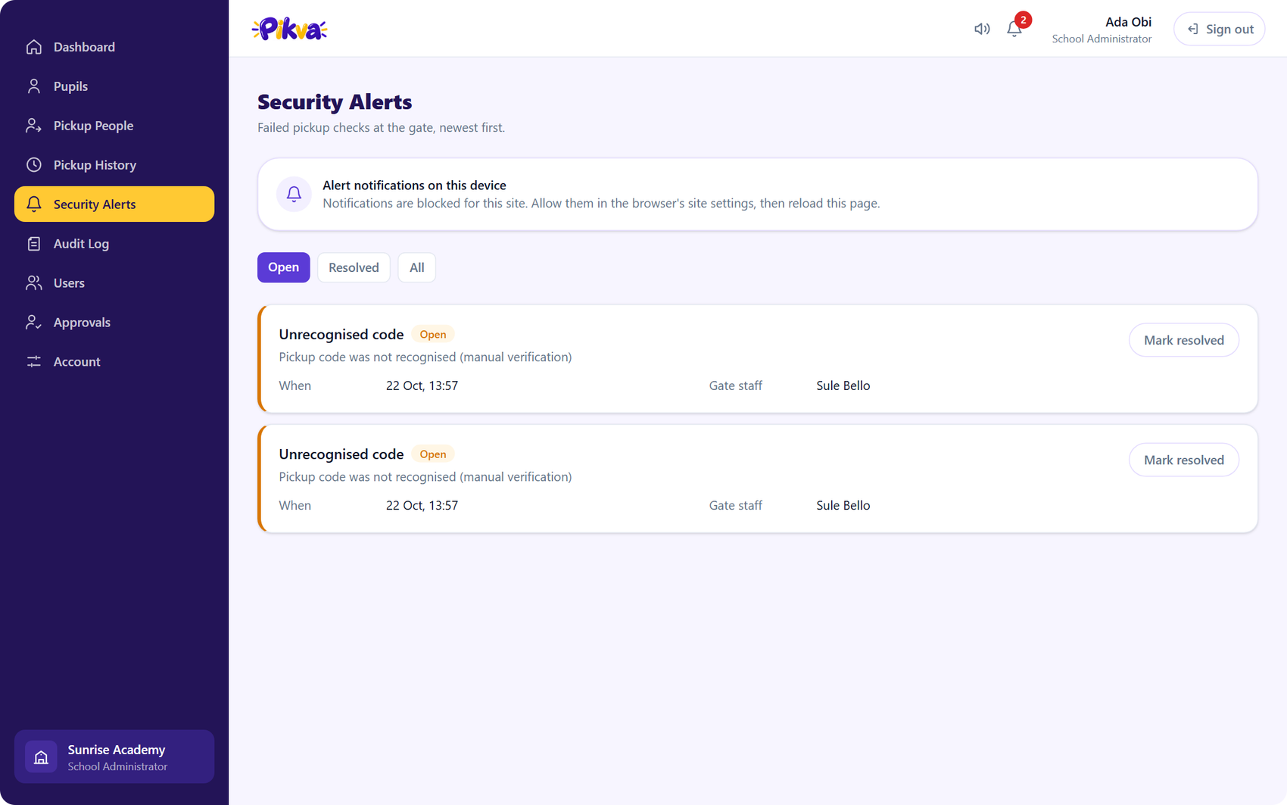
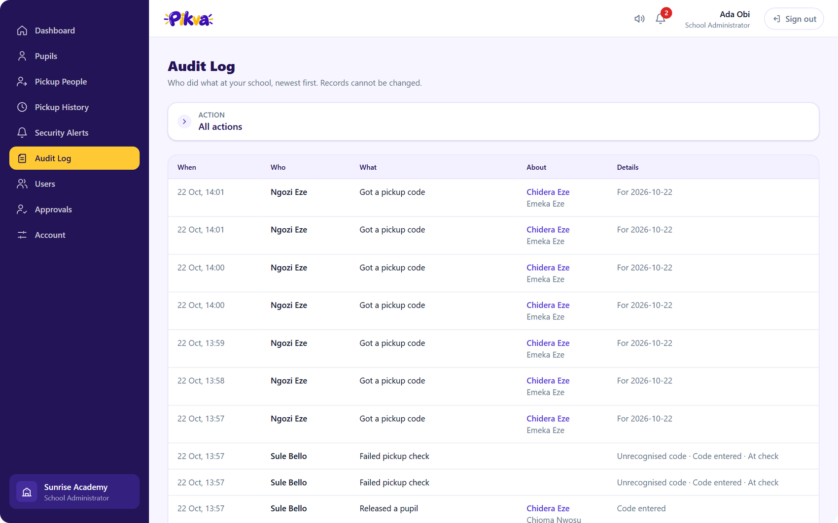
Every failure raises an alert, every action is logged
Security alerts
Audit log
Wrong codes and refusals appear at once, by email and push, until an admin resolves them.
A read-only record of who did what and when, filterable by action.
Notes:
Open alerts stay loud until resolved. The audit log cannot be edited from the app.

Slide 11
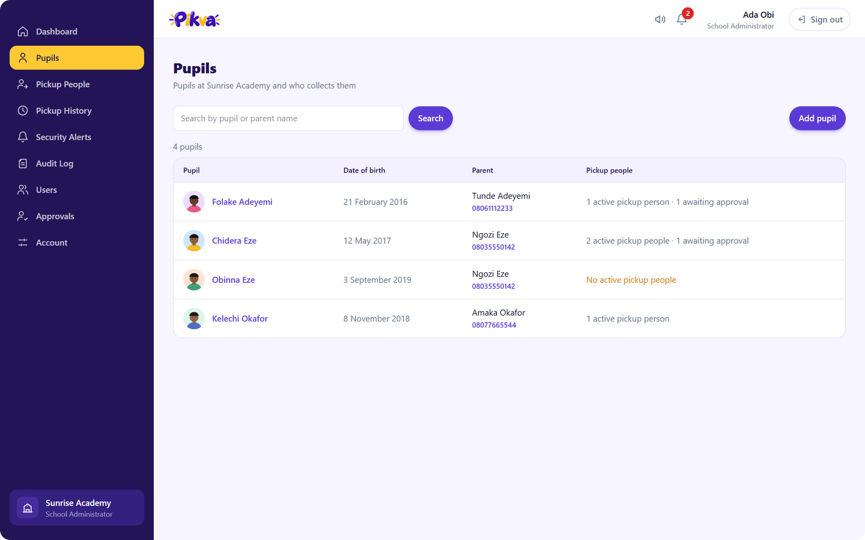
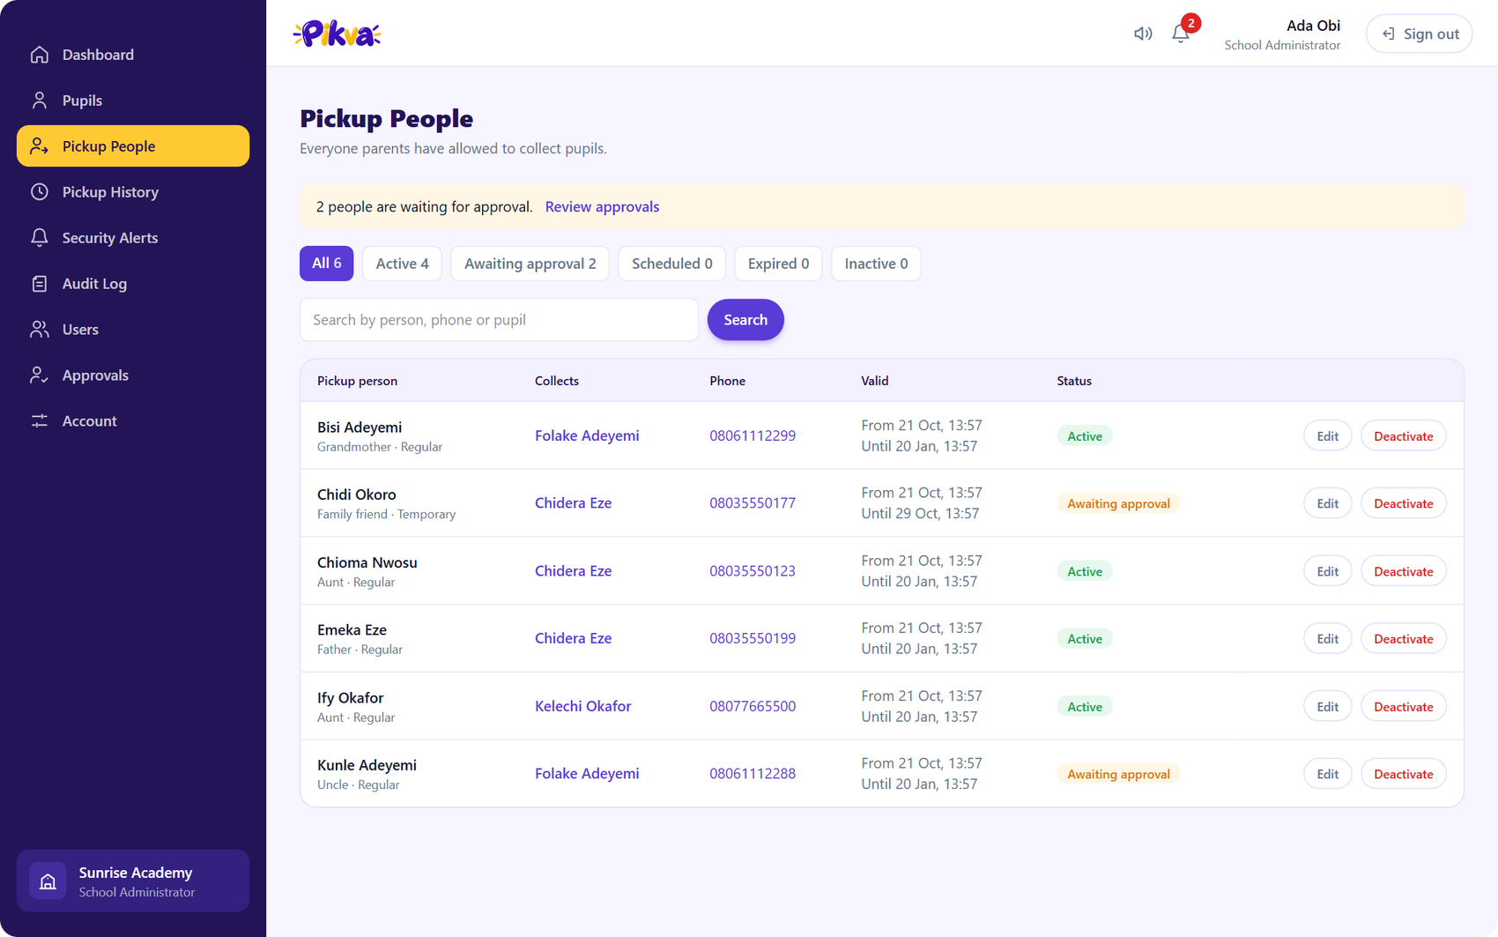
Pupils and pickup people, managed in one place
Pupils
Pickup people
Search by pupil or parent, with parent contact details and pickup counts.
Filter by status, edit dates, deactivate or reactivate in one place.
Notes:
Mention that admins can view, edit and deactivate pickup people but only parents can add them.

Slide 12
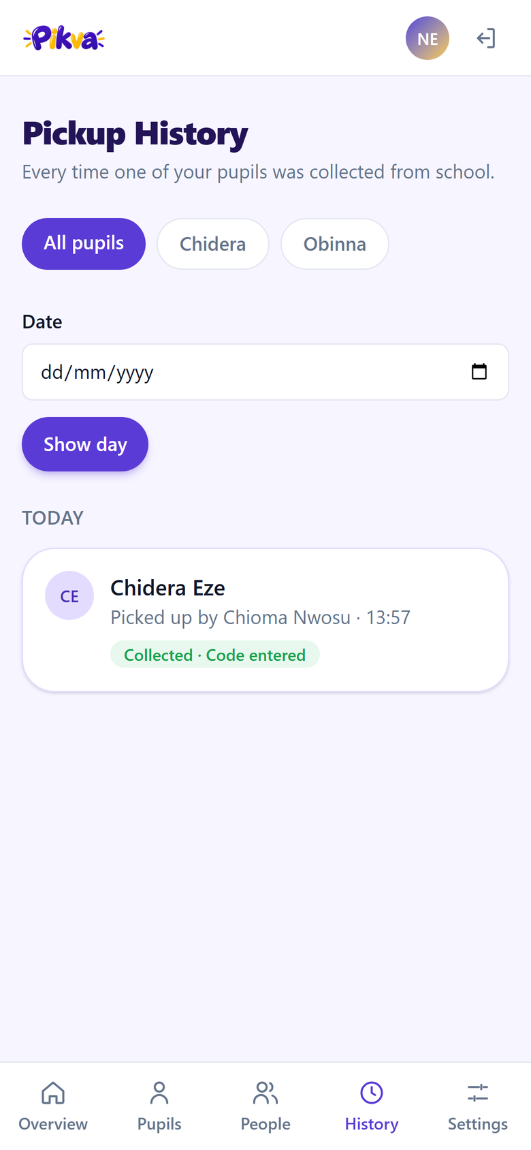
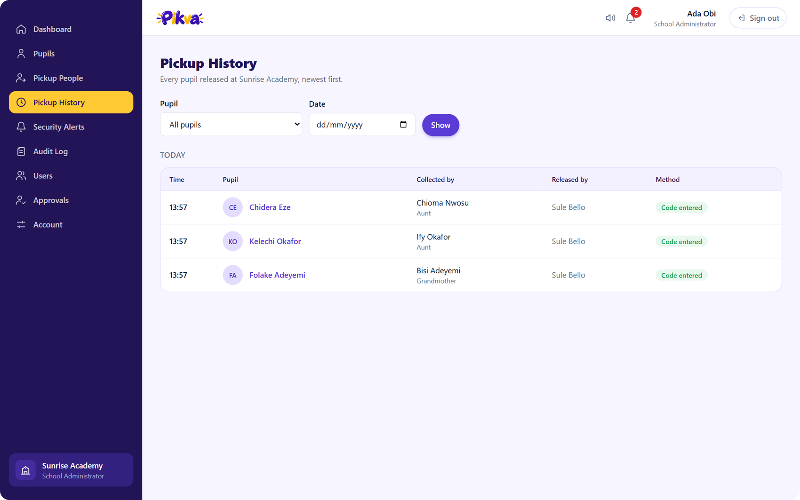
Every pickup is on the record
For the school and for parents
Admins filter by pupil and date. Parents see their own children's history, without staff names.
Notes:
Admins see who released the child. Parents see the history but not the staff member's name, by design.

Slide 13
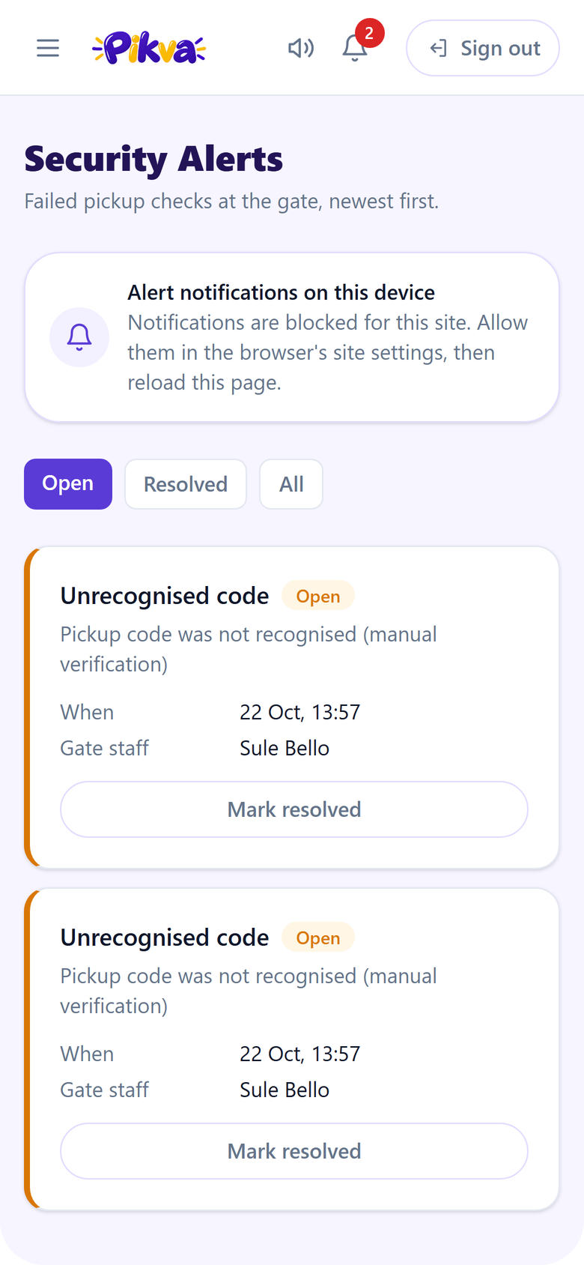
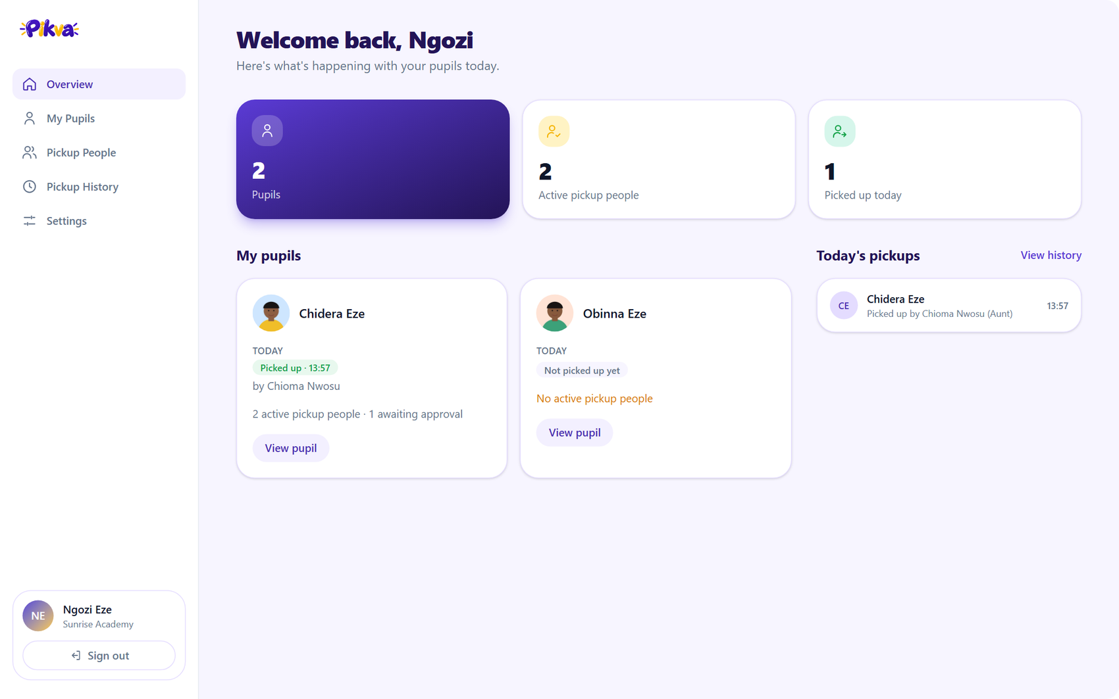
Built for desktop and phone
The same app, sized to the screen
Menus turn into a slide-in drawer and bottom tabs on phones. Every page was checked at phone and desktop widths.
Notes:
The same pages adapt: sidebar on desktop, drawer or bottom tabs on phones.

Slide 14




Built to be trusted
450+
200+
20+
backend tests
frontend unit tests
browser end-to-end tests
Passwords and codes are hashed
Rate limits everywhere
Argon2 passwords; pickup codes stored only as hashes.
Sign-in, gate checks and code requests are throttled.
Strict role and school scoping
Single-use, expiring codes
Each person sees only their own school's data.
A code works once and expires the same day.
Notes:
Test counts are lower bounds from the last full release check. Re-run the suites before quoting exact numbers.

Slide 15
Business model: schools subscribe, families stay free
Core: per-pupil subscription
Setup and training
Add-ons, later
Charged per pupil, per term. Includes admin, parent and gate access, alerts, history and support.
One-off: onboarding the school, importing pupils and parents, training gate staff.
SMS alerts, multi-campus schools, reports and exports.
WORKED EXAMPLE
₦600
300
₦540,000
per pupil, per term
pupils in the school
per school, per year (3 terms)
Illustrative figures to be validated in the pilot
Notes:
The school is the customer. Parents and gate staff never pay. The price is a proposal to test with the pilot school, not a final number.

Slide 16




Low cost to serve, simple way to grow
WHAT IT COSTS TO RUN
HOW WE GROW
Hosting
API, database and Redis, shared across all schools.
1
Pilot
Run one school for a term at a reduced price, with weekly check-ins.
Email and push
Set-password links and security alerts.
2
Prove
Turn results into a case study: pickups logged, incidents caught, parent feedback.
Photo storage
Small, cleaned pickup-person and pupil photos.
3
Grow
Support and onboarding
Reach other schools through proprietors' networks and referrals.
The main cost, and the reason for the setup fee.
Notes:
Cost per extra pupil is tiny. The real work is onboarding and support. Land one school, prove it, then grow by referral.

Slide 17
Where we are and what comes next
Built
Before going live
Next
Admin, parent and gate web portals
Approvals, codes, QR and photos
Alerts by email and push, audit log
Password reset and account management
Secure school onboarding
Verified email sending domain
HTTPS deployment and backups
Pupil photos shown at the gate
Flutter mobile app for parents and gate
School time zone for code expiry
Pilot with a real school
Notes:
Be candid: the web app is feature-complete for a supervised pilot. The mobile app and production setup are the next milestones.

Slide 18
Thank you
Questions and live demo
Authorise · Approve · Verify · Record
Notes:
Switch to the live app for the demo: admin sign-in, add a pickup person as the parent, approve, issue the code, verify at the gate.

