Slide 1
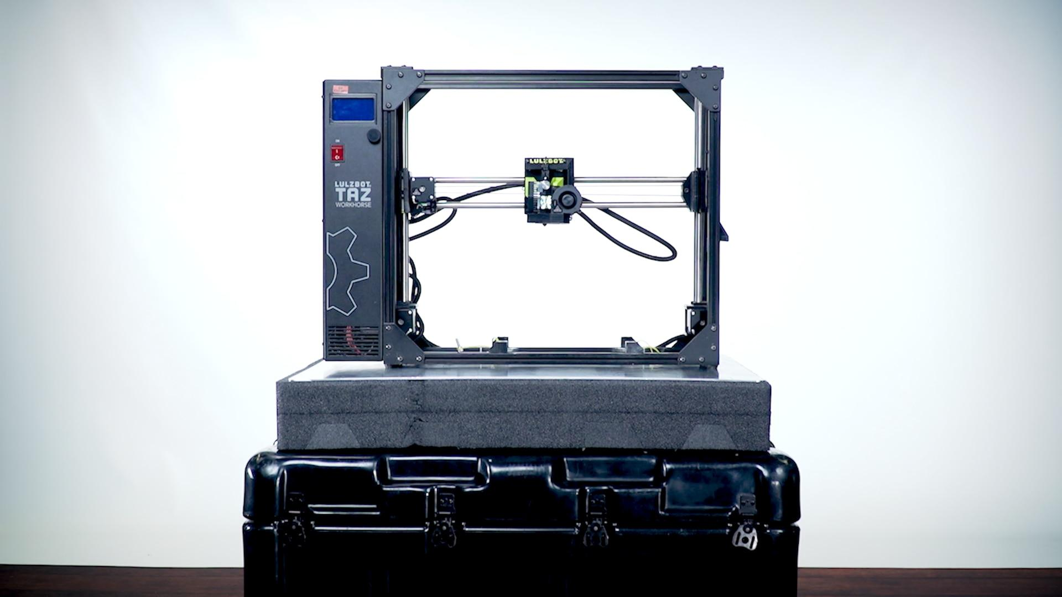
3-D Printing
Frank Coste
CSIT 100

Slide 2
Introduction
3-D printing creates physical objects from digital designs
Works by building items layer by layer
Used in medicine, engineering, construction, and education
Rapidly growing technology
This presentation explains its history, uses, advantages, and future

Slide 3
What is 3-D printing?
A manufacturing process that builds objects one layer at a time
Converts 3-D computer models into real objects
Known as additive manufacturing
Works with many materials (plastic, resin, metal, concrete)

Slide 4
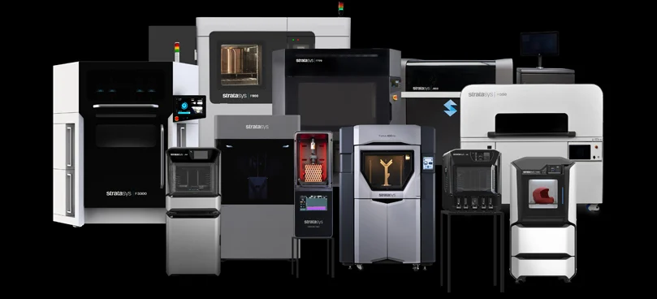
Early History
Began in the early 1980s
Charles Hull invented stereolithography (SLA) in 1984
SLA used UV light to solidify liquid resin
Hull founded 3D systems, an early industry leader
Laid the foundation for modern additive manufacturing

Slide 5
Development of Modern Techniques
Fused Deposition Modeling (FDM) introduced
Selective Laser Sintering (SLS) developed
Laminated Object Manufacturing (LOM) created
New methods allowed printing with plastics, metals, ceramics, composites
Expanded the range of real-world uses

Slide 6
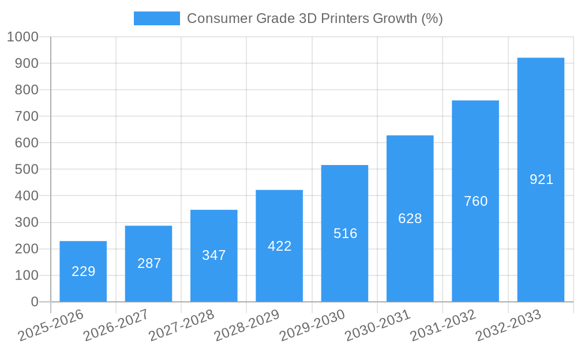
Rise of Consumer 3-D Printers
Late 2000s → affordable desktop printers appear
Technology opens to hobbyists and schools
Allows small businesses to prototype cheaply
Growth of brands like MakerBot and Creality
Makes 3-D printing widely accessible

Slide 7
Medical Applications
Custom prosthetics made for perfect fit
Surgical models print patient-specific anatomy
Bioprinting used for tissues and research
Helps doctors plan surgeries more accurately
Personalized medical devices improve patient care

Slide 8
Engineering & Industrial Uses
Rapid prototyping saves time and money
Designers can test models without expensive molds
Aerospace uses 3-D printing for lightweight, complex parts
Allows small-batch manufacturing
Helps companies innovate faster

Slide 9
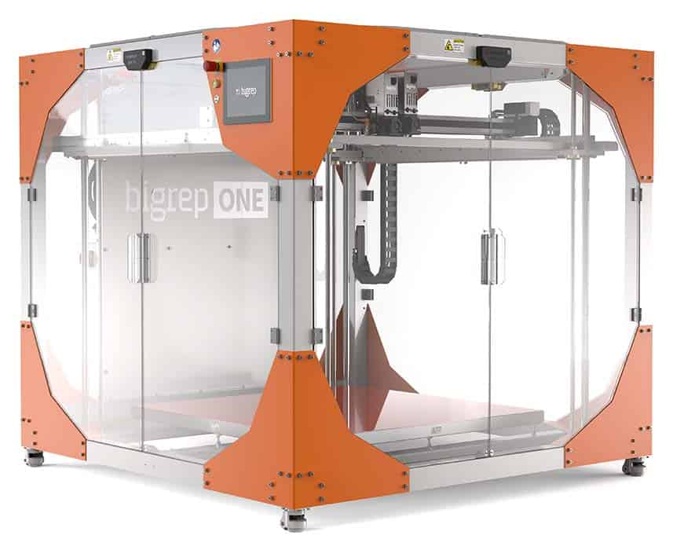
Construction Applications
Large 3-D printers can build walls and entire homes
Concrete printing reduces waste
Construction becomes faster and more affordable
Useful for disaster relief and low-income housing

Slide 10
Education & Learning
Supports hands-on learning and creativity
Students build physical models from digital designs
Used in engineering, architecture, math, art, and more
Encourages problem-solving and innovation
Teachers can make custom tools and lab equipment

Slide 11
Advantages & Challenges
Advantages:
High customization
Less material waste
Faster prototyping
Complex shapes are easy to create
Challenges:
Advanced printers and materials are expensive
Some printed parts are weaker
Slow for large or detailed prints
Intellectual property concerns (easy copying)

Slide 12
Future of 3-D Printing
Bioprinting organs could save lives
Aerospace will print tools and parts in space
3-D printed homes may help solve global housing shortages
Better materials = stronger, more reliable prints
Technology will continue to grow across industries

Slide 13
Sources
Image source: click here
Image source: click here
Image source: click here

