Slide 1

To be or not to be
an AT

Slide 2
Variations in MDR/EU Vocabularies
Dataset type NAL, or CAT or authority tables, includes
https://publications.europa.eu/en/web/eu-vocabularies/at-concept/-/resource/authority/dataset-type/NAL/?target=Browse
Name authority list
About tab
https://publications.europa.eu/en/web/eu-vocabularies/at-dataset/-/resource/dataset/access-right Name authority list
Editorial texts
https://publications.europa.eu/en/web/eu-vocabularies/controlled-vocabularies
Authority tables or
https://publications.europa.eu/en/web/eu-vocabularies/authority-tables
Authority Tables In order to harmonise and standardise the codes and the associated labels (…) These NALs are also known as (Common) Authority Tables (CATs), controlled vocabularies or value lists. The following NALs are maintained in the Metadata Registry: (…)

Slide 3
Variations in MDR/EU Vocabularies
Descriptions https://publications.europa.eu/en/web/eu-vocabularies/at-dataset/-/resource/dataset/access-right The Access right NAL provides the access rights or restrictions to resources. or
https://publications.europa.eu/en/web/eu-vocabularies/at-dataset/-/resource/dataset/corporate-body
This table provides the varying names of EU corporate bodies for a given time span.
Releases
https://publications.europa.eu/en/web/eu-vocabularies/releases
Name authority list
Breadcrumb
https://publications.europa.eu/en/web/eu-vocabularies/authority-tables
Authority tables

Slide 4
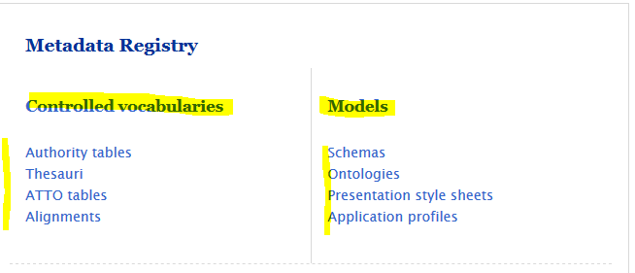
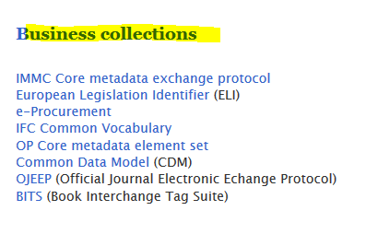
EU Vocabularies's assets

Slide 5
Metadata standardisation, authority tables, EuroVoc and the vocabulary management tool VocBench
Willem van Gemert & Anikó Gerencsér
Publications Office of the European Union Standardisation Unit
Metadata Sector
FISMA meeting, 28 June 2018
Metadata standardisation – Lessons learned
Create common code lists if used by more than one system
(…)
Notes:
5

Slide 6
Tímea's email [redacted]
- Name authority list, name authority file, authority list are identified as lists of proper names, not classes so this term would cover only a minority of our authority tables. (Yes, I know that we use named instead of name but we are practically the only one to do so; this term version is not a big step in the direction of harmonisation and/or unequivocal understanding.)
- I think structured vocabulary term could also be interesting ("An organized set of terms, headings or codes representing concepts and their interrelationships, which can be used to support information retrieval.") but it would not be ideal to differentiate authority tables from thesauri – thesauri also have a structure – and the parallel use of structured vocabulary contra controlled vocabulary terms could not help unambiguity.
- Ontologies are identified as a type of vocabularies while we categorised them as models.
- Mappings are relationships between a concept in one vocabulary and one or more concepts in another [vocabulary] by the definition which makes reference to ISO. We should take this into consideration in the editorial content.

Slide 7
and bucket list…
We need a term for the above mentioned "authority tables" + thesauri + ATTO tables + alignments together, normally called controlled vocabularies. If we keep this name, controlled vocabularies cannot be used as synonym of authority tables because authority tables represent only a subset of controlled vocabularies.
We need a term for the above mentioned "controlled vocabularies" and models (= schemas + ontologies + presentation style sheets + application profiles) together, normally called assets.

Slide 8
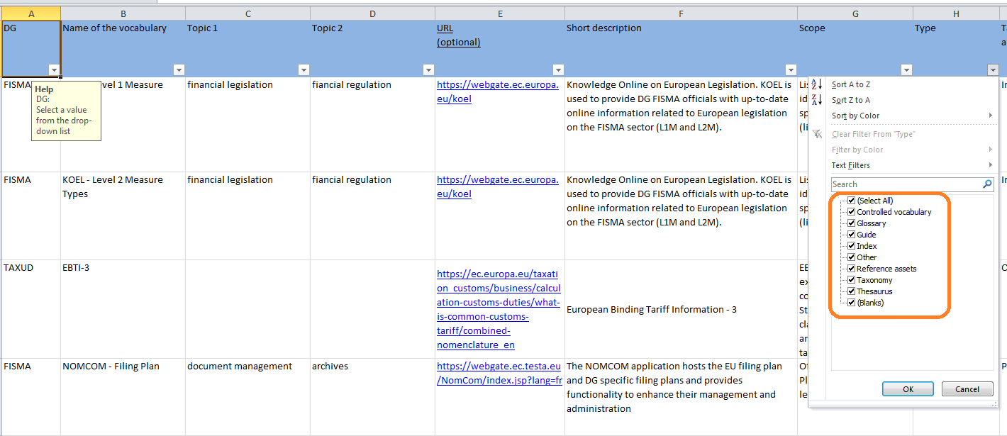
Inventory of controlled vocabularies

Slide 9
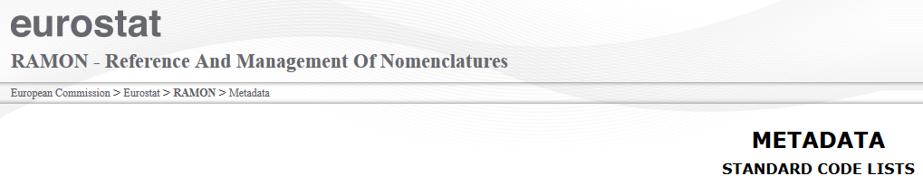
The use of harmonised (common) code lists is crucial in the processes of collection, exchange and dissemination of data in order to facilitate their understanding and comparability. The Eurostat Standard Code LIsts (SCLs) are defined on the basis of official classifications and their creation follow a certain number of basic 'rules', like:
- Codes made of less than 12 digits
- Alphanumerical codes starting with a letter (avoiding 'leading zeroes')
- Some special characters allowed ( the dash '-' for intervals and the undersocre '_' for sums) Introduction The Eurostat standard code lists (SCL)
Code lists (dictionaries)
Code lists are structural metadata. They provide the coding for the dimensions used in a table, e.g. UNIT, AGE, SEX, etc. All code lists currently used in Eurobase are available in the code list (see 'dic'), in EN, FR and DE. Code lists are very relevant when writing table titles: the terminology used in table titles should be coherent with code lists where applicable. Glossary

Slide 10
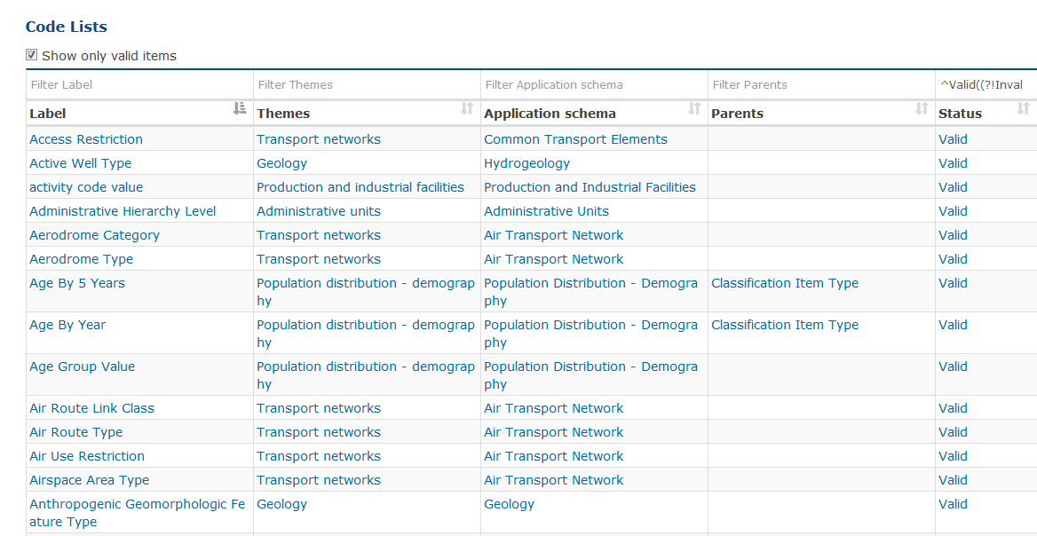
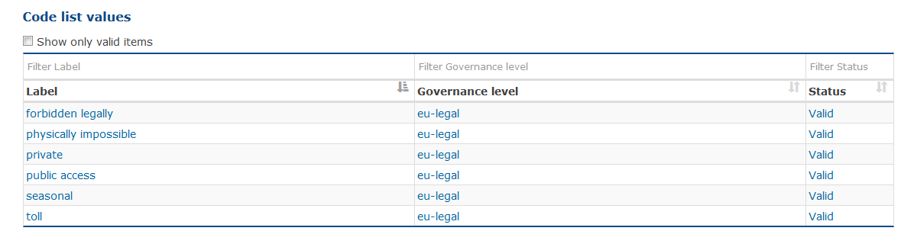
INSPIRE code list register
http://inspire.ec.europa.eu/codelist

Slide 11
Inspire metadata
Application Shema (grouped by theme)
All the application schemas of the consolidated INSPIRE UML data model.
Code list register (grouped by application schema/theme) possibly has paents
The INSPIRE code list register contains the code lists and their values
Feature Concept Dictionary (grouped by theme)
The common feature concept dictionary contains terms and definitions required for specifying thematic spatial object types and it is main role is in particular to support the harmonisation effort and to identify conflicts between the specifications of the spatial object types in the different themes
Glossary
contains general terms and definitions that specify the common terminology used in the INSPIRE Directive and in the INSPIRE Implementing Rules documents. The glossary supports the use of a consistent language in different documents when referring to the terms.
Metadata code list
Reference document register
Theme register

Slide 12
Source: COMMISSION REGULATION (EU) No 1089/2010
‘abstract type’ means a type that cannot be instantiated, but which may have attributes and association roles,
‘association role’ means a value or object, to which a type has a relationship, as referred to in Article 8 (2b) of Directive 2007/2/EC,
‘attribute’ means a characteristic of a type, as referred to in Article 8 (2c) of Directive 2007/2/EC,
‘code list’ means an open enumeration that can be extended
‘enumeration’ means a data type whose instances form a fixed list of named literal values. Attributes of an enumerated type may only take values from this list
‘identifier’ means a linguistically independent sequence of characters capable of uniquely and permanently identifying that with which it is associated, in accordance with EN ISO 19135,
‘instantiate’ means to create an object that is conformant with the definition, attributes, association roles and constraints specified for the instantiated type,
‘package’ means a general purpose mechanism for organizing elements into groups,
‘register’ means a set of files containing identifiers assigned to items with descriptions of the associated items, in accordance with EN ISO 19135,
‘type’ means spatial object type or data type,
‘data type’ means a descriptor of a set of values that lack identity, in accordance with ISO 19103

Slide 13
COMMISSION REGULATION (EC) No 1205/2008
controlled vocabulary (e.g. thesaurus, ontology)

Slide 14

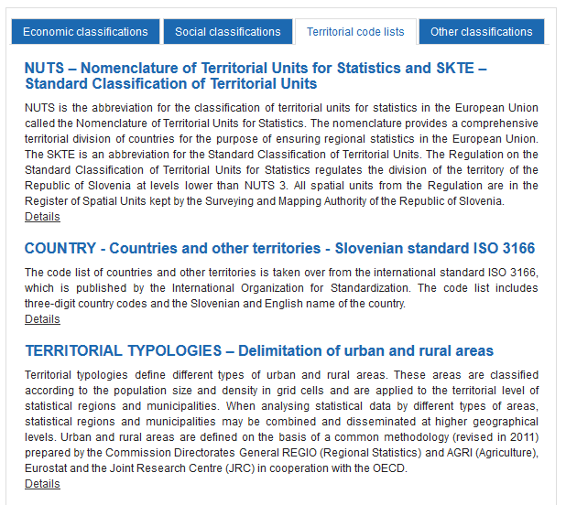

Slide 15
UNSD - United Nations Statistics Division
UN glossary of classification terms A draft document of classification terms approved by the Expert Group in 2000.
Code, code letters and numbers
Normally consists of one or more alphabetic, numeric or alpha/numeric characters assigned to a descriptor in a classification. Each code is unique to a property within a classification. If the property changes, then the code should also be changed. Codes can be linked to other codes with common characters, especially in hierarchical classifications. For example, in ISIC Rev. 3, Technical and vocational secondary education has a class code 8022, which is linked to Group 802 Secondary education and to Division 80 Education. Concepts
Are abstract summaries, general notions, knowledge etc. of a whole set of behaviours, attitudes or characteristics which are seen as having something in common.Concepts are used to assist in presenting/conveying precise meaning, categorising, interpreting, structuring and making sense of classifications.
Normalised heading and codes
This refers to standardisation of headings/titles and their codes in the classifications. For example, the titles and use of n.e.c. (not elsewhere classified) categories and the codes given to them, as well as the code ending in zero should normally be standardised, e.g. by using the title of the aggregate group when naming its n.e.c. group, and by using 9 as the last digit for n.e.c. categories and 0 to be equivalent with
coding to the higher level, e.g. because the information needed for a more detailed code is not available.
https://unstats.un.org/unsd/classifications/bestpractices

Slide 16
UNECE
https://www.unece.org/cefact/locode/service/location UN/LOCODE Code List by Country
United Nations Code for Trade and Transport Locations (UN/LOCODE)
The list below allows obtaining the UN/LOCODE Code List 2017-2 for each country. The current version was published in December 2017. By selecting a country, the system displays the entire UN/LOCODE Code List of the country. The list of country names (official short name in English as in ISO 3166) appears in alphabetical order, with the corresponding ISO 3166-1-alpha-2 code elements.
cross-domain code lists (…)
2. INFORMATION NOTES ON CODE LISTS AND CODE VALUES
The use of the SDMX technical standards does not impose on user organisations the direct application of the code lists shown above. However, especially for cross-domain concepts, the mapping of the code lists used by individual organisations to the pivot code values and pivot code descriptions is recommended
SDMX CONTENT-ORIENTED GUIDELINES https://www.unece.org/fileadmin/DAM/stats/documents/ece/ces/.../crp.1.add.2.e.pdf

Slide 17
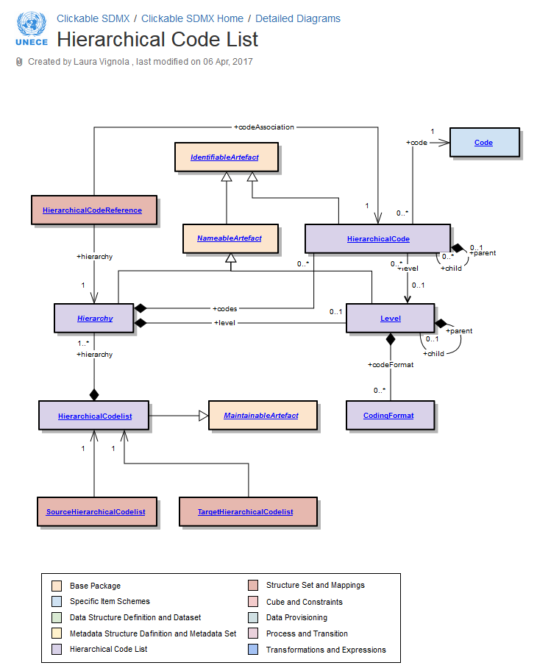

Slide 18
https://statswiki.unece.org/display/ClickSDMX/Hierarchical+Code+List
Explanation of the diagram
Codelist described in the section on structural definitions supports a simple hierarchy of Codes, and restricts any child Code to having just one parent Code. Whilst this structure is useful for supporting the needs of the DataStructureDefinition and the MetadataStructureDefinition, it may not sufficient for supporting the more complex associations between codes that are often found in coding schemes such as a classification scheme. Often, the Codelist used in a DataStructureDefinition is derived from a more complex coding scheme.
(…)
The principal features of the HierarchicalCodelist are:
•A child code can have more than one parent.
•There can be more than one code that has no parent (i.e. more than one “root node”).
•There may be many hierarchies (or “views”) defined, in terms of the associations between the codes. Each hierarchy serves a particular purpose in the reporting, analysis, or dissemination of data.
•The levels in a hierarchy can be explicitly defined or they can be implicit: (i.e. they exist only as parent/child relationships in the coding structure).
The basic principles of the HierarchicalCodelist are:
•The HierarchicalCodelist is a specification of the Codes comprising the scheme and the specification of the structure of the Codes in the scheme in terms of one or more Hierarchy.
•The Codes in the HierarchicalCodelist are not themselves a part of the scheme, rather they are references to Codes in one or more external Codelists.
•Any individual Code may participate in many Hierarchys, in order to give structure to the HierarchicalCodelist.
•The Hierarchy of Codes is specified in HierarchicalCode. This references the Code and its immediate child HierarchicalCodes.
•A Hierarchy can have formal levels (hasFormalLevels=”true”). However, even if hasFormalLevels=”false” the Hierarchy can still have one or more Levels associated in order to document information about the HierarchicalCodes.
(…)
https://statswiki.unece.org/display/ClickSDMX/Hierarchical+Code+List

Slide 19
UNESCO Thesaurus
The UNESCO Thesaurus is a controlled and structured list of terms used in subject analysis and retrieval of documents and publications in the fields of education, culture, natural sciences, social and human sciences, communication and information. Continuously enriched and updated, its multidisciplinary terminology reflects the evolution of UNESCO's programmes and activities.

Slide 20
ISO Standards
ISO 4217 is the International Standard for currency codes.
The purpose of ISO 4217:2015 is to establish internationally recognised codes for the representation of currencies. Currencies can be represented in the code in two ways: a three-letter alphabetic code and a three-digit numeric code. ISO 3166-1-alpha-2 English country names and code elements. This list states the country names (official short names in English) in alphabetical order as given in ISO 3166-1 and the corresponding ISO 3166-1-alpha-2 code elements.

Slide 21
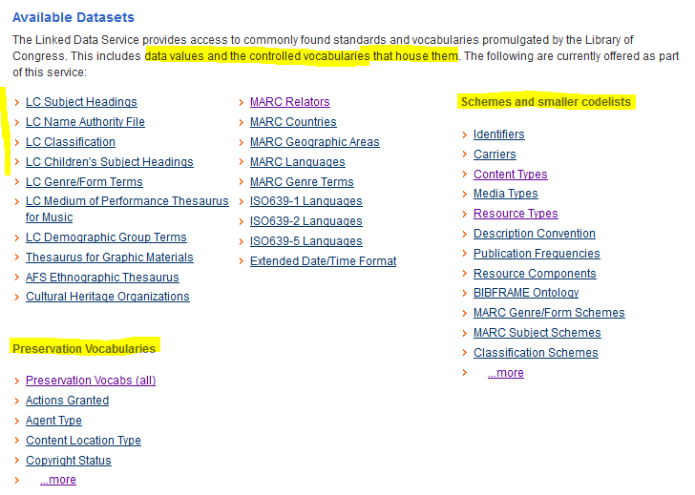
Library of Congress

Slide 22
Library of Congress
Library of Congress Authorities, you can browse and view authority headings for Subject, Name, Title and Name/Title combinations; and download authority records in MARC format for use in a local library system.
Subject Authorities
Name Authorities
Title Authorities
Keywords Authorities
Headings List Types The Headings List Types reflect the various controlled vocabularies and thesauri that appear in Library of Congress authorities. This information is derived from several authoritative lists or thesauri whose short titles appear in the far right column of the Headings List display.
MARC Code List for Relators The MARC Code Lists for Relators, Sources, Description Conventions have been reorganized. Relator terms and codes can be accessed on this page (below). The source code list parts can now be accessed at Source Codes for Vocabularies, Rules, and Schemes.
The Library of Congress Name Authority File (NAF) file provides authoritative data for names of persons, organizations, events, places, and titles. Its purpose is the identification of these entities and, through the use of such controlled vocabulary, to provide uniform access to bibliographic resources.
Available Datasets
The Linked Data Service provides access to commonly found standards and vocabularies promulgated by the Library of Congress. This includes data values and the controlled vocabularies that house them. The following are currently offered as part of this service:
MADSScheme
http://www.loc.gov/standards/mads/rdf/v1.html#MADSScheme
controlled value lists: controlled values for names (personal, corporate, geographic, etc.), thesauri, taxonomies, subject heading systems, ...
Schemes and smaller codelists
eg. Identifiers
Carriers
Content Types
...
Preservation Vocabularies
eg. Preservation Vocabs (all)
Actions Granted
LC Demographic Group Terms

Slide 23
SDMX Content-Oriented Guidelines (COG)
Code Lists
Code lists are predefined sets of terms from which some statistical coded concepts take their values. SDMX cross-domain code lists are used to support cross-domain concepts. The use of common code lists will help users to work even more efficiently, easing the maintenance of and reducing the need for mapping systems and interfaces delivering data and metadata to them.
https://sdmx.org/?page_id=4345

Slide 24
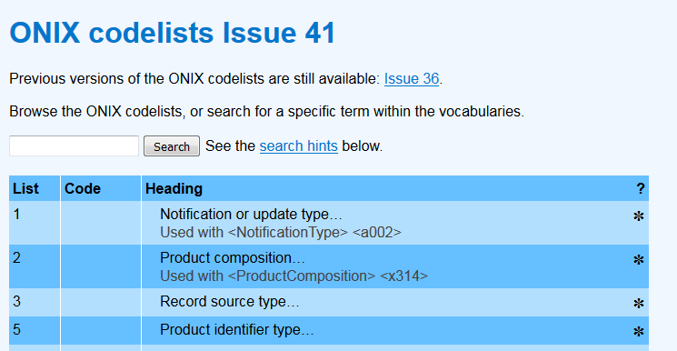
EDItEUR - ONIX
https://www.editeur.org/14/Code-Lists/ About ONIX for Books codelists
Codelists – sometimes called controlled vocabularies – are a vital part of ONIX. They form part of the shared semantics of an ONIX message. The codelists contain a list of language-independent (often numerical) code values that are used in ONIX messages, plus for each code there is a short label and sometimes a longer note to define the meaning of the code. In principle, labels and notes may be in any language: although the meaning of almost all codes is originally defined in English, translation of labels and/or notes into another language does not alter the meaning of the code itself. Code BB in list 150 means ‘Hardback book’, but equally it means ‘精装’ (jīngzhuāng shū) and ‚Gebundene ausgabe‘. Thus the meaning of an ONIX message using a particular code value is understandable and unambiguous, whatever the languages used by sender and recipient of the data.

Slide 25
ONIX [Codelists in other languages]

Slide 26
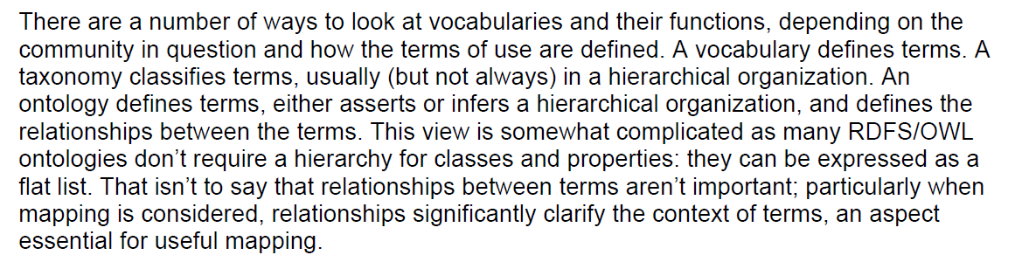

flat lists
Issues in Vocabulary Management

Slide 27
flat lists
https://link.springer.com/article/10.1057/dam.2010.29
Taxonomies and controlled vocabularies best practices for metadata
TYPES OF CONTROLLED VOCABULARIES
Term list
The simplest kind of controlled vocabulary is a flat term list, sometimes called a ‘pick list’.
Term lists are often utilized for administrative and structural metadata elements, such as a list of possible file formats, rights status or retention status. Term lists are also used in descriptive metadata elements, such as content type, language, department/source and so on. Controlled vocabularies of subject terms, however, may be too large and complex for simple term lists. Term lists are often displayed within drop-down boxes for a field, but could display as button or check-box items.
Authority file
Taxonomy
Thesaurus

Slide 28
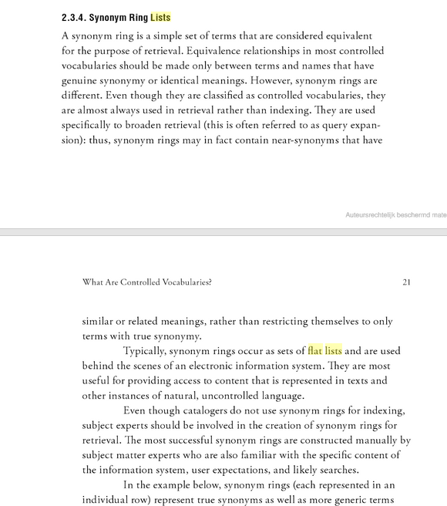
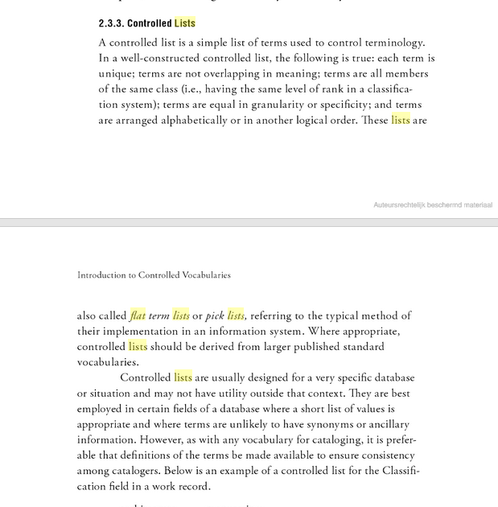
Introduction to Controlled Vocabularies: Terminology for Art, Architecture, and Other Cultural Works Patricia Harpring

Slide 29

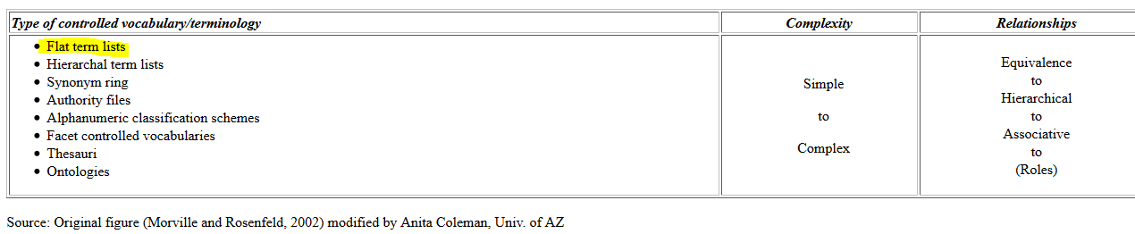
http://www.dlese.org/Metadata/vocabularies/term_expln.php
Flat term lists A flat term list controlled vocabulary is a list of terms with no ordering implied. Good vocabularies include definitions and attribution if necessary. Each term is easily differentiated from each other term (no overlap). Terms are on the same scale, that is one term won't encompass other terms. For example:
…

Slide 30
The Getty Research Institute
http://www.getty.edu/research/tools/vocabularies/
Getty vocabularies are valued as authoritative
o Grow through contributions from experts o Contributors and sources are cited
A controlled vocabulary is an organized arrangement of words and phrases used to index content and/or to retrieve content through browsing or searching. It typically includes preferred and variant terms and has a defined scope or describes a specific domain. The purpose of controlled vocabularies is to organize information and to provide terminology to catalog and retrieve information. While capturing the richness of variant terms, controlled vocabularies also promote consistency in preferred terms and the assignment of the same terms to similar content.
Types of Controlled Vocabularies
Subject Heading Lists
Controlled Lists
A controlled list is a simple list of terms used to control terminology. In a well-constructed controlled list, the following is true: each term is unique; terms are not overlapping in meaning; terms are all members of the same class (i.e., having the same level of rank in a classification system); terms are equal in granularity or specificity; and terms are arranged alphabetically or in another logical order.
Synonym Ring Lists
A synonym ring is a simple set of terms that are considered equivalent for the purpose of retrieval. Equivalence relationships in most controlled vocabularies should be made only between terms and names that have genuine synonymy or identical meanings. However, synonym rings are different. Even though they are classified as controlled vocabularies, they are almost always used in retrieval rather than indexing.

Slide 31
Authority Files
Taxonomies
A taxonomy is an orderly classification for a defined domain. It may also be known as a faceted vocabulary.
Alphanumeric Classification Schemes
Thesauri
Ontologies
Whereas the vocabularies discussed above are the ones most commonly used for art information, discussions of controlled vocabularies may also include ontologies.
Folksonomies
Folksonomy is a neologism referring to an assemblage of concepts represented by terms and names (called tags) that are compiled through social tagging.

Slide 32
Online Dictionary for Library and Information Science by Joan M. Reitz
https://www.abc-clio.com/ODLIS/odlis_c.aspx
controlled vocabulary
An established list of preferred terms from which a cataloger or indexer must select when assigning subject headings or descriptors in a bibliographic record, to indicate the content of the work in a library catalog, index, or bibliographic database. Synonyms are included as lead-in vocabulary, with instructions to see or USE the authorized heading. For example, if the authorized subject heading for works about dogs is "Dogs," then all items about dogs will be assigned the heading "Dogs," including a work titled All about Canines. A cross-reference to the heading "Dogs" will be made from the term "Canines" to ensure that anyone looking for information about dogs under "Canines" will be directed to the correct heading. Controlled vocabulary is usually listed alphabetically in a subject headings list or thesaurus of indexing terms. The process of creating and maintaining a list of preferred indexing terms is called vocabulary control.
The utility of controlled vocabulary in the online environment has been challenged, but a study by Tina Gross and Arlene G. Taylor (College & Research Libraries, May 2005) found that more than one-third of records retrieved by successful keywords searches in OPACs would be lost if subject headings were not present, and for some searches the loss was as high as 80-100 percent. Synonymous with controlled terms. Compare with free-text search.
authoritative
A source that is official. Also, a work known to be reliable because its authenticity or integrity is widely recognized by experts in the field.
authority
The knowledge and experience that qualifies a person to write or speak as an expert on a given subject. In the academic community, authority is indicated by credentials, previously published works on the subject, institutional affiliation, awards, imprint, reviews, patterns of citation, etc.
authority control
The procedures by which consistency of form is maintained in the headings (names, uniform titles, series titles, and subjects) used in a library catalog or file of bibliographic records through the application of an authoritative list (called an authority file) to new items as they are added to the collection. Authority control is available from commercial service providers.
authority file
A list of the authoritative forms of the headings used in a library catalog or file of bibliographic records, maintained to ensure that headings are applied consistently as new items are added to the collection. Separate authority files are usually maintained for names, uniform titles, series titles, and subjects. All the references made to and from a given heading are also included in the file. See also: authority control.

Slide 33
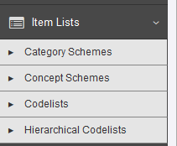
Registry
What is the SDMX Global] Registry The SGR is the technical infrastructure that supports this global initiative and, more generally, the implementation of SDMX, by making its metadata material, DSDs and related artefacts (concept schemes, metadata structure definitions, code lists, etc.), publicly and centrally available. https://registry.sdmx.org/FusionRegistry/
.INT Zone Management
IANA>.int
The .int domain is a specialized domain offering registrations solely to intergovernmental organisations. In brief, the .int domain is used for registering organisations established by international treaties between or among national governments.

Slide 34
INSPIRE code list register
The INSPIRE code list register contains the code lists and their values, as defined in the INSPIRE implementing rules on interoperability of spatial data sets and services (Commission Regulation (EU) No 1089/2010). NOTE: It does not yet include references to external code lists and the additional code lists and extended values proposed in the Data Specification Technical Guidelines.
http://inspire.ec.europa.eu/codelist

Slide 35
Library and Archives Canada
http://www.bac-lac.gc.ca/eng/Pages/home.aspx
How to Register a Controlled Vocabulary
The function of the Registry of Controlled Vocabularies is two-fold:
To provide a metadata repository of controlled vocabularies used in resource discovery metadata by GC departments and agencies.
To make the vocabularies available to search engines, information creators and those involved in developing and maintaining vocabularies.
A vocabulary can be registered by submitting the required information using the rules and criteria listed below.
Controlled vocabularies, including thesauri, flat lists of preferred terms and value sets or additional standardized lists may be registered if deemed to be of use within the Government of Canada context.

