Slide 1
Cybersecurity Threats
Cristian Alexandru Soare
Costin-Tiberiu Vasilescu

Slide 2
Overview
Number of reported attacks: 3000
Total financial loss: $151.480 Million
Number of affected users: 1.510 Millions

Slide 3
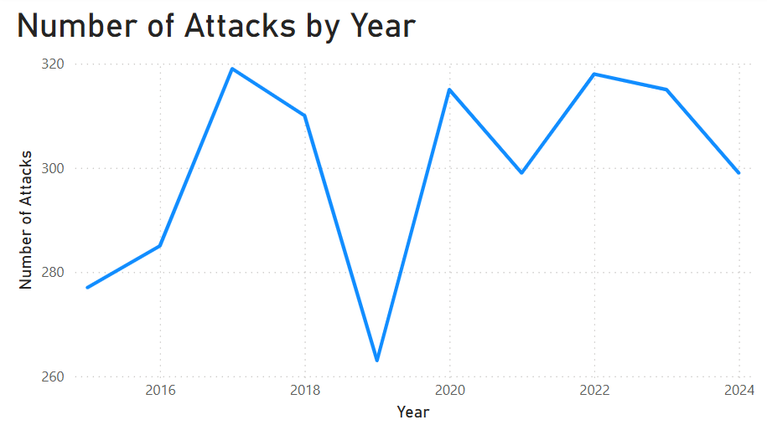
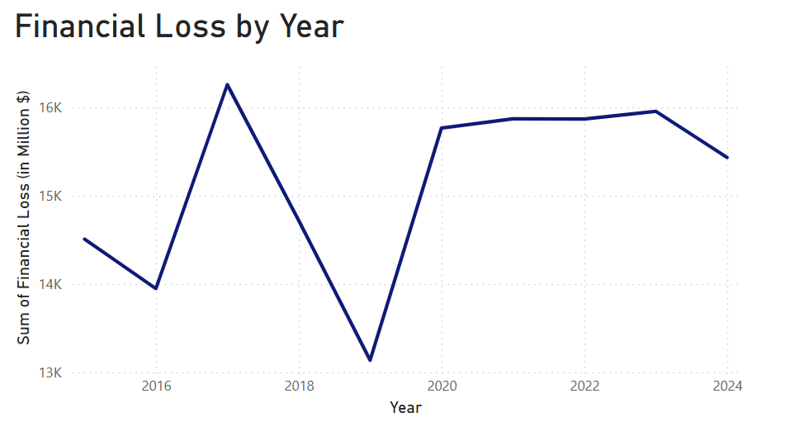
Trends over the years
Attack numbers fluctuate year to year—spikes in 2017 & 2022, drop in 2019
Financial loss stays consistently high, even in years with fewer attacks.

Slide 4
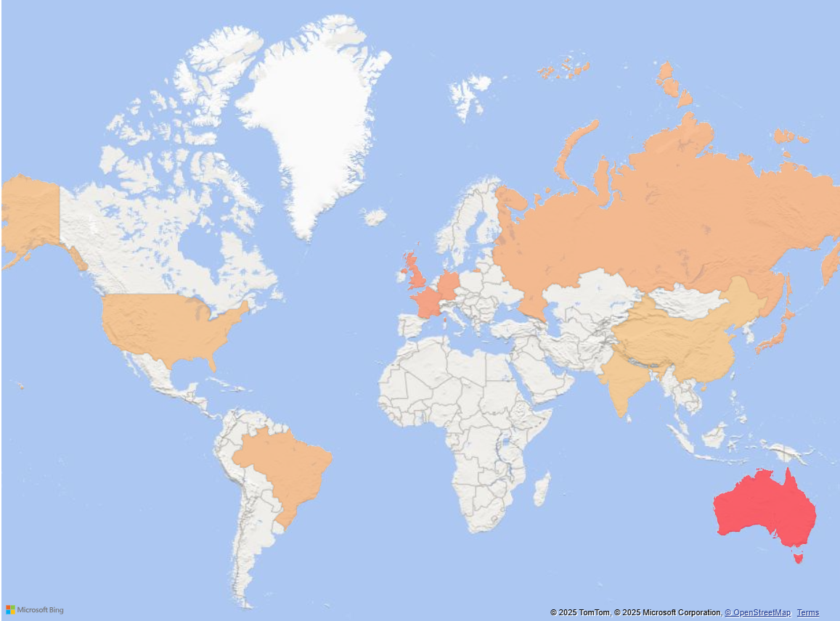
Financial Impact
/ Country

Slide 5
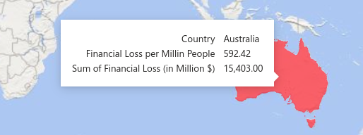
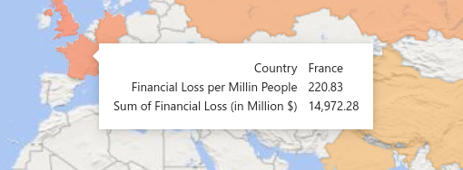
Financial Loss / Population
Higher impact on
Australia?

Slide 6
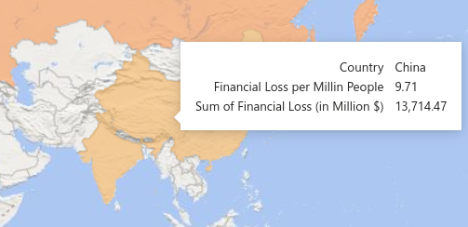
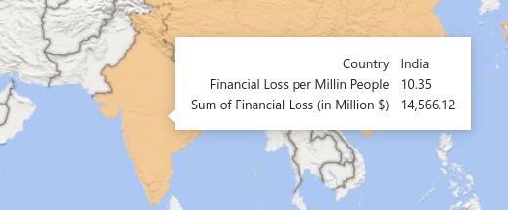
Financial Loss / Population
Difference in reporting accuracy?

Slide 7
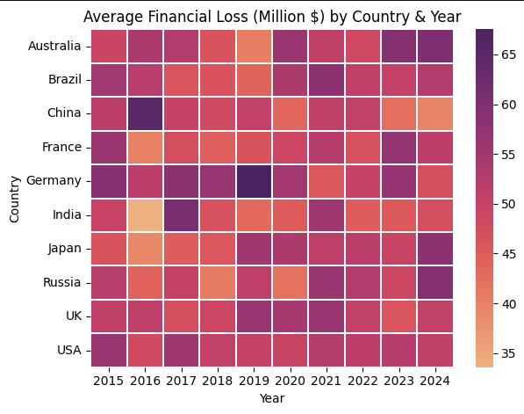
Financial Loss Heatmap
Highest losses:
China in 2016 and Germany in 2019

Slide 8
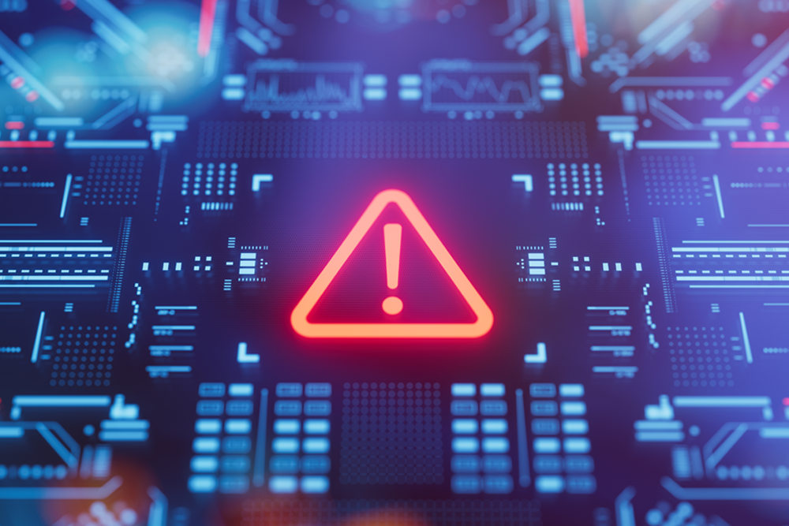
What happened?
China:
Credential-stuffing raid on Alibaba’s Taobao
Mirai IoT botnet fallout in China
Germany:
Rheinmetall Automotive malware outage
Emotet shuts down the City of Frankfurt’s IT network

Slide 9
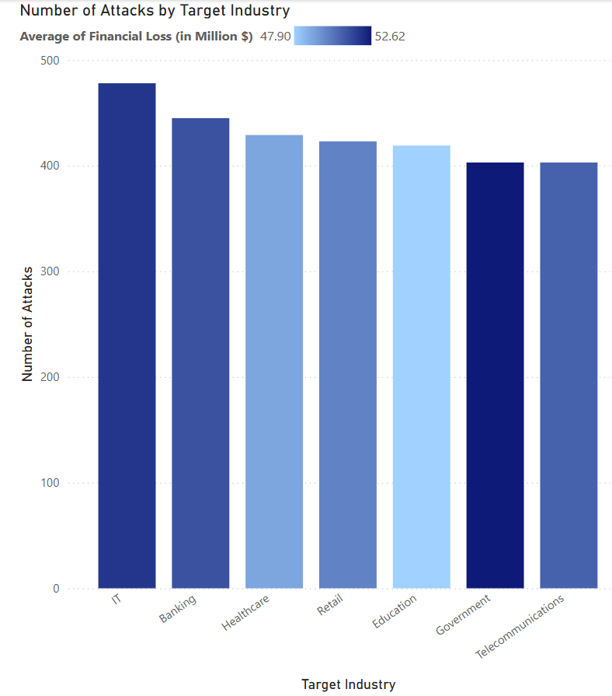
What Industries are Targeted?
IT and Banking face the highest number of attacks.
Government attacks are more costly

Slide 10
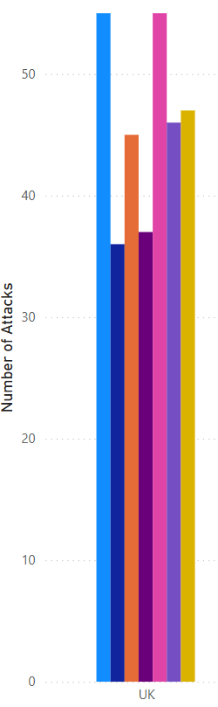
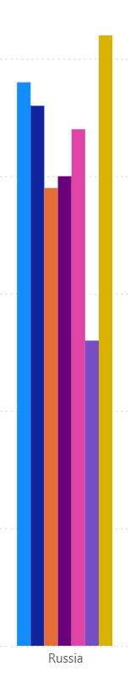
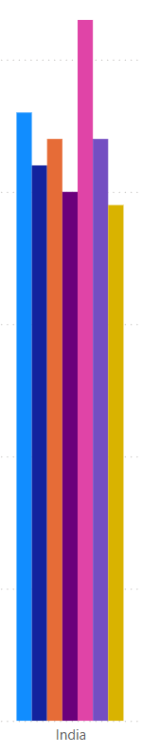
Attacked Industry / Country
UK: IT and Banking
Russia: Telecomunications
India: IT

Slide 11
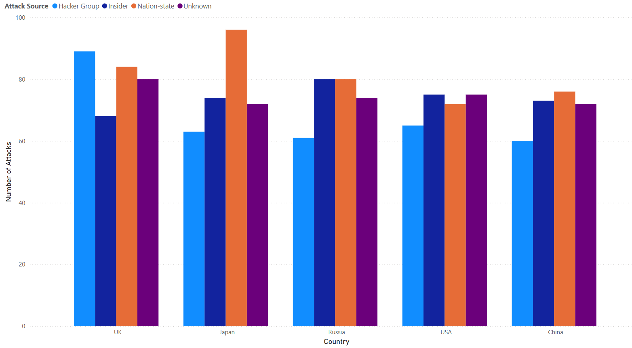
Attack Source / Country

Slide 12
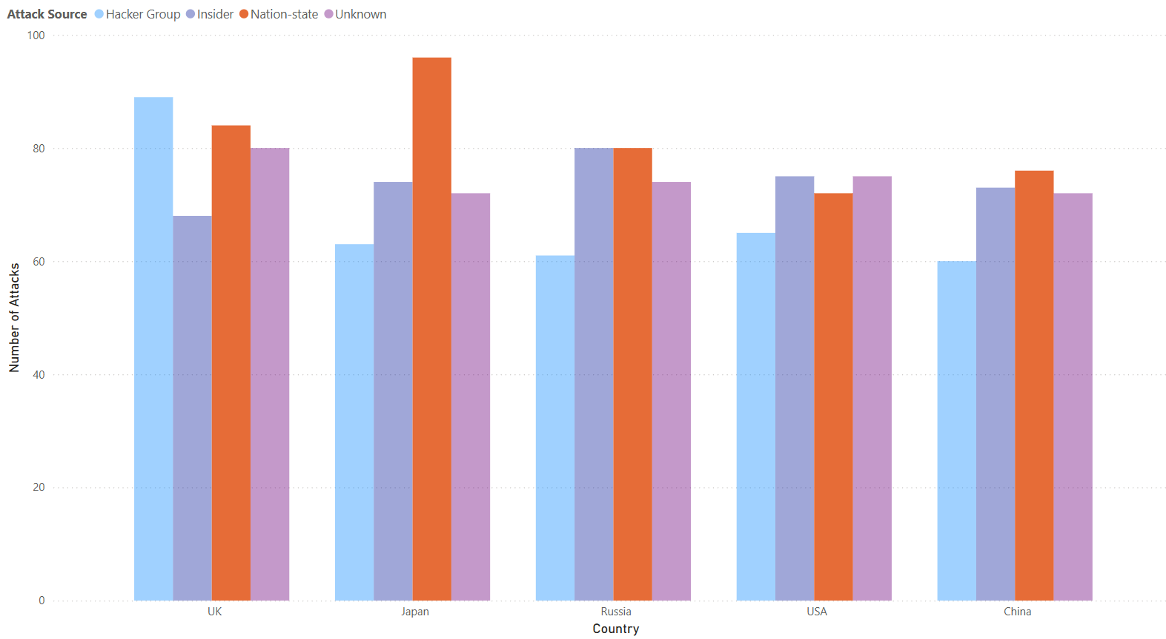

Slide 13
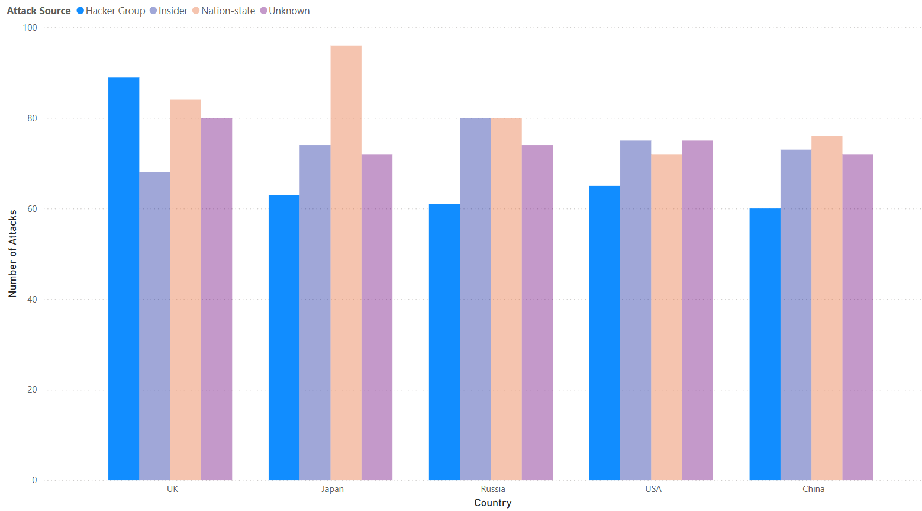

Slide 14
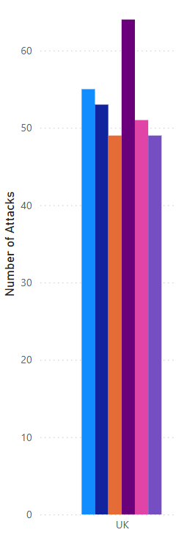
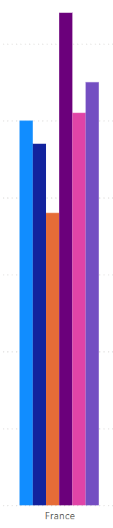
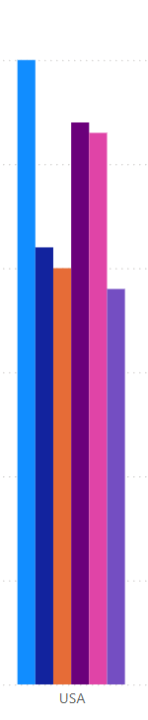
Attack Type / Country
UK and France have a problem with Phising attacks
USA struggles with DDOS attacks

Slide 15
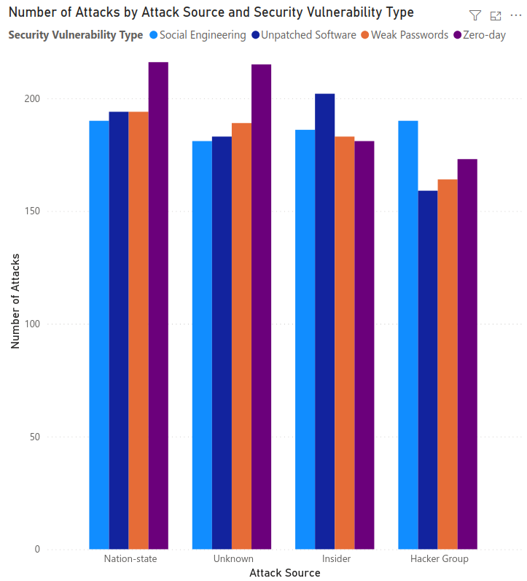
Attack Source / Vulnerability
Nation-state: Zero-day
Insider: Unpatched Software
Hacker Group: Social Engineering

Slide 16
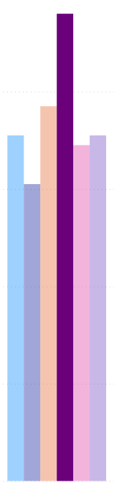
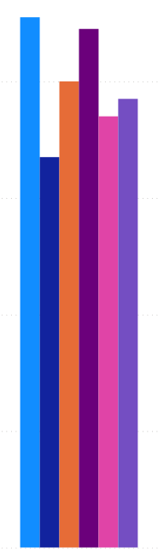
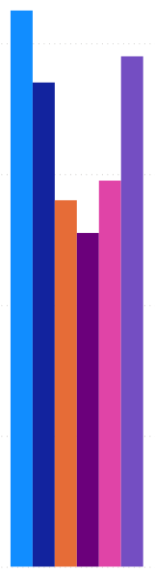
Attack Type / Industry
Banking: Phising
IT: DDoS, Phishing
Telecomunications: DDoS, SQL Injection
Banking
IT
Telecomunications

Slide 17
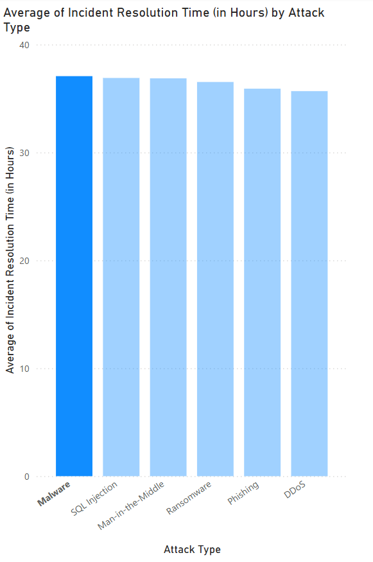
Average Resolution Time / Attack Type
We can see that the hardest type of attack to resolve is Malware

Slide 18
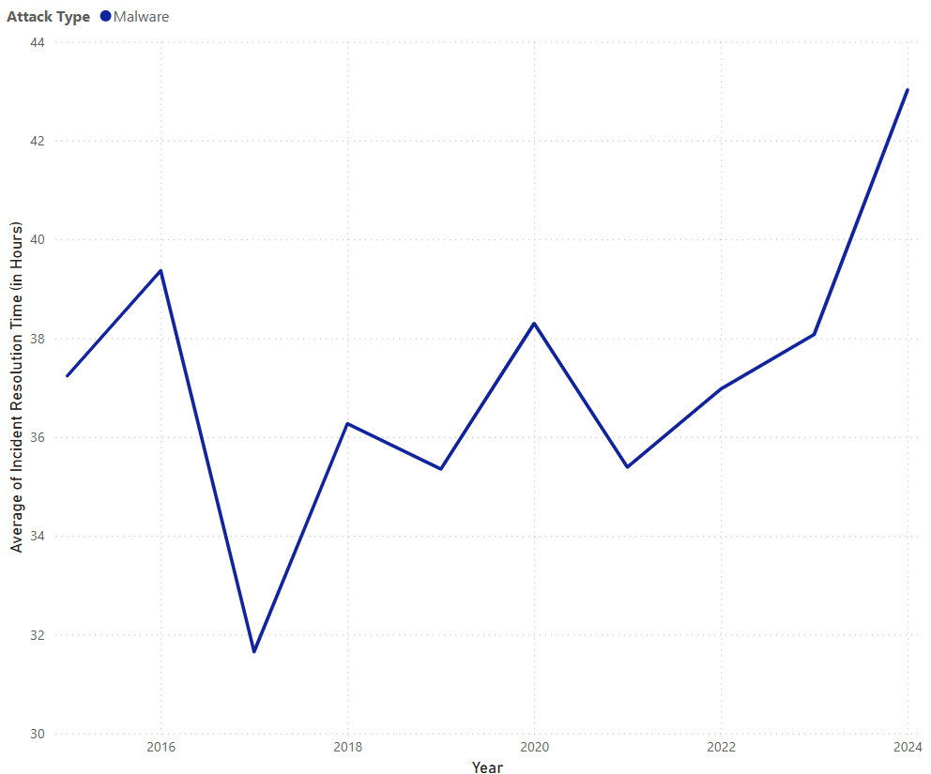
Average Resolution Time / Attack Type
Increase of Resolution Time over the years for Malware attacks

Slide 19
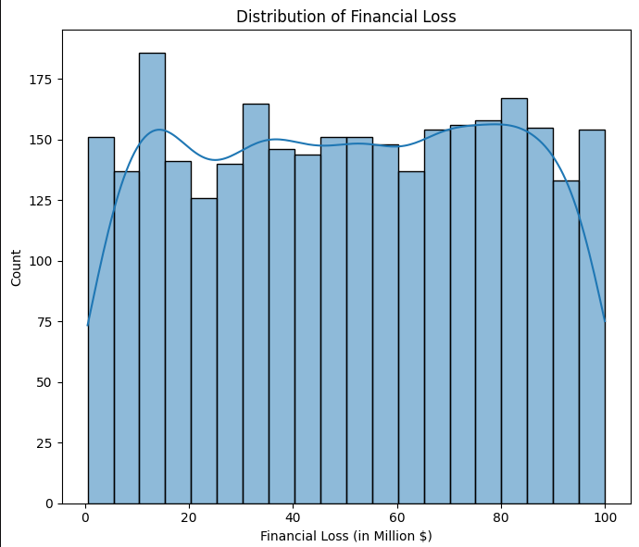
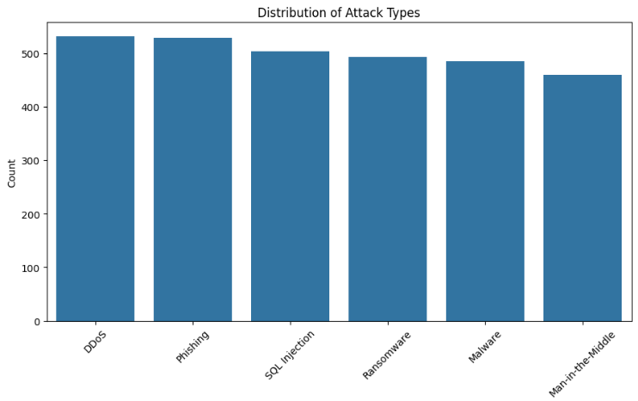
Unhappy Ending (boring data)

Slide 20
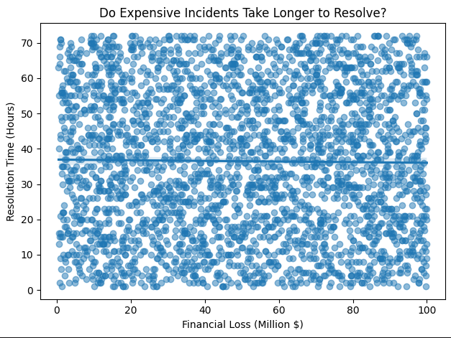
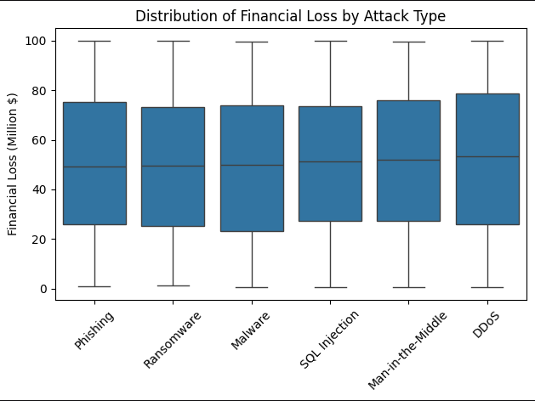
Unhappy Ending (boring data)
Potentially synthetic?

Slide 21
Thank You! and stay safe

