Slide 1



Emoji Translator
= monkey (easy one, right?)
= grinning face with big eyes
Student: Constantin Soare

Slide 2
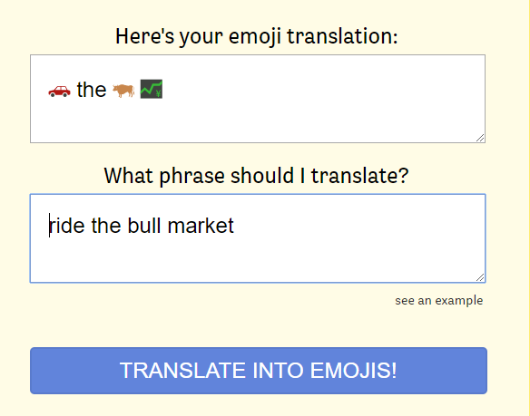
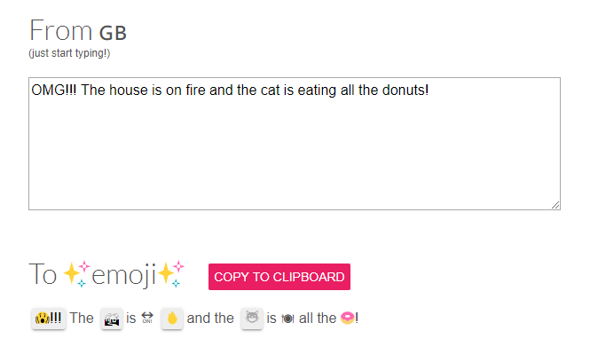
What?
Alternatives
Not limited to these!

Slide 3
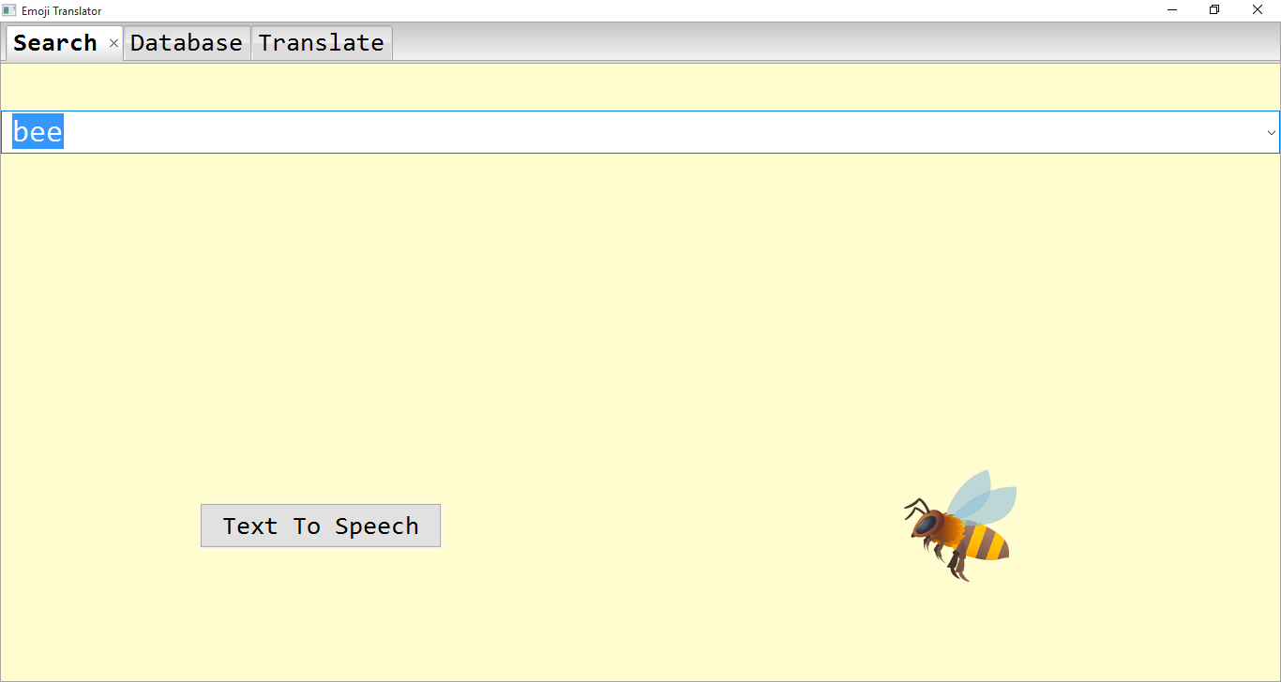
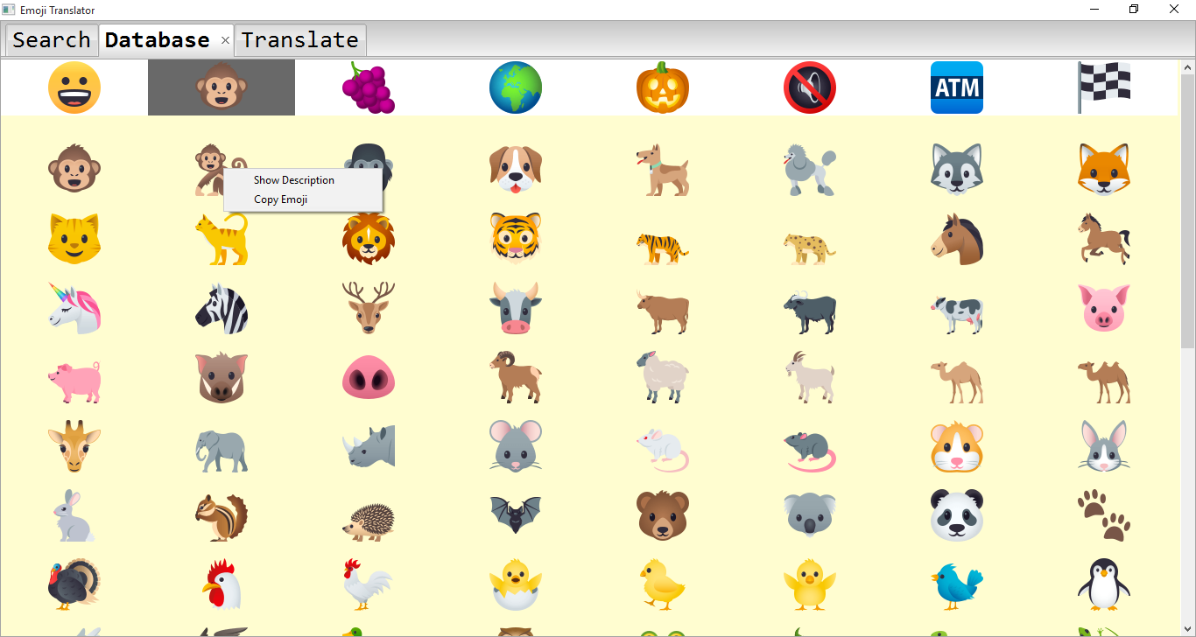
What?
My Project
Apart from being fun, emojis are useful!
No quick way to compose messages with emojis (and know 100% what they mean!)
Emoji accessibility is one of the main objectives.
App for PC users.

Slide 4



























Why?
Most emojis are small.
Hard to differentiate.
Especially on PCs!
People can't always tell what an emoji means.
It takes a lot to compose messages with emojis! - Have to look for each one every time.
Actually double the size of an emoji!

Slide 5


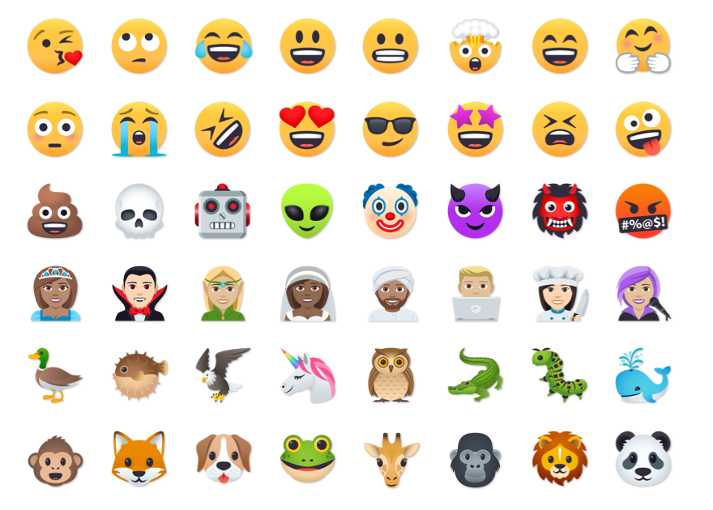

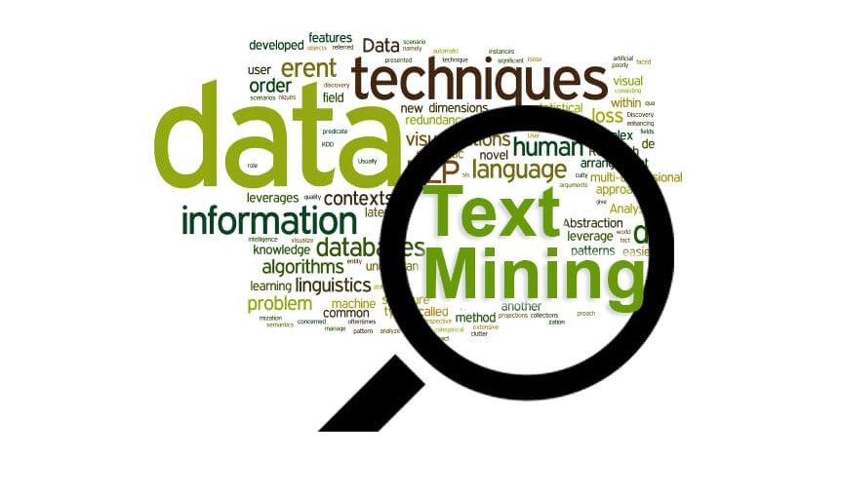


How?

Slide 6



What to expect in April?
Hopefully something that's
not
The app will be able to improve the user's experience with emojis.
Using machine learning, every user account will be personalized:
searches
composing messages (with most used emojis)
the “actual” meaning of an emoji
Emoji-To-Speech, Speech-To-Emoji

Slide 7


Thanks for your attention!
Q&A time!

