Slide 1
Communication-Optimal
Strassen Algorithm
Chris Ostrouchov^{[1]}
^{[1]} UTK Material Science and Engineering

Slide 2
Motivations
Classical Matrix Multiplication O(N^3)
C_11 = A_11 * B_11 + A_12 * B_21 C_12 = A_11 * B_12 + A_12 * B_22
C_11 = A_11 * B_11 + A_12 * B_21 C_12 = A_11 * B_12 + A_12 * B_22
4 + 8 x
Strassen-Winograd Algorithm O(N^2.81)
T_0 = A_11 S_0 = B_11 Q_0 = T_0 * S_0 U_1 = Q_0 + Q_3
T_1 = A_12 S_1 = B_21 Q_1 = T_1 * S_1 U_2 = U_1 + Q_4
T_2 = A_21 + A_22 S_2 = B_12 - B_11 Q_2 = T_2 * S_2 U_3 = U_1 + Q_2
T_3 = T_2 - A_11 S_3 = B_22 - S_2 Q_3 = T_3 * S_3 C_11 = Q_0 + Q_1
T_4 = A_11 - A_21 S_4 = B_22 – B_12 Q_4 = T_4 * S_4 C_12 = U_3 + Q_5
T_5 = A_12 - T_3 S_5 = B_22 Q_5 = T_5 * S_5 C_21 = U_2 - Q_6
T_6 = A_22 S_6 = S_3 - B_21 Q_6 = T_6 * S_6 C_22 = U_2 + Q_2
14 + 7 x

Slide 3
Parallel Matrix Multiplication
Problem Size
Classical
Strassen

Slide 4
Parallel Matrix Multiplication
Communication (SUMMA, PUMMA)
P_0
P_0
P_0
P_N
P_N
Broadcast (Row / Column)
Power Considerations
As # Cores Communication Cost

Slide 5
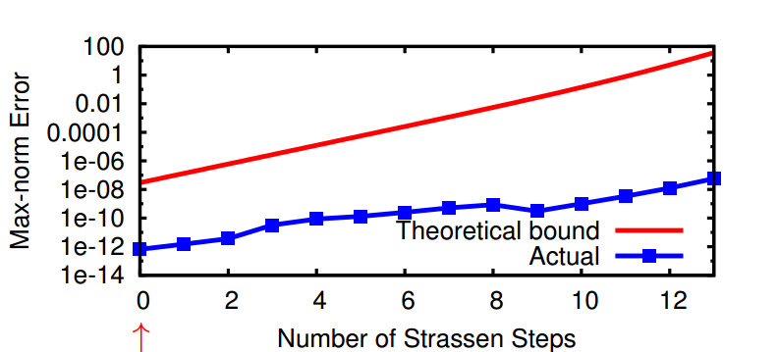
If it is so great why is it not used?
[1]
Stability
  Preconditioning matrix
  Cutoff number of recursion steps
Not allowed in Linpack Benchmark!
[1] Communication-Optimal Parallel Algorithm for Strassen's Matrix Multiplication. Simons Institute Workshop

Slide 6
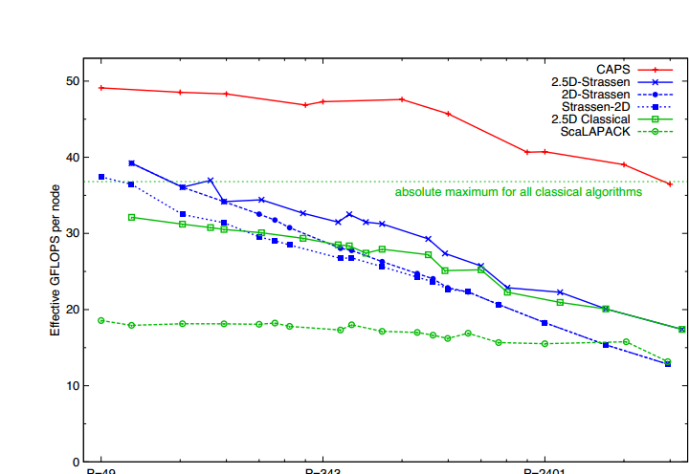
(CAPS) Communication-Avoidig Parallel Strassen
University of Berkeley (James Demmel Group)^{[1]}
[1] “Communication-Optimal Parallel Algorithm for Strassen's Matrix Multiply
Grey Ballard, James Demmel, Olga Holtz, Bejamin Lipshitz

Slide 7
(CAPS) Algorithm
Maximize Local Memory Usage
# dfs = l = log_2(4n / (P^(1/2.8) * sqrt(M))
1
DFS
# bfs = k = log_7(P)
BFS
1 x 1/4
7 x 1/16
T_0 = A_11 S_0 = B_11 Q_0 = T_0 * S_0 U_1 = Q_0 + Q_3
T_1 = A_12 S_1 = B_21 Q_1 = T_1 * S_1 U_2 = U_1 + Q_4
T_2 = A_21 + A_22 S_2 = B_12 - B_11 Q_2 = T_2 * S_2 U_3 = U_1 + Q_2
T_3 = T_2 - A_11 S_3 = B_22 - S_2 Q_3 = T_3 * S_3 C_11 = Q_0 + Q_1
T_4 = A_11 - A_21 S_4 = B_22 – B_12 Q_4 = T_4 * S_4 C_12 = U_3 + Q_5
T_5 = A_12 - T_3 S_5 = B_22 Q_5 = T_5 * S_5 C_21 = U_2 - Q_6
T_6 = A_22 S_6 = S_3 - B_21 Q_6 = T_6 * S_6 C_22 = U_2 + Q_2

Slide 8
(CAPS) Algorithm
Minimize Communication
P = 343 (7^3)
DFS
P = 343
BFS
P=49
P/7
P/7
P/7
P/7
P/7
P=49
P=7
P/7
P/7
P/7
P/7
P/7
P=7
Each processor has its own problem
P=1
P/7
P/7
P/7
P/7
P/7
P=1

Slide 9
(CAPS) Algorithm Limitations
Processors 7^k
Berkeley's CAPS Implementation
  P = {1,2,3,6} * 7^k
Block Size = 7^k * scaling_factor
Dim n = 2^s*7^k*scale
Padding
Dynamic Peeling
000000
+
0 0 0 0 0 0 0 0 0 0 0

Slide 10
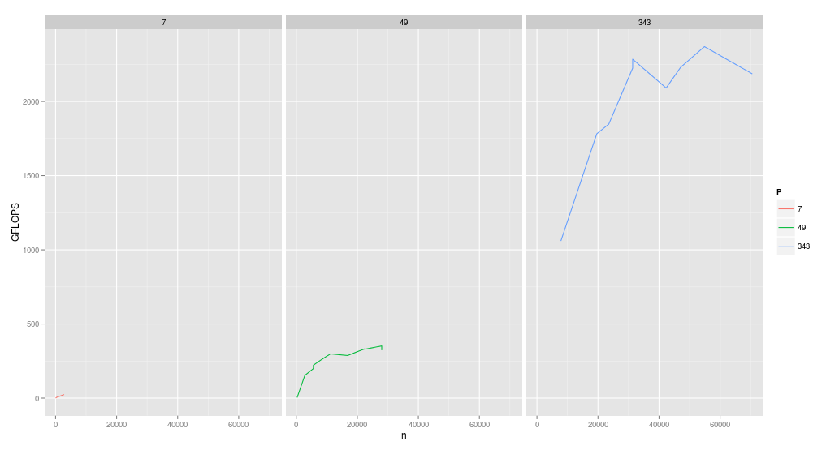
GFLOPS vs. Dimension
2.5 TFLOPS!

Slide 11
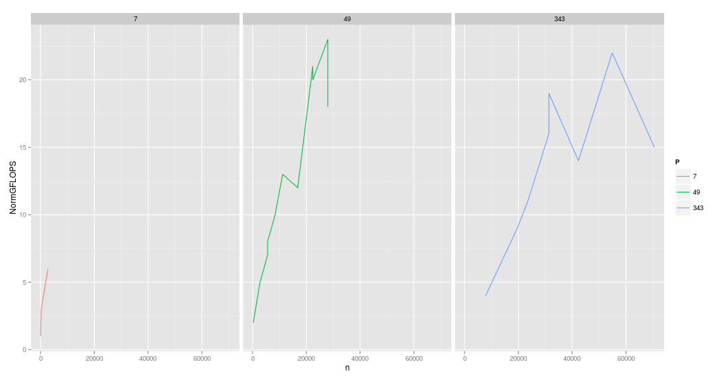
Normalized GFLOPS vs. Dim
Faster than ScaLAPACK

Slide 12
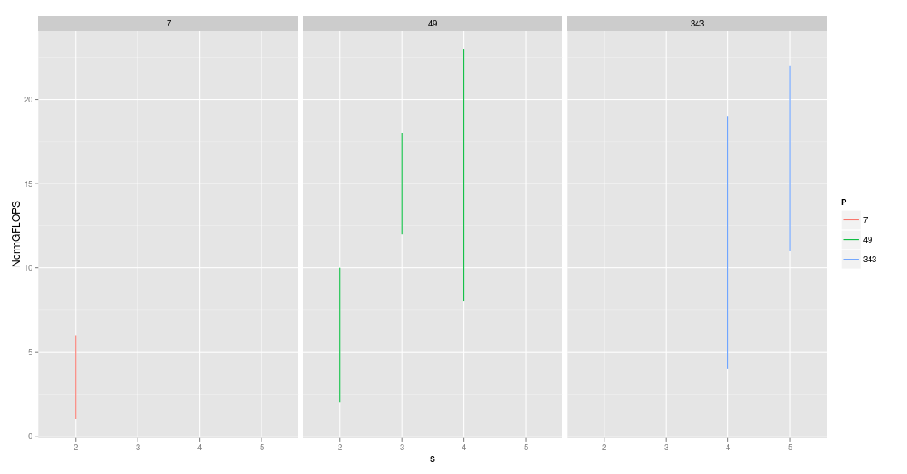
Picking Correct Parameters
k = log_7(P)
n = 2^s*7^(k/2)*scale
l = log_2(4n / (P^(1/2.8) * sqrt(M))

Slide 13
Observations
CAPS has optimal communication for Strassen's Algorithm
As we more towards Exaflop machines the advantage of this algorithm will grow
Similar folding ideas can be applied to other algorithms
Achieving peak performance is an art with how sensitive parameters are in CAPS

Slide 14
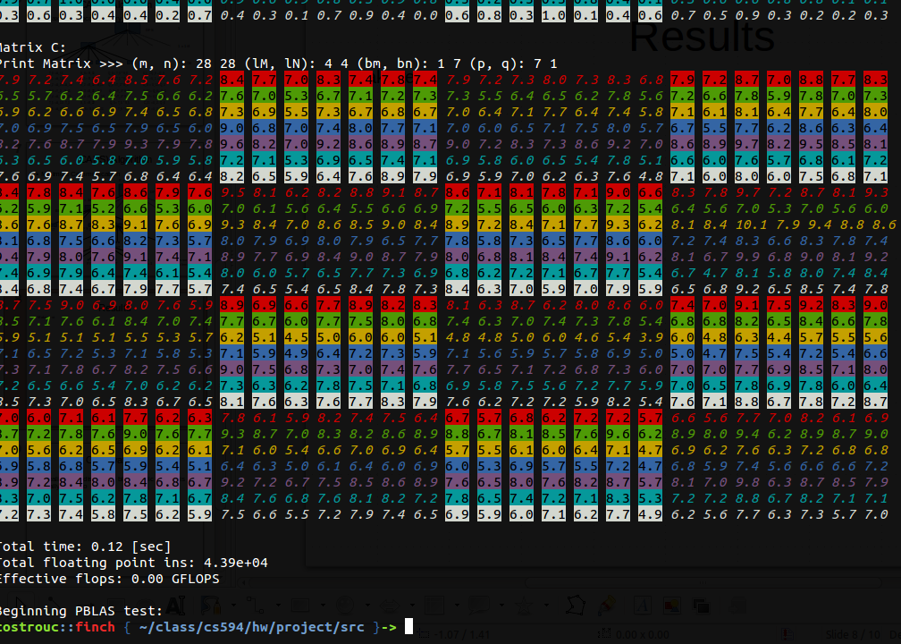
Thanks!
My debugger
I would like to heavily acknowledge the paper written
by James Demmel and his group “Communication-Optimal
Parallel Algorithm for Strassen's Matrix Multiply”.
As my whole project was based on their algorithm.
CAPS - Berkeley
https://github.com/lipshitz/CAPS

