Slide 1
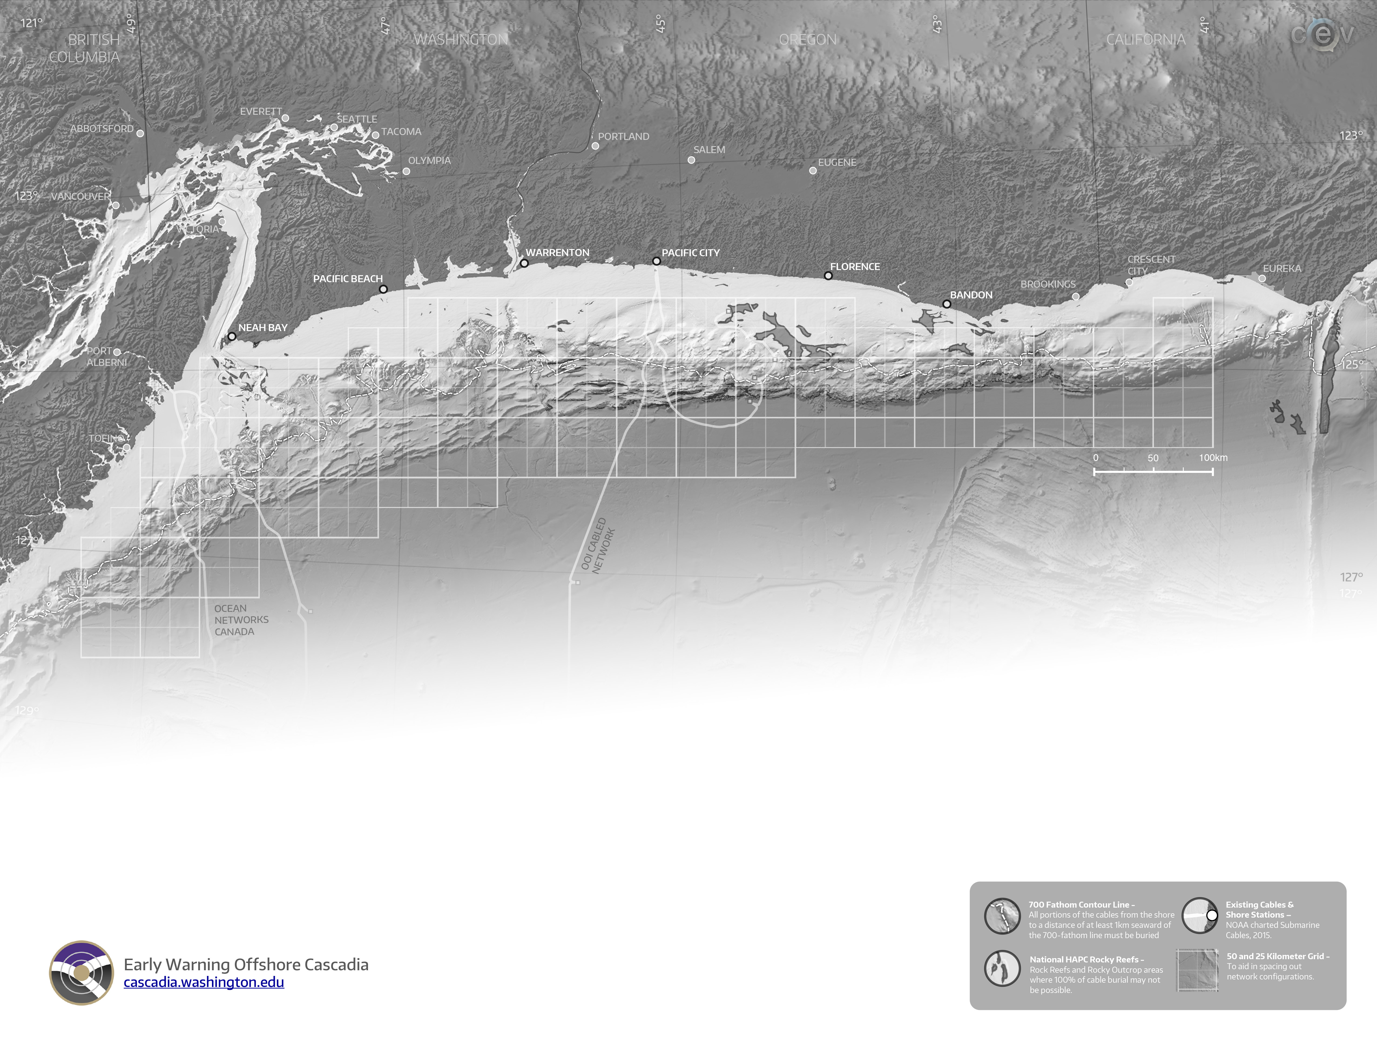
Seismic+Pressure – Hardwired
Seismic+Pressure – Hardwired + 10W Wireless Connection
Branching Unit
500 Watts Junction Box – With ROV Wet Mates
GPS Buoy

Slide 2
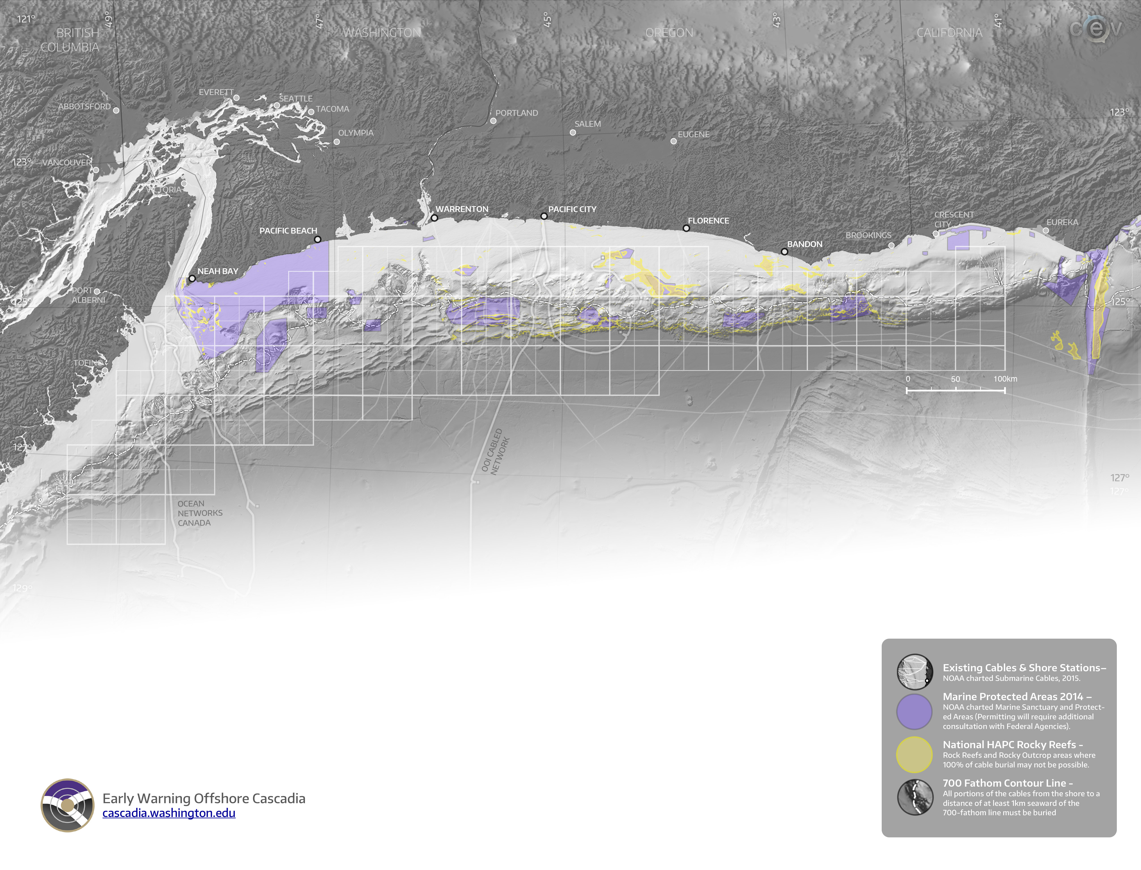
Seismic+Pressure – Hardwired
Seismic+Pressure – Hardwired + 10W Wireless Connection
Branching Unit
500 Watts Junction Box – With ROV Wet Mates
GPS Buoy

Slide 3
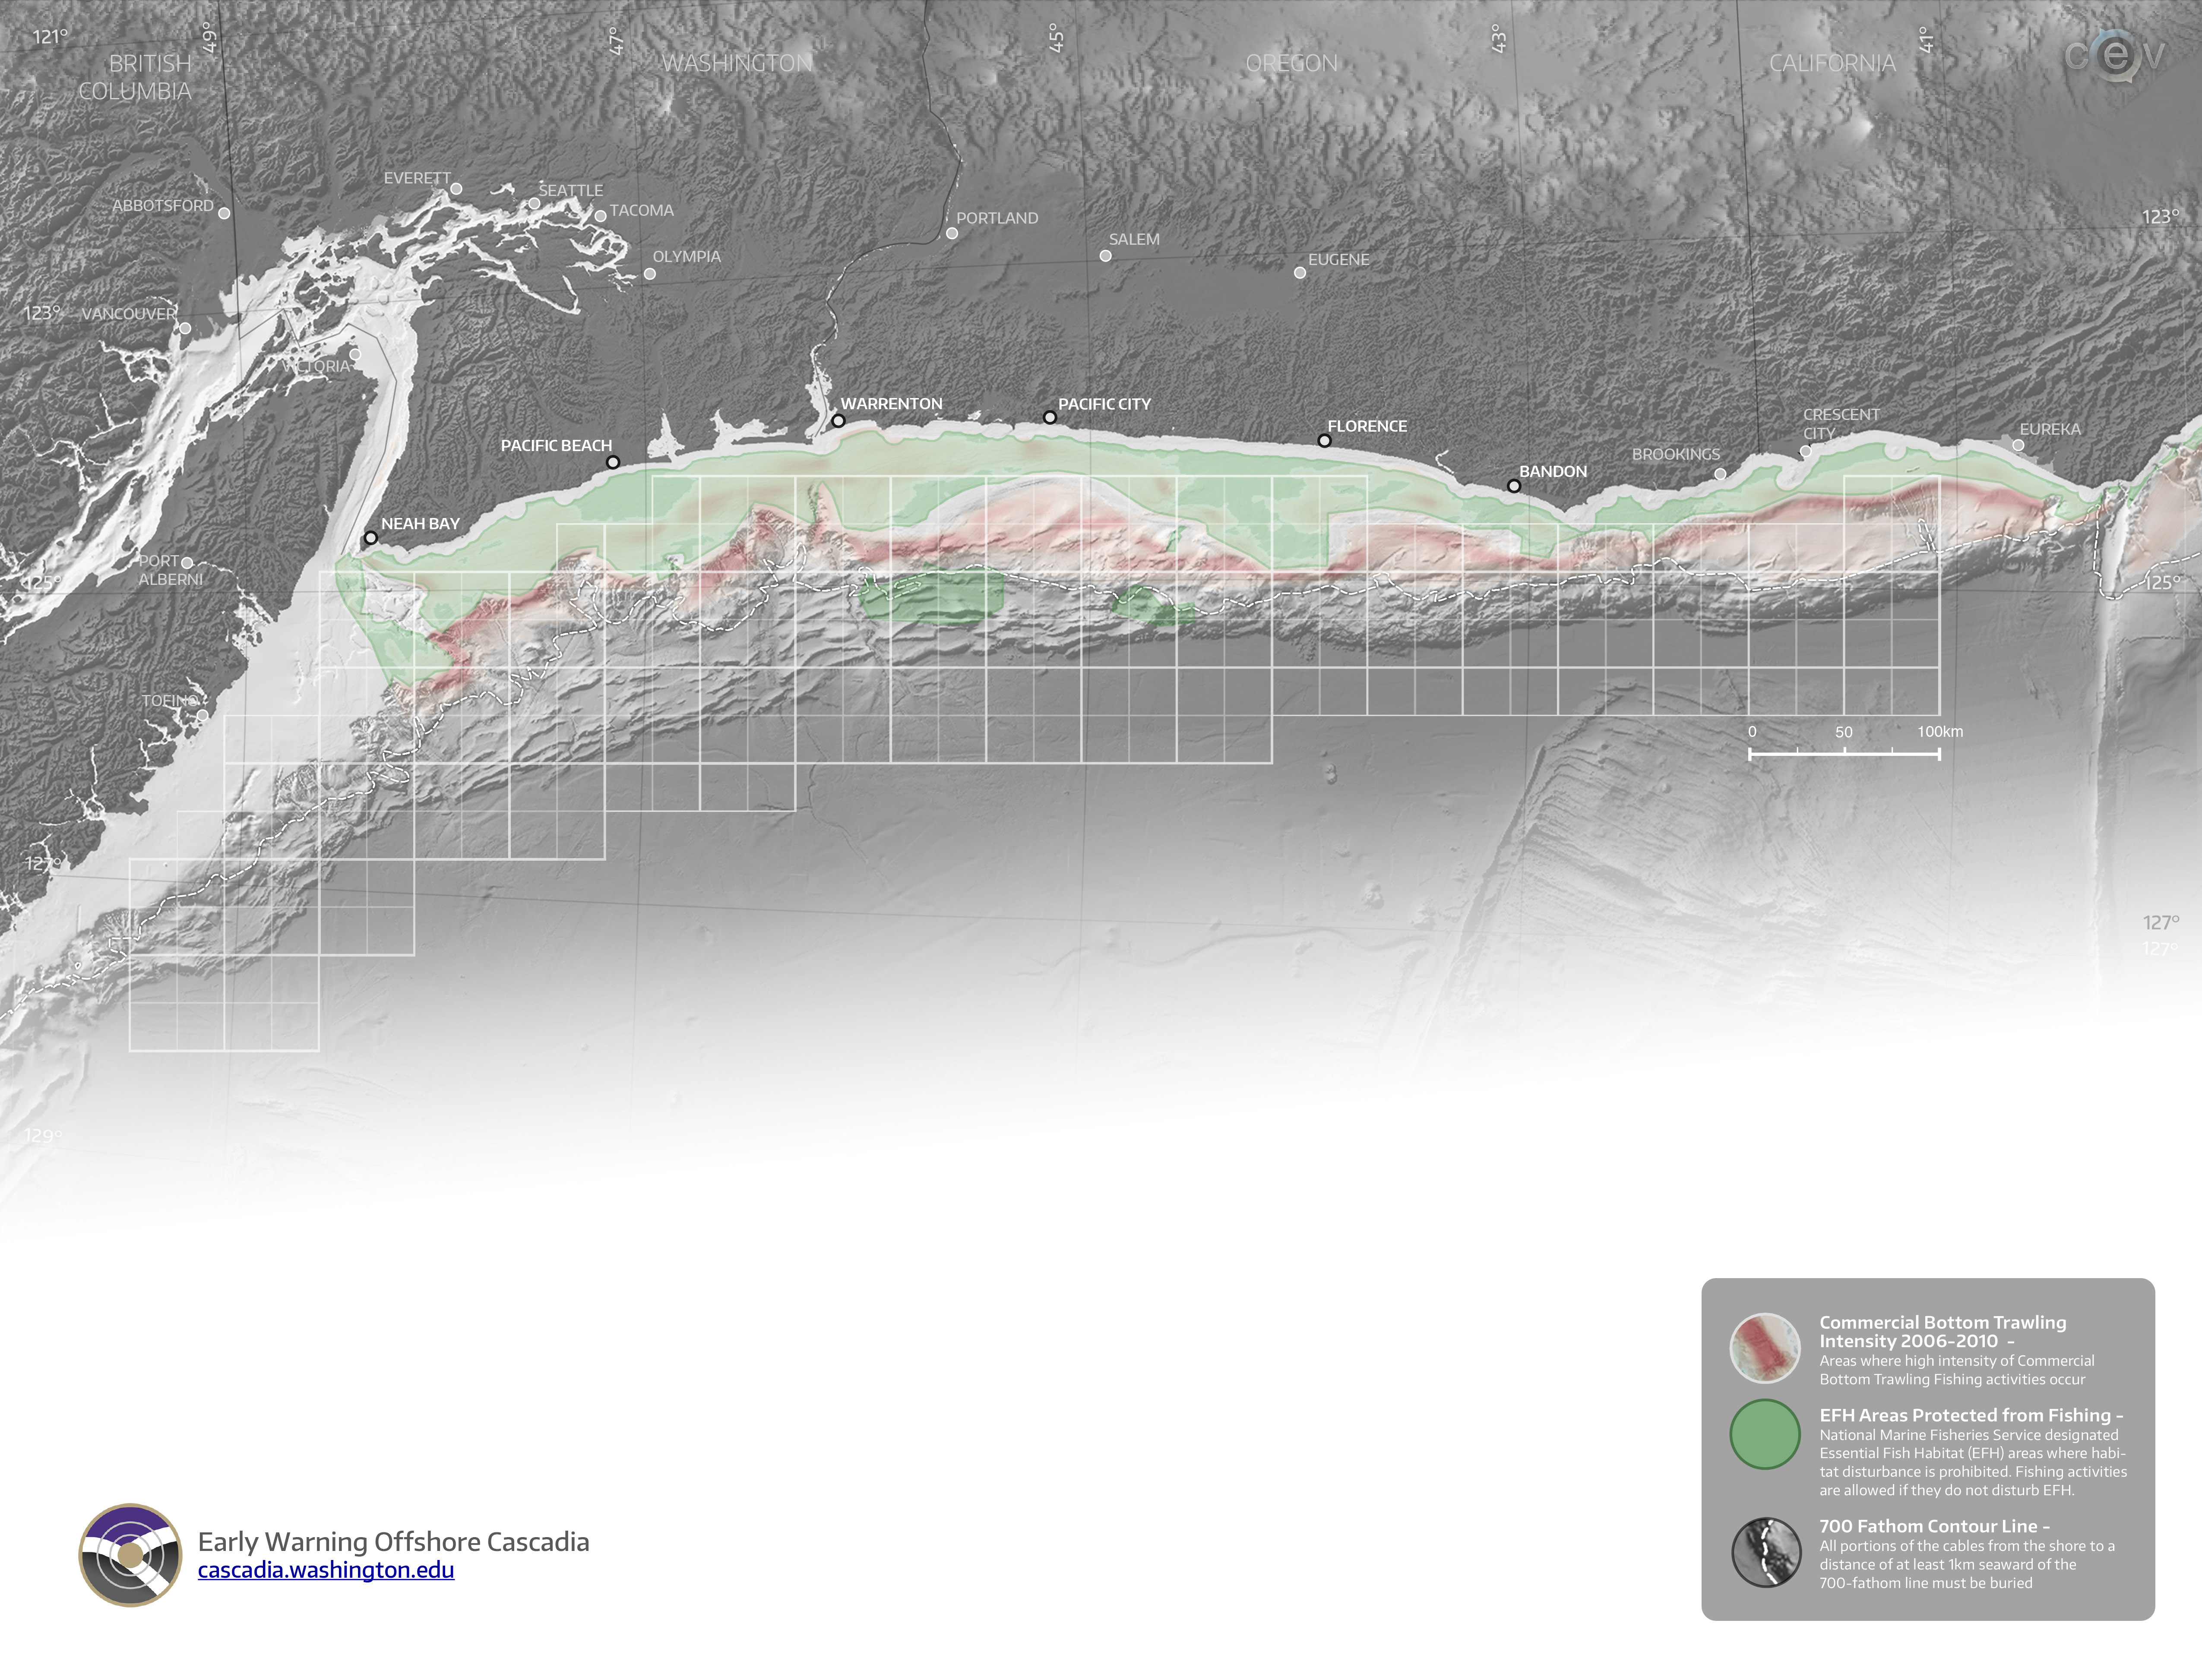
Seismic+Pressure – Hardwired
Seismic+Pressure – Hardwired + 10W Wireless Connection
Branching Unit
500 Watts Junction Box – With ROV Wet Mates
GPS Buoy

Slide 4
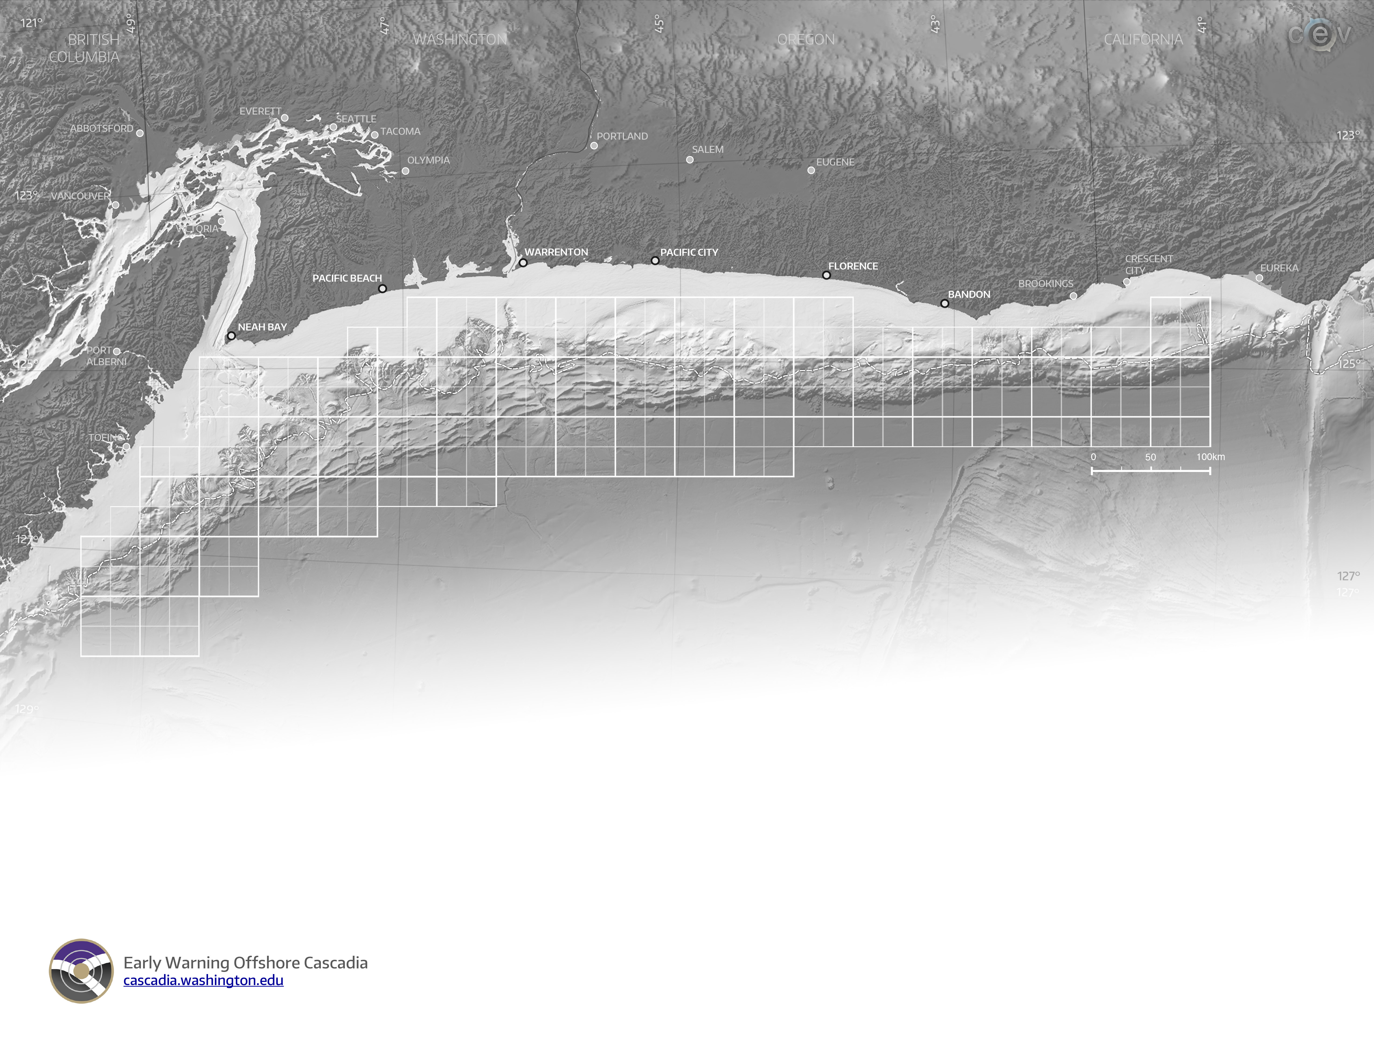
Seismic+Pressure – Hardwired
Seismic+Pressure – Hardwired + 10W Wireless Connection
Branching Unit
500 Watts Junction Box – With ROV Wet Mates
GPS Buoy

Slide 5
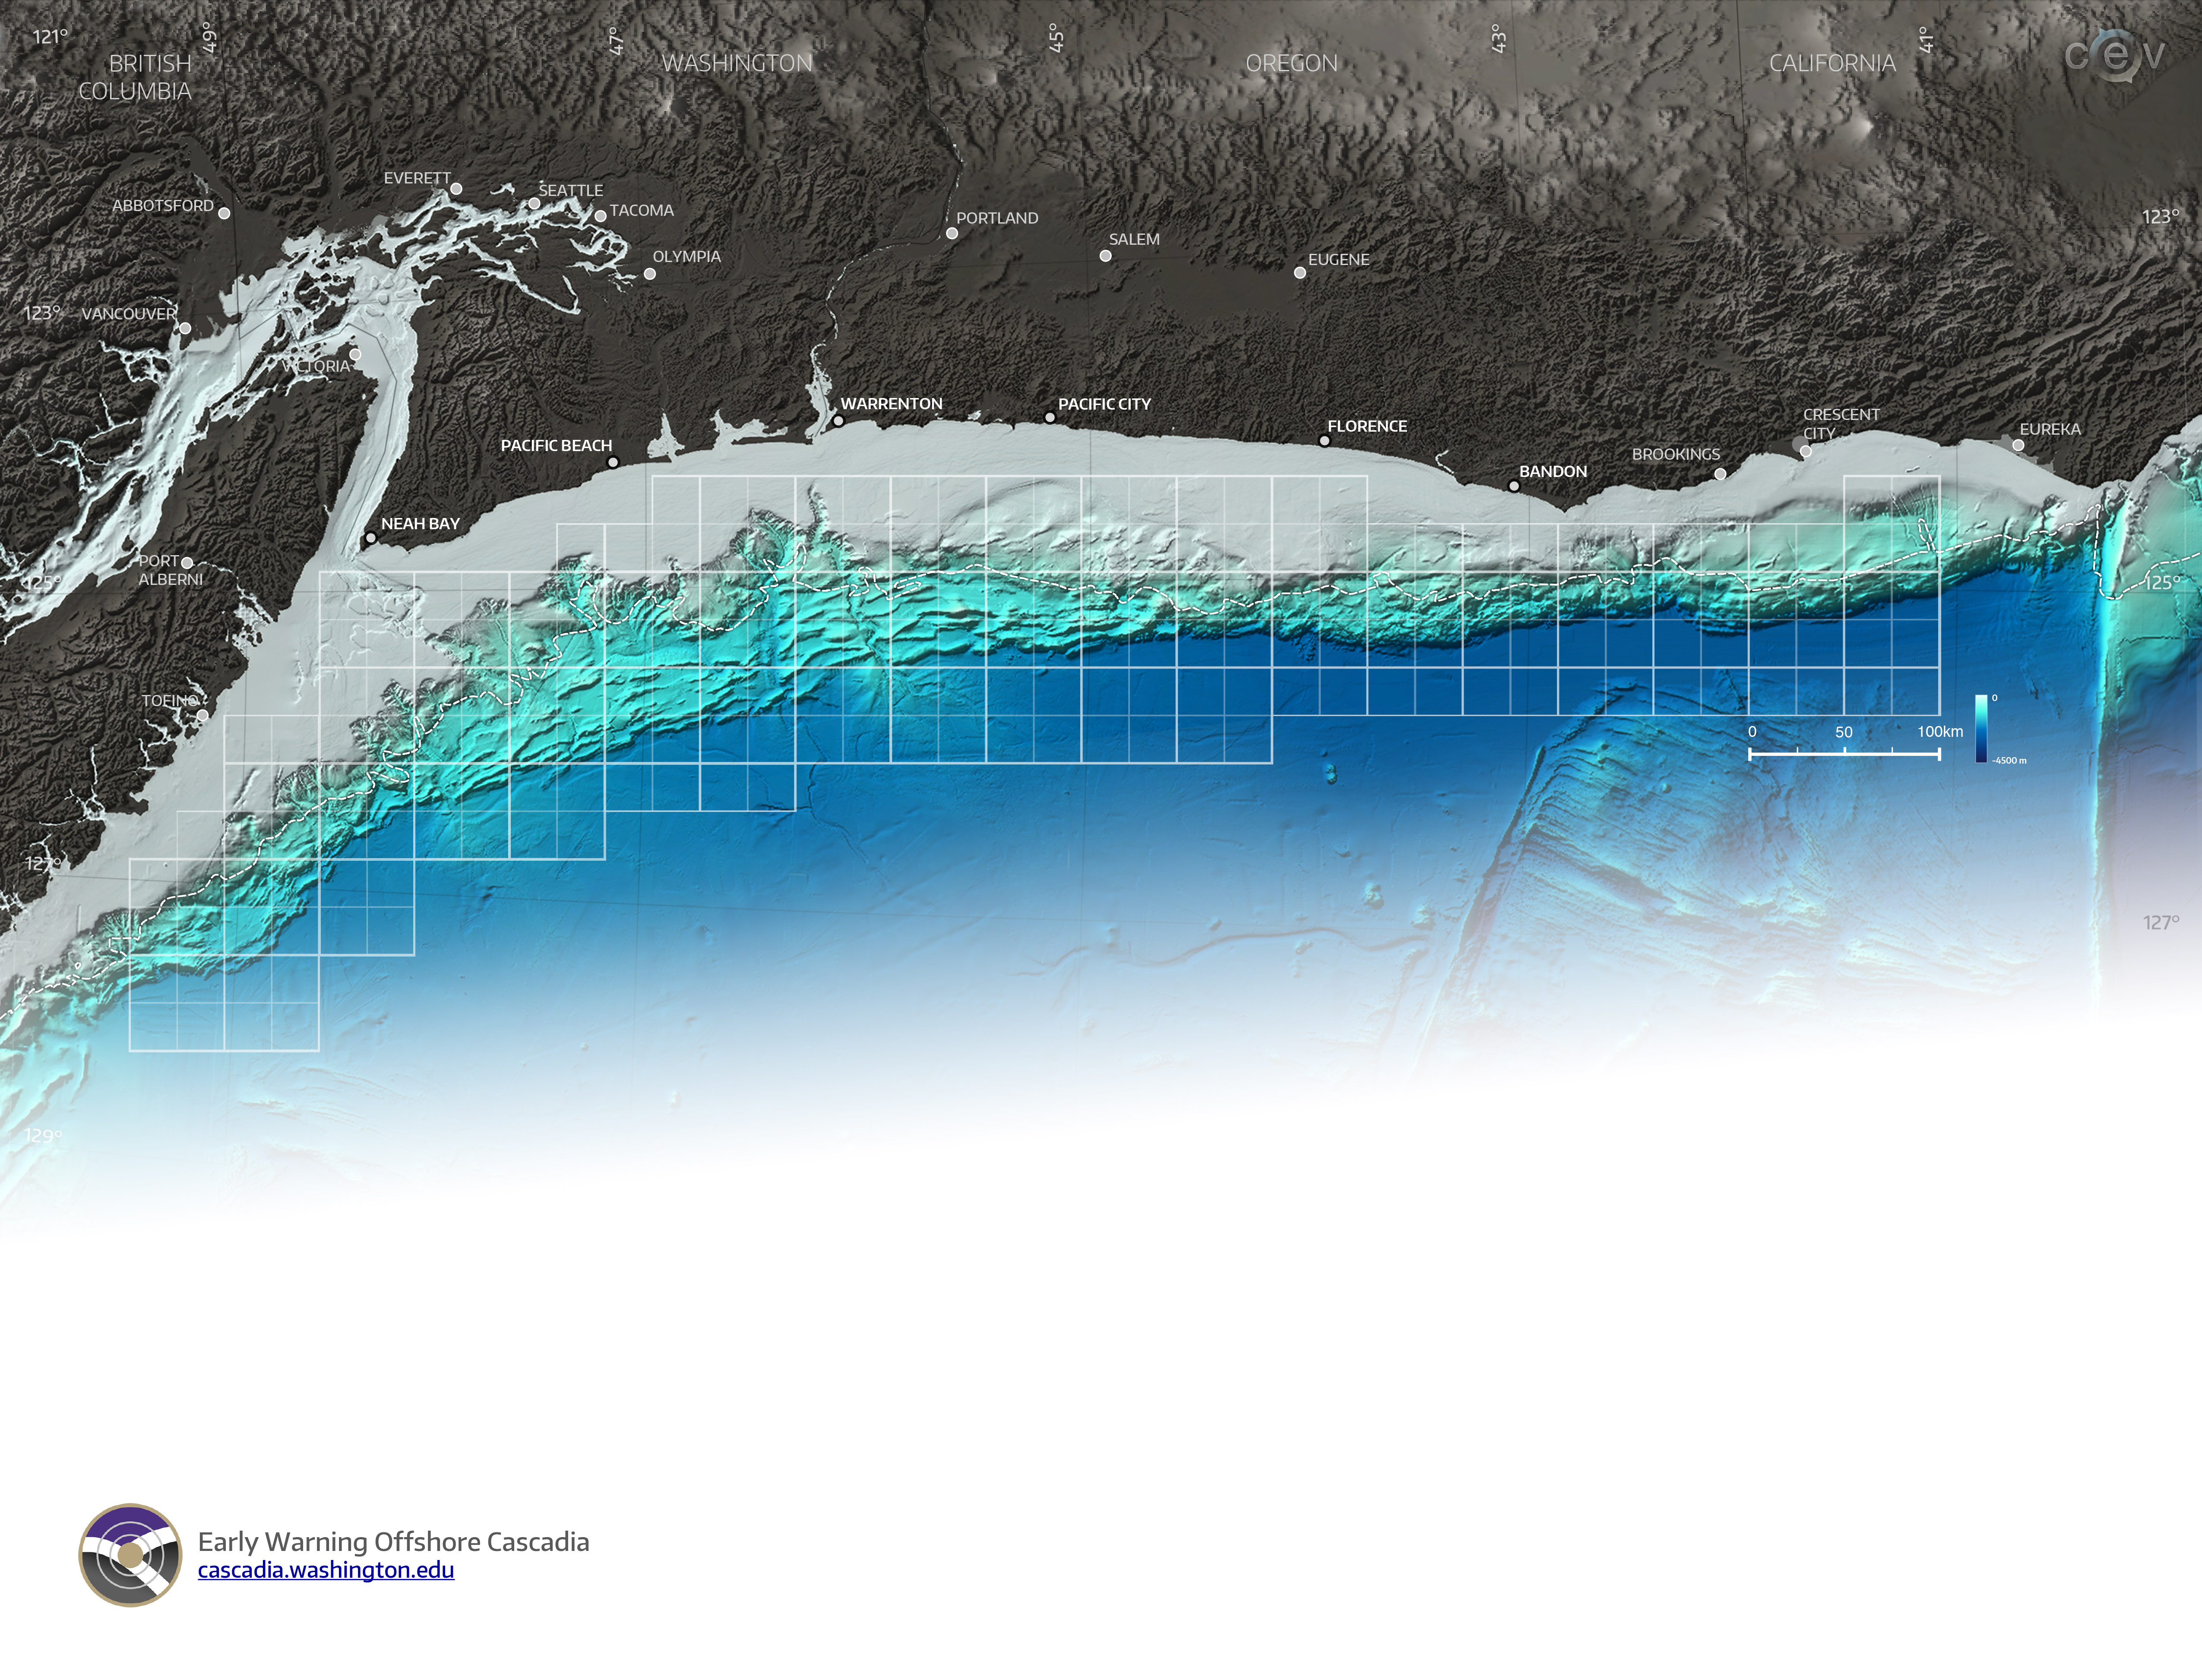
Seismic+Pressure – Hardwired
Seismic+Pressure – Hardwired + 10W Wireless Connection
Branching Unit
500 Watts Junction Box – With ROV Wet Mates
GPS Buoy

