Slide 1


CodeIgniter
Framework

Slide 2
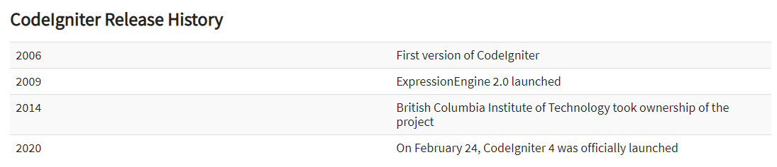

Slide 3


CodeIgniter
What is CodeIgniter?
CodeIgniter Features
Small footprint

Slide 4
CODEIGNITER
Blazing fast
Loosely coupled
Short learning curve

Slide 5
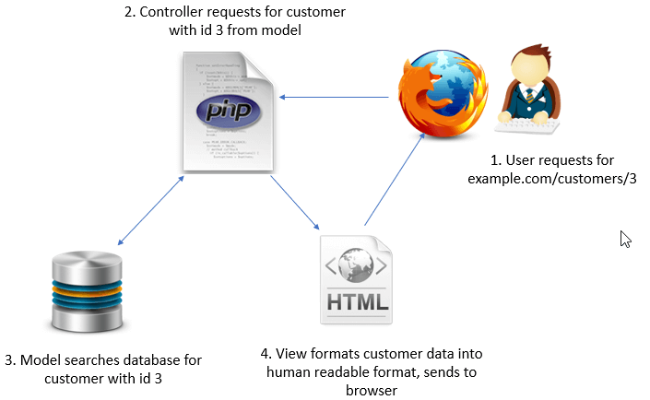
How CodeIgniter Works?

