Slide 1

Graph database with Neo4j
Mitja J. Kotnik

Slide 2

Graph databases
Handle and store data relationships
Two elements: a node and a relationship
Node -> entity (person, category,…)
Relationship -> connection between two nodes (visits, has,…)
Property -> name/value pairs
Relationships have priority in graph databases
No broken links -> delete node & relationship
Minutes-to-Miliseconds Performance
Responsive

Slide 3
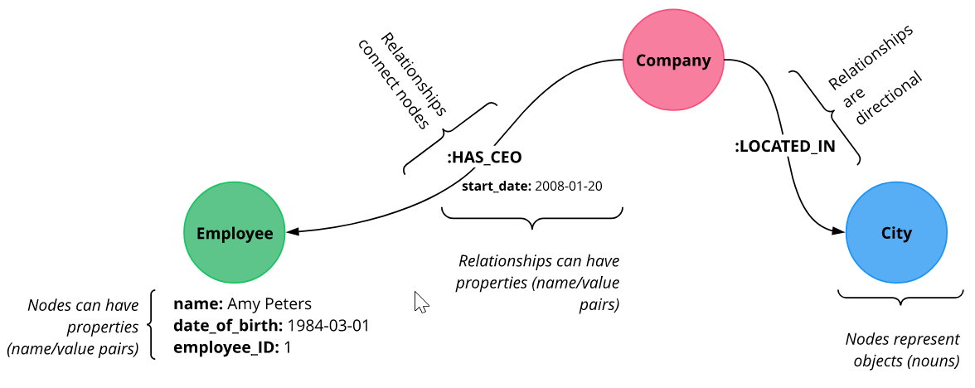

Slide 4
Relational vs Graph Models
Graph database (next generation relational database)
Each node in graph database has list of relationships
No need of JOIN operations (expensive search/match comutation)
Each entity table -> label on node
Each row -> is a node
Each column -> node property
Join tables -> relationships

Slide 5
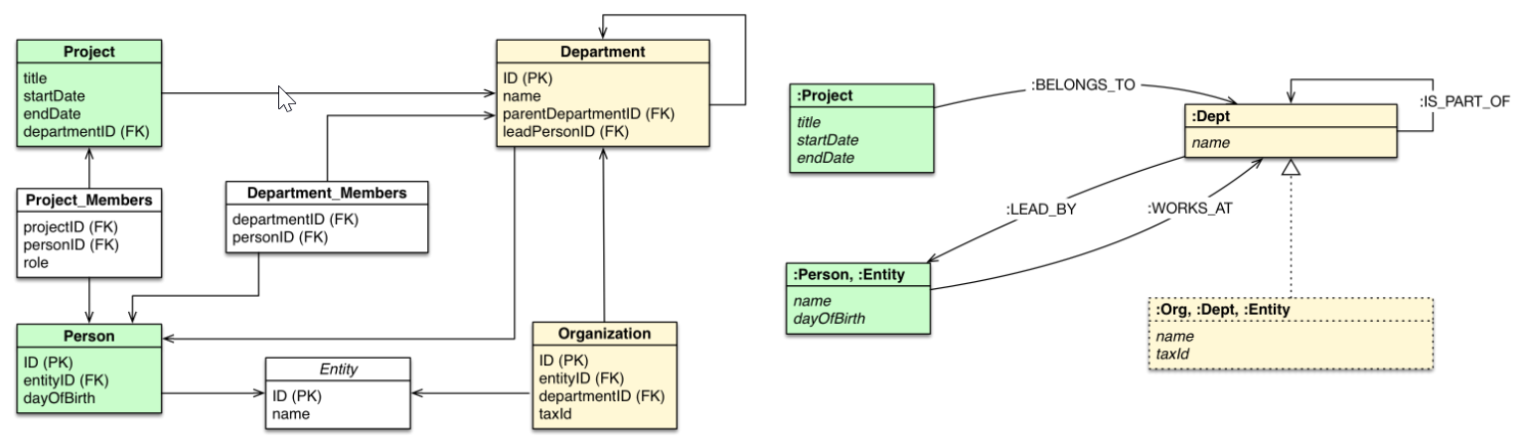

Slide 6
SQL vs. Cypher
SQL performance issues with connected data
Data-relationships SQL query – multiple liner (Cypher – few lines)
Lengthly SQL queries -> time to run / human coding mistakes
Short queries -> more readable / less mistakes
SQL (tables and joins) / Cypher (relationships between entities)
Cypher – query language for graph technologies (openCypher)

Slide 7
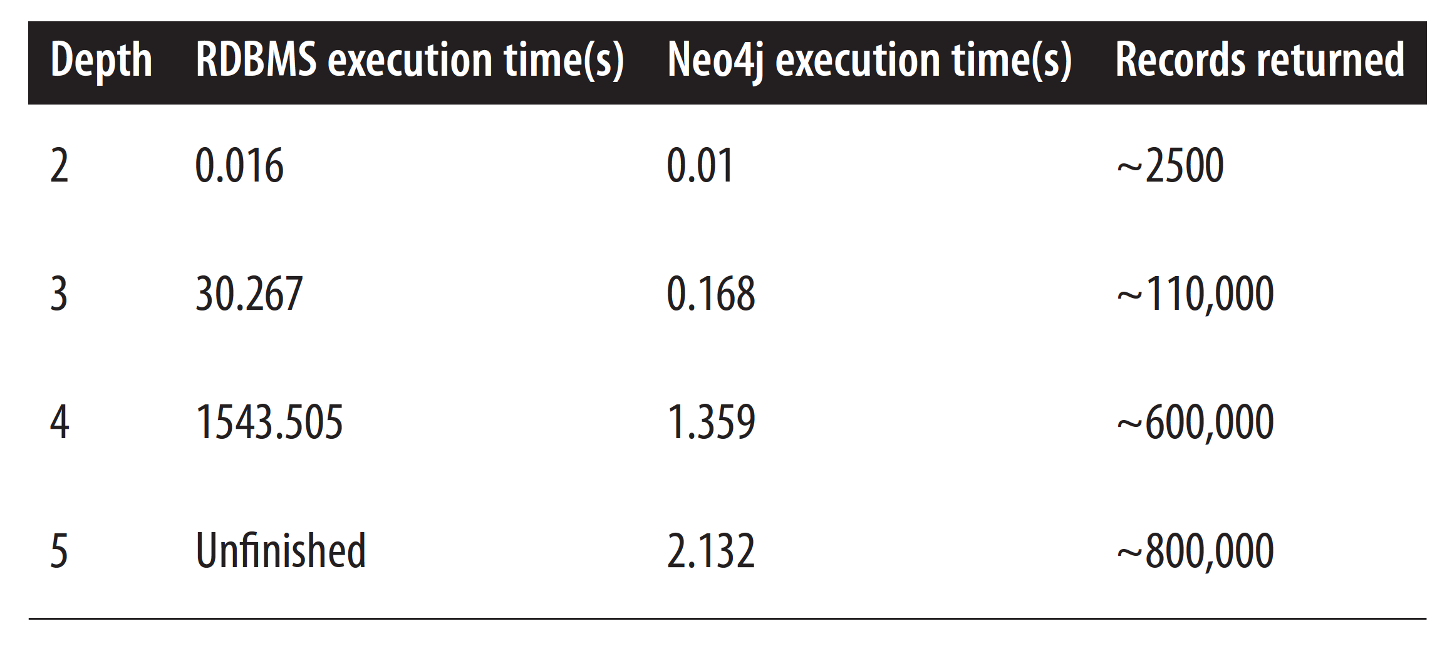

Slide 8
Import data from RDBMS to Graph
Three types of import
Migrate all data
Migrate graph data
Duplicate graph data
LOAD CSV
Neo4j-import command (bulk insert)

Slide 9

Cypher
Uses Ascii-art syntax
(a) –[:LIKES]-> (b)
(p:Person) – nodes
-[k:KNOWS]-> - relationships

Slide 10
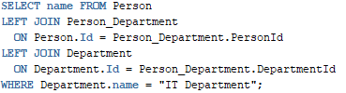


Slide 11
Cypher examples
CREATE
CREATE (a:Artist { Name : "Strapping Young Lad" })
(a)-[r:RELEASED]->(b)
RETURN
CREATE (a:Album { Name: "Killers"}), (b:Album { Name: "Fear of the Dark"})
RETURN a,b
MATCH (p:Person)
WHERE p.Name = „Kevin Spacey“
DELETE

