Slide 1
When it comes to scheduling algorithms many different ones pick and choose the different processes and the orders that the processess get CPU time.
The Round Robin Scheduling algorithm is the fairest of them all. What I mean to say is each process, no matter the amount of CPU time needed to be completed, all get the same CPU burst times.

Slide 2
Definitions
-Time Quantum – the amount of time the CPU gives each process per CPU burst until the CPU moves to the next process.
-Waiting time – the amount of time the process spends waiting on the CPU after it has been added to the queue to finish the process.
-Preemption – An interrupt is allowed during the process execution i.e. if the CPU is working on a process and another process wants the CPU’s attention the CPU can move to the process that caused the interrupt.
-CPU Utilization – always keep the CPU busy; don’t waste this resource!
-Ready Queue – the queue of processes with their respective order of execution; its treated as a circular queue with the RR algorithm.
-Turnaround time – time between submission and completion

Slide 3
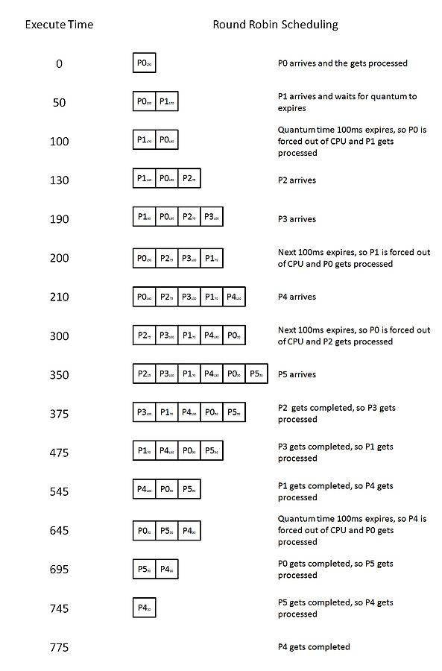
Time Quantum: 100
Process Name Arrival Time Execute Time
P0 0 250
P1 50 170
P2 130 75
P3 190 100
P4 210 130
P5 350 50

Slide 4
Time Quantum: 100
Process Name Arrival Time Execute Time
P0 0 250
P1 50 170
P2 130 75
P3 190 100
P4 210 130
P5 350 50
9 context shifts
Gantt Chart
P0 | P1 | P0 | P2 | P3 | P1 | P4 | P0 | P5 | P4
0 100 200 300 375 475 545 645 695 745 775

Slide 5
Below is the Waiting times of the Processes
Processes | Time waited until the first CPU time was received | Time waited after the first wait time |  | Throughput
P0 | 100 | 345 |  | 5/775
P1 | 50 | 275 |  | = 0.00645
P2 | 170
P3 | 185
P4 | 335 | 100
P5 | 345
Sum all of the waiting times/# of processes: | 1905/5
Overall Average Waiting Time = | 381

Slide 6
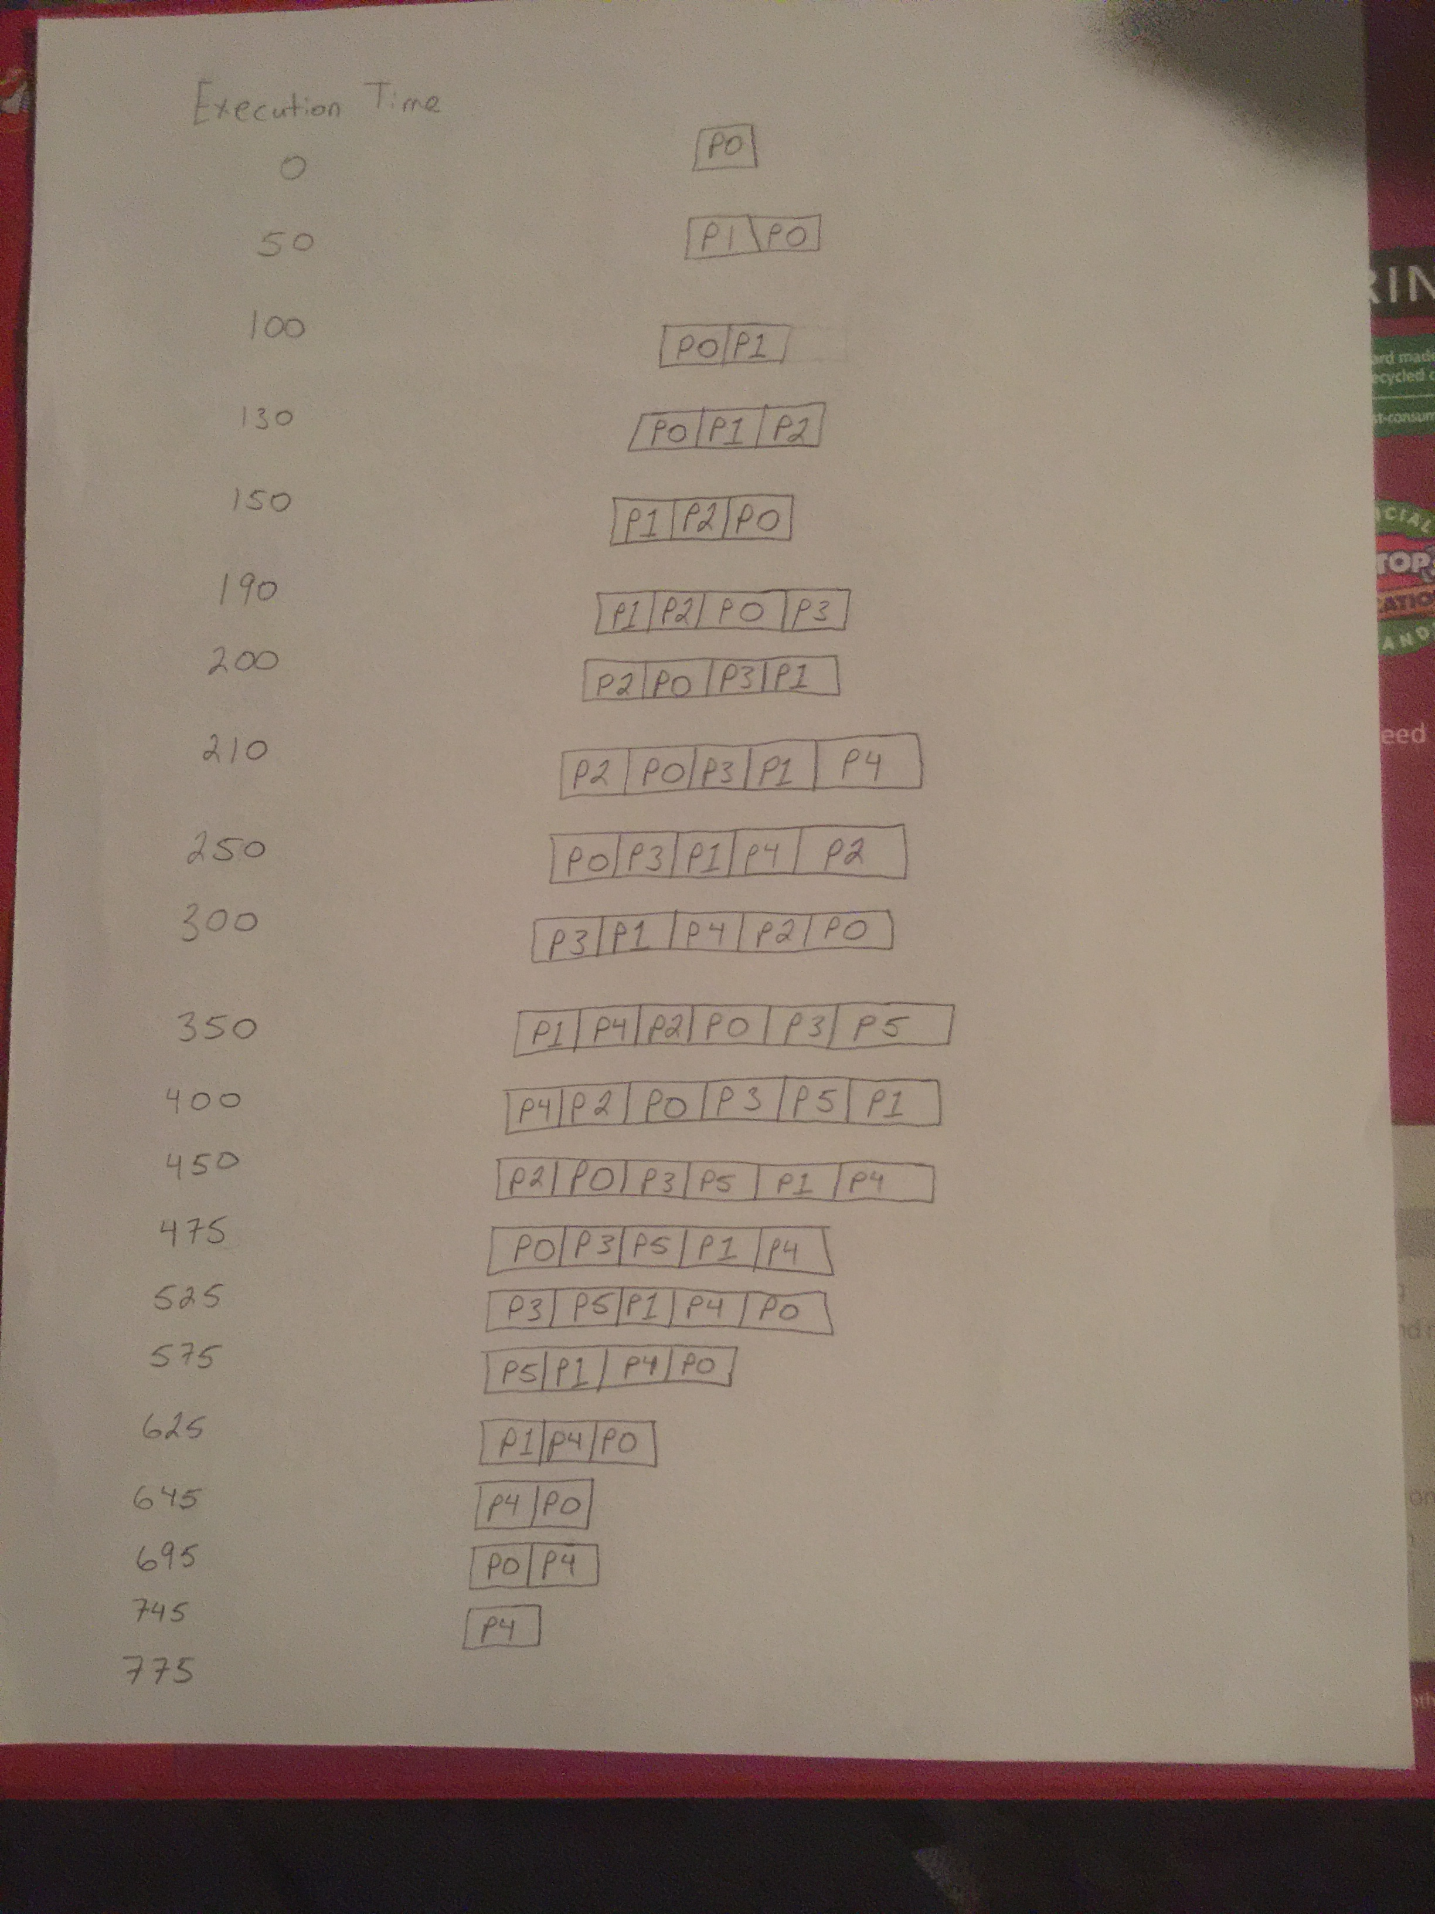
Time Quantum: 50
Process Name Arrival Time Execute Time
P0 0 250
P1 50 170
P2 130 75
P3 190 100
P4 210 130
P5 350 50
16 context shifts
Gantt Chart
P0 | P1 | P0 | P1 | P2 | P0 | P3 | P1 | P4 | P2
0 50 100 150 200 250 300 350 400 450
P0 | P3 | P5 | P1 | P4 | P0 | P4
475 525 575 625 645 695 745 775

Slide 8
Processes |  |  |  |  |  | Throughput
P0 | 50 | 100 | 175 | 170 |  | 5/775
P1 | 50 | 150 | 225 |  |  | = 0.00645
P2 | 70 | 200
P3 | 110 | 225
P4 | 190 | 195 | 50
P5 | 225
Sum all of the waiting times/# of processes: | 2135/5
Overall Average Waiting Time = | 427

Slide 9
Considering the Time Quantum
Time quantum context switches
11 0
7 1
0.5 20
0 10
0 7 10
0 0.5 1 1.5 2 2.5 3 3.5 4 4.5 5 5.5 6 6.5 7 7.5 8 8.5 9 9.5 10
We want the time quantum to be large with respect to the context switch… though we don’t want it too large.
If the time quantum is too large, RR scheduling turns into a First Come First Serve Scheduling Algorithm.
If the time quantum is too small, there will be too many context switches which can be costly.
A good rule is to make 80% of the CPU bursts shorter than the time quantum.

Slide 10
Ex: if there are 10 processes and 8 of them have a required CPU burst time of 80 then it would be an okay decision to choose a time quantum of 80.

Slide 11
Improving turnaround time
It is about choosing the right time quantum. The smaller the time quantum gets the more context switches are needed which in turn increases the turnaround time (the time from submission to completion).

