Slide 1
Rapid Prototype
Mis-Conceptions: Every single screen has to be replicated in the rapid prototype. If a user selects a button and some new view comes up, the rapid prototype needs to be updated to show this.
Challenges: So many little details
Changes: At just about every increment and even iteration the rapid prototype changed
What we learned: Make sure it is rapid. Many changes will need to happen and we don’t want to waste time!

Slide 2
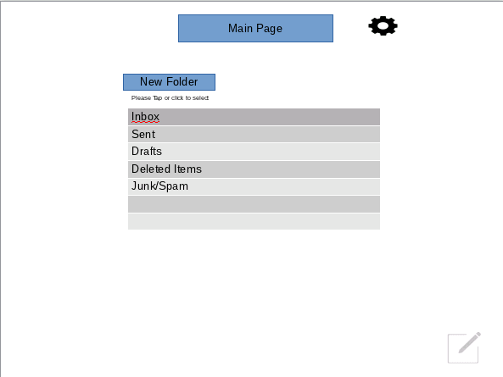
At first we just had this page:

Slide 3
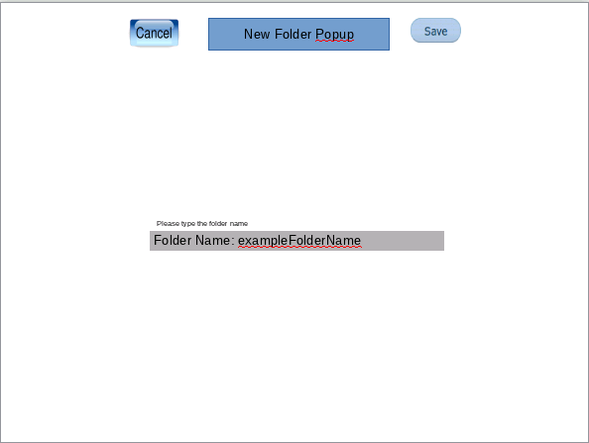
Later we added the new folder popup page

Slide 4
Requirements
Mis-Conceptions:
Challenges: Getting all of the group to agree on what the target project is actually going to do. Constructing all of the features/use cases. I.e. having a priority sender, can we forward emails (or multiple emails at once), can we create new folders.
Changes: There are use cases that are left out as time passes that have to be added, and even some use cases must be removed completely to make the product more feasible to develop.
What we learned: There can begin to be a giant number of use cases create from a small type of software project.

Slide 5
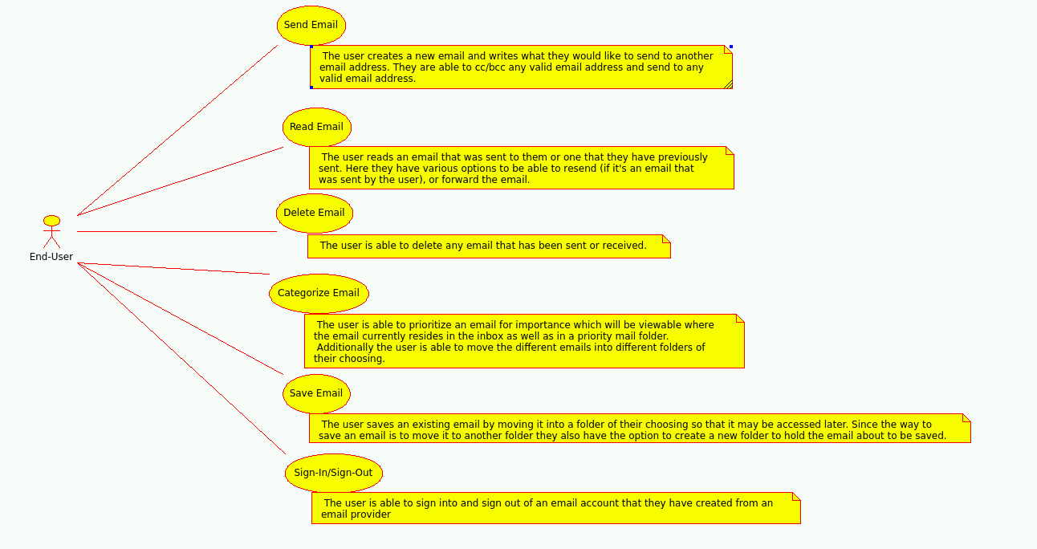
This was our first iteration of our use cases

Slide 6
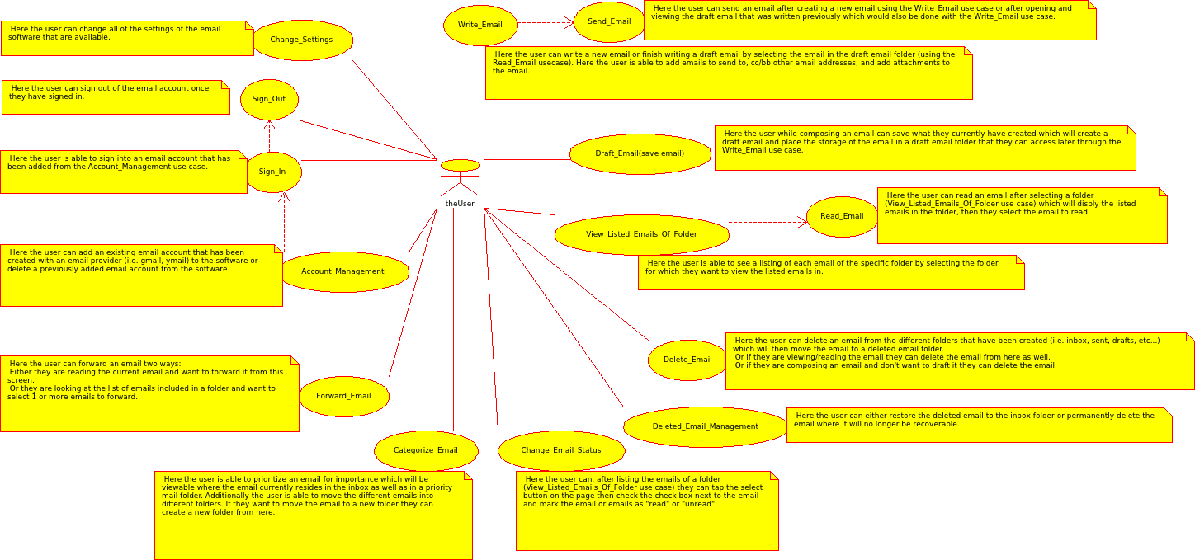
This has an account management use case which is later broken up further

Slide 7
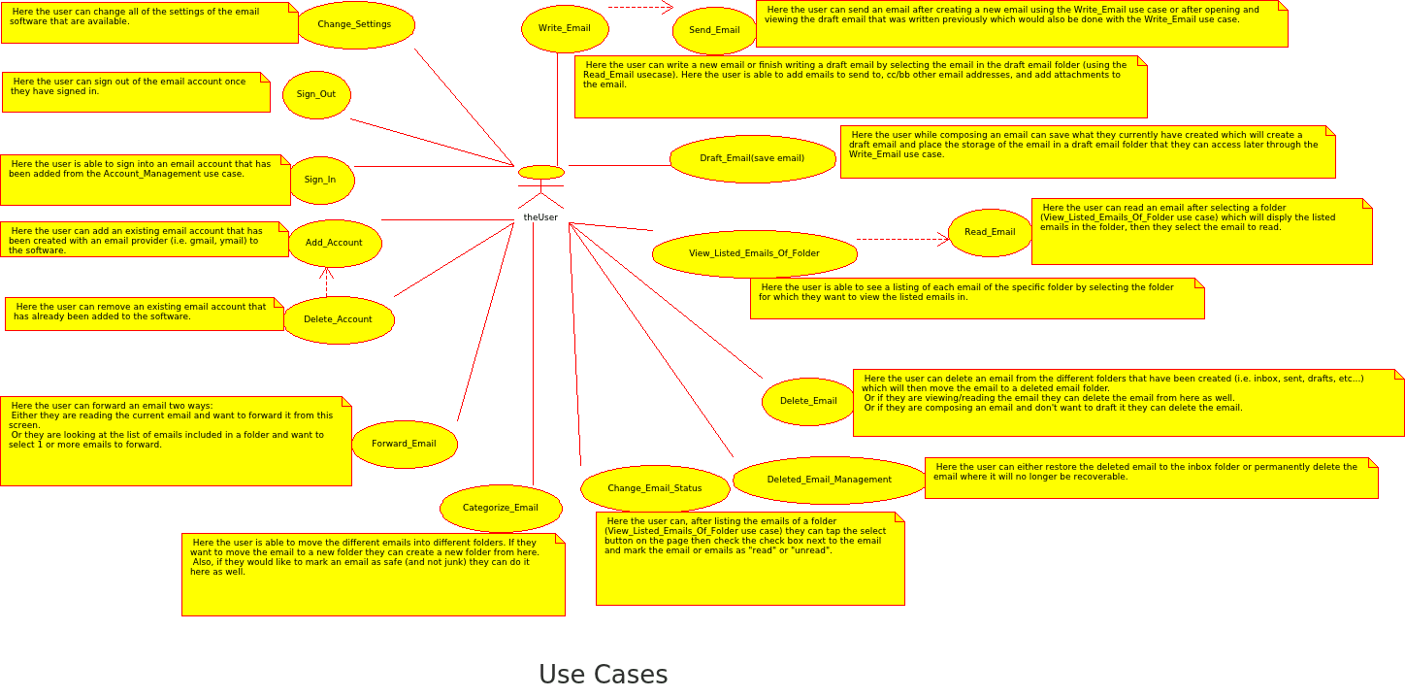
Here is our final iteration of our use cases

Slide 8
Analysis
Mis-Conceptions: Understanding the difference between a state and an action in the state chart and making sure that these things are represented correctly. Also determining the difference between different states that may be very similar, but are still different states at the end of the day. (i.e getting to a compose screen after selecting forward on an email is a different screen…”state”...than getting to a compose screen after selecting reply on an email.
Also understanging that the Sequence Diagram shows the message passing of the classes.
Challenges: Figuring out what all of the Class diagram pieces should be and what all classes are needed to accomplish the task(s) the software project is trying to accomplish.
Changes: We made 3 to 4 iterations to the state chart to get the states taken care of. We consolidated two of the classes into one after realizing a better design and added a few more classes. The Sequence Diagrams had to be completely redon
What we learned: Things change through every stage in the cycle. And when something changes it “trickles down” all the way back to the rapid prototype. Also, every state in the application has to be replicated. Which can be exhausting. It is a good thing to have multiple eyes looking over the information; it’s easy to miss things when so much data is going into a diagram.

Slide 9
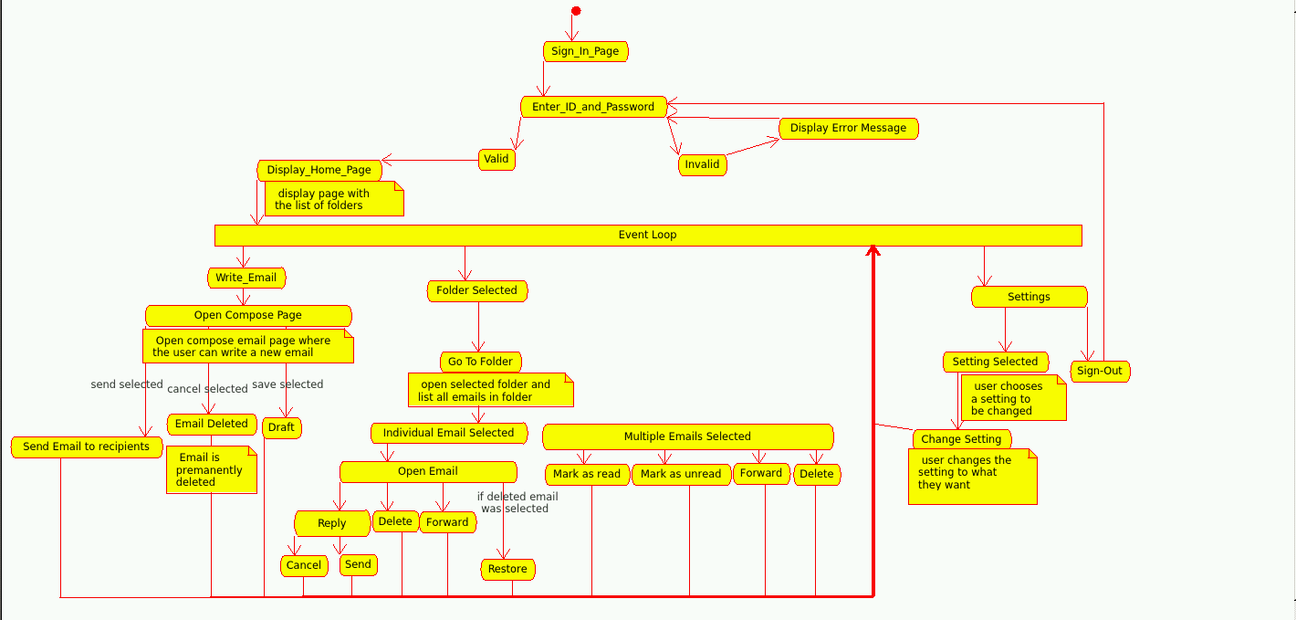
This is one of our first iterations of the state chart

Slide 10
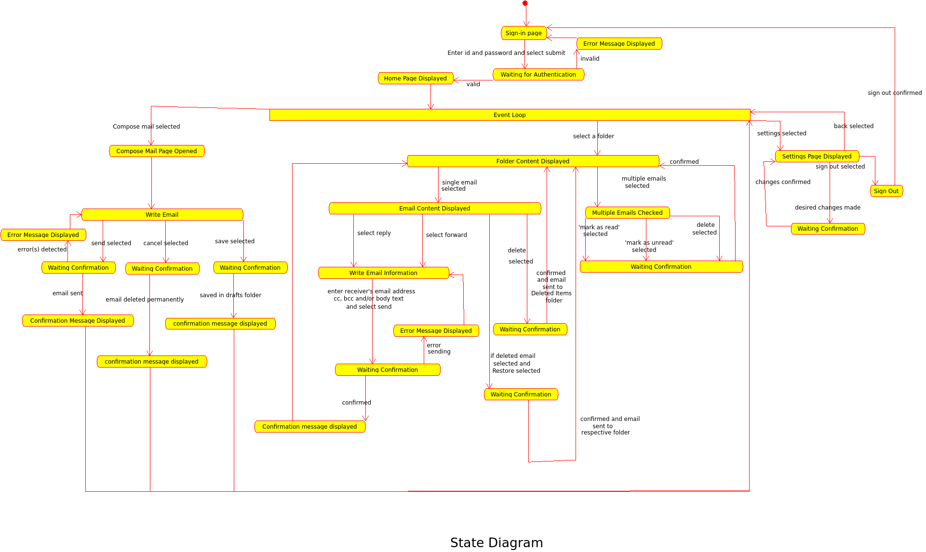
Final iteration of our state diagram

Slide 11
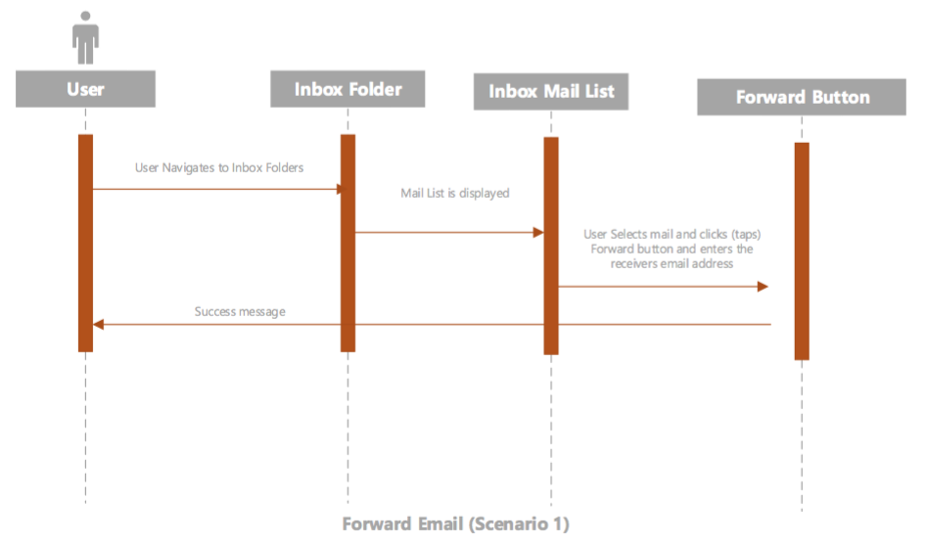
This was our first iteration of our scenarios

Slide 12
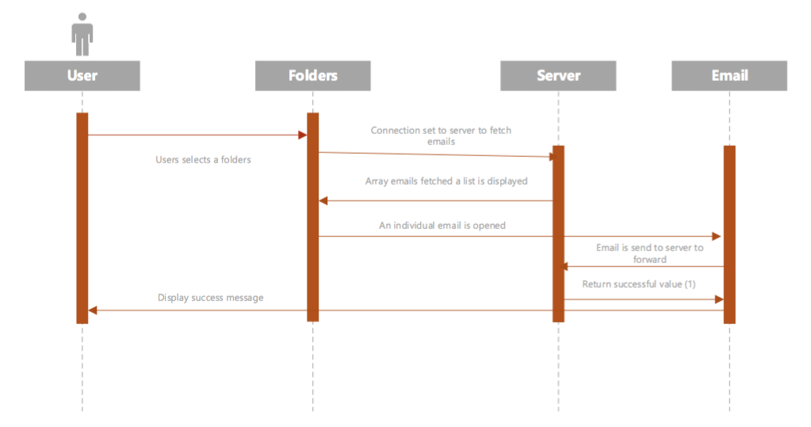
Final iteration of our scenarios

Slide 13
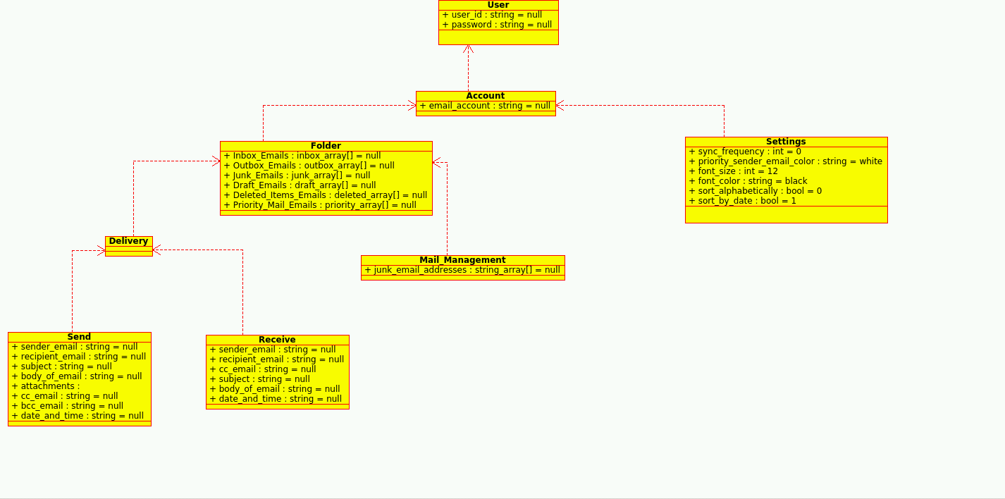
One of our first iterations of our class diagram

Slide 14
Design
Mis-Conceptions: Understanding that the pseudo code is almost line for line that the implementation code would be. And not everyone does the pseudo code the same.
Challenges: Hooking up each others class implementations and combining them all together was… a different kind of experience. Some of the functions that I wrote in my Email class Suzal wrote in his Folder class so extra work was being done which was resolved after a few meetings.
Changes: We ran into an issue with completing our Class Diagram and had to alter the way the properties were set up.
What we learned: Code walkthroughs saved us a lot of issues since we were able to communicate the issues with the duplicated code we had which allowed us to assign the responsibility of that particular piece of code to just one class and once it was done the other person could just call on that method and use it with minimal effort.
Also, during the design we decided to take out a few features that were going to be more of a problem than anything which helped a lot in getting the project completed. And just like in every other phase, when something is change, the changes trickle back down all they way to the rapid prototype (pretty much)

Slide 15
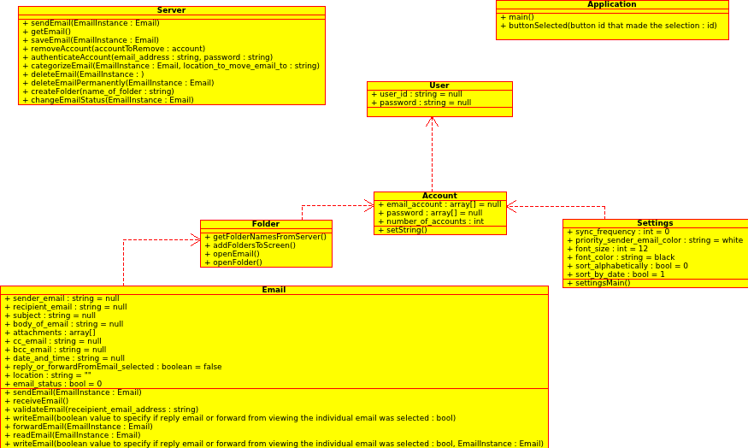
Final iteration of our class diagram

