Slide 1
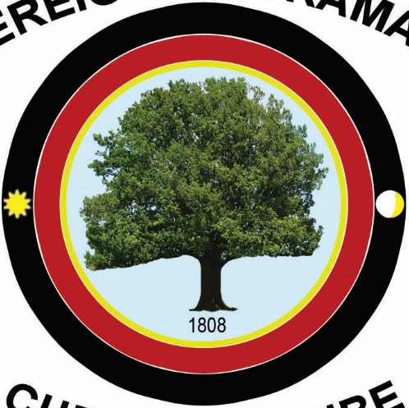
Sovereign Chickamauga
Cherokee Tribe

