Slide 1

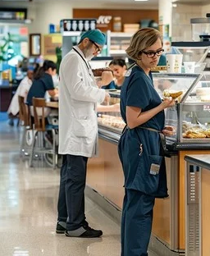
Hospital Cafeteria Optimization
Prepared by Candice Filar

Slide 2

Outline
Problem Statement

Slide 3
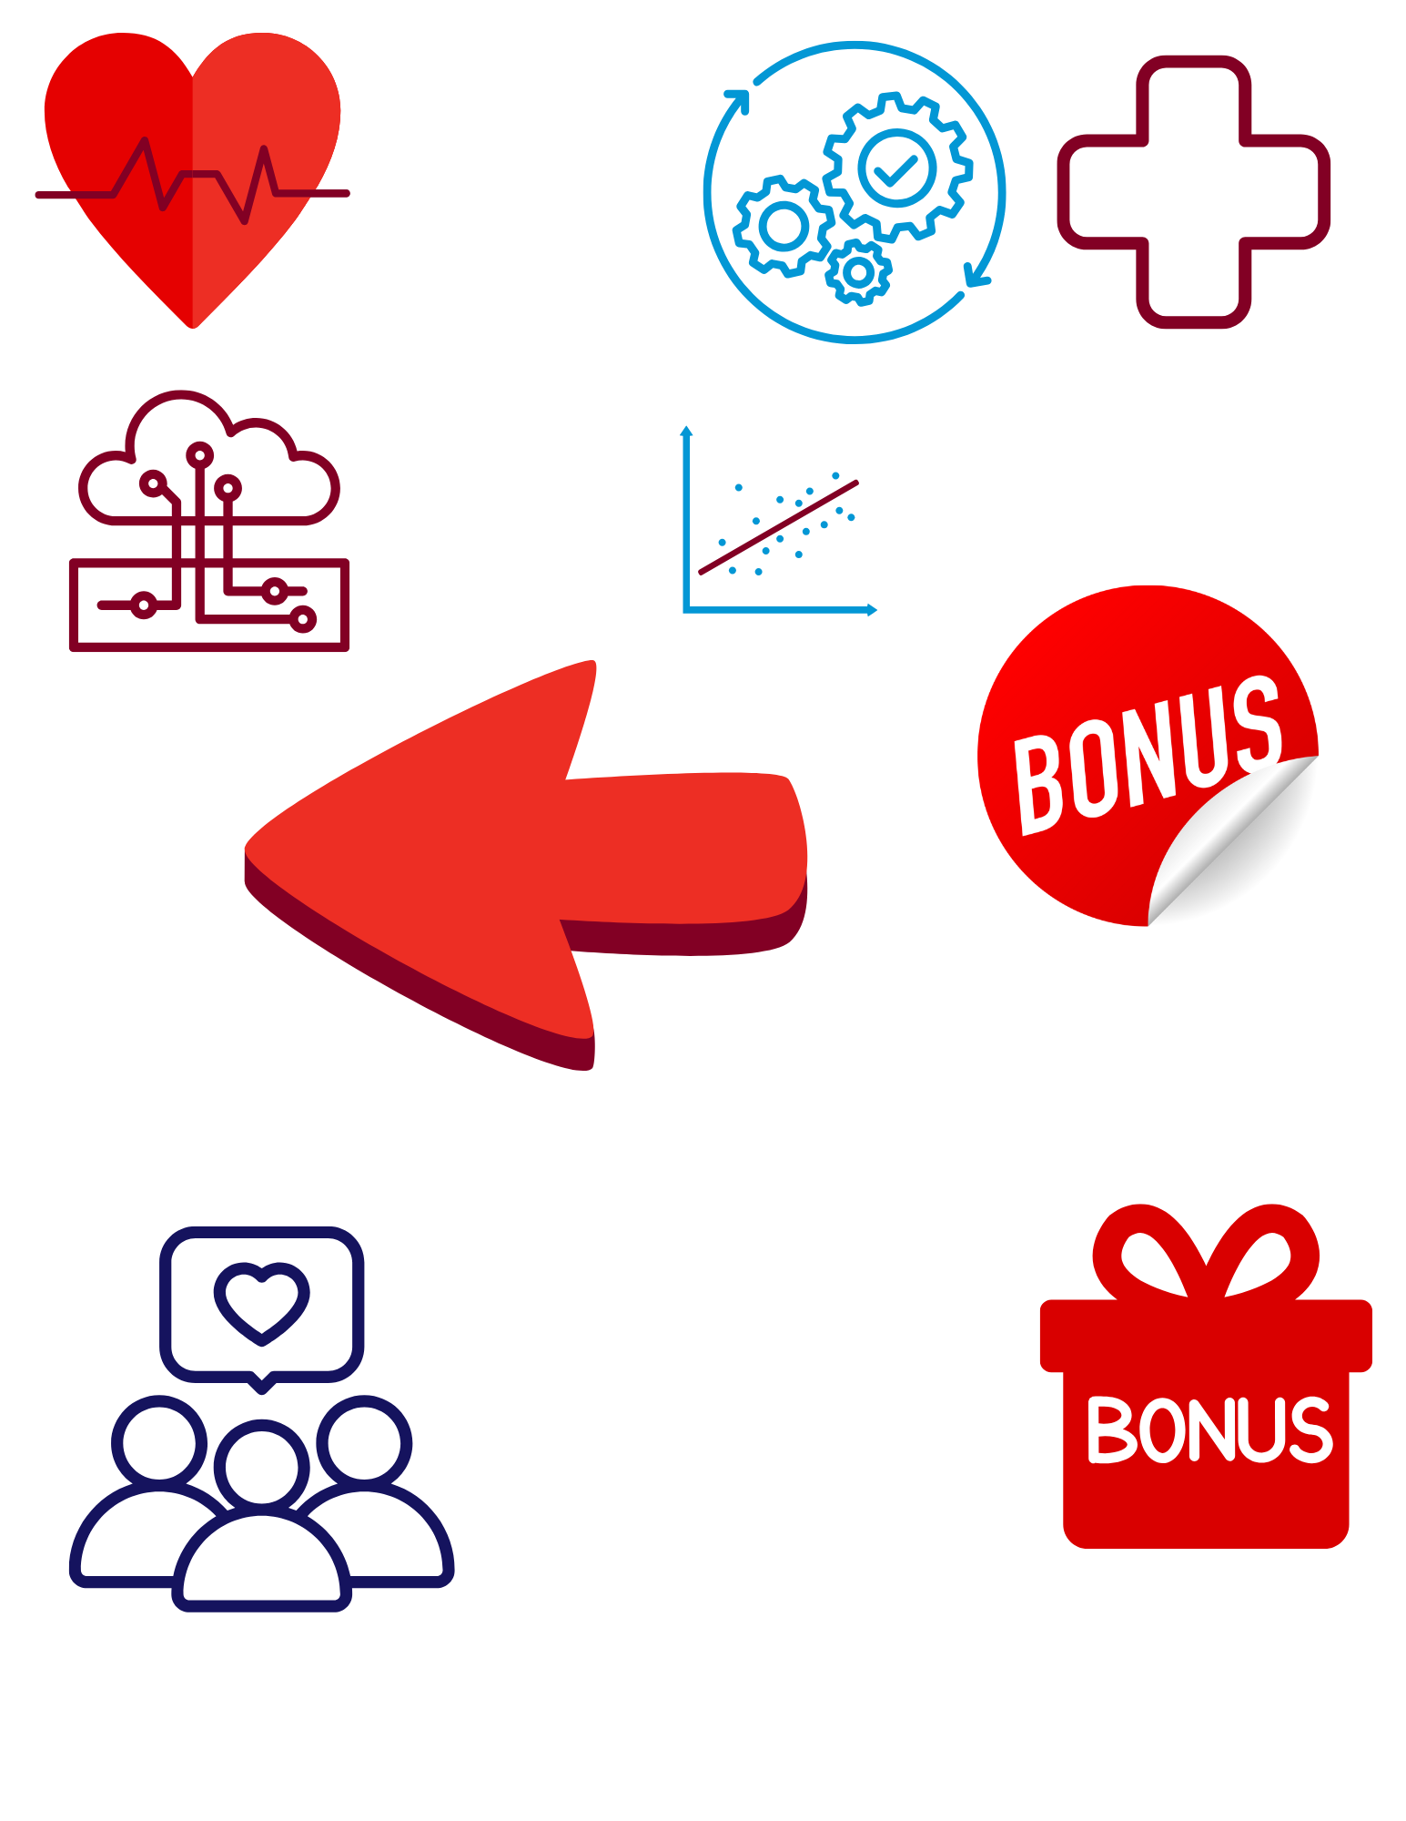
Outline
Problem Statement
Profile
Site; Customer

Slide 4
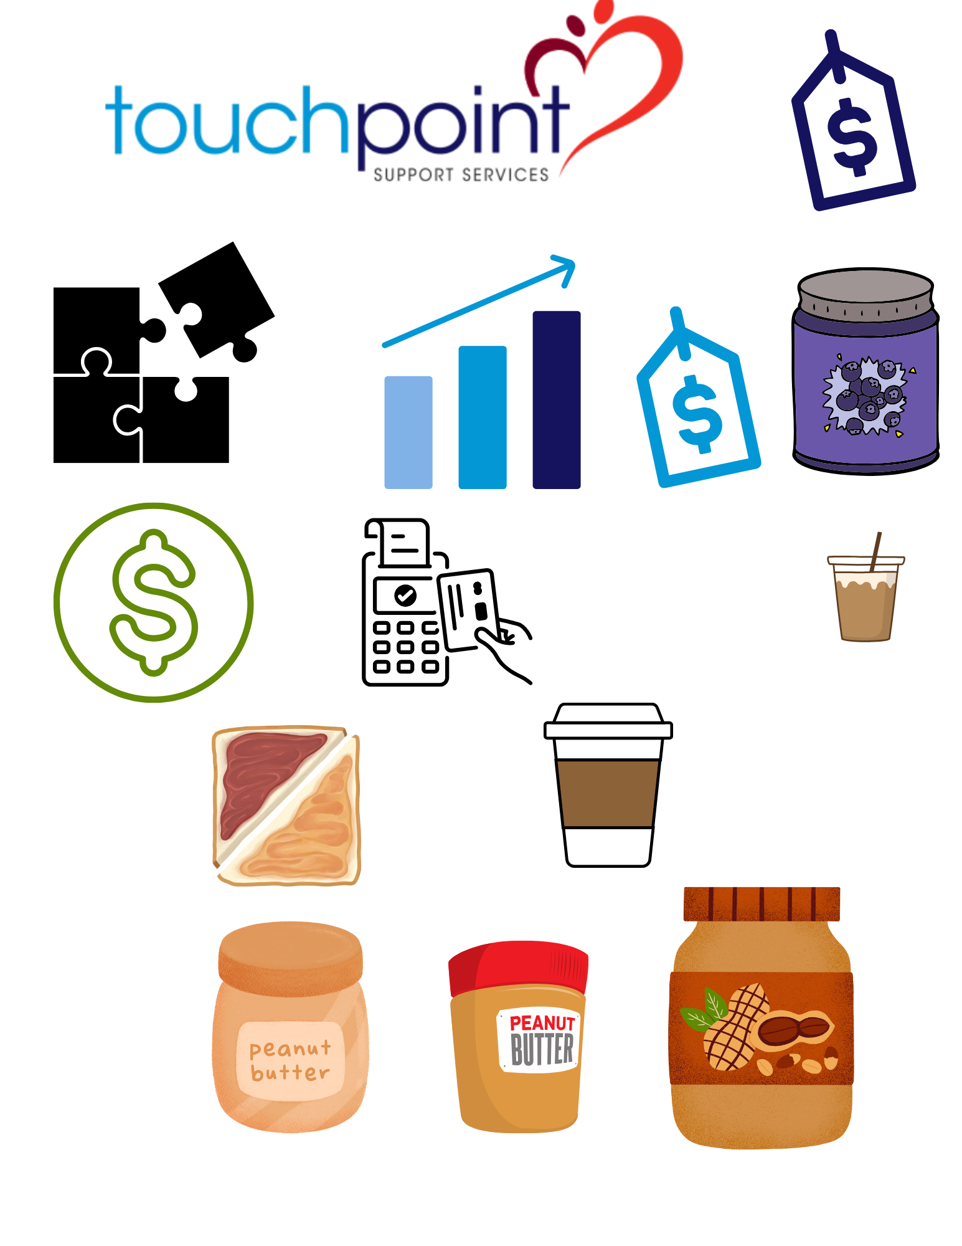
Outline
Problem Statement
Recommendation
Assortment; Pricing; Operations
Profile

Slide 5
Outline
Problem Statement
Recommendation
Profile
Appendix
Data; Modeling

Slide 6
Problem Statement
Using the last 6 months of Hospital POS data, identify key trends & data insights to provide a holistic business recommendation

Slide 7
Profile

Slide 8
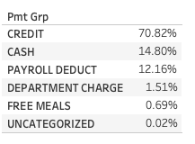
Profile
High level of Seasonality
Day of Week
Hour
Payment type
Customer

Slide 9
Profile
Assumptions
We assume NLP model to tag items as Drinks/Food is true
We assume total cost is 70% of Revenue for Drinks & 35% for Food
High level of Seasonality
Day of Week
Hour
Payment type
Pricing type
91% Customers purchase items less than $10
56% purchase less than $5
Site Comparison
Hospital B
Slightly more seasonality
Generates 5% more Revenue with smaller assortment
Hospital A
Has 70% of Free or Dept charged Meals ($39k)
Higher revenue tickets (Items/Check; $/Check)
Same $/check if free meals removed
Customer
Site

Slide 10
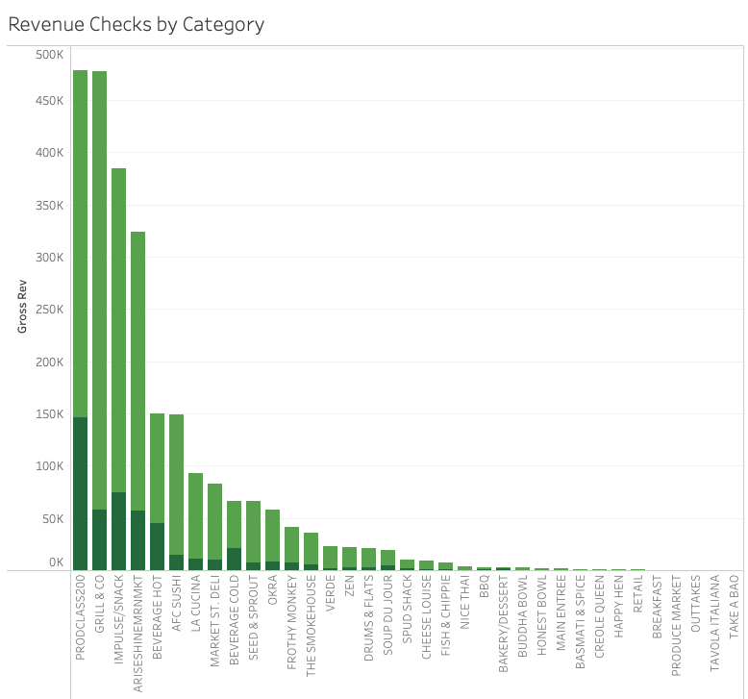
Recommendation
Top 7 Categories make 80% total Rev
Reduce low-seller assortment
Less than 10 different sales days in 2 different months
161 items removed
Results
13.40% decrease in items
2.23% decrease in sales
Similar impact in both sites
Not captured ops cost (food/labor)
Assortment

Slide 11
Recommendation
Assortment
Healthier items priced XX% more than unhealthy items
Pricing

Slide 12
Recommendation
Assortment
Investigate Free/Dept charge meals for Hospital A
Validate staffing correctly for hours/DOW
Pricing
Operational

Slide 13
Appendix
Need add’l data for monthly/annual seasonality
Data
Modeling

Slide 14

Outline
Profile
Customer
Site
Recommendations
Assortment
Pricing
Operations
Appendix
Data review
Modeling Details
Problem Statement
Profile
Recommendation
Appendix

Slide 15
