Slide 1

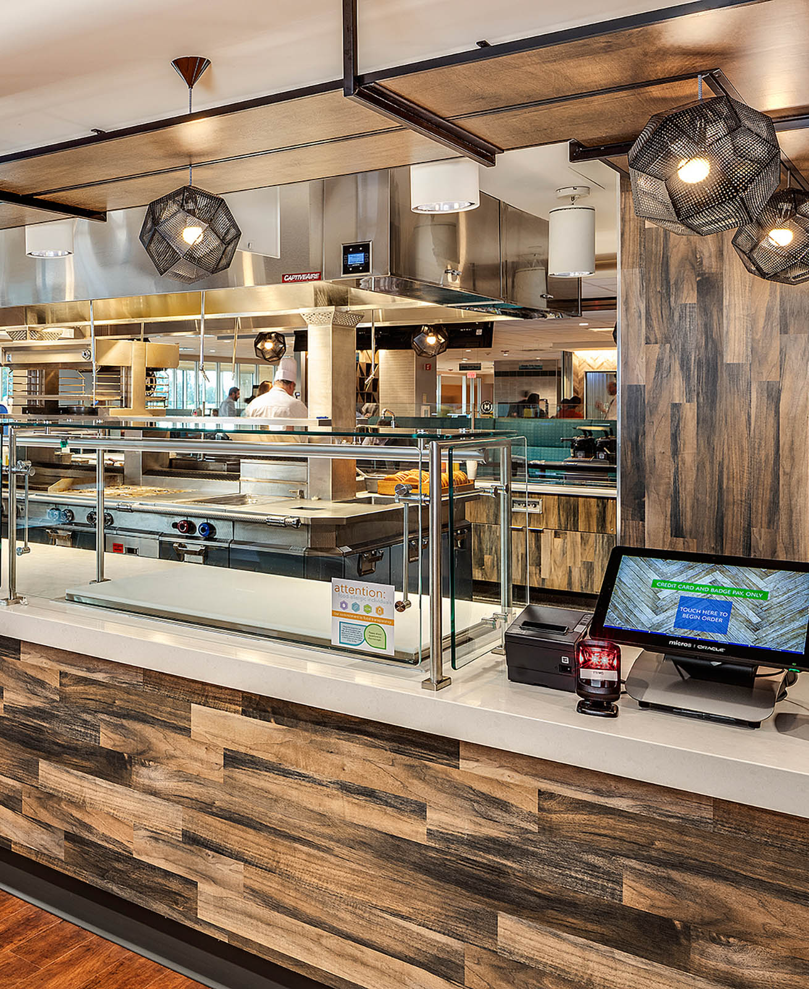
Hospital Cafeteria Optimization
Prepared by Candice Filar

Slide 2

Outline
Problem Statement

Slide 3
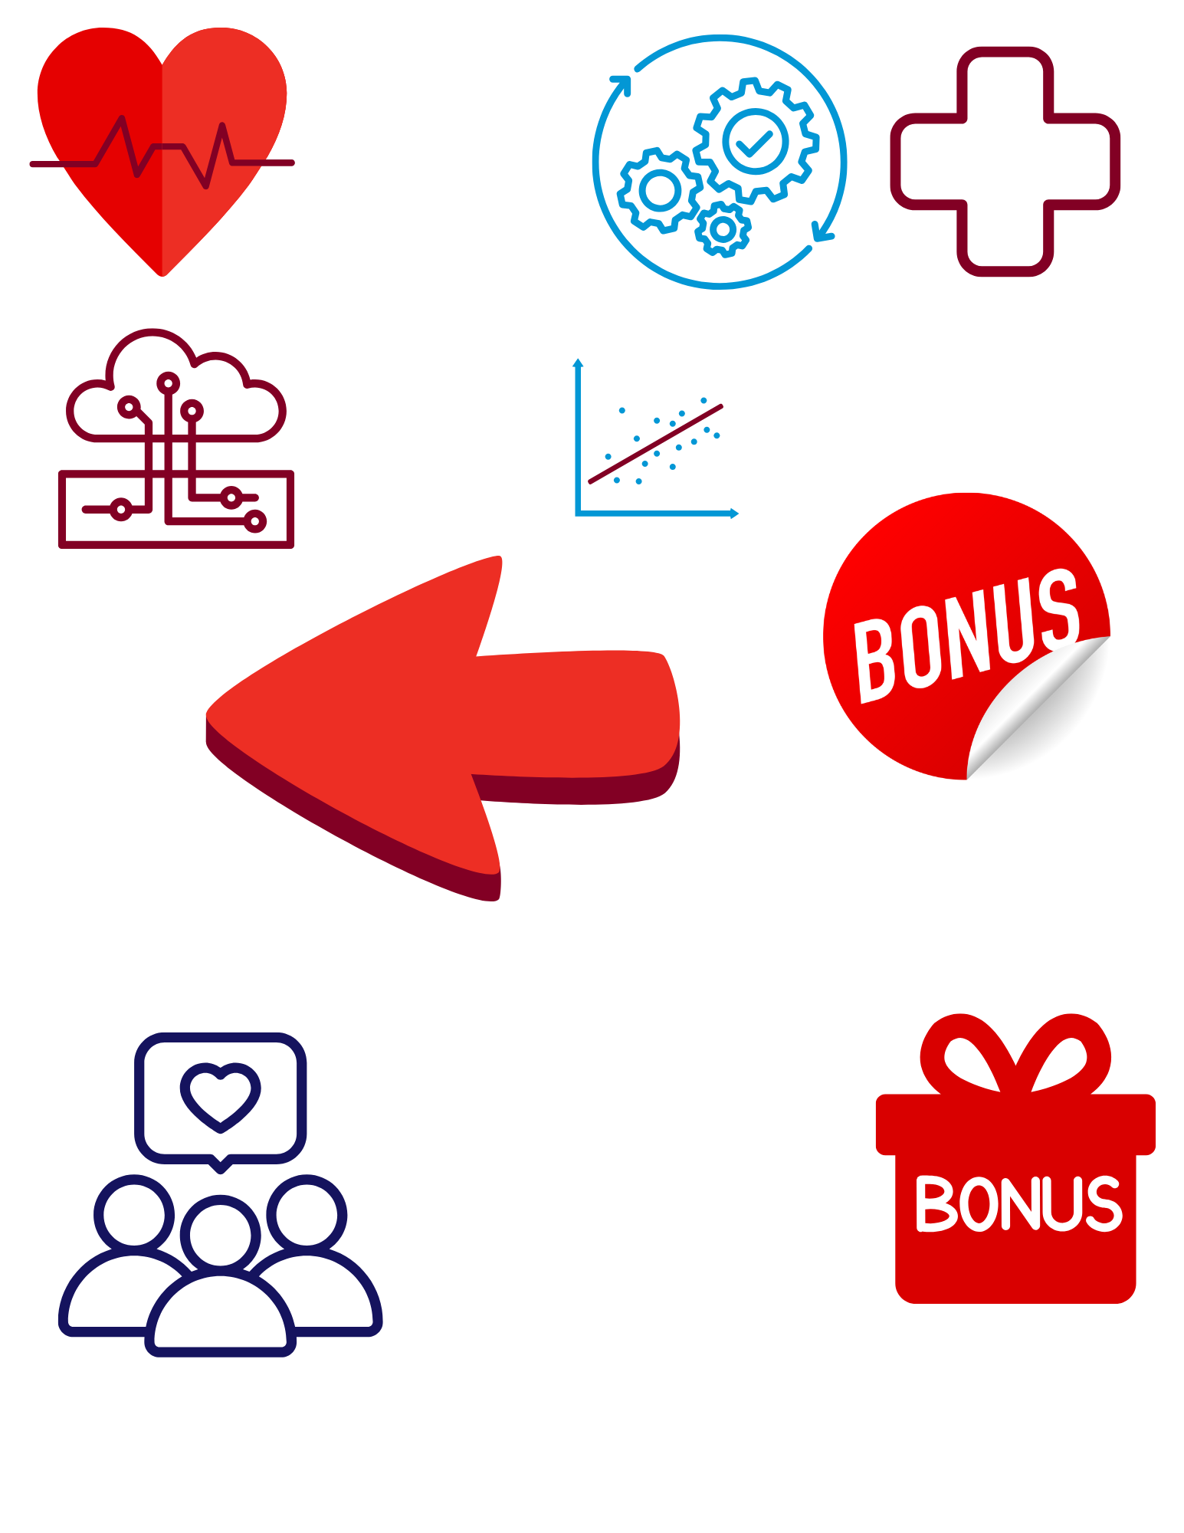
Outline
Problem Statement
Profile
Site; Customer

Slide 4

Outline
Problem Statement
Profile
Assortment
Low Velocity Items; Investment Categories

Slide 5
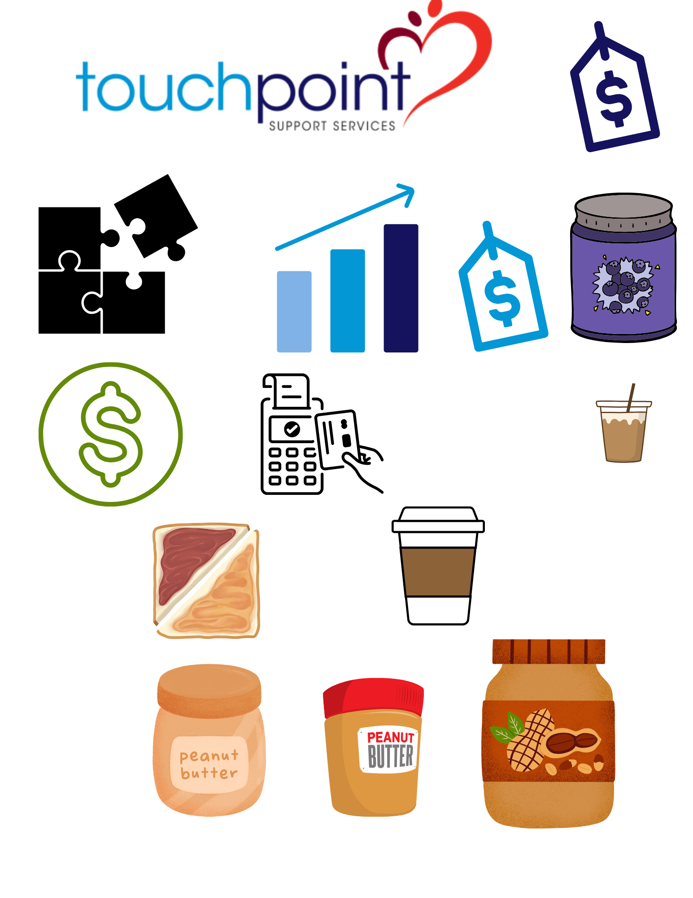
Outline
Problem Statement
Pricing
Healthy Incentive
Profile
Assortment

Slide 6
Outline
Problem Statement
Pricing
Profile
Recommendation
Summary; Future Analyses
Assortment

Slide 7
Outline
Problem Statement
Pricing
Profile
Recommendation
Assortment
Appendix
Data; Modeling

Slide 8
Problem Statement
Using the last 6 months of Hospital POS data, identify key trends & data insights to provide a holistic business recommendation

Slide 9
Profile

Slide 10
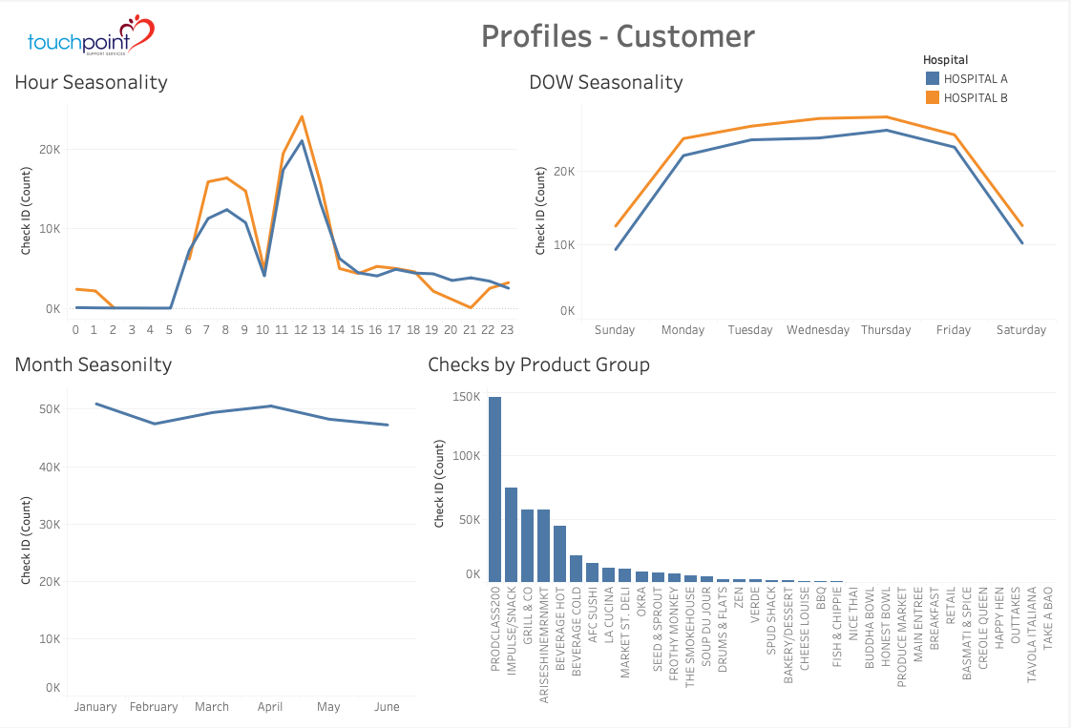
Profile
High level of Seasonality
Day of Week
Hour
Consistent MoM revenue
Snacks; grill; Beverages highest product groups
Customer

Slide 11
Profile
Assumptions
We assume NLP model to tag items as Drinks/Food Healthy/Unhealthy is true
We assume total cost is 70% of Revenue for Drinks & 35% for Food
Site

Slide 12
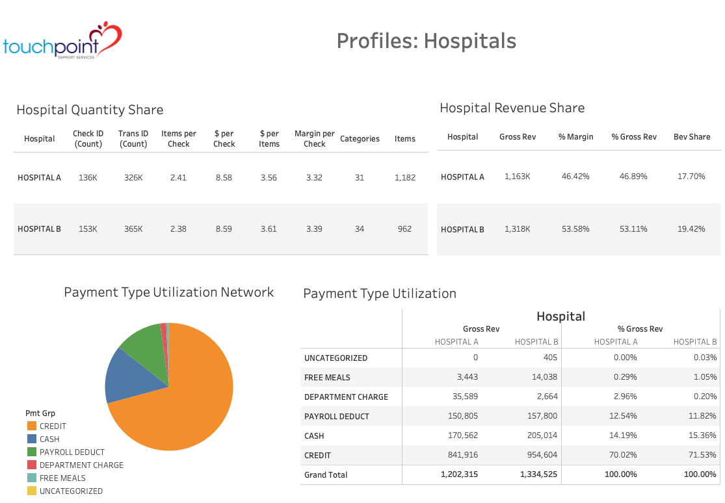
Profile
Hospital B
Generates 7% more Margin with smaller assortment
Hospital A
Has 70% of Free or Dept charged Meals ($39k)
Higher revenue tickets (Items/Check; $/Check)
Same $/check if free meals removed
Site

Slide 13
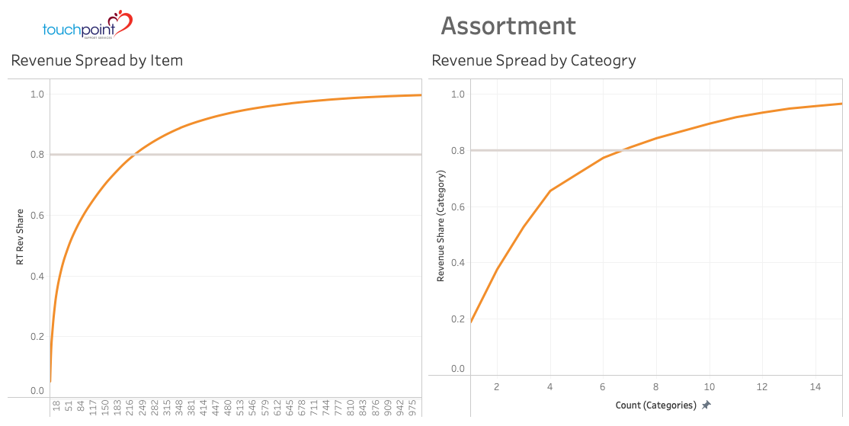
Assortment
Top 20% (7) Categories & 16% (229) of Items make 80% total Rev
Reduce low-seller assortment
Less than 10 different sales days
161 items removed
Results
13.40% decrease in items
2.23% decrease in sales
Similar impact in both sites
Not captured reduced ops cost (food/labor)
Low Sellers

Slide 14
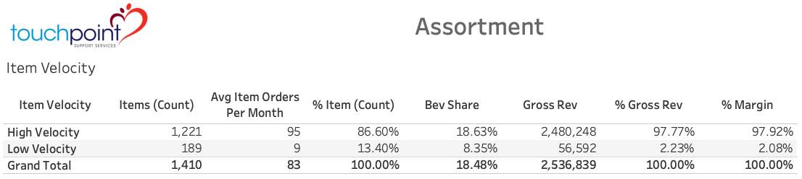
Assortment
Top 20% (7) Categories & 16% (229) of Items make 80% total Rev
Reduce low-seller assortment
Less than 10 different sales days
161 items removed
Results
13.40% decrease in items
2.23% decrease in sales
Similar impact in both sites
Not captured reduced ops cost (food/labor)
Low Sellers

Slide 15
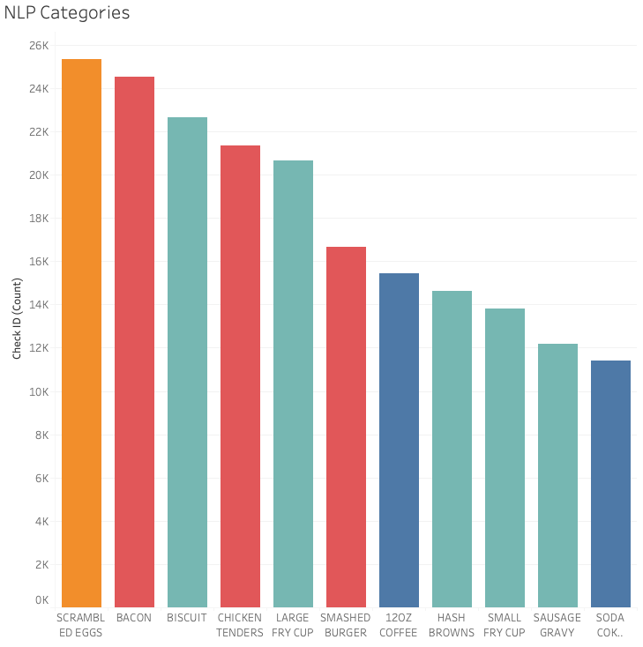
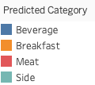
1 - Reduce assortment by 13%; Decrease revenue 2%
Assortment
NLP to categorize items
Facebook pretrained model BERT
Manual adjustment on top categories
Improved Classification

Slide 16
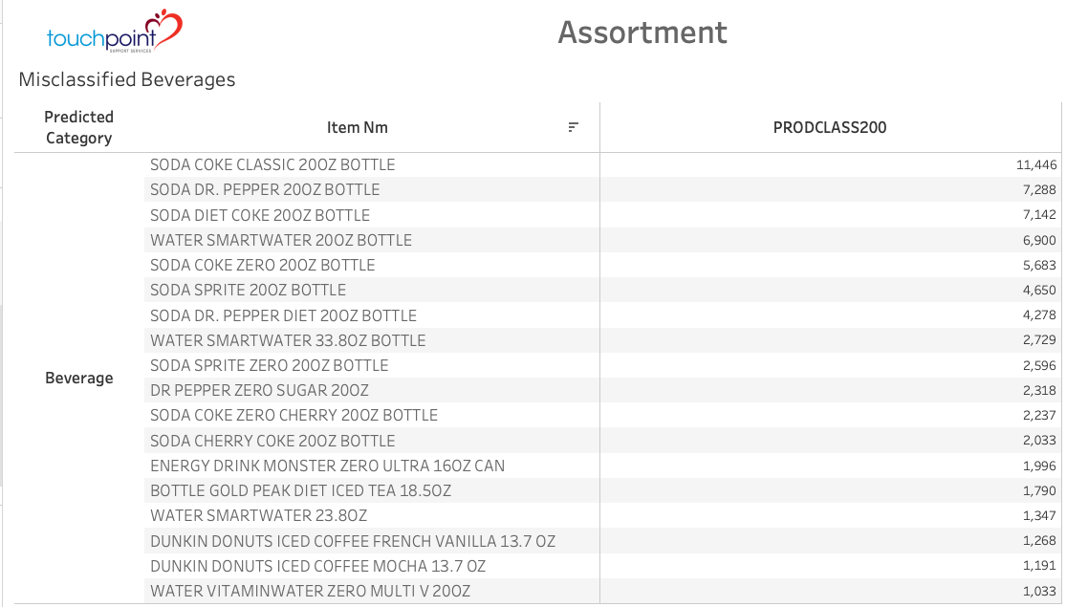
1 - Reduce assortment by 13%; Decrease revenue 2%
Assortment
Use NLP to categorize items
Use Facebook pretrained model BERT
Used manual adjustment on top categories
Misclassified Drinks in Prod2020
10% of checks
Assortment - Items

Slide 17
1 - Reduce assortment by 13%; Decrease revenue 2%
2 – NLP to classify items
Assortment
Difference in margin between Bev vs. Food (65%; 35%)
Bev is 18% of total network
Uneven share between Healthy vs Unhealthy
Margin Spread

Slide 18
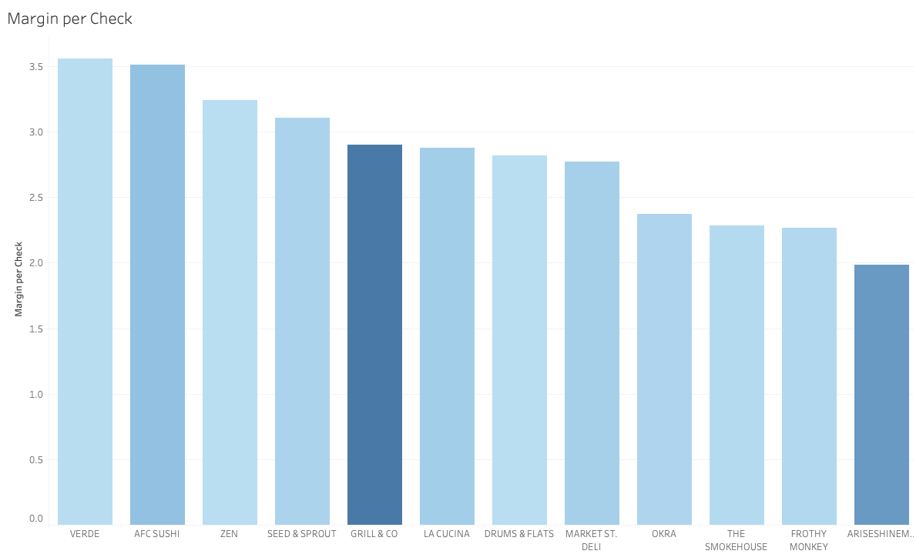

1 - Reduce assortment by 13%; Decrease revenue 2%
2 – NLP to classify items
3 – Uneven Bev distribution between Healthy category
3 – Four investment categories
Assortment
Low-volume/high-margin categories
Investment Opty!

Slide 19
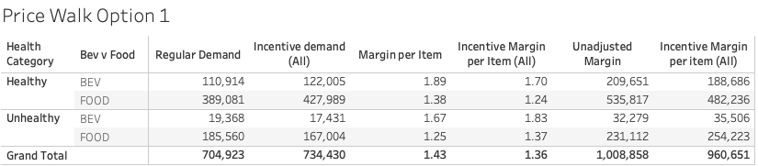
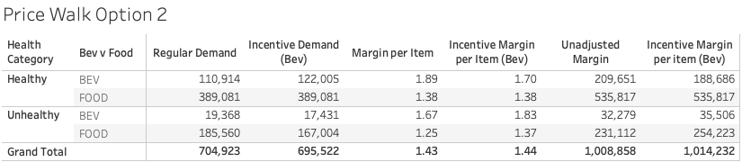
Pricing
Assumptions:
1 – Elasticity between Healthy/Unhealthy is 1
2 – Margin is constant regardless of demand
Option 1
⬇️ healthy price by 10%; ⬆️ unhealthy price by 10%
⬆️ demand 4%
⬇️ profit 4.7% 😬
Option 2
⬇️ healthy bev by 10%; ⬆️ unhealthy price by 10%
⬇️ demand 1.3%
⬆️ profit 0.05% 🥳
Option 3
Pricing optimization model
Incentive Pricing

Slide 20
Recommendation
Today
Validate staffing patterns match weekly/hourly seasonality
Tomorrow
Optimization model to minimize labor
Evaluate offering part-time positions for flex staffing
Today
Reduce unnecessary comp’d meals from Hospital A
Tomorrow
Instill guidelines + budget for comp’d meals
Today
Remove low-velocity items
NLP item classification
Tomorrow
Invest in low-volume high margin categories
Today
Discount healthy beverages, less work more money
Tomorrow
Price Optimization
Customer Profile
Site Profile
Assortment
Incentive Pricing

Slide 21
Appendix
Need add’l data for monthly/annual seasonality
NLP uses FB bart-large-mnli with zero-shot classification
Zero shot is pretrained, allowing categorization without providing training set
Made manual edits on vol categories
Data
Modeling

Slide 22
