Slide 1
Workshop 2 – Using Couchbase

Slide 2
Agenda
Using Query Workbench / cbq
Using the REST API
Using the SDK (.NET / Java / Node)

Slide 3
Open source FTW
https://github.com/couchbaselabs/workshop
If you find a typo, mistake, or spot an improvement, please send a pull request!
Notes:
Couchbase is open source
And so this lab is open source
Please feel free to contribute, as this material will be used beyond this conference

Slide 4
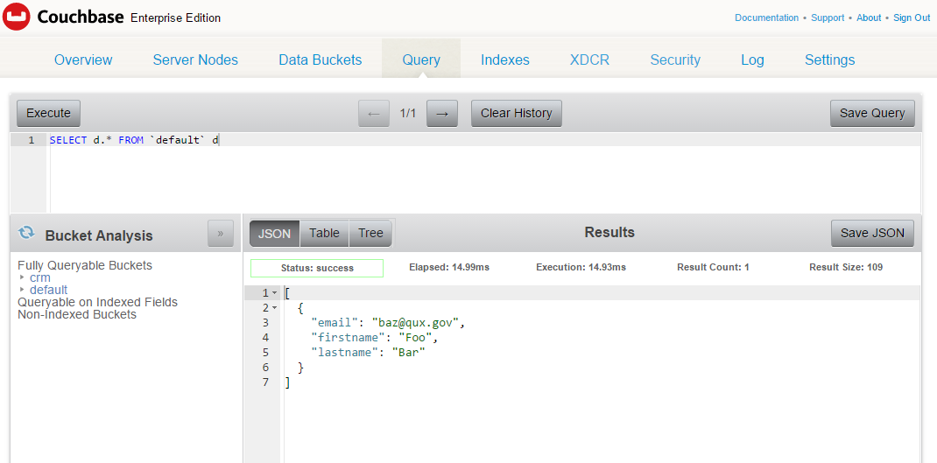
Query Workbench
http://localhost:8091

Slide 5
cbq
Command Line N1QL tool
Windows: C:\Program Files\Couchbase\Server\bin
OS X: /Applications/Couchbase Server.app/Contents/Resources/couchbase-core/bin
Linux: /opt/couchbase/bin/cbq
Docker: docker exec –it db /bin/bash

Slide 6
REST API
REST API documentation: http://developer.couchbase.com/documentation/server/4.5/rest-api/rest-intro.html
Cluster details: http://localhost:8091/pools/default

Slide 7
REST API
Cluster
Nodes
Server Group
Buckets
Indexes
Views
XDCR
Compaction
Log
User/Security
N1QL

Slide 8
Exercise 1: N1QL
Create a primary index on default bucket
CREATE PRIMARY INDEX on `default`
Add document(s) to default bucket
Use “Create Document” button in Documents view
SELECT documents
SELECT d.* FROM `default` d

Slide 9
Query Workbench

Slide 10
Exercise 2: REST API
Cluster details: http://localhost:8091/pools/default

Slide 11
/pools/default
{
"storageTotals": {
"ram": {
"total": 2061664256,
"quotaTotal": 268435456,
"quotaUsed": 209715200,
"used": 1674903552,
"usedByData": 119026504,
"quotaUsedPeraNode": 209715200,
"quotaTotalPerNode": 268435456
},
"hdd": {
"total": 59151257600,
"quotaTotal": 59151257600,
"used": 1183025152,
"usedByData": 130504611,
"free": 57968232448
}
},
"ftsMemoryQuota": 256,
"indexMemoryQuota": 512,
"memoryQuota": 256,
"name": "default",
"alerts": [], // etc…..
Notes:
It may not be as nicely formatted in your browser

Slide 12
Exercise 3: Using SDK in “Hello World”
https://github.com/couchbaselabs/workshop/tree/master/connect2016/developer/02
dotnet
java
node
Insert document(s)
Select documents with N1QL
Fill in the blanks: look for “TODO”

Slide 13
SDK: .NET
How to install
NuGet: Install-Package CouchbaseNetClient
How to connect to a Couchbase cluster
//connecting to a Couchbase cluster
var config = new ClientConfiguration();
config.Services = new List<Uri> { “couchbase://localhost” };
ClusterHelper.Initialize(config);
//opening a bucket in the cluster
_bucket = ClusterHelper.GetBucket("travel-sample", “password");
//preparing N1ql
var myQuery = QueryRequest.Create(“SELECT * FROM `travel-sample`“);
//creating and saving a Document
var document = new Document<MyType> { Id = “123”, Content = new MyType() };
_bucket.Insert(document);

Slide 14
SDK: Node
How to install
npm install couchbase
How to connect to a Couchbase cluster
//including the Node.js dependency
var Couchbase = require(”couchbase");
//connecting to a Couchbase cluster
var cluster = new Couchbase.Cluster("couchbase://localhost:8091");
//opening a bucket in the cluster
var myBucket = cluster.openBucket("travel-sample", “password");
//preparing N1ql
var myQuery = Couchbase.N1qlQuery();
//creating and saving a Document
var document = { firstname: “Matt", lastname: “Groves“ };
myBucket.insert("my-key", document, function(error, result) {});

Slide 15
SDK: Java
How to install
Edit the pom.xml file
How to connect to a Couchbase cluster
// connecting to a cluster
Cluster cluster = CouchbaseCluster.create("localhost");
// opening a bucket in the cluster
Bucket bucket = cluster.openBucket("default");
// preparing N1QL
N1qlQuery query = N1qlQuery.parameterized(“SELECT * FROM `travel-sample`”);
// creating and saving a document
JsonObject person = JsonObject.create()
.put("firstName", "John")
.put("lastName", "Doe");
bucket.upsert(JsonDocument.create(key, person));

Slide 16
Questions

