Slide 1
Workshop B – Using Couchbase

Slide 2
Agenda
Using Query Workbench / cbq
Using the REST API
Using the .NET SDK

Slide 3
Open source FTW
https://github.com/couchbaselabs/aspnet-nosql-workshop
If you find a typo, mistake, or spot an improvement, please send a pull request!
Notes:
Couchbase is open source
And so this lab is open source
Please feel free to contribute, as this material will be used beyond this conference

Slide 4
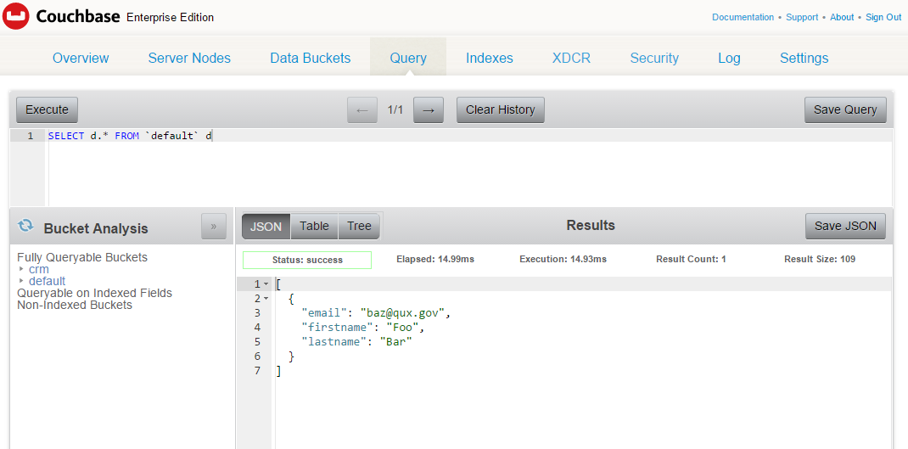
Query Workbench
http://localhost:8091

Slide 5
cbq
Command Line N1QL tool
Windows: C:\Program Files\Couchbase\Server\bin
OS X: /Applications/Couchbase Server.app/Contents/Resources/couchbase-core/bin
Linux: /opt/couchbase/bin/cbq
Docker: docker exec –it db /bin/bash

Slide 6
REST API
REST API documentation: https://developer.couchbase.com/documentation/server/current/rest-api/rest-intro.html
Cluster details: http://localhost:8091/pools/default

Slide 7
REST API
Cluster
Nodes
Server Group
Buckets
Indexes
Views
XDCR
Compaction
Log
User/Security
N1QL

Slide 8
Exercise 1: N1QL
Create a primary index on default bucket
CREATE PRIMARY INDEX on `default`
Add document(s) to default bucket
Use “Create Document” button in Documents view
SELECT documents
SELECT d.* FROM `default` d

Slide 9
Query Workbench

Slide 10
Exercise 2: REST API
Cluster details: http://localhost:8091/pools/default
Notes:
You will need to use the cluster credentials to execute this

Slide 11
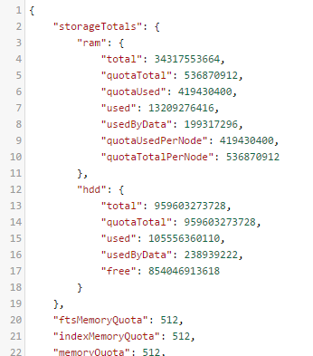
/pools/default
Notes:
It may not be as nicely formatted in your browser

Slide 12
Exercise 3: Using SDK in “Hello World”
https://github.com/couchbaselabs/aspnet-nosql-workshop/tree/master/02
dotnet_workshop (incomplete)
dotnet (complete)
Insert document(s)
Select documents with N1QL
Fill in the blanks: look for “TODO”

Slide 13
How to install .NET SDK
NuGet: Install-Package CouchbaseNetClient

Slide 14
Connect to Couchbase
var config = new ClientConfiguration();
config.Servers = new List<Uri> {
new Uri("couchbase://localhost")
};
ClusterHelper.Initialize(config);
_bucket = ClusterHelper.GetBucket("default");
Notes:
Connect to one or more nodes
Get the bucket by name, password if you set one

Slide 15
Insert a document
IDocument<dynamic> doc = new Document<dynamic>
{
Id = Guid.NewGuid().ToString(),
Content = new
{
firstName = "Connie",
lastName = "James",
city = "Columbus, Ohio",
country = "USA",
type = "person"
}
};
_bucket.Insert(document);
Notes:
Create a new Document object. You can use any type, I’m using dynamic to be lazy.
Specify an Id, it can be any string, must be unique within the bucket. I’m using Guid to be lazy
Content is an instance of the type specified in the Document. It will be serialized to JSON. I’m using anonymous object to be lazy
bucket.Insert to save new document.

Slide 16
Insert, Replace, Upsert
IDocumentResult<dynamic> result1 = _bucket.Insert(document);
IDocumentResult<dynamic> result2 = _bucket.Upsert(document);
IDocumentResult<dynamic> result3 = _bucket.Replace(document);
Task<IDocumentResult<dynamic>> result4 = _bucket.InsertAsync(document);
Task<IDocumentResult<dynamic>> result5 = _bucket.UpsertAsync(document);
Task<IDocumentResult<dynamic>> result6 = _bucket.ReplaceAsync(document);
Task<IDocumentResult<dynamic>[]> result7 = _bucket.InsertAsync(
new List<IDocument<dynamic>> { document, document2 });
Task<IDocumentResult<dynamic>[]> result8 = _bucket.UpsertAsync(
new List<IDocument<dynamic>> { document, document2 });
Task<IDocumentResult<dynamic>[]> result9 = _bucket.ReplaceAsync(
new List<IDocument<dynamic>> { document, document2 });
Notes:
Insert creates a new document, fails if it already exists.
Upsert creates a new document, or updates existing document if it already exists
Replace updates existing document, fails if it doesn’t exist.
There are also async versions
And with async you can perform the operation on multiple documents

Slide 17
Getting document(s) by key(s)
IOperationResult<dynamic> aDocument = _bucket.Get<dynamic>("key");
IDictionary<string, IOperationResult<dynamic>> multipleDocuments = _bucket.Get<dynamic>(
new List<string> {"key1", "key2", "key3"}
);
Notes:
Use the Get<T> to get a document by key. It will be serialized into an object of they type you specify.
I’m using dynamic to be lazy
You can also get multiple documents at once by specifying multiple keys. The result will be a Dictionary of key and object.

Slide 18
Results
public interface IResult
{
bool Success { get; }
string Message { get; }
Exception Exception { get; }
}
Insert, Replace, Upsert
Get
public interface IDocumentResult : IResult
{
ResponseStatus Status { get; }
string Id { get; }
}
public interface IOperationResult : IResult
{
ulong Cas { get; }
ResponseStatus Status { get; }
string Id { get; }
}
public interface IDocumentResult<T> : IDocumentResult
{
Document<T> Document { get; }
T Content { get; }
}
public interface IOperationResult<out T> : IOperationResult
{
T Value { get; }
}
Notes:
These are results of the operations.
In this lab we’re not going to use all of these. I’ve also omitted some properties to make things a little simpler.
IResult is the base interface for all results. Success,Message,Exception can be examined to see what went wrong, if anything
IDocumentResult isn’t terribly interesting, except for maybe Status
For gets, again the Status might be useful. The Cas value is “check and set”, this is useful for locking. “Cas” might be a couchbase specific name, but other nosql database usually have something similar.

Slide 19
Questions

