Slide 1
Workshop 3 – Building a RESTful API

Slide 2
Agenda
Create a RESTful API backend

Slide 3
Platforms
.NET - ASP.NET WebAPI
Or .NET Core – ASP.NET Core WebAPI
Couchbase (document database)

Slide 4
ASP.NET
Relies on IIS
Controllers contain methods
Global.asax.cs
Notes:
This is the traditional ASP.NET for Full .NET framework
Though if you compare it to ASP.NET 1.0 back in the day you'd hardly recognize it
Startup and request level config is done in Global.asax.cs, which typically calls out to files like WebApiConfig, RouteConfig, etc

Slide 5
ASP.NET Core
Runs as a "command line" app, uses Kestrel server
Controllers contain methods
Can run on .NET or .NET Core
Notes:
ASP.NET Core is the cross-platform version of ASP.NET
Instead of being dependent on IIS, it has its own web server called Kestrel

Slide 6
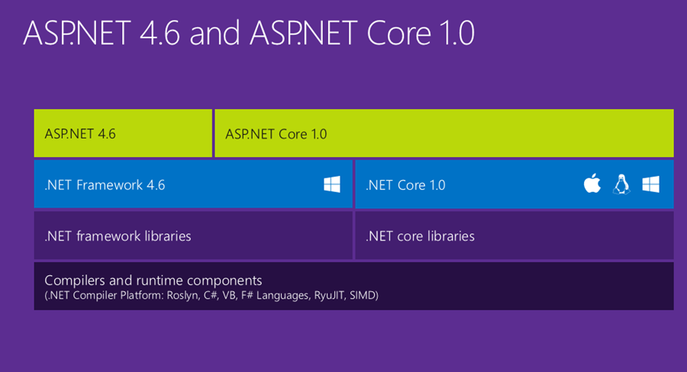
ASP.NET vs ASP.NET Core
Notes:
This is a graphic from Hanselman's blog

Slide 7
ASP.NET vs ASP.NET Core
 | ASP.NET | ASP.NET Core
Cross platform? | No | Yes
Can use Kestrel? | No | Yes
Can use IIS? | Yes (required) | Yes
Works on Full .NET? | Yes | Yes
Works on .NET Core? | No | Yes
Notes:
Confusing part is that ASP.NET Core can be used with both .NET and .NET Core
In this workshop, I've given you source code for ASP.NET Core on .NET Core and ASP.NET on Full .NET just to keep things simple
It's all a bit confusing, here's a table I made. It's a bit of a simplification, but I think it's accurate.
Don't even mention Mono, that just makes it more complicated.
Why would I not use ASP.NET Core?
If you already are using ASP.NET then you may not need to change. ASP.NET support isn't going away, no need to leave
3rd party library support for ASP.NET Core will get there, but libraries and 3rd part tools may not support it yet.

Slide 8
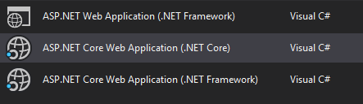
ASP.NET vs ASP.NET Core
Notes:
Visual Studio bears this out with three options:
First one: classic ASP.NET on the full .NET framework (this is one of your options in this workshop)
Second one: new ASP.NET core on the .NET Core framework (this is the other option in this workshop)
Third one: new ASP.NET core on the full .NET framework (not covered in this workshop)

Slide 9
WebAPI
There are a lot of similarities between ASP.NET and ASP.NET Core
Similar to MVC:
Controllers: classes that inherit from a special base class
Methods: endpoints
Optional async/await
Notes:
If you've not used WebAPI before, think of it like MVC, except you're generally returning JSON (or XML) instead of HTML from Razor templates
If you've not used MVC you may struggle a bit with this workshop
But don't worry, you'll get through it, and you're gonna like it a lot more than ASP.NET WebForms..
If you've not used ASP.NET WebForms or any ASP.NET before or any C# before, then you're really going to struggle since this is only a half-day workshop.
I encourage you to sit near someone who has a bit more experience.

Slide 10
ASP.NET WebAPI vs ASP.NET Core WebAPI
WebAPI/MVC convergence
CORS
Configuration
Startup
Static files
Casing / JsonProperty

Slide 11
Core WebAPI Convergence
In ASP.NET Core, MVC and WebAPI converge
Instead of Controller and ApiController, there is just Controller
Instead of IHttpActionResult (WebAPI) there is just IActionResult

Slide 12
CORS
Cross-Origin Resource Sharing
ASP.NET
[EnableCors(origins: "*", headers: "*", methods: "*")]
ASP.NET Core
app.UseCors(builder => builder
.AllowAnyHeader()
.AllowAnyMethod()
.AllowAnyOrigin());
Notes:
In this workshop, CORS is turned off. This is because Angular will be running on one port, the backend on another. This will be a CORS violation and the browser will error.
You can ultimately deploy them on the same port, but sometimes you don't want that.
In both these examples, I'm allowing cross-domain requests from anywhere, for anything. That may be fine, but it may not be what you want.

Slide 13
Startup
ASP.NET
Global.asax.cs
System.Web.HttpApplication
protected void Application_Start()
ASP.NET Core
Program.cs – console application
Startup.cs – used by Program.cs
public void ConfigureServices(IServiceCollection services)
public void Configure(IApplicationBuilder app, IHostingEnvironment env, ILoggerFactory loggerFactory)
Notes:
Application start is where you can setup route configuration, register WebAPI, filters, etc
ASP.NET Core is basically a console application. But you aren't going to typically mess with Program.cs, certainly not in this workshop
Startup class is used by the WebHostBuilder in Program.cs, this is where you'lll do the application startup

Slide 14
Configuration
ASP.NET
Web.config (XML)
ConfigurationManager.AppSettings
ASP.NET Core
appsettings.json (JSON)
IConfigurationSection settingsSection = Configuration.GetSection("MySettings");
MySettings settings = settingsSection.Get<MySettings>();
services.Configure<MySettings>(settingsSection);
Notes:
ASP.NET uses the famous web.config, you can access it with ConfigurationManager API
ASP.NET core uses a JSON file called appsettings.json (you can call it whatever you want actually, it's not magical like Web.config)
There's an API for accessing it and sections of it
It can be bound to C# objects
And it can be configured as a service to use in constructor injection

Slide 15
Static Files
ASP.NET
Put static files wherever
ASP.NET Core
Put static files in wwwroot folder

Slide 16
Casing / JsonProperty
ASP.NET
return Ok(result.Value);
Result object serialized
Resultant JSON is PascalCased
ASP.NET Core
return Ok(result.Value);
Result object serialized
Resultant JSON is camelCased
Use [JsonProperty("FirstName")] to PascalCase
Notes:
I got a little bleary-eyed at this part, so I hope I'm wrong, but I don't think I am
There may be more global options for PascalCasing en masse, not needed for this workshop

Slide 17
Questions

Slide 18
Exercise: Fill in the blanks
Fill in the blanks to make the application work
dotnet_workshop or dotnetcore_workshop
Completed versions are in dotnet, dotnetcore
Checkout the code from Github
https://github.com/couchbaselabs/aspnet-nosql-workshop/tree/master/03
The source code is also available on USB sticks
You can test with Postman / Fiddler / curl
Notes:
If all else fails, you can test with your browser

Slide 19
ASP.NET
dotnet_workshop
Look for TODOs
Files included:
CouchbaseConfig.cs
PersonController.cs
Web.config

Slide 20
ASP.NET Core
dotnetcore_workshop
Look for TODOs
Files included:
appsettings.json
PersonController.cs
Startup.cs

Slide 21
How to execute
Execute RESTful API backend:
Visual Studio: F5 (or ctrl+f5)
dotnet run from command line

Slide 22
Exercise: Getting Started
At the end of the lab, your app should be able to list, add, edit, and delete.
If you have questions or are running into a problem, I'll be walking around helping you individually.

