Slide 1
Workshop C – Building a Full-stack Application

Slide 2
Agenda
Create a RESTful API backend

Slide 3
Platforms
.NET - ASP.NET WebAPI
Or .NET Core – ASP.NET Core WebAPI
Couchbase (document database)

Slide 4
Exercise: Fill in the blanks
Fill in the blanks to make the application work
dotnet_workshop or dotnetcore_workshop
Completed versions are in dotnet, dotnetcore
Checkout the code from Github
https://github.com/couchbaselabs/aspnet-nosql-workshop/tree/master/03
The source code is also available on USB sticks

Slide 5
Exercise: Getting Started
We’re going to fill in one of the blanks together, one for each language/platform.
The rest of the them are up to you.
At the end of the lab, your app should be able to list, add, edit, and delete.
If you have questions or are running into a problem, we’ll be walking around helping you individually.

Slide 6
ASP.NET
Relies on IIS
Controllers contain methods
Global.asax.cs
Notes:
This is the traditional ASP.NET for Full .NET framework
Though if you compare it to ASP.NET 1.0 back in the day you'd hardly recognize it
Startup and request level config is done in Global.asax.cs, which typically calls out to files like WebApiConfig, RouteConfig, etc

Slide 7
ASP.NET Core
Runs as a "command line" app, uses Kestrel server
Controllers contain methods
Can run on .NET or .NET Core
Notes:
ASP.NET Core is the cross-platform version of ASP.NET
Instead of being dependent on IIS, it has its own web server called Kestrel

Slide 8
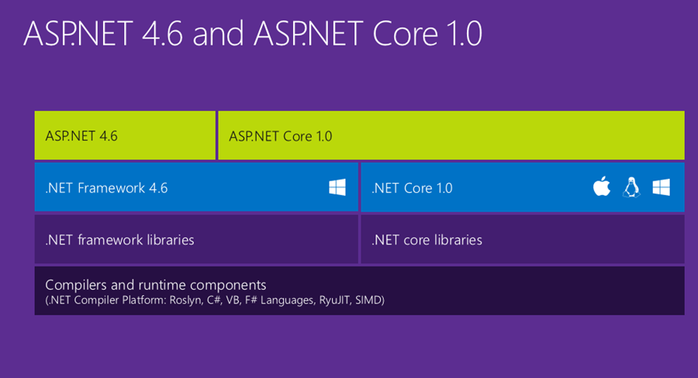
ASP.NET vs ASP.NET Core
Notes:
This is a graphic from Hanselman's blog

Slide 9
ASP.NET vs ASP.NET Core
 | ASP.NET | ASP.NET Core
Cross platform? | No | Yes
Can use Kestrel? | No | Yes
Can use IIS? | Yes (required) | Yes
Works on Full .NET? | Yes | Yes
Works on .NET Core? | No | Yes
Notes:
Confusing part is that ASP.NET Core can be used with both .NET and .NET Core
In this workshop, I've given you source code for ASP.NET Core on .NET Core and ASP.NET on Full .NET just to keep things simple
It's all a bit confusing, here's a table I made. It's a bit of a simplification, but I think it's accurate.
Don't even mention Mono, that just makes it more complicated.
Why would I not use ASP.NET Core?
If you already are using ASP.NET then you may not need to change. ASP.NET support isn't going away, no need to leave
3rd party library support for ASP.NET Core will get there, but libraries and 3rd part tools may not support it yet.

Slide 10
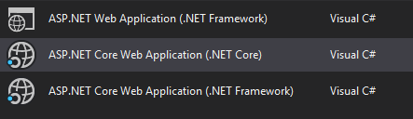
ASP.NET vs ASP.NET Core
Notes:
Visual Studio bears this out with three options:
First one: classic ASP.NET on the full .NET framework (this is one of your options in this workshop)
Second one: new ASP.NET core on the .NET Core framework (this is the other option in this workshop)
Third one: new ASP.NET core on the full .NET framework (not covered in this workshop)

Slide 11
WebAPI
There are a lot of similarities between ASP.NET and ASP.NET Core
Similar to MVC:
Controllers: classes that inherit from a special base class
ASP.NET – ApiController
ASP.NET Core – Controller
Methods: endpoints
Optional async/await
Notes:
If you've not used WebAPI before, think of it like MVC, except you're generally returning JSON (or XML) instead of HTML from Razor templates
If you've not used MVC before, then you are in for a treat. You may struggle a bit with this workshop
But don't worry, you'll get through it, and you're gonna like it a lot more than ASP.NET WebForms..
If you've not used ASP.NET WebForms or any ASP.NET before or any C# before, then you're really going to struggle since this is only a half-day workshop.
I encourage you to sit near someone who has a bit more experience.

Slide 12
ASP.NET WebAPI vs ASP.NET Core WebAPI
IHttpActionResult vs IActionResult
CORS attribute
CORS policy
Web.config vs appsettings.json
Global.asax vs Startup

Slide 13
ASP.NET
Look for TODOs
Files included:

Slide 14
ASP.NET Core
Look for TODOs
Files included:

Slide 15
How to execute
Execute RESTful API backend:
Visual Studio: F5 (or ctrl+f5)
dotnet run from command line
Notes:
We started this workshop a while ago, but we haven’t been keeping up with Angular, so you might get an error message if you don’t use 1.0.0-beta.10
Then kick off the angular server with ng serve

Slide 16
Questions

