Slide 1
ASP.NET with NoSQL Workshop
Matthew D. Groves (@mgroves)

Slide 2
Workshop Agenda
Install database (Couchbase)
Hello, world .NET console application
ASP.NET WebAPI RESTful services
Angular UI

Slide 3
Prereqs
Visual Studio 2017
Couchbase Server 5.x
node/npm/angular-cli
(or Postman / Fiddler / etc?)
Source code
(or you can follow along and build from scratch)
Notes:
Visual studio: 2015 might work if you want to use .NET full framework, Visual Studio Core might work if you want to use .net core. I have Visual Studio Core on USB sticks
Couchbase Server: 4.6 or greater will work. If you've installed Couchbase Server 5 Beta that's fine, but let me know. I have 5.x on these USB sticks.
Node/npm/angular – the last part of this workshop is creating an Angular frontend to consume a webapi backend. If we run out of time, or you don't want to do that, then you can use the already finished angular source code I've created, or you can use.
Source code – you can pull it down from github or I have it on the USB sticks. You don't need to write the whole program from scratch, I'll give you a fill-in-the-blank version as well as the completed version.

Slide 4
Workshop 1 – Setting up Couchbase

Slide 5
Agenda
Installation locally
Installation on cloud (Amazon / Azure)
Installation with Docker
Basic Configuration

Slide 6
1.1 – Installing Couchbase Server

Slide 7
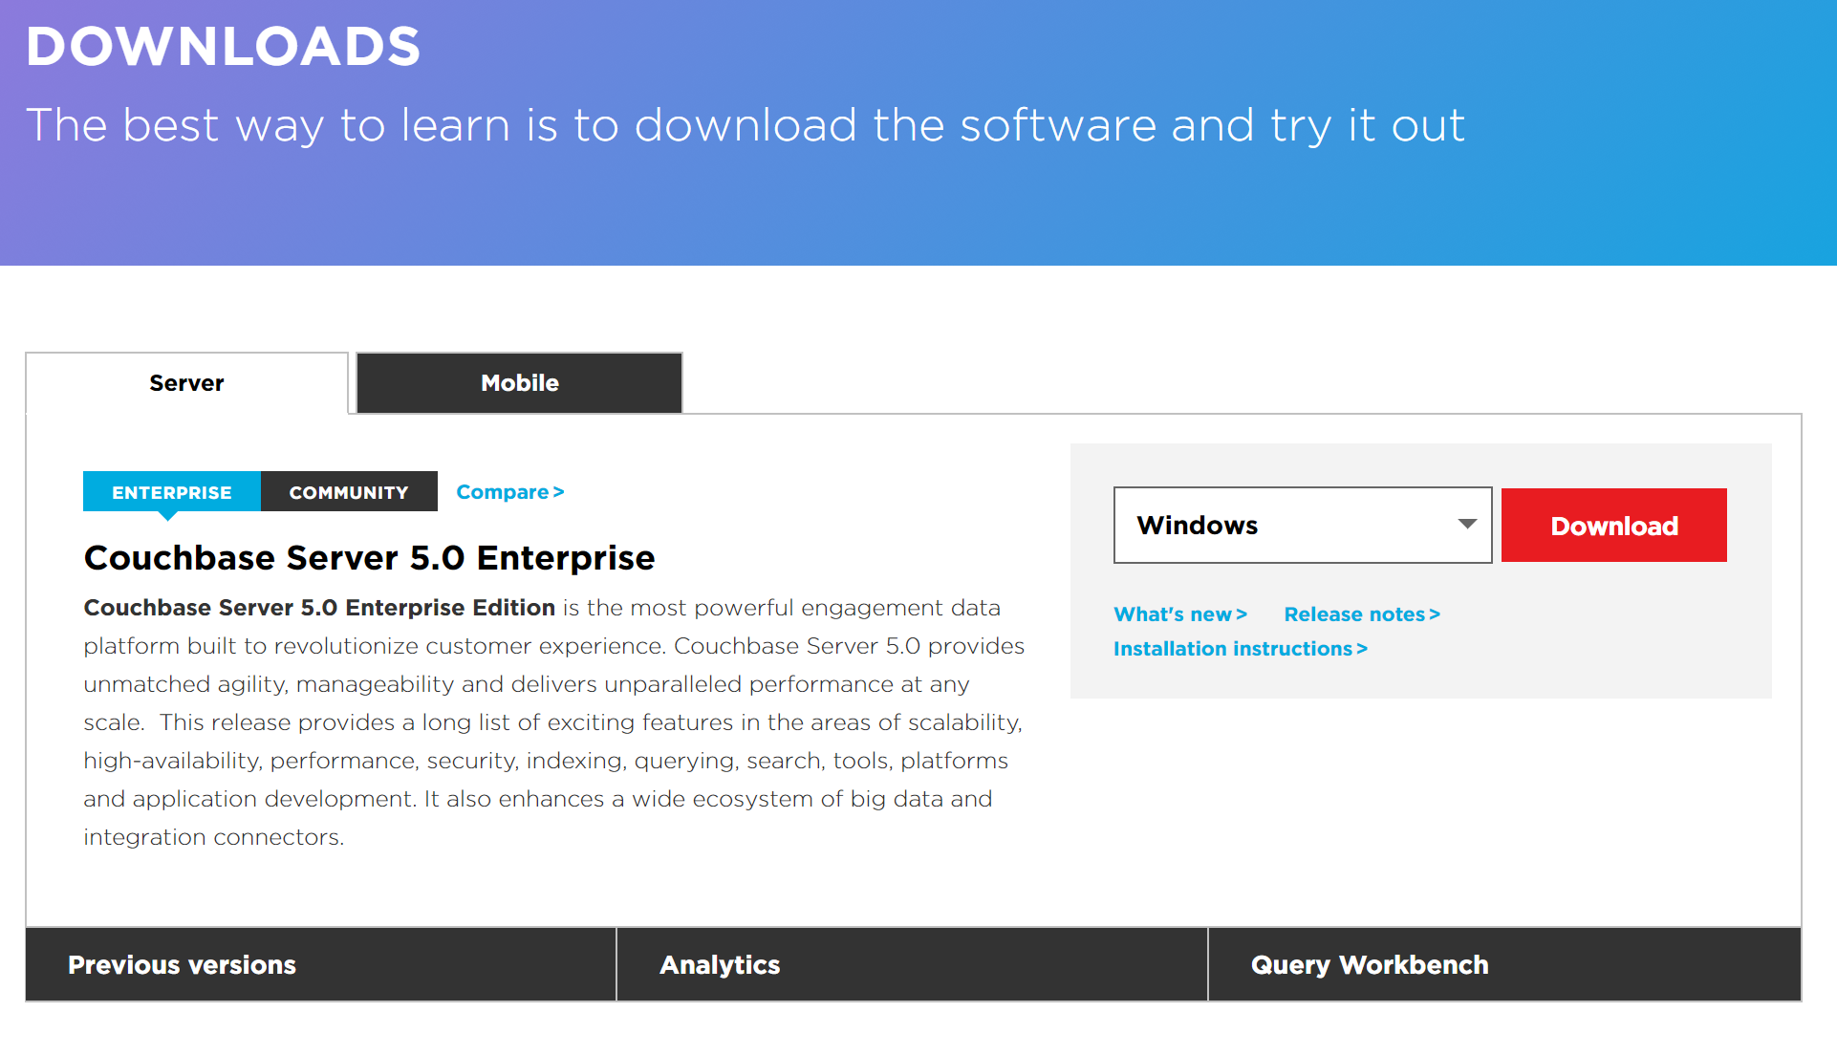
Install Locally: Windows/Mac/Ubuntu
http://couchbase.com/downloads
USB thumb drive available
Notes:
Doesn’t work on Ubuntu 16
Doesn’t work on Mac OS X “Sierra”
If you don’t have those, you can use a cloud instance, or docker, or a VM

Slide 8
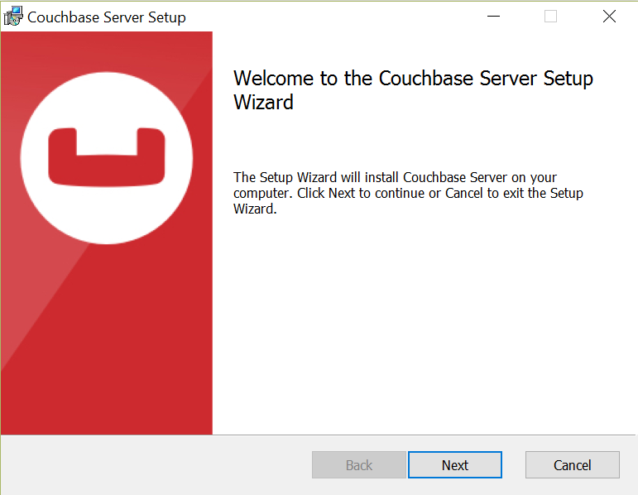
Install

Slide 9
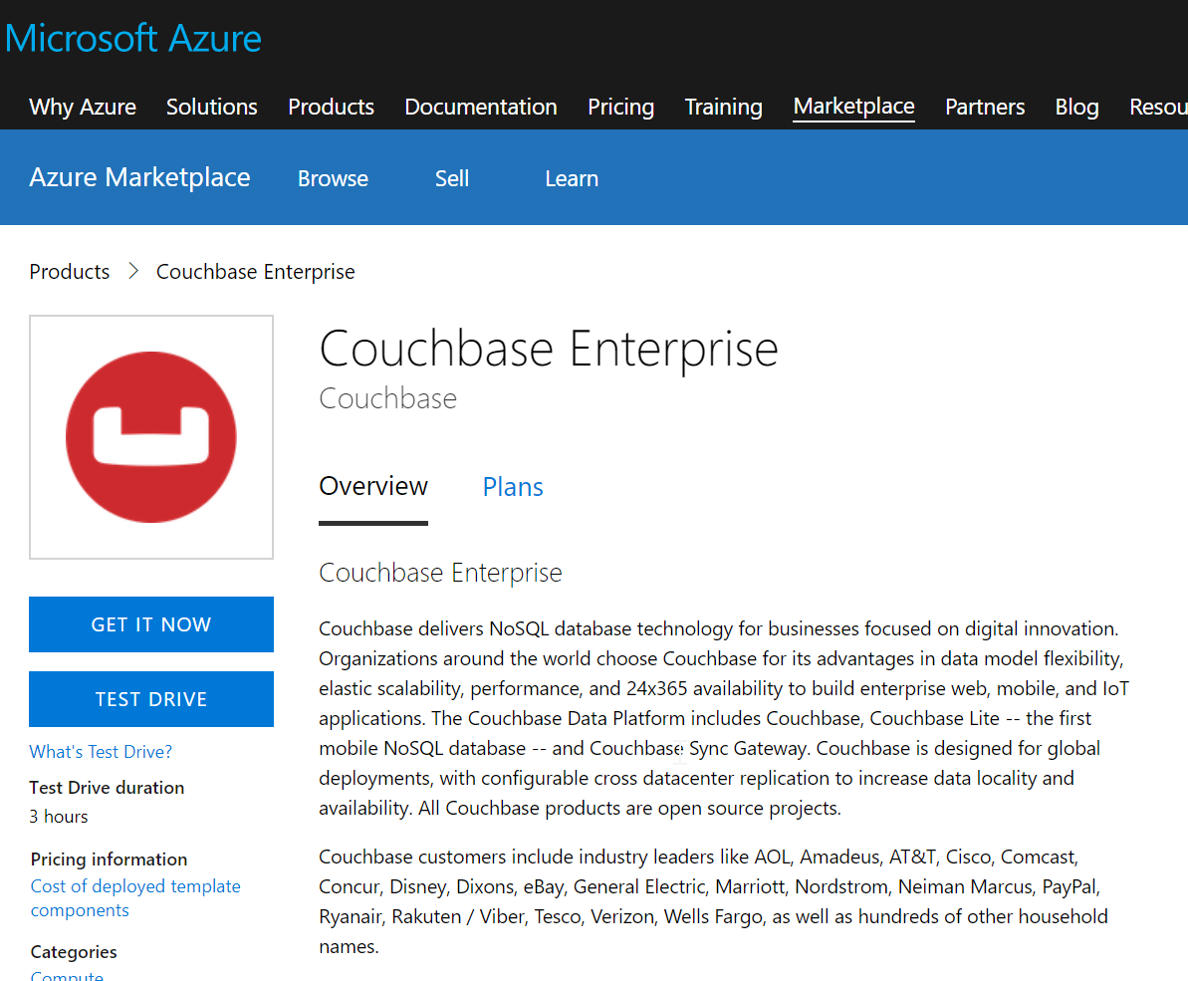
Install on Cloud: Azure
https://portal.azure.com
https://azuremarketplace.microsoft.com/en-us/marketplace/apps/couchbase.couchbase-enterprise
Notes:
You can install on Azure
I also want to point out the "Test Drive" option
This will run a Couchbase cluster on Azure VMs but it won't cost you anything
It stays up for 3 hours
You do need an azure account to use it
If anyone is struggling with installing it locally, this can be a backup plan
But it relies on wifi being decent, only sticks around for 3 hours at a time, and it takes around 5 or so minutes for the cluster to spin to life

Slide 10
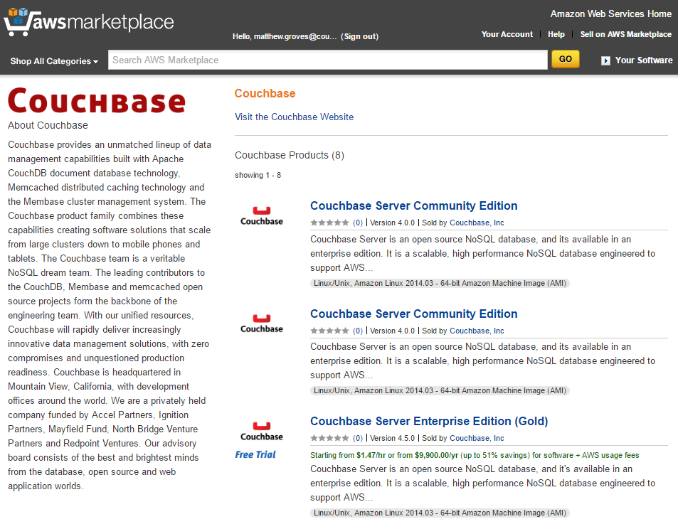
Install on Cloud: Amazon
https://aws.amazon.com/marketplace

Slide 11

Install with Docker
https://hub.docker.com/_/couchbase/
couchbase:enterprise-5.0.0
docker run -d −−name db -p 8091-8094:8091-8094 –p 11210:11210 couchbase: enterprise-5.0.0 docker ps -a
Notes:
Because we tagged the version that we just loaded with couchbase:4.6.0 this should work.
Normally, when you are trying this at home, you can skip that previous slide and just do this.
-d run detached so we get returned to the command line
--name to give it a friendly name of “db”
-p to specify which ports to publish
And finally ‘couchbase’ to pull the couchbase image from docker hub
You can use docker-compose to do this as well, but we’re just doing the one image so it doesn’t make much difference.

Slide 12
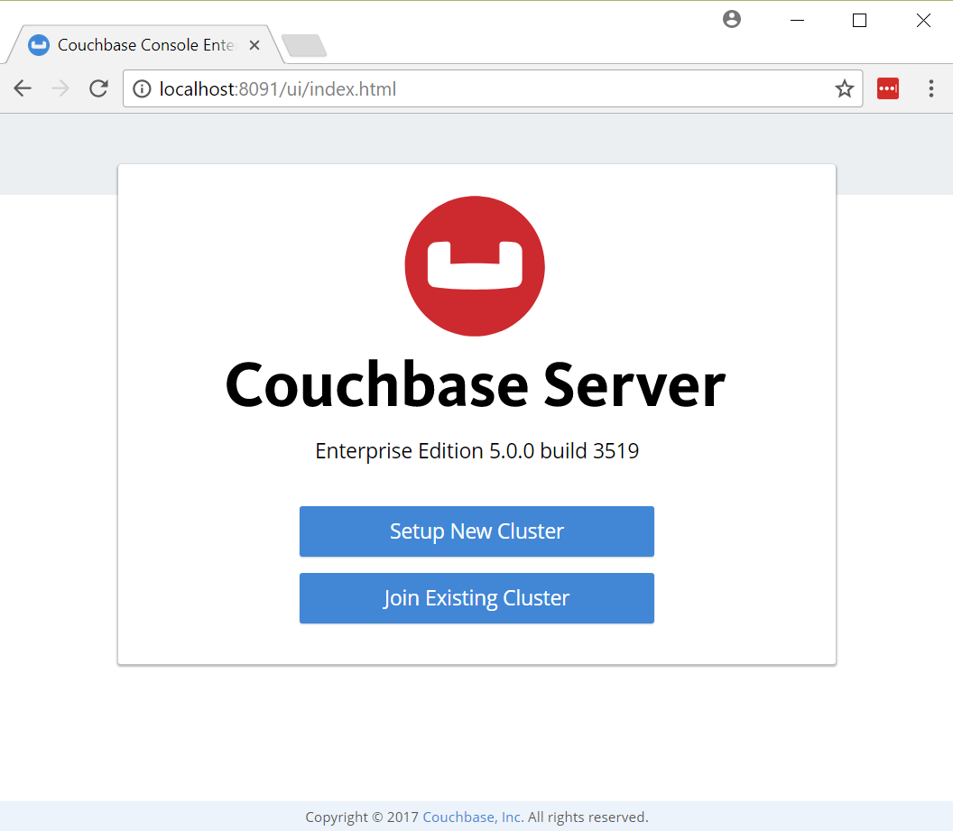
Configuration
http://localhost:8091
Notes:
If you see this, then you've completed the first part of the lab!

Slide 13
1.2 – Configuring Couchbase Server

Slide 14
Configuration
http://localhost:8091

Slide 15
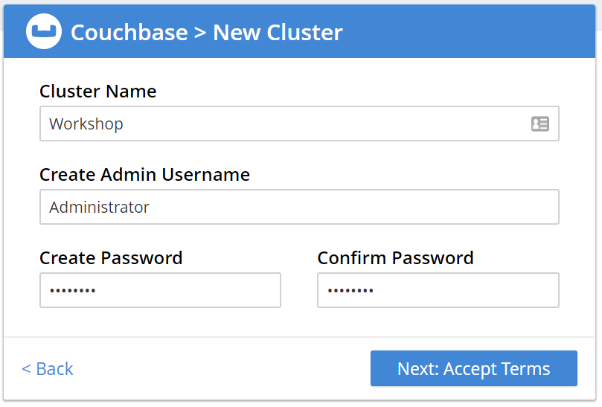
Configuration
Notes:
Make sure to remember your login and password
Write it down for today's workshop if you have to
If you forget it, then you may have to reinstall at some point and no one wants that

Slide 16
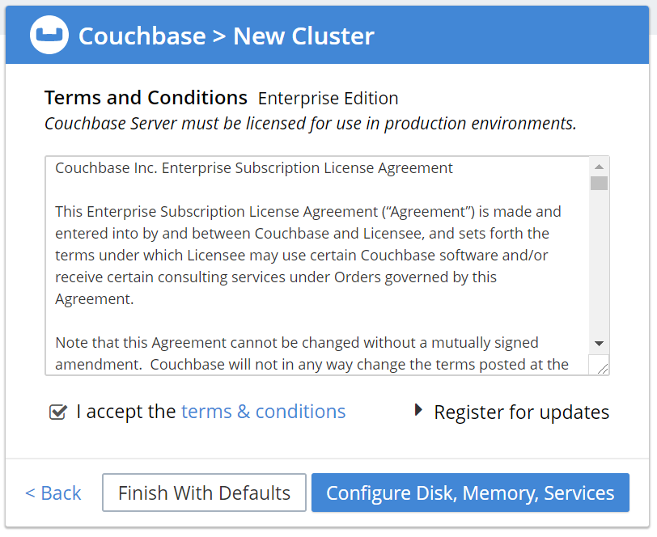
Configuration
Notes:
We're going to click the blue button to look through configuration
Though we probably won't make any changes to it

Slide 17
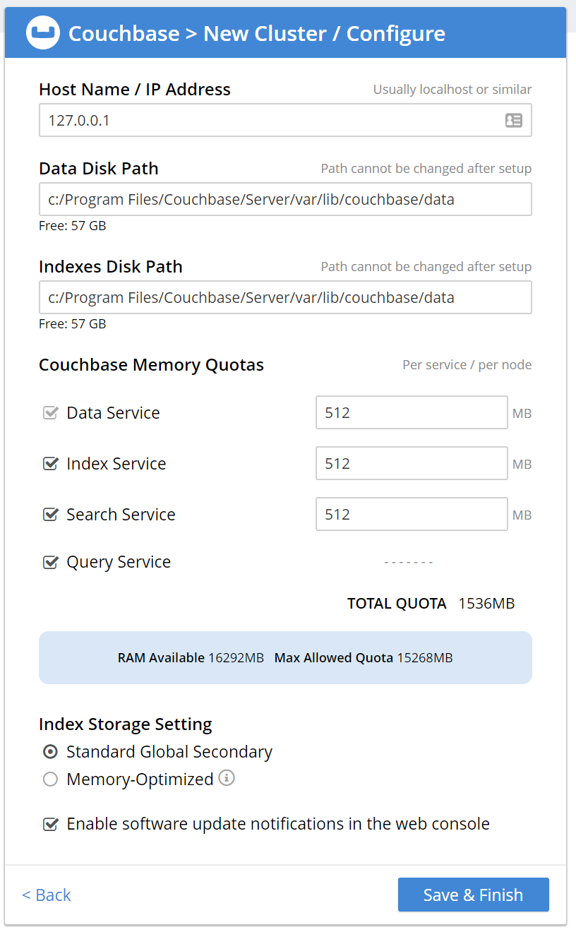
Configuration
Notes:
This is a little smooshed to fit it on a slide
Configure which services and how much ram to give them
We won't be using the "Search Service" today, so you can uncheck that if you want
We don't need a huge amount of RAM, so you can set Data Service to 512 or even 256

Slide 18
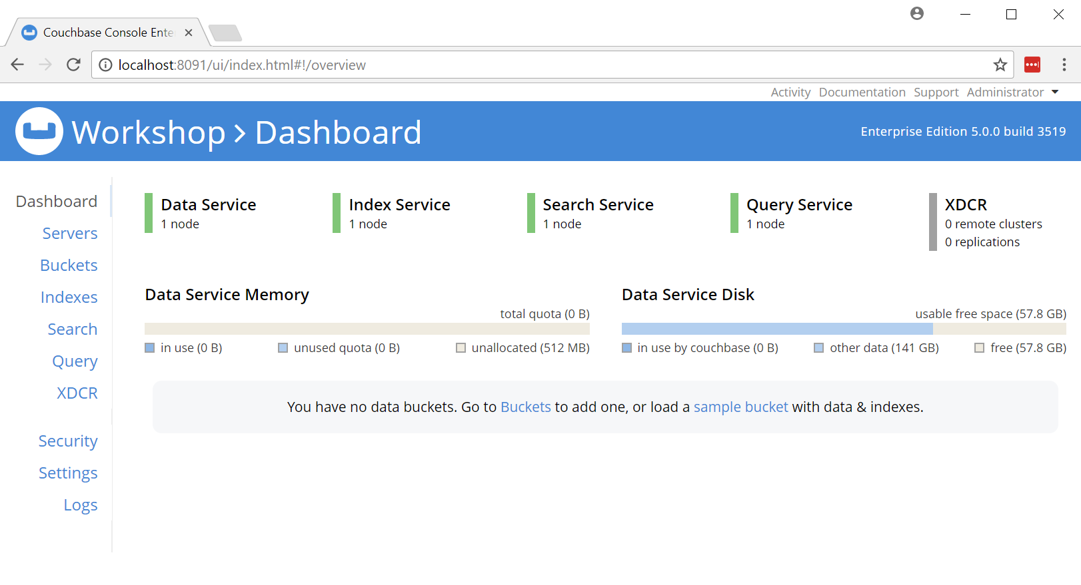
Configuration
Notes:
If you see this screen, you've completed the workshop!

Slide 19
Demo
Notes:
Tour
Servers
Buckets, create new
Documents
Query
Settings
Sample buckets
Create documents
Create a doc with firstname, lastname, email
Create another doc with firstname, middlename, lastname, email
Modelling
Keys
Type field
Array
Hierarchy
Security
Create user
Add roles
Logs
Indexes, primary index
Search? XDCR?

Slide 20
Questions

