Slide 1
Workshop 1 – Setting up Couchbase

Slide 2
Agenda
Installation locally
Installation on cloud (Amazon / Azure)
Installation with Docker
Basic Configuration

Slide 3
1.1 – Installing Couchbase Server

Slide 4
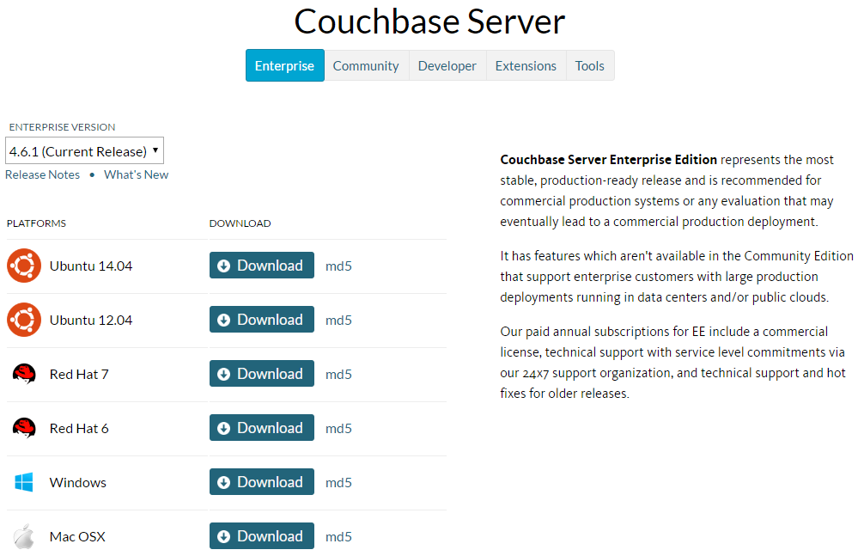
Install Locally: Windows/Mac/Ubuntu
http://couchbase.com/nosql-databases/downloads
USB thumb drives are available
Notes:
Doesn’t work on Ubuntu 16
Doesn’t work on Mac OS X “Sierra”
If you don’t have those, you can use a cloud instance, or docker, or a VM

Slide 5
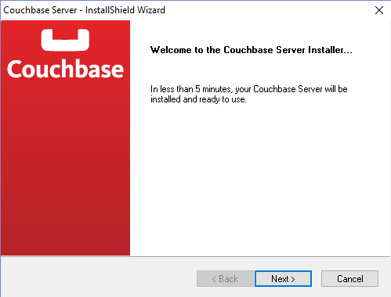
Install

Slide 6
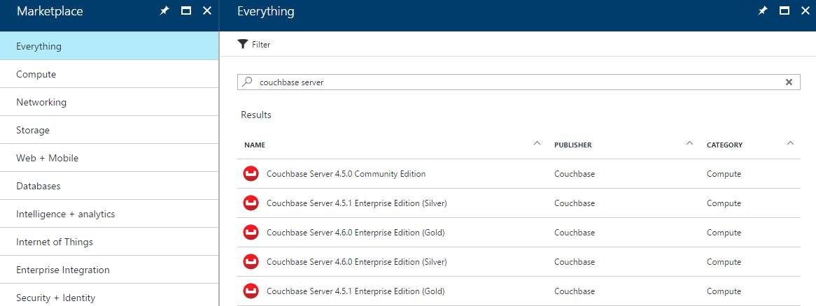
Install on Cloud: Azure
https://portal.azure.com

Slide 7
Install on Cloud: Azure
Select Couchbase Server, click Create
Step 1 Basics: Name, user name, Auth type, Password, Subscription, Resource Group, Location
Step 2 Size: Pick a size (4 cores, 4gb RAM recommended)
Step 3 Settings:
Virtual network -> subnet name
Network security group -> add inbound rule (TCP, source port *, destination port *)
Network security group -> add outbound rule (TCP, destination port *, source port *)
Step 4 Summary
Step 5 Buy
Wait for deployment
Access Couchbase Console via the Public IP address, port 8091 (e.g. http://168.1.2.3:8091)
Video: http://blog.couchbase.com/2017/june/couchbase-on-the-microsoft-azure-marketplace-video
Notes:
The network settings may not be optimal for going into production. They are simplified for this lab.
Azure will be getting easier soon, especially when it comes to multi-node clusters.

Slide 8
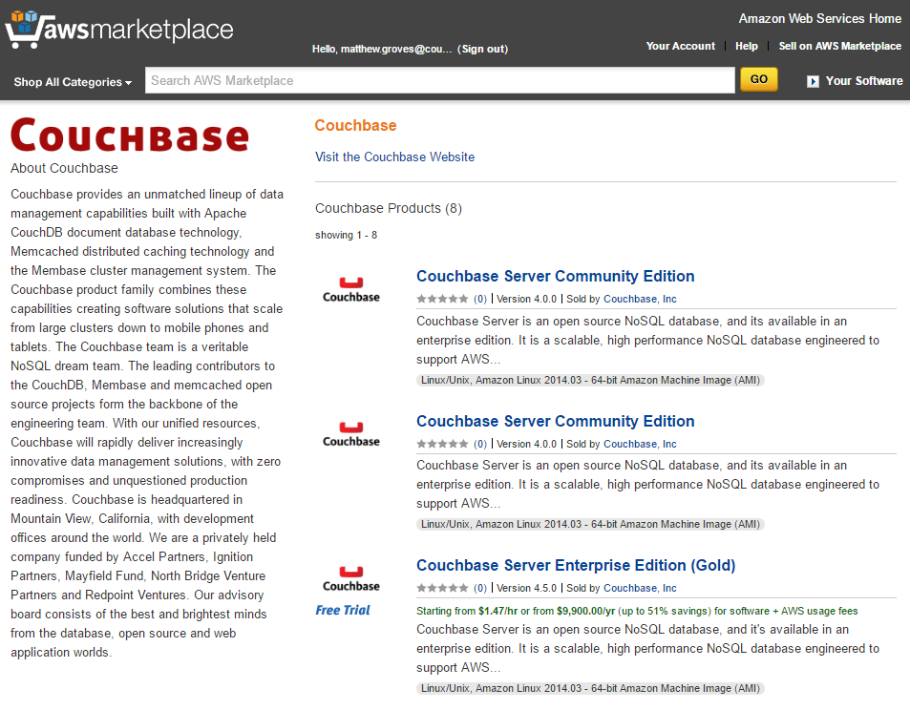
Install on Cloud: Amazon
https://aws.amazon.com/marketplace

Slide 9
Install on Cloud: Amazon
Select Couchbase Server, click Continue
Choose pricing (4 cores, 4gb RAM recommended)
Select VPC (or create new VPC)
Select Security Group (or create new security group based on seller settings)
Click “Accept”
Wait for initialization (EC2 console)
Access Couchbase Console via Public DNS port 8091 (e.g. http://ec2-52-1-3-4.compute-1.amazonaws.com:8091)
Notes:
Amazon will be getting easier soon, especially when it comes to multi-node clusters

Slide 10
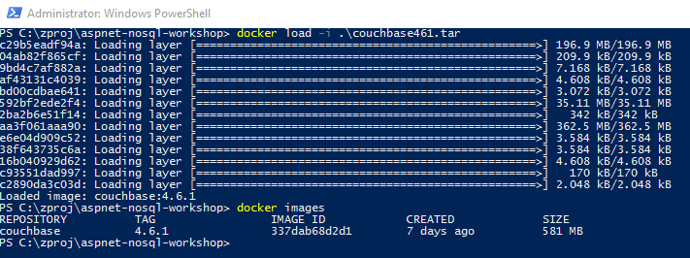
Install with Docker (offline)
couchbase460.tar available on USB drives
docker load –i /the/path/to/couchbase461.tar
Notes:
I'm not going to teach you docker in this workshop, but using docker is an option.
If you have not already installed couchbase with docker, I recommend that you do it this way
Normally, you don’t have to take these steps, and docker will find the image online at docker hub
But since we are all on hotel wifi at the same time, I recommend you do this (unless the wifi is really good)
(I used docker save couchbase:4.6.1 –o couchbase461.tar to create the tar file)

Slide 11

Install with Docker
https://hub.docker.com/_/couchbase/
couchbase:4.6.1
docker run -d −−name db -p 8091-8094:8091-8094 –p 11210:11210 couchbase:4.6.1
docker ps -a
Notes:
Because we tagged the version that we just loaded with couchbase:4.6.0 this should work.
Normally, when you are trying this at home, you can skip that previous slide and just do this.
-d run detached so we get returned to the command line
--name to give it a friendly name of “db”
-p to specify which ports to publish
And finally ‘couchbase’ to pull the couchbase image from docker hub
You can use docker-compose to do this as well, but we’re just doing the one image so it doesn’t make much difference.

Slide 12
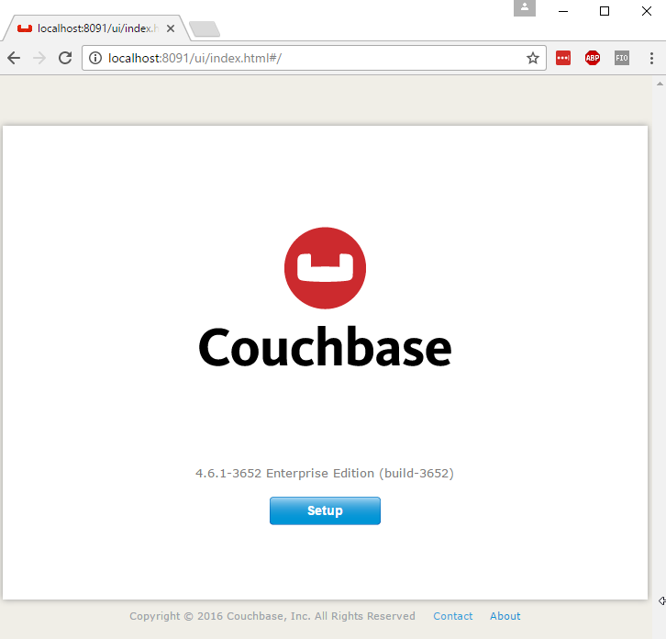
Configuration
http://localhost:8091
Notes:
If you see this, then you've completed the first part of the lab!

Slide 13
1.2 – Configuring Couchbase Server

Slide 14
Configuration
http://localhost:8091

Slide 15
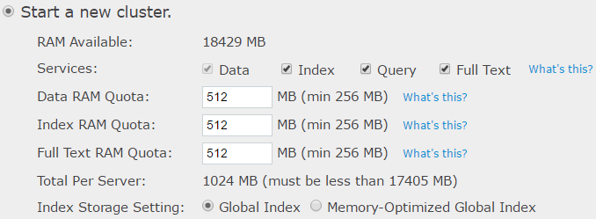
Configuration
Notes:
Full Text is optional
Not using it in this workshop, but if you want to check it out later install it now
The RAM available will vary; if you are on docker it will be low, but that's fine

Slide 16
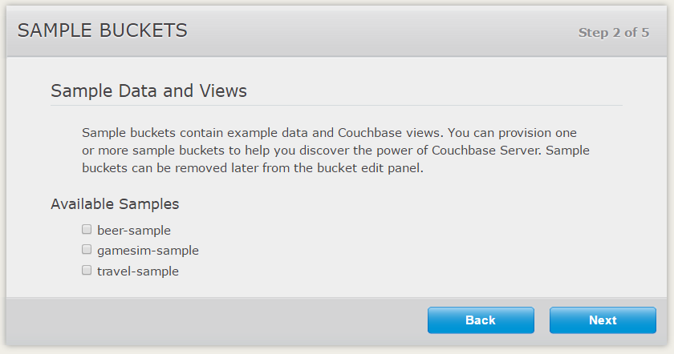
Configuration
Notes:
Step 2 is sample data buckets
We aren't using them, and they can be installed later, so just hit next

Slide 17
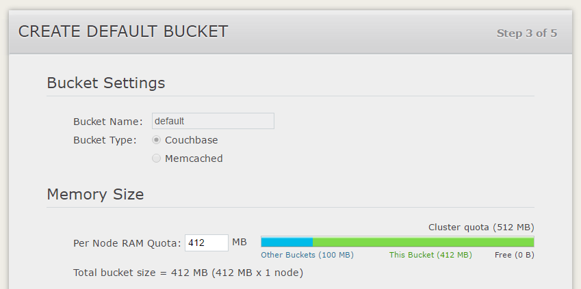
Configuration
Notes:
You can optionally create a bucket called 'default'. You can skip this, and I recommend not using a bucket named 'default' in production. But for this lab it's fine.
I'd recommend not using the full RAM quota, but it can be changed later
Recommend sticking with the default settings otherwise

Slide 18
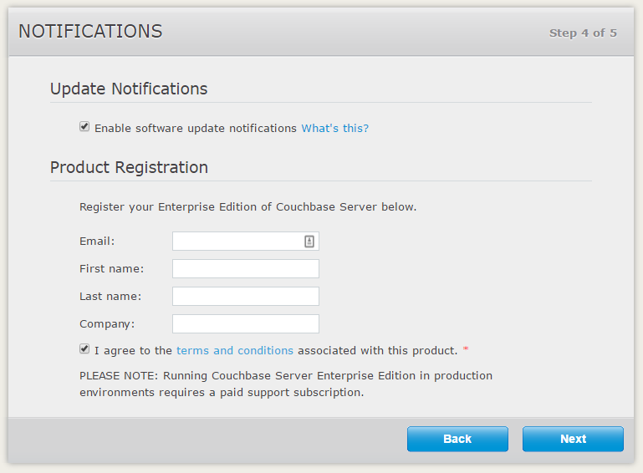
Configuration
Notes:
Enterprise Edition is what we're using today. You need a license to go into production with it, but for development it's totally fine.
There's also a free Community Edition that you can go into production with, it's usually one release behind, and there are some features that will always be enterprise only.
I don't think we're using any enterprise features in today's lab, but I will call them out if I see them.
If you have licensing questions, come talk to me later.

Slide 19
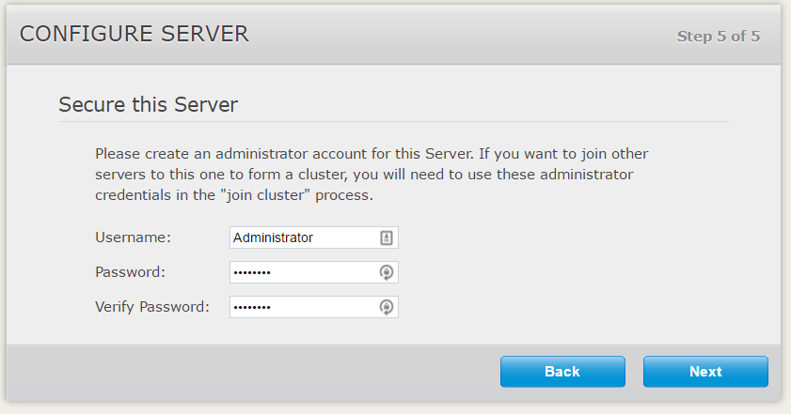
Configuration
Notes:
Enter a username/password for admin
Don't forget these credentials, write them down if you have to.

Slide 20
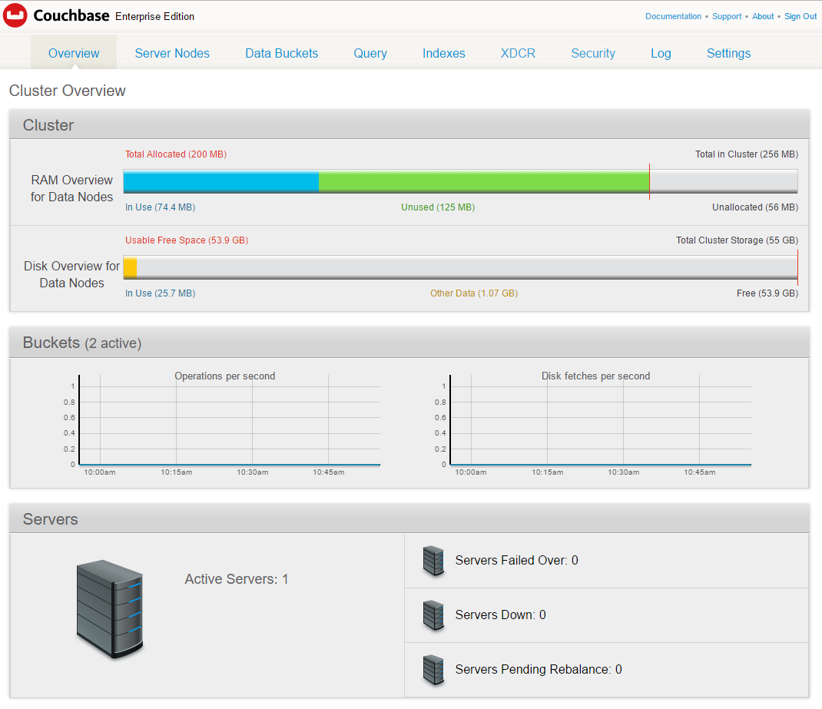
Configuration
Notes:
If you see this screen, you've completed the workshop!

Slide 21
Questions

