Slide 1
Workshop 2 – Using Couchbase

Slide 2
Agenda
What is NoSQL?
What is a document database?
Why NoSQL?
Using the .NET SDK to interact with Couchbase
Notes:
Spend a brief period on "why", if you want to know more, let's talk afterwards!

Slide 3
Open source FTW
https://github.com/couchbaselabs/aspnet-nosql-workshop
If you find a typo, mistake, or spot an improvement, please send a pull request!
Notes:
Couchbase is open source
And so this lab is open source
Please feel free to contribute, as this material will be used beyond this conference

Slide 4
NoSQL: Document Database
NoSQL is an umbrella term
We’ll be looking at a subset called “document databases”
It's like a key/value database:
The key is some unique identifier
The value is in a known format (typically JSON)

Slide 5
Document
Key: Foo::123::456
Value: {
"name" : "Matt",
"twitter" : "@mgroves",
"favoriteMovies" : [
"Star Wars",
"Willy Wonka",
"Glitter"
],
"type" : "user"
}
Notes:
Here's an example of a document.
There's a key and a value. The database knows this is a JSON document, so it's able to parse out the object, get individual values, and so on.
It's not a table. There are no columns, rows, etc.
In couchbase, documents are stored in a collection called a "bucket". Each document within the bucket must have a unique key.
Typically a bucket contains all kinds of documents. It might be helpful to divide them up in some way, by adding a "type" field, for instance
The "type" field isn't special to couchbase. Some document databases have a reserved field like _id, that's basically the same as the key
Some document databases allow you to a level of organization between a bucket and a document.

Slide 6
Why NoSQL document databases?
Architecture
Performance
Scaling
Flexibility
Notes:
Architecture: Couchbase has a memory-first strategy. It was created as a sort of intersection between memcached and CouchDb. Everything goes through RAM but gets persisted to disk.
Performance: Couchbase's memory-first architecture means that key-based operations are extremely fast
Scaling: Couchbase and other NoSQL databases are built with the idea of scaling out via distributed database in mind. Rack up another server and add it to the cluster. I find Couchbase's scaling process to be extremely easy: no load balancer, only one node type, auto-sharding built in
Flexibility: Not a rigid data schema. This can be helpful for prototyping, iterative agile development, data evolution, avoiding downtime/migration, but also useful for use cases where you're aggregating data from multiple sources

Slide 7
Document database use cases
Big data
Profile management
Content management
Customer 360 view
IoT
Fraud detection
Catalogs
Personalization
Digital communication
Caching
Mobile (with Couchbase Mobile)
https://www.couchbase.com/use-cases
Notes:
Big data – paypal monitoring site traffic
Profile – a fortune 50 company manages 1 billion profiles (probably apple?, pokemon go)
Content – fortune 500 media company (replaced SQL Server)
Customer 360 – fortune 200 global apparel brand
IoT – Fortune 100 telecom track connected devices
Fraud – a leading fraud detection platform
Catalogs – Tesco, one of their multiple use cases for couchbase
Personalization – advertising.com (AOL), Hadoop integration
Digital communication – LivePerson (chosen over mongo & Cassandra)
Caching – LinkedIn to monitor 16 million time series databases
Mobile – Ryanair airline mobile app (faster booking times, there's an amazing video of before and after)

Slide 8
NoSQL: Saving data
NoSQL operations
Insert
Update
Upsert
SQL (N1QL) options
INSERT
UPDATE
DELETE
MERGE
etc

Slide 9
NoSQL: Retrieving Data
NoSQL operations
Get (by key)
Views/indexes
Map/Reduce
SQL (N1QL) options
SELECT

Slide 10
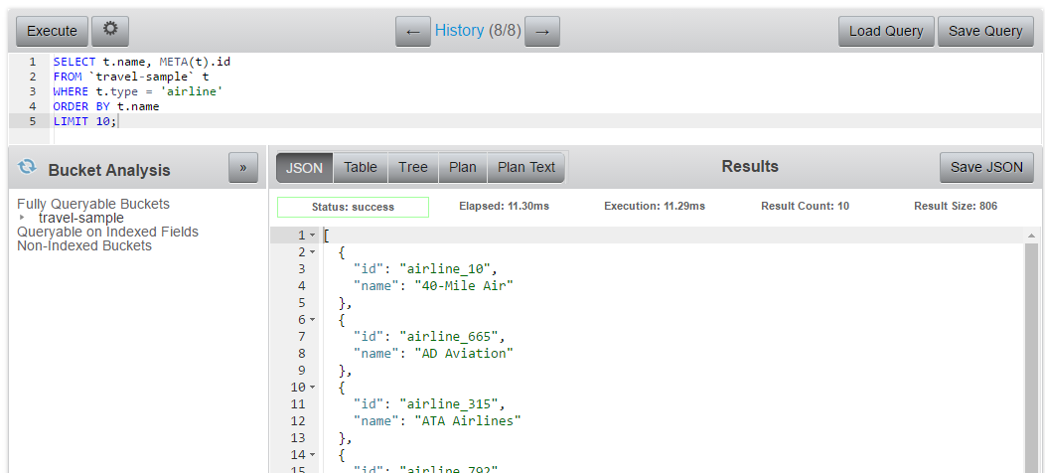
Query Workbench
http://localhost:8091
Notes:
Just to show you what I mean when I say the database understands JSON
Here's Couchbase's Query workbench
I can type in a SQL (N1QL) query here, I can reference fields within the JSON documents (t.name), I can use WHERE on fields, I can ORDER by fields, etc
If this were a plain key/value store, I couldn't do that, because my database has to allow for all kinds of data: XML, binary, text, whatever.

Slide 11
Exercise

Slide 12
How to install .NET SDK
NuGet: Install-Package CouchbaseNetClient

Slide 13
Connect to Couchbase
var config = new ClientConfiguration();
config.Servers = new List<Uri> {
new Uri("couchbase://localhost")
};
ClusterHelper.Initialize(config);
IBucket _bucket = ClusterHelper.GetBucket("bucketname");
Notes:
Connect to one or more nodes
Get the bucket by name, password if you set one

Slide 14
Insert a document
IDocument<dynamic> doc = new Document<dynamic>
{
Id = Guid.NewGuid().ToString(),
Content = new
{
firstName = "Connie",
lastName = "James",
city = "Columbus, Ohio",
country = "USA",
type = "person"
}
};
_bucket.Insert(doc);
Notes:
Create a new Document object. You can use any type, I’m using dynamic to be lazy.
Specify an Id, it can be any string, must be unique within the bucket. I’m using Guid to be lazy
Content is an instance of the type specified in the Document. It will be serialized to JSON. I’m using anonymous object to be lazy
bucket.Insert to save new document.

Slide 15
Insert, Replace, Upsert
IDocumentResult<dynamic> result1 = _bucket.Insert(document);
IDocumentResult<dynamic> result2 = _bucket.Upsert(document);
IDocumentResult<dynamic> result3 = _bucket.Replace(document);
Task<IDocumentResult<dynamic>> result4 = _bucket.InsertAsync(document);
Task<IDocumentResult<dynamic>> result5 = _bucket.UpsertAsync(document);
Task<IDocumentResult<dynamic>> result6 = _bucket.ReplaceAsync(document);
Task<IDocumentResult<dynamic>[]> result7 = _bucket.InsertAsync(
new List<IDocument<dynamic>> { document, document2 });
Task<IDocumentResult<dynamic>[]> result8 = _bucket.UpsertAsync(
new List<IDocument<dynamic>> { document, document2 });
Task<IDocumentResult<dynamic>[]> result9 = _bucket.ReplaceAsync(
new List<IDocument<dynamic>> { document, document2 });
Notes:
Insert creates a new document, fails if it already exists.
Upsert creates a new document, or updates existing document if it already exists
Replace updates existing document, fails if it doesn’t exist.
There are also async versions
And with async you can perform the operation on multiple documents

Slide 16
Getting document(s) by key(s)
IOperationResult<dynamic> aDocument = _bucket.Get<dynamic>("key");
dynamic result = await _bucket.GetAsync<dynamic>(id);
IDictionary<string, IOperationResult<dynamic>> multipleDocuments = _bucket.Get<dynamic>(
new List<string> {"key1", "key2", "key3"}
);
Notes:
Use the Get<T> to get a document by key. It will be serialized into an object of they type you specify.
I’m using dynamic to be lazy
You can also get multiple documents at once by specifying multiple keys. The result will be a Dictionary of key and object.

Slide 17
Results
public interface IResult
{
bool Success { get; }
string Message { get; }
Exception Exception { get; }
}
Insert, Replace, Upsert
Get
public interface IDocumentResult : IResult
{
ResponseStatus Status { get; }
string Id { get; }
}
public interface IOperationResult : IResult
{
ulong Cas { get; }
ResponseStatus Status { get; }
string Id { get; }
}
public interface IDocumentResult<T> : IDocumentResult
{
Document<T> Document { get; }
T Content { get; }
}
public interface IOperationResult<out T> : IOperationResult
{
T Value { get; }
}
Notes:
These are results of the operations.
In this lab we’re not going to use all of these. I’ve also omitted some properties to make things a little simpler.
IResult is the base interface for all results. Success,Message,Exception can be examined to see what went wrong, if anything
IDocumentResult isn’t terribly interesting, except for maybe Status
For gets, again the Status might be useful. The Cas value is “check and set”, this is useful for locking. “Cas” might be a couchbase specific name, but other nosql database usually have something similar.

Slide 18
Questions

Slide 19
Workshop 1: N1QL
Create a primary index on default bucket
CREATE PRIMARY INDEX on `default`
Add document(s) to default bucket
Use “Create Document” button in Documents view
SELECT documents
SELECT d.* FROM `bucketname` d
Notes:
In Couchbase, Buckets have no indexing to start with. So N1QL queries won't work.
We can create a PRIMARY INDEX to enable all SQL queries. Note that this is basically like a table scan, so it's only recommended for development
Create a document in the web console
Select document(s) from a bucket
[demonstrate]

Slide 20
Workshop 2: Using SDK in "Hello World"
Write a console program that:
Insert document(s)
Select documents with N1QL
Start with dotnet_workshop / dotnetcore_workshop folders
Fill in the blanks: look for “TODO”
Notes:
Write a console program to do these things
To make things a little easier, I've given you a fill-in-the-blank version in dotnet_workshop and dotnetcore_workshop
Just look for the TODOs
[demonstrate]

