Slide 1
Workshop 2 – Using Couchbase

Slide 2
Agenda
What is NoSQL?
What is a document database?
Using the .NET SDK to interact with Couchbase

Slide 3
Open source FTW
https://github.com/couchbaselabs/aspnet-nosql-workshop
If you find a typo, mistake, or spot an improvement, please send a pull request!
Notes:
Couchbase is open source
And so this lab is open source
Please feel free to contribute, as this material will be used beyond this conference

Slide 4
NoSQL: Document Database
NoSQL is a umbrella term
We’ll be looking at a subset called “document databases”
It's like a key/value database:
The key is some unique identifier
The value is in a known format (typically JSON)

Slide 5
Document
Key: Foo::123::456
Value: {
"name" : "Matt",
"twitter" : "@mgroves",
"favoriteMovies" : [
"Star Wars",
"Willy Wonka",
"Glitter"
],
"type" : "user"
}
Notes:
Here's an example of a document.
There's a key and a value. The database knows this is a JSON document, so it's able to parse out the object, get individual values, and so on.
It's not a table. There are no columns, rows, etc.
In couchbase, documents are stored in a collection called a "bucket". Each document within the bucket must have a unique key.
Typically a bucket contains all kinds of documents. It might be helpful to divide them up in some way, by adding a "type" field, for instance
The "type" field isn't special to couchbase. Some document databases have a reserved field like _id, that's basically the same as the key
Some document databases allow you to a level of organization between a bucket and a document.

Slide 6
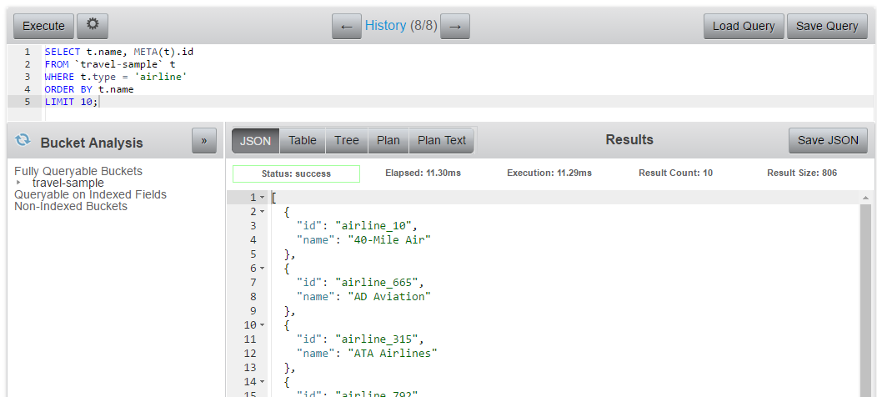
Query Workbench
http://localhost:8091
Notes:
Just to show you what I mean when I say the database understands JSON
Here's Couchbase's Query workbench
I can type in a SQL (N1QL) query here, I can reference fields within the JSON documents (t.name), I can use WHERE on fields, I can ORDER by fields, etc
If this were a plain key/value store, I couldn't do that, because my database has to allow for all kinds of data: XML, binary, text, whatever.

Slide 7
NoSQL: Saving data
NoSQL operations
Insert
Update
Upsert
SQL (N1QL) options
INSERT
UPDATE
DELETE
MERGE
etc

Slide 8
NoSQL: Retrieving Data
NoSQL operations
Get
Views/indexes
Map/Reduce
SQL (N1QL) options
SELECT

Slide 9
How to install .NET SDK
NuGet: Install-Package CouchbaseNetClient

Slide 10
Connect to Couchbase
var config = new ClientConfiguration();
config.Servers = new List<Uri> {
new Uri("couchbase://localhost")
};
ClusterHelper.Initialize(config);
Bucket _bucket = ClusterHelper.GetBucket("bucketname");
Notes:
Connect to one or more nodes
Get the bucket by name, password if you set one

Slide 11
Insert a document
IDocument<dynamic> doc = new Document<dynamic>
{
Id = Guid.NewGuid().ToString(),
Content = new
{
firstName = "Connie",
lastName = "James",
city = "Columbus, Ohio",
country = "USA",
type = "person"
}
};
_bucket.Insert(doc);
Notes:
Create a new Document object. You can use any type, I’m using dynamic to be lazy.
Specify an Id, it can be any string, must be unique within the bucket. I’m using Guid to be lazy
Content is an instance of the type specified in the Document. It will be serialized to JSON. I’m using anonymous object to be lazy
bucket.Insert to save new document.

Slide 12
Insert, Replace, Upsert
IDocumentResult<dynamic> result1 = _bucket.Insert(document);
IDocumentResult<dynamic> result2 = _bucket.Upsert(document);
IDocumentResult<dynamic> result3 = _bucket.Replace(document);
Task<IDocumentResult<dynamic>> result4 = _bucket.InsertAsync(document);
Task<IDocumentResult<dynamic>> result5 = _bucket.UpsertAsync(document);
Task<IDocumentResult<dynamic>> result6 = _bucket.ReplaceAsync(document);
Task<IDocumentResult<dynamic>[]> result7 = _bucket.InsertAsync(
new List<IDocument<dynamic>> { document, document2 });
Task<IDocumentResult<dynamic>[]> result8 = _bucket.UpsertAsync(
new List<IDocument<dynamic>> { document, document2 });
Task<IDocumentResult<dynamic>[]> result9 = _bucket.ReplaceAsync(
new List<IDocument<dynamic>> { document, document2 });
Notes:
Insert creates a new document, fails if it already exists.
Upsert creates a new document, or updates existing document if it already exists
Replace updates existing document, fails if it doesn’t exist.
There are also async versions
And with async you can perform the operation on multiple documents

Slide 13
Getting document(s) by key(s)
IOperationResult<dynamic> aDocument = _bucket.Get<dynamic>("key");
IDictionary<string, IOperationResult<dynamic>> multipleDocuments = _bucket.Get<dynamic>(
new List<string> {"key1", "key2", "key3"}
);
Notes:
Use the Get<T> to get a document by key. It will be serialized into an object of they type you specify.
I’m using dynamic to be lazy
You can also get multiple documents at once by specifying multiple keys. The result will be a Dictionary of key and object.

Slide 14
Results
public interface IResult
{
bool Success { get; }
string Message { get; }
Exception Exception { get; }
}
Insert, Replace, Upsert
Get
public interface IDocumentResult : IResult
{
ResponseStatus Status { get; }
string Id { get; }
}
public interface IOperationResult : IResult
{
ulong Cas { get; }
ResponseStatus Status { get; }
string Id { get; }
}
public interface IDocumentResult<T> : IDocumentResult
{
Document<T> Document { get; }
T Content { get; }
}
public interface IOperationResult<out T> : IOperationResult
{
T Value { get; }
}
Notes:
These are results of the operations.
In this lab we’re not going to use all of these. I’ve also omitted some properties to make things a little simpler.
IResult is the base interface for all results. Success,Message,Exception can be examined to see what went wrong, if anything
IDocumentResult isn’t terribly interesting, except for maybe Status
For gets, again the Status might be useful. The Cas value is “check and set”, this is useful for locking. “Cas” might be a couchbase specific name, but other nosql database usually have something similar.

Slide 15
Questions

Slide 16
Workshop 1: N1QL
Create a primary index on default bucket
CREATE PRIMARY INDEX on `default`
Add document(s) to default bucket
Use “Create Document” button in Documents view
SELECT documents
SELECT d.* FROM `bucketname` d
Notes:
In Couchbase, Buckets have no indexing to start with. So N1QL queries won't work.
We can create a PRIMARY INDEX to enable all SQL queries. Note that this is basically like a table scan, so it's only recommended for development
Create a document in the web console
Select document(s) from a bucket

Slide 17
Workshop 2: Using SDK in "Hello World"
Write a console program that:
Insert document(s)
Select documents with N1QL
Start with dotnet_workshop / dotnetcore_workshop folders
Fill in the blanks: look for “TODO”
Notes:
Write a console program to do these things
To make things a little easier, I've given you a fill-in-the-blank version in dotnet_workshop and dotnetcore_workshop
Just look for the TODOs

