Slide 1

Smart traffic prediction with NuPIC
Yuwei Cui
Aug 7, 2014
Sprint Demo

Slide 2
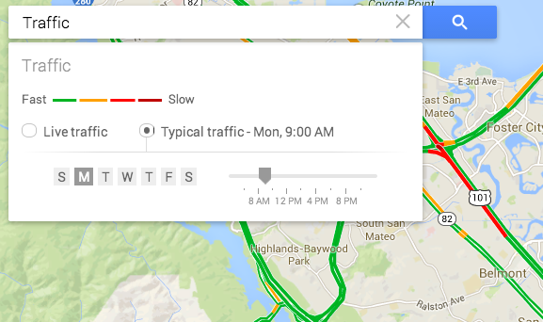
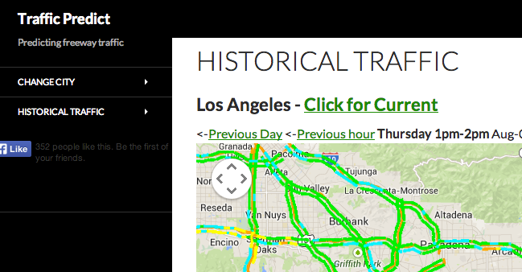
Motivation
Most GPS apps only provide current traffic condition
Existing traffic prediction system use very simple algorithms (historical average)
Improve traffic conditions, reduce delays, facilitate better utilization of available capacity

Slide 3
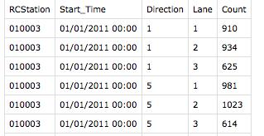
Data Source
NY state highway data service
Continuous count data from sensors in the road
Typically collected hourly, also available in smaller intervals for some sensors (15 min, 10 min, 5 min, etc.)
Station ID, Time, Direction, Lane, Count
Simple data selection, cleaning, aggregation

Slide 4
Daily and weekly patterns

Slide 5
Seasonal Variations

Slide 6
CLA in action
./run.py 'cleanTrafficData30291' --plot

Slide 7
Overall performance
medium swarm size, only included the same station

